Slide 1
New Users Focused Session
Keshab Sapkota
(krsapko@sandia.gov)
June 27, 3:30 - 4:30pm
1026/518 (CINT)
CINT Nanofabrication Workshop Series (CNWS)
https://cint.lanl.gov/news/events1.shtml

Slide 2
CINT Nanofabrication Workshop Series (CNWS)
https://cint.lanl.gov/news/events1.shtml
Goals: Help integration lab (IL) users community to
Smooth out learning curve for new users with no/little prior fabrication experience
Address fabrication bottlenecks for the users and minimize/avoid “rediscovering the wheel”
Discuss advanced fabrication topics with experts and learn from each other
Workshop Topics
Introductory Topics
Planning & design, fab process flow, sample handling, troubleshooting
Workshop Format
Presentation on Nanofabrication
(30 minutes)
(30 min)
Intermediate Topics
Lithography, chemical processes, etching, depositions, metrology, holistic approach, troubleshooting
New IL Users
Panel discussion
(30 minutes)
Advanced Topics
Materials specific, device architecture specific, complex process flow, integration
Existing IL Users

Slide 3
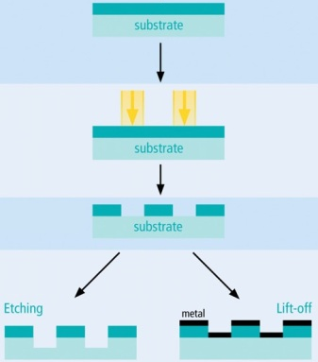
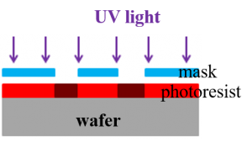
What is Nanofabrication?
Nanofabrication is a process of creating nanoscale structures
Nanofabrication is primarily a top-down process
Nanofabrication inherits the traits of microfabrication
Nanofabrication is primarily a planar process, can be obtain 3D shapes in some special cases
Lithography
Microscale process at CINT
Development
Nanoscale process at CINT
Nanofabrication has similarity with microfabrication but involves additional complexities due to reduced size
GaN 3D structures (Sandia)
Example of a planar process

Slide 4
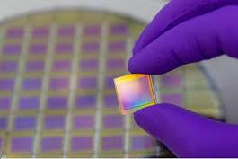
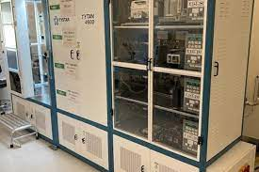
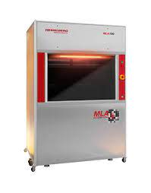
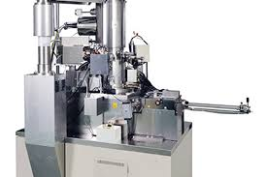
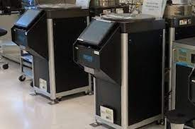
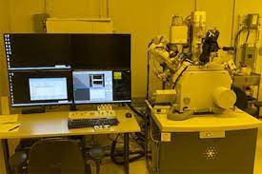
CINT cleanroom capabilities
Sample preparation
Wet benches, dicing tool, lapper, scribers, Plasma/UV/Ozone cleaning
LP-CVD, PE-CVD, ALD
Poly-si, dielectrics (SiO2, SiNx, Al₂O₃, TiO₂, & more)
CVD, ALD
Diced sample
Asher
LP-CVD
Lithography,
Patterning
Mask aligners, Laser writer (MLA), 100 kV EBL, 30kV EBL, FIB
Photolitho resolution ~ 1 um
EBL resolution down to 10 nm
Dry etch: Plasma milling, RIE, ICP, BOSCH
Chemistry: Cl₂, BCl₃, O₂, Fl, Ar, CH₄, SF₆
Well developed processes for Si, SiGe, GaN, GaAs, Diamond, & more
Etching
MLA
EBL
ICP
PVD dep Metal/Dielectric
E-beam evaporators, thermal evaporators, RF/DC sputterer
Materials: metals, alloys, dielectrics, semiconductors
Optical microscopes, SEMs, reflectometers, profilometer
Metrology
NanoSpec
SEM

Slide 5
Design of Fabrication
Define problem, set goals
Device needs
Theory and simulation
Test a concept/theory, prototyping
Identify parameters
Fabrication shape, size, resolution
Materials stack, compatibility, integration needs
Measurement requirements
Identify Fab process
Identify sample size, design pattern
Step by step process flow based on parameters
Identify steps that need testing/optimization
Feedback
Execute Fab
Work in parts: test/optimize unknown steps- can be parallelized, may need multiple experiments
Put them together once individual steps are tested
Measurement & Analysis
Inspect/measure sample at each step when possible
Use reference sample with primary sample to enable additional measurements

Slide 6
Optimization
Controllable: Resist thickness, dose, plasma power
Partially controllable: Photoresist edge beads
Uncontrollable: Tools dependent variation
Uncontrolled: humidity and its impact on photoresist film
Design of Fabrication
Define problem, set goals
Controlled variables
Uncontrolled variables
Identify parameters
Error
Yield
Feedback
Identify Fab process
Optimize process
Execute Fab
Unknown variables
Iteration
Measurement & Analysis
Optimization of a process by iteration

Slide 7
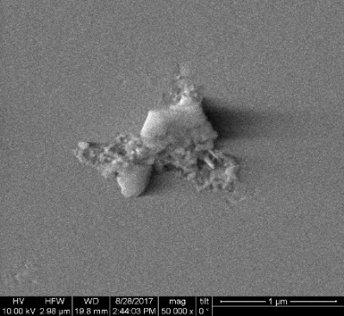
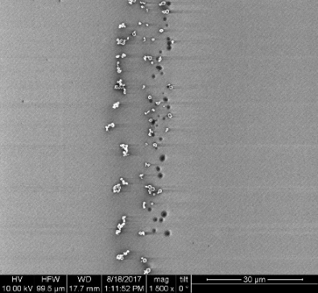
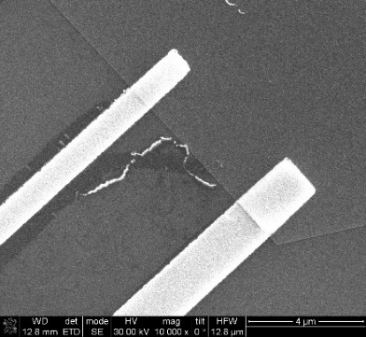
Sample Cleaning
Sample size: use dicing tool scriber to cut sample/ substrate to desired size
Sample cleaning
Samples with gunk
Metal particles
Leftover hydrocarbon after liftoff
Acetone airbrush, Methanol, IPA
Oxygen plasma (Barrel ash, ozone, LOLA)
Ammonia peroxide, piranha
Hydrocarbon/gunk removal:
Acetone airbrush (forceful), IPA
Ammonia peroxide (some), piranha (~all)
Metal particles removal:
HF, BOE (removes different oxides)
Hot bases e.g. KOH (removes Al₂O₃, SiO₂, attacks Si
Oxide removal:

Slide 8
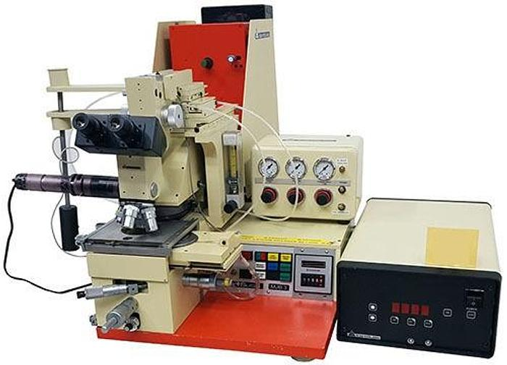
Patterning by Lithography
Lithography: process of creating patterns on a polymer/film
Photolithography
Electron-beam lithography
Mask aligner
Maskless aligner
100 kV EBL
Resolution depends on wavelength (nm)
Resolution depends electron energy (kV), beam current (pA)
Mask Aligner
Resolution available at CINT ~1um
Fast patterning
Maskless Aligner
Patterning from CAD design without mask
Patterning Slower than mask aligner
High resolution, down to 10nm
Slow patterning speed
Maskless patterning, create patterns directly from CAD design
Expose on Photoresist
Expose on E-beam resist

Slide 9
Photolithography
Exposure
Dose depends on exposure wavelength
Wavelengths: g-line: 436nm, h-line: 405nm, i-line: 365nm
Optimal dose depends on surface reflectivity. Glass: 10%, Si: 30%, Metal: ~90%
Resolution: governed by Rayleigh criteria.
Rayleigh criteria for resolution
Silicon VLSI technology
$$Resolution (R) α \frac{λ}{NA}, Depth of Focus \left(DOF\right) α \frac{λ}{NA^{2}}$$
DOF restricts the photoresist thickness
Resolution and DOF are competing effects
CINT: Proximity & Contact patterning
Soft Contact: resolution 2um
Hard Contact: resolution 1um
CINIT: Laser writer (MLA) with h-line
Resolution >0.6um
Edge Beads and Wedge Error and Compensation (WEC)
Thicker photoresist at the edge of sample (edge effect)
WEC due to tilted sample
Soak a Q-tip in acetone and gently remove the edge beads

Slide 10
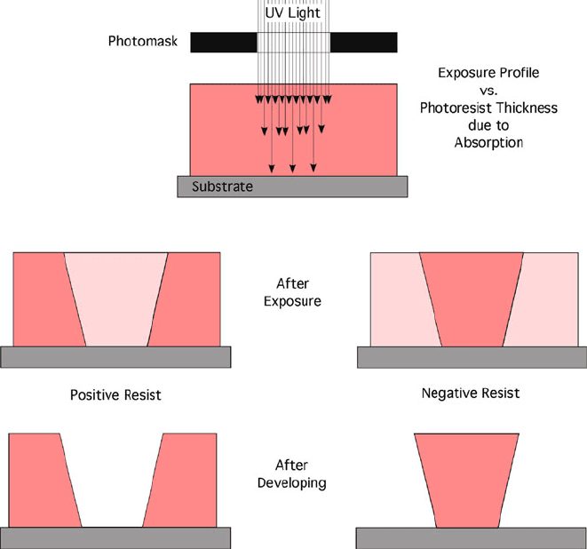
Photoresist: positive tone, negative tone, chemically amplified
Photoresist
Resin
e.g. Novolak
Photoactive compound e.g. DNQ➔ Carboxylic acid
Solvents or Thinner
e.g. PGMEA, Anisole
Chemical matrix, binder
photon/electron activates chemical reaction
Keeps photoresist in solution form
Positive & negative tone resists
Polymerization
Exposing photoresist with photons, electrons
Negative tone
Crosslinking
Decomposition
Positive tone
Positive tone
Negative tone
Image reversal resist
Can be used as positive or negative tone resist
As positive tone: single exposure; as negative tone: exposure ➔ bake ➔ flood exposure
Chemically amplified resist (CAR)
Light is absorbed by photoacid generators (PAGs) ➔ multiple photoacid molecules per photon
High quantum yield ➔ high sensitivity, low exposure dose

Slide 11
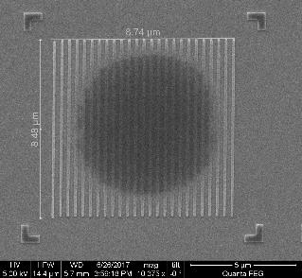
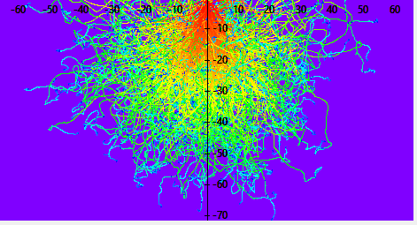
Electron Beam Lithography (EBL)
EBL writing is achieved by series of discrete point exposures
Spot size
Shot pitch
$$Dose=I∗t/A$$
Spot size, electron energy, beam current, resolution
Spot size defines resolution limit
For higher resolution: smaller aperture, low beam current, high energy electrons
Proximity Effect & Shot noise
Proximity effect: Scattered and secondary electrons contribute to unwanted dose
Shot noise: statistical in nature
Smaller feature size ➔ larger shot noise
EBL exposure scheme
Low dose resist
Scale in um
Low dose resist
Proximity effect observed
on HSQ
Use Software tool e.g. Tracer for proximity effect correction (PEC)

Slide 12
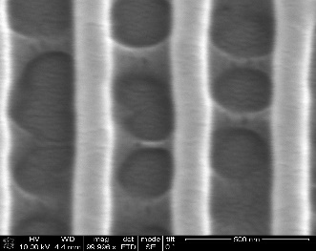
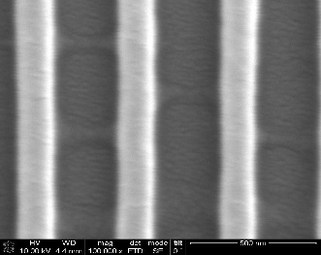
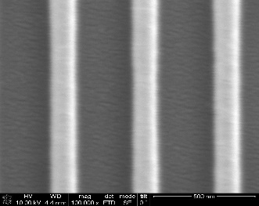
Optimization for high resolution patterning
Choice of right EBL tool
JEOL: large area write, high resolution write, stitching of the pattern, proximity correction
SEM Nabity: Patterning contacts on 1D/2D materials, smaller area EBL, resolution down to 30nm
Beam optimization
Dose test, Dose test, Dose test
Optical and EBL: carry out series of dose test to identify optimal dose for the patterning
Wobble
Focus & tilt
Astigmatism
Dose test: Increased dose
Rounded corners: too much dose
Development control
Higher resolution with dilute developers; cold development ➔ higher resolution (requires higher dose)
Post process
Consider post processes (e.g. loftoff, etching) for final resolution of the feature

Slide 13
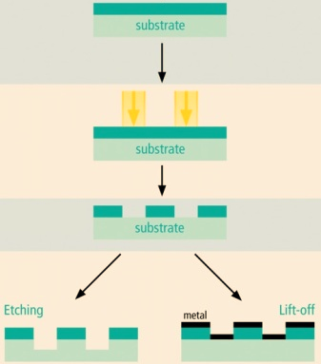
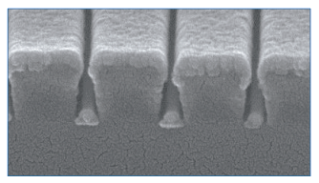
Common Fabrication Steps: Pattern transfer
Pattern transfer, a planner process, depends on the 3D parameters e.g., resist thickness, mask thickness, undercuts, lateral dimensions, etc.
Pattern transfer by liftoff
Clean developed pattern (e.g. Dscum, BOE, etc) for good adhesion and contact
Non-conformal metal dep, soak in acetone/PG remover
Things to consider
Typical adhesive metal layers: Ti, Ta, Cr
Dep rate, grains formation & film quality, heat transfer
Resist cracking & burn out due to excessive heating
Lithography
Development
Pattern transfer by etching
Pattern transfer by Liftoff

Slide 14
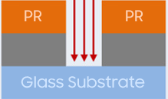
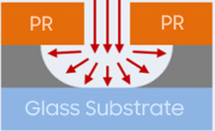
Common Fabrication Steps: Pattern transfer
Pattern transfer, a planner process, depends on the 3D parameters e.g., resist thickness, mask thickness, undercuts, lateral dimensions, etc.
Pattern transfer by etching
Masks: Polymer, metal, dielectric
Dry etch: Milling (physical) or reactive etching (chemical) -Anisotropic
Wet etch: Isotropic or crystal plane selective
Things to consider
Mask to material etch selectivity
RIE (highly anisotropic), ICP (high power plasma), or milling
Temperature and high energy plasma heating
Examples:
Cl-plasma: GaN, III-V semiconductor
F-plasma: Si, Ge, SiGe, BOSCH cycle for deep etching
Ion milling for metals
Wet etch: acid or base (oxides can be etched by both HF and hot bases), temperature, selectivity, safety
Plasma etch (aniso)
Wet etch (iso)
GaN in KOH
Wet etch (Crystal plane selective)

