Slide 1

Micro-/Nano- Fabrication:
Qualifying Material for Quantum Electronic Devices
Presented by:
Troy Hutchins-Delgado
(troyhutchins@unm.edu)
Host: Keshab Sapkota
(krsapko@sandia.gov)
April 28, 3:30 - 4:30pm
1026/518 (CINT)
CINT Nanofabrication Workshop Series (CNWS)

Slide 2
Micro-/Nano- Fabrication:
Qualifying Material for Quantum Electronic Devices
Troy A. Hutchins-Delgado
troyhutchins@unm.edu
tahutch@sandia.gov
Notes:
Hi everyone. I’m Troy Hutchins, a PhD candidate in the optical science and engineering program at the University of New Mexico. I am also a graduate intern here at Sandia working in the quantum phenomena department. Today, I will be building upon what Keshab has discussed in his presentations. Specifically, I will use my work at Sandia qualifying material for quantum electronic devices as a means to generically discuss micro- and nano- fabrication here at CINT.

Slide 3
Fabrication Golden Rules
Do not reinvent / Keep it simple
  Start from known processes
  Verify using short loops
  Minimize failure points
Know the constraints / capabilities
  Take into what each tool, chemical, process, material, etc. can do
  Add design tolerances
Be consistent, organized, & detailed
  Practice your process
  Clean workspaces
  Track everything
Treat everything/everyone with respect
  Respect tools, CINT staff, and other users
  Follow ALL rules
  Be considerate and communicate
Notes:
First, I would like to take the time emphasizing what I call “fabrication golden rules”. These rules are meant to make your work more efficient and effective here at CINT. Number 1 do not reinvent and keep things simple. Don’t beat your head against a wall starting from scratch trying to make an impossible device. You should start with a known process whether it be from a technical datasheet, a journal article, or another user. From there, you should use short loops by performing measurements on your material and make test structures to verify steps in your fabrication process are working as expected. Doing so, you can figure out and minimize the failure points in your design or process. Number 2 know the constraints and capabilities. You should always try to use the right tool for the job, so you should take into account what each tool, process, materials, & chemicals can do. Furthermore, you should add tolerances into your design to account for any unexpected variations that may occur during the fabrication process. Number 3 be consistent, organized, and detailed. You should practice you process to develop muscle memory in order to be consistent with your process. Always keep a clean workspace and track everything you do. Number 4 treat everything and everyone with respect.

Slide 4
Device Engineering Cycle
Material Design
Material Design
Process Development
Process Sheets
Mask Design
Cross Sections, Equivalent Circuits, & Schematics
Fabrication
Testing/Measurements
Testing
Process Development
Fabrication
Process Sheet
Cross Sections
Mask Design
Notes:
Here I have a layout of a device engineering cycle. While every step in the cycle could lead to any other step in the cycle as shown, I will be discussing the steps in logical order of material design, process development, process sheets, mask design, cross sections, fabrication, and testing or measurements. Just keep in mind actual execution of the device engineering cycle can be rather messy or complicated.

Slide 5
Material Design & Characterization
Growth
  Molecular Beam Epitaxy (MBE)
    III-V
  Metal Organic Chemical Vapor Deposition (MOCVD)
    III-V
    III-Nitrides
    IV nanowires
Physical/Structural Characterization
  X-Ray Diffraction/Reflection (XRD/XRR)
  Scanning Electron Microscopy (SEM)
  Scanning Transmission Electron Microscopy (STEM)
  Energy Dispersive X-Ray Spectroscopy (EDXS)
  Atomic Form Microscopy (AFM)
  Secondary Ion Mass Spectroscopy (SIMS)
Optical Characterization
  Transmission/Reflection/Absorption Spectroscopy
  Photoluminescence (PL)
  Photoluminescence Excitation (PLE)
  Time-Resolved PL (TRPL)
  Raman
  Ellipsometry
Notes:
Whether you bought or grew your own material or will have it grown here at CINT, your material had to be designed at one point. Before proceeding with the rest of the device engineering cycle, and especially before going to fabrication, you should check how the actual material compares to your design and expectations. CINT offers multiple methods for growth, physical characterization, and optical characterization of which many are listed here. The exception is secondary ion mass spectroscopy or SIMS which is used identify material composition as a function of depth including doping or impurities. For a more complete list of growth, synthesis, and characterization capabilities you can refer to the CINT website and talk with the CINT staff. Also, keep in mind that in may be in your best interest to outsource some of the characterization to either CINT staff if listed so in you proposal or with a company in order to reach your project goals.

Slide 6
Material Design & Characterization
Hutchins-Delgado, Troy A., Andrew J. Miller, Robin Scott, Ping Lu, Dwight R. Luhman, and Tzu-Ming Lu. "Characterization of Shallow, Undoped Ge/SiGe Quantum Wells Commercially Grown on 8-in.(100) Si Wafers." ACS Applied Electronic Materials 4, no. 9 (2022): 4482-4489.
Notes:
Here is an example of material that we designed and Lawrence Semiconductor Research Lab grew for us. They then did both in house characterization and outsourced characterization of the material. Here TEM & SIMS show that the actual material very slightly differs from what was intended in the design. However, the material quality was shown to excellent and consistent across the wafer. Therefore, we can take into account the actual material composition and structure when comparing experimental results with theory with any devices we make.

Slide 7
Process Development
Cleaning
  Wet
    Degrease (Solvent Clean)
    Organic/Particle Removal (Standard-Clean 1)
    Oxide Strip (HF/BOE)
    Ionic Clean (Standard-Clean 2)
  Dry
    Hydrogen Plasma
    Oxygen Plasma
    UV/Ozone
Lithography
  Photo
    Contact
    Direct/Maskless
  Electron Beam
    Nabity
    JEOL
Pattern Transfer
  Lift-Off
  Etch Back
Deposition
  Physical Vapor Deposition (PVD)
    Thermal
    Electron Beam
    Sputter
  Chemical Vapor Deposition (CVD)
    Low-Pressure/Thermal
    Plasma Enhanced
    Atomic Layer Deposition (ALD)
Material Removal
  Wet: Solvents/Acids/Bases
  Dry
    Ion Milling
    Reactive Ion Etching (RIE)
    Inductively Coupled Plasma (ICP)/RIE
  Mechanical
Annealing
Notes:
To start developing a process, it’s important to understand the main process steps and the capabilities that CINT offers. Here, I have outline the main steps and subsequent capabilities that CINT offers to execute steps. You should always start by cleaning your samples. Also, it’s important to clean between various steps because the steps can introduce possible contamination or impurities. Lithography is needed to transfer a pattern. CINT offers contact and maskless photolithography systems as well as 30kV Nabity and 100kV JEOL ebeam lithography systems. After lithography, the pattern can be transferred using liftoff or etch back. Material can be deposited either using physical vapor deposition of chemical vapor deposition tools. Material can be removed using either wet chemistry, dry chemistry, or mechanical means. Also, there are a variety of annealing or heating methods offered. Once you have your fabrication process outlined, it’s a good idea to consult with John Nogan, Tony James, and your affiliate CINT scientist to check over your process to verify it will work and that you have the selected the best tools for each task.

Slide 8

Process Sheets
Notes:
When developing your fabrication process, you should create process sheets. The process sheets can start off as your process outline, and as you develop the process, fill the process sheets with all the specific details of your exact process. As I mentioned earlier, you want to be as specific and detailed as possible. Essentially, you want a process sheet so detailed such that a random person off the street could follow your process and replicate your results. This may be the case for effective information transfer within your group, for a publication, or for simply revisiting a process after a long time.

Slide 9
Mask Design
Negative Mask, Positive Resist
Positive Mask, Positive Resist
Negative Mask, Negative Resist
Positive Mask, Negative Resist
Notes:
I would like to start the mask design section with a discussion of the various mask and resist types. It’s important to understand each combination of mask and resist types in order to utilize them effectively. The two most common combinations are use the same tone mask and resist as shown by the off diagonal figures are commonly used for liftoff. With a positive mask and resist combination, the area of exposed resist (as indicated by the dark green) will be developed away leaving near vertical or positive slopes sidewalls. An example application would be liftoff that is proceeded by an etch to remove an oxide where you want to minimize undercutting. Also, this combination is used for ebeam lithography with liftoff. For most photolithography with liftoff, a negative mask and resist combination is commonly used. Here the unexposed resist is developed away leaving negative slope sidewalls of resist. The negative slope sidewalls are more effective for liftoff due to material less likely to stick to the sidewalls. Finally, we have opposing mask and resist combinations which are commonly used for etch back. A negative mask and positive resist are usually used with photolithography such that your etch mask has near vertical sidewalls. A positive mask and negative resist are commonly used with ebeam lithography etch masks. While these examples are the common use cases, by understanding them, you can go beyond the common cases if your process requires it. The exact resist sidewall profile can be varied by using different resists, doses, developers, development times, and combinations of resist or copolymers. An example would be using two or more layers of different resists or copolymers like PMMA450 and PMMA950 positive tone bilayers which can be used to create an effective negative tone sidewall profile.

Slide 10
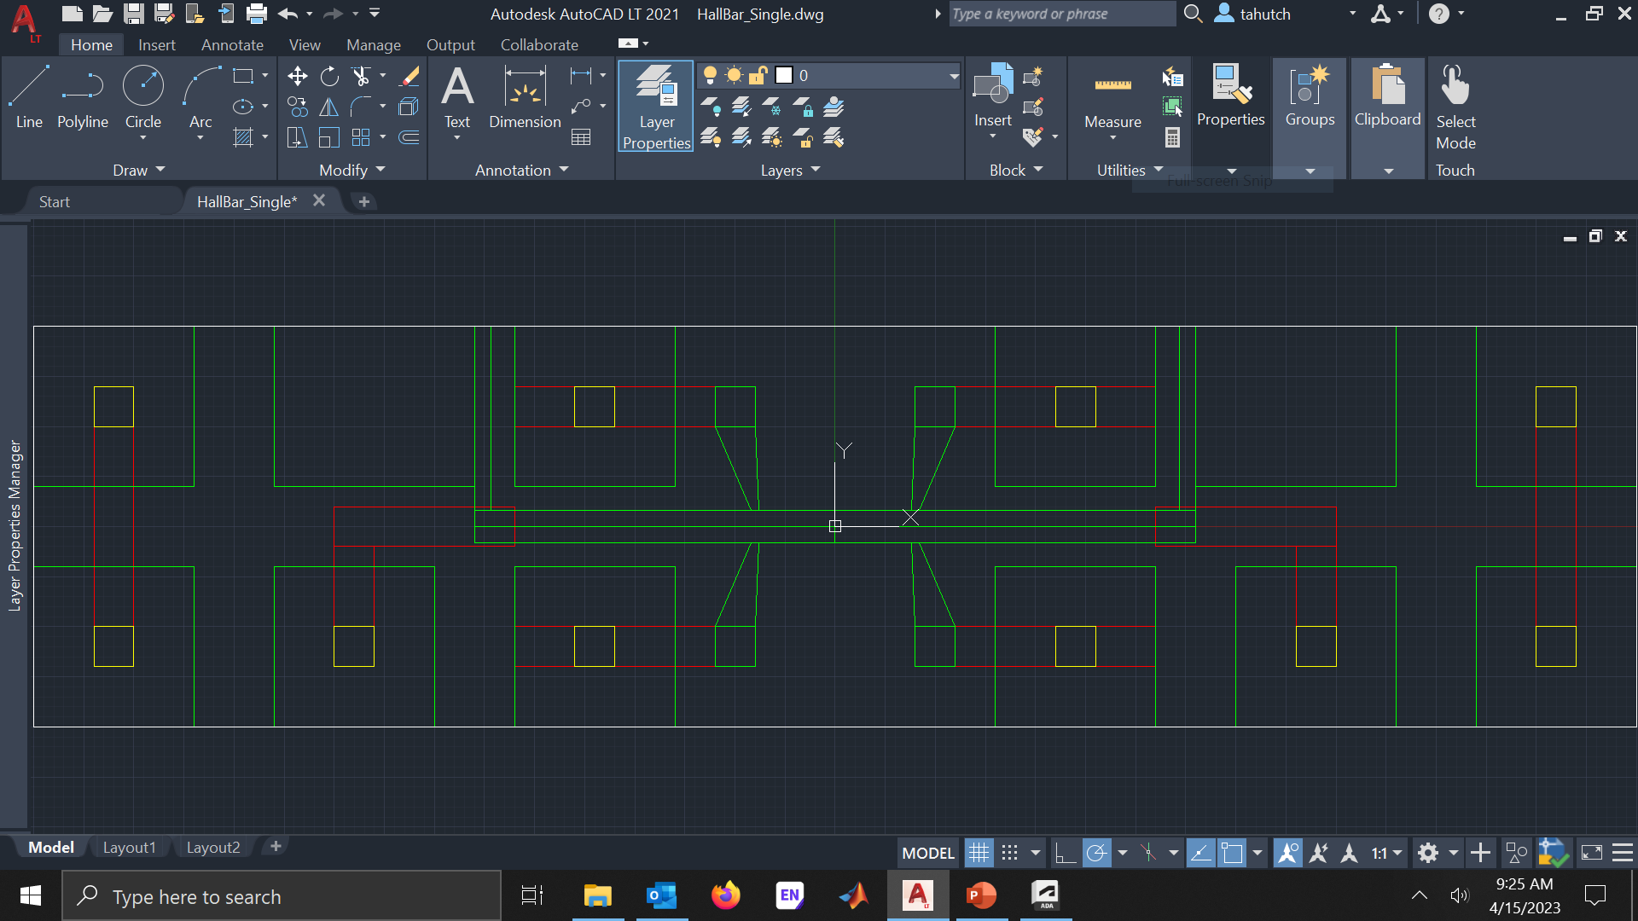
Mask Design Example: Hall Bar FET
Notes:
Next, I will discussing a Hall bar field effect transistor as a simple example device. I’ll start by talking about the mask design. There are plenty of computer aided design or CAD tools out there. Many of them are free or fairly affordable. I personally prefer AutoCAD because that’s what I’ve been using since high school. Also, the full version of AutoCAD and other products from the company Autodesk are freely available with a .EDU email. Another CAD option would be DesignCAD which is fairly affordable and is the CAD program for the Nabity EBL systems. When making the mask in a CAD program, I prefer the entire design be a positive mask. While CAD programs can perform logical operations and invert masks, I find that a positive design mask gives me more flexibility because logical operations and mask inversions can be performed at the tool or with other software. Likewise, I also prefer to have distinct features of a device have their own layer within the CAD program even if the features will be written together at the lithography stage. Again, this gives the flexibility of being able to turn on/off layers instead of redesigning another layer for changing a process or troubleshooting.

Slide 11
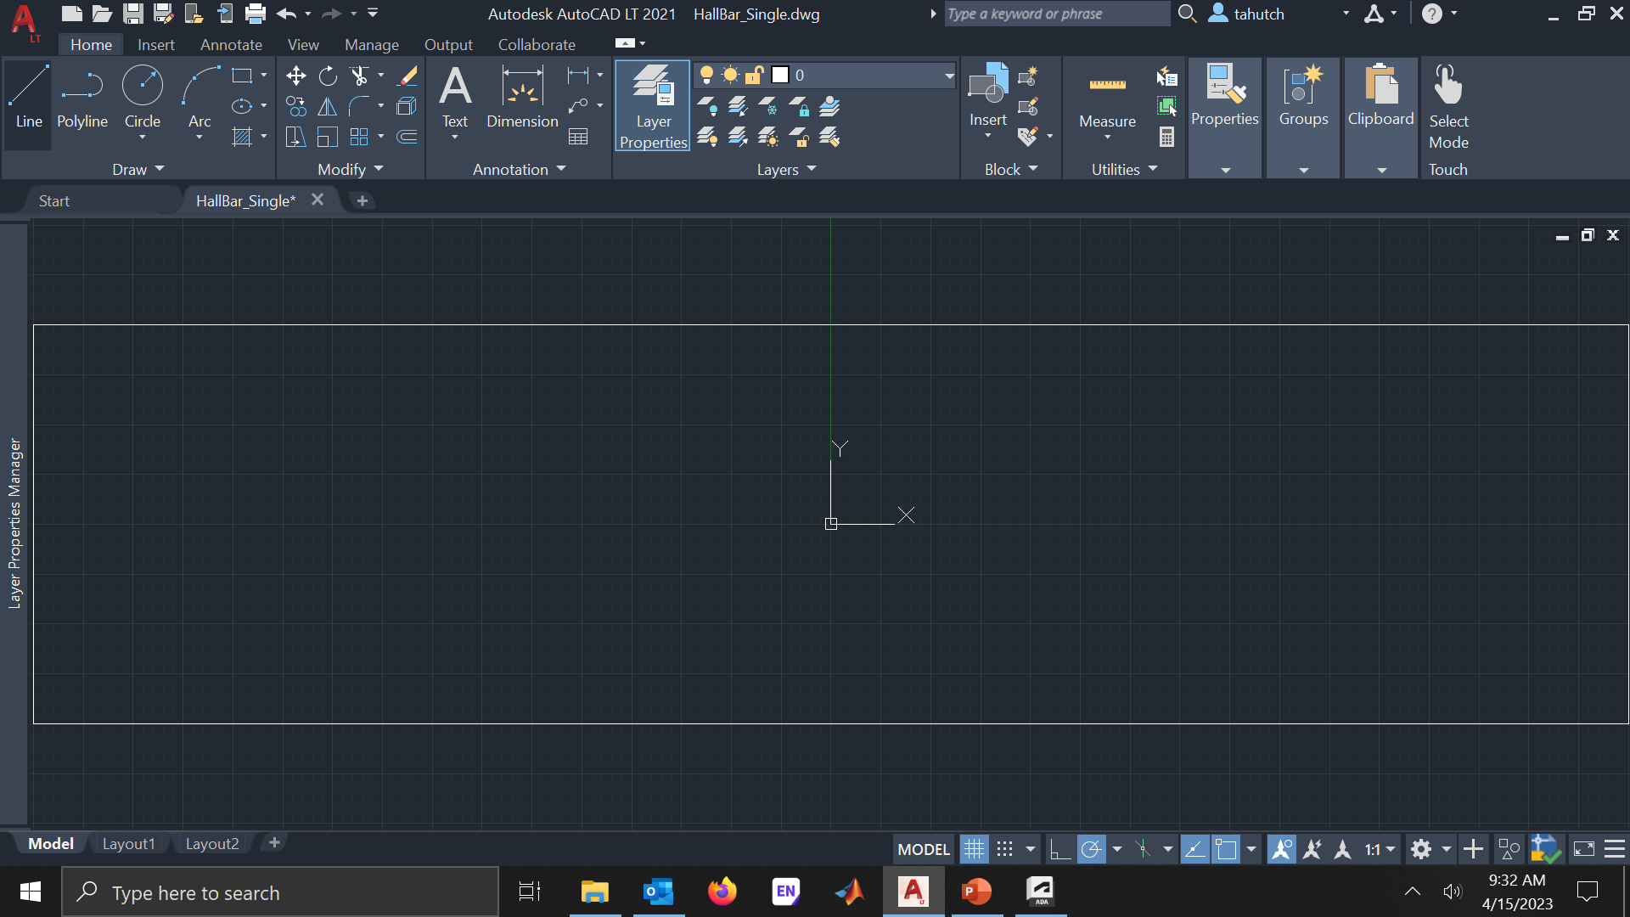
Hall Bar FET: Device/Chip Boundary

Slide 12
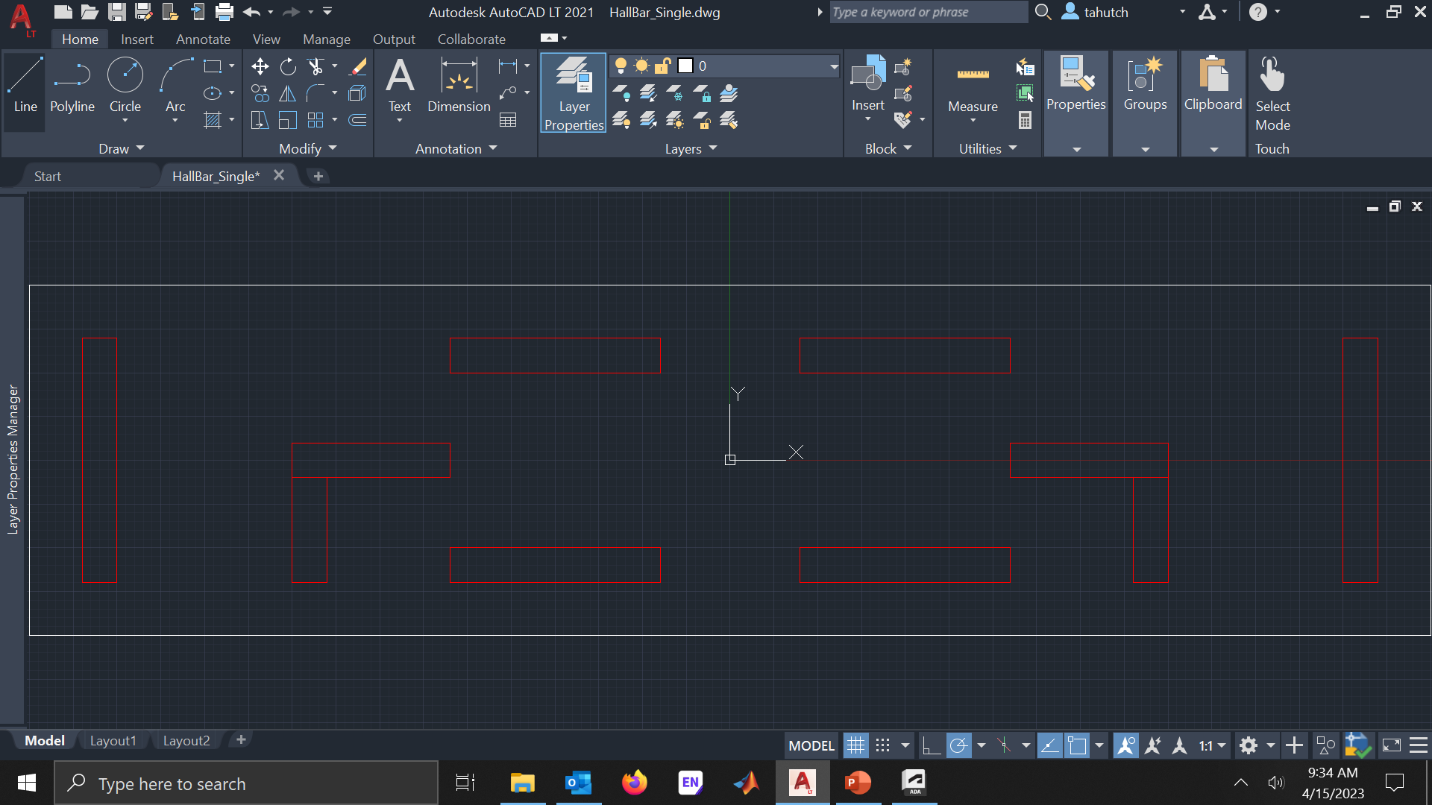
Hall Bar FET: Implant/Ohmics

Slide 13
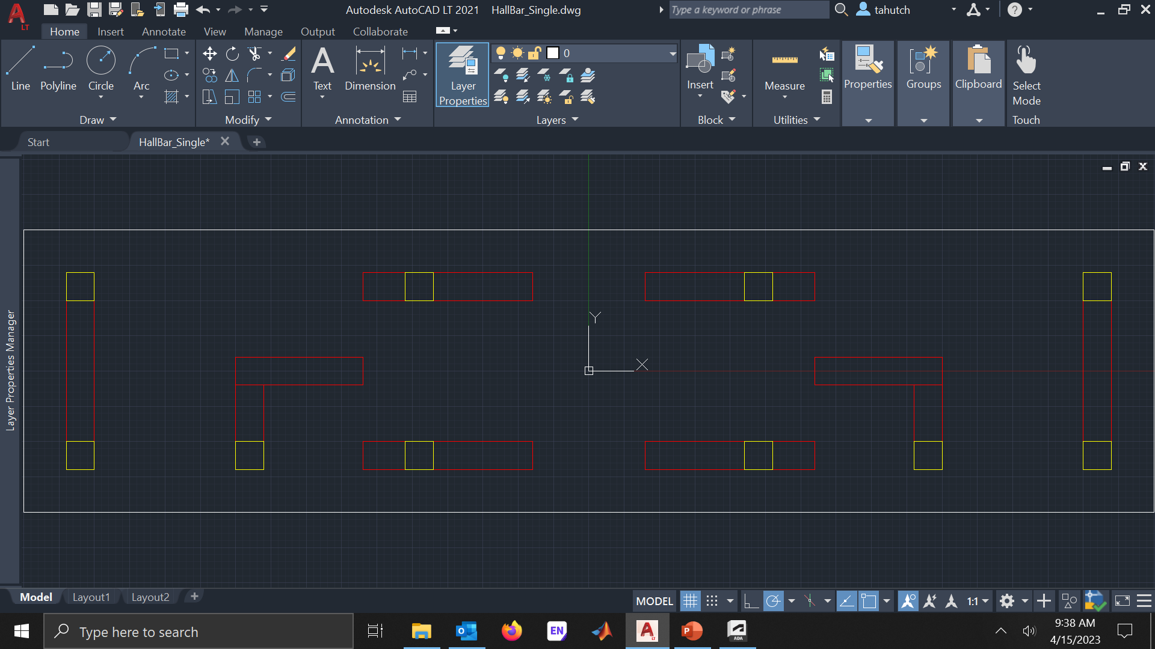
Hall Bar FET: Vias

Slide 14
Hall Bar FET: Gate/Contact Pads

Slide 15
Cross Sections: Layer 1 – Implant/Ohmics
Surface Preparation
ALD Oxide
Spin Resist
Develop & BOE
Metalization
Expose
RTA – Solid State Reaction
Lift-off
ALD Oxide

Slide 16
Cross Sections: Layer 2 – Vias
Spin Resist
Expose
Develop
Lift-Off
Metalization
BOE

Slide 17
Cross Sections: Layer 3 – Vias
Spin Resist
Expose
Metalization
Clean
Ion Mill
Develop

Slide 18
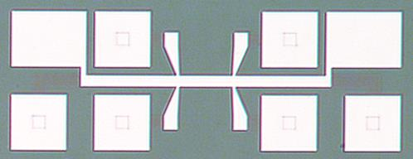
Cross Sections: Final Micro-Device
Ti/Au via
Ti/Au contact
Al₂O₃
PtSiGe
Ge/SiGe
Hutchins-Delgado, Troy A., Andrew J. Miller, Robin Scott, Ping Lu, Dwight R. Luhman, and Tzu-Ming Lu. "Characterization of Shallow, Undoped Ge/SiGe Quantum Wells Commercially Grown on 8-in.(100) Si Wafers." ACS Applied Electronic Materials 4, no. 9 (2022): 4482-4489.

Slide 19
Testing: Device Cross Section
Ti/Au via
Ti/Au contact
Al₂O₃
PtSiGe
Ge/SiGe
Hutchins-Delgado, Troy A., Andrew J. Miller, Robin Scott, Ping Lu, Dwight R. Luhman, and Tzu-Ming Lu. "Characterization of Shallow, Undoped Ge/SiGe Quantum Wells Commercially Grown on 8-in.(100) Si Wafers." ACS Applied Electronic Materials 4, no. 9 (2022): 4482-4489.

Slide 20
Electrical Characterization
Current-Voltage (I-V)
Capacitance-Voltage (C-V)
Impedance Spectroscopy
Transmission Line Measurement (TLM)
Deep-Level Transient Spectroscopy (DLTS)
Hall Effect
Notes:
Here is a short list of electrical characterizations of which I have used here at CINT. This list is by no means exhaustive of what can be done at CINT and I again refer you to the CINT website for a more complete list. However, most electrical characterizations are in someway derived from a current-voltage measurement since these are macroscopic quantities we can easily and reliably measure.

Slide 21

Electrical (Hall) Experimental Setup
Lock-In #1
A1 B1
Lock-In #3
I O
Magnet Power Supply
D
B1
S
V_{xx}
DC Voltage
Source
(V_{gate})
V_{gate}
V_{xy}
$$B_{⊥}$$
I_{SD}
I_{SD}
G
A1
B2
A2
A2 B2
Lock-In #2
Notes:
Here is the schematic of the experimental setup for electrical transport characterization of the material. A DC voltage source is connected to the gate of the Hall bar device to control the carrier density via field-effect. A lock-in amplifier provides a sinusoidal voltage bias across the device longitudinally from source to drain. The same lock-in amplifier also measures the longitudinal current. A longitudinal resistance is measured by dividing the measured potential difference across A2/B2 by the measured longitudinal current. Likewise, a transverse resistance is measured by dividing the transverse potential difference across A1/B1 by the longitudinal current. A magnetic field is swept to induce the Hall effect to extract the carrier density and mobility from the resistances.

Slide 22
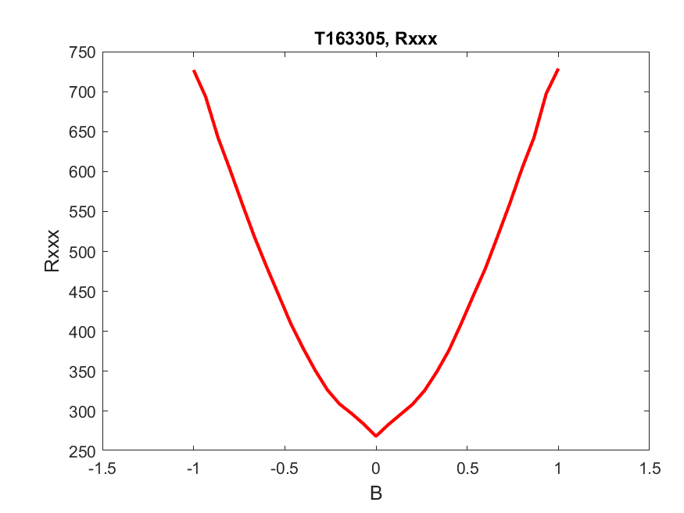
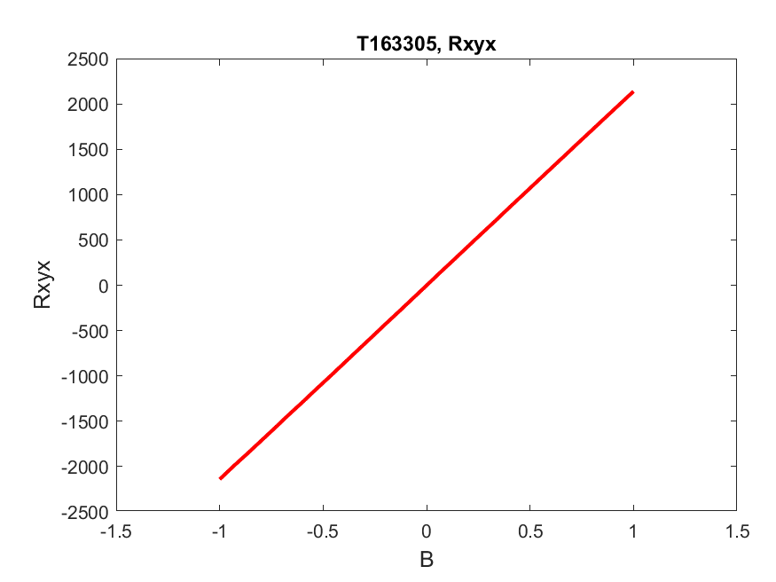

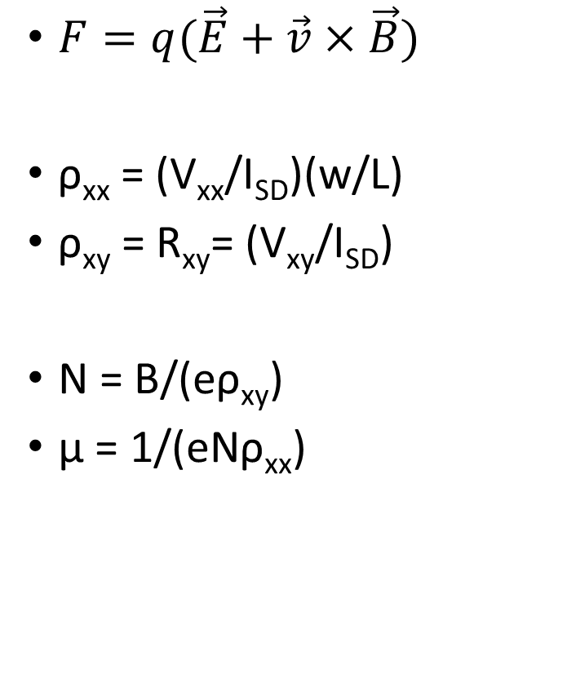



Hall Measurement Details
$F=q(\vec{E}+\vec{v}×\vec{B})$
ρ_{xx} = (V_{xx}/I_{SD})(w/L)
ρ_{xy} = R_{xy}= (V_{xy}/I_{SD})
N = B/(eρ_{xy})
μ = 1/(eNρ_{xx})
$$V_{gate}$$
$$B_{⊥}$$
$$R_{xy}$$
$$R_{xx}$$

Slide 23
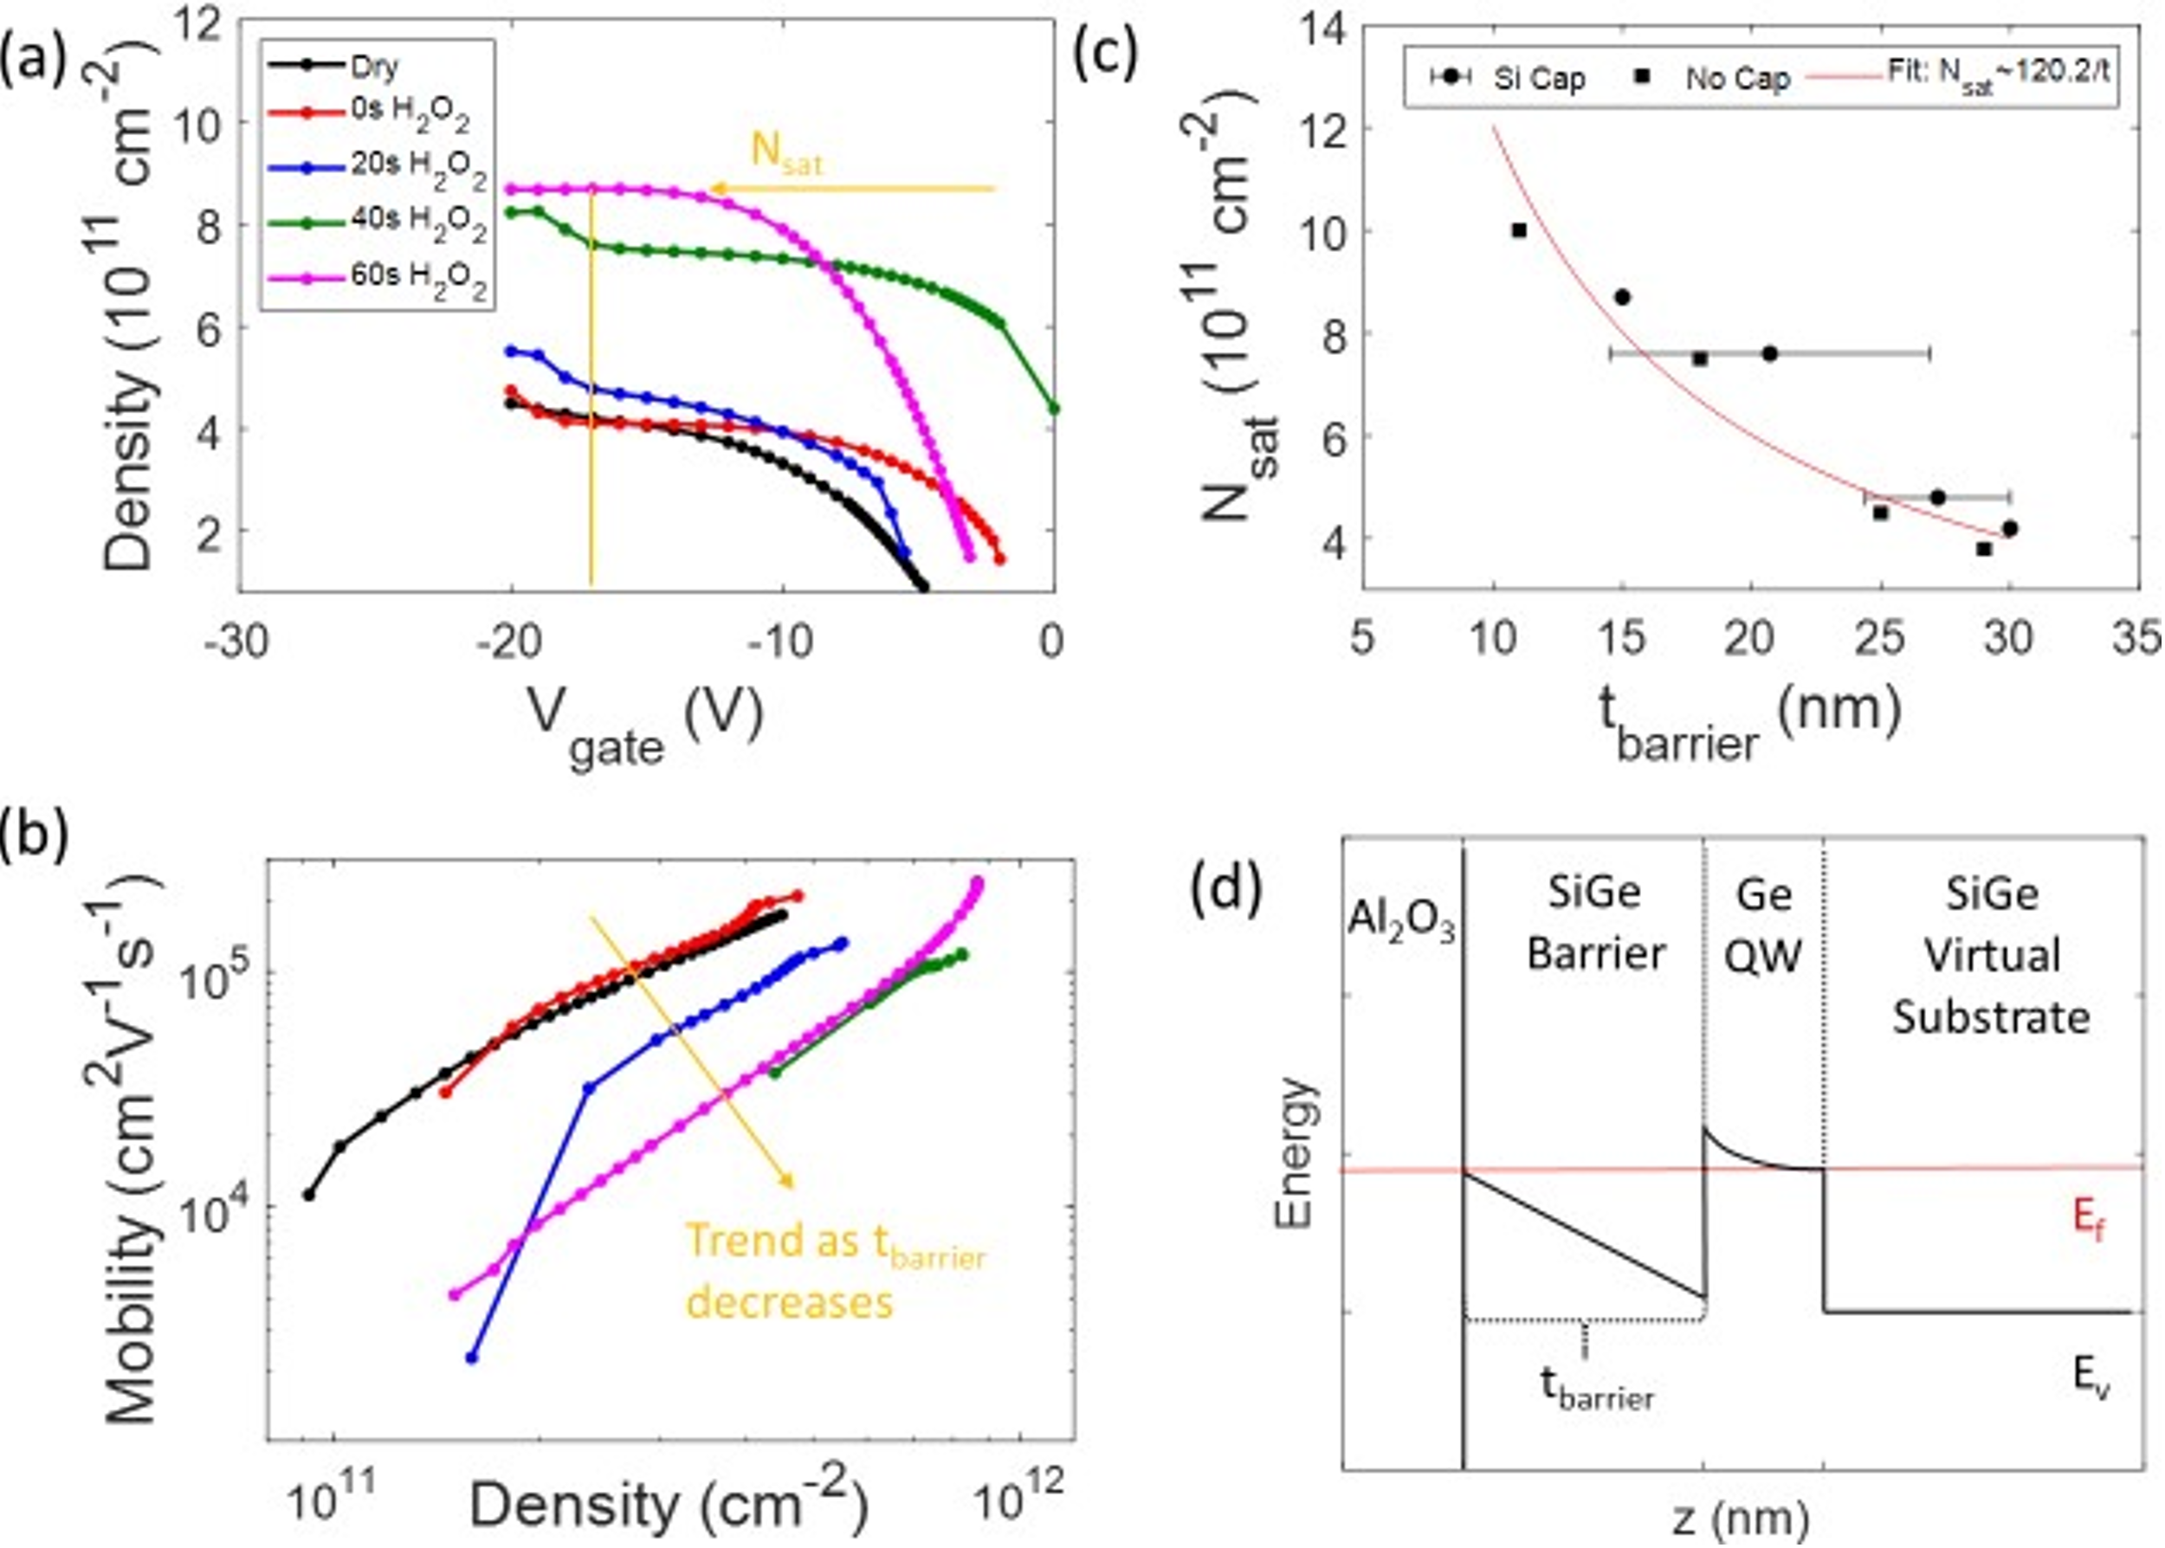
Hall Measurement Example
Hutchins-Delgado, Troy A., Andrew J. Miller, Robin Scott, Ping Lu, Dwight R. Luhman, and Tzu-Ming Lu. "Characterization of Shallow, Undoped Ge/SiGe Quantum Wells Commercially Grown on 8-in.(100) Si Wafers." ACS Applied Electronic Materials 4, no. 9 (2022): 4482-4489.
Notes:
Here is an example of the Hall measurements we performed on our material that I showed earlier. We investigated how various surface preparations affected our material and its transport properties. We showed that the surface preparations could be used to control the top barrier thickness or depth of the quantum well to tune the transport properties. Likewise, you could use Hall measurements to study how transport properties change as a function of material composition, growth techniques, induced defects, etc.

Slide 24
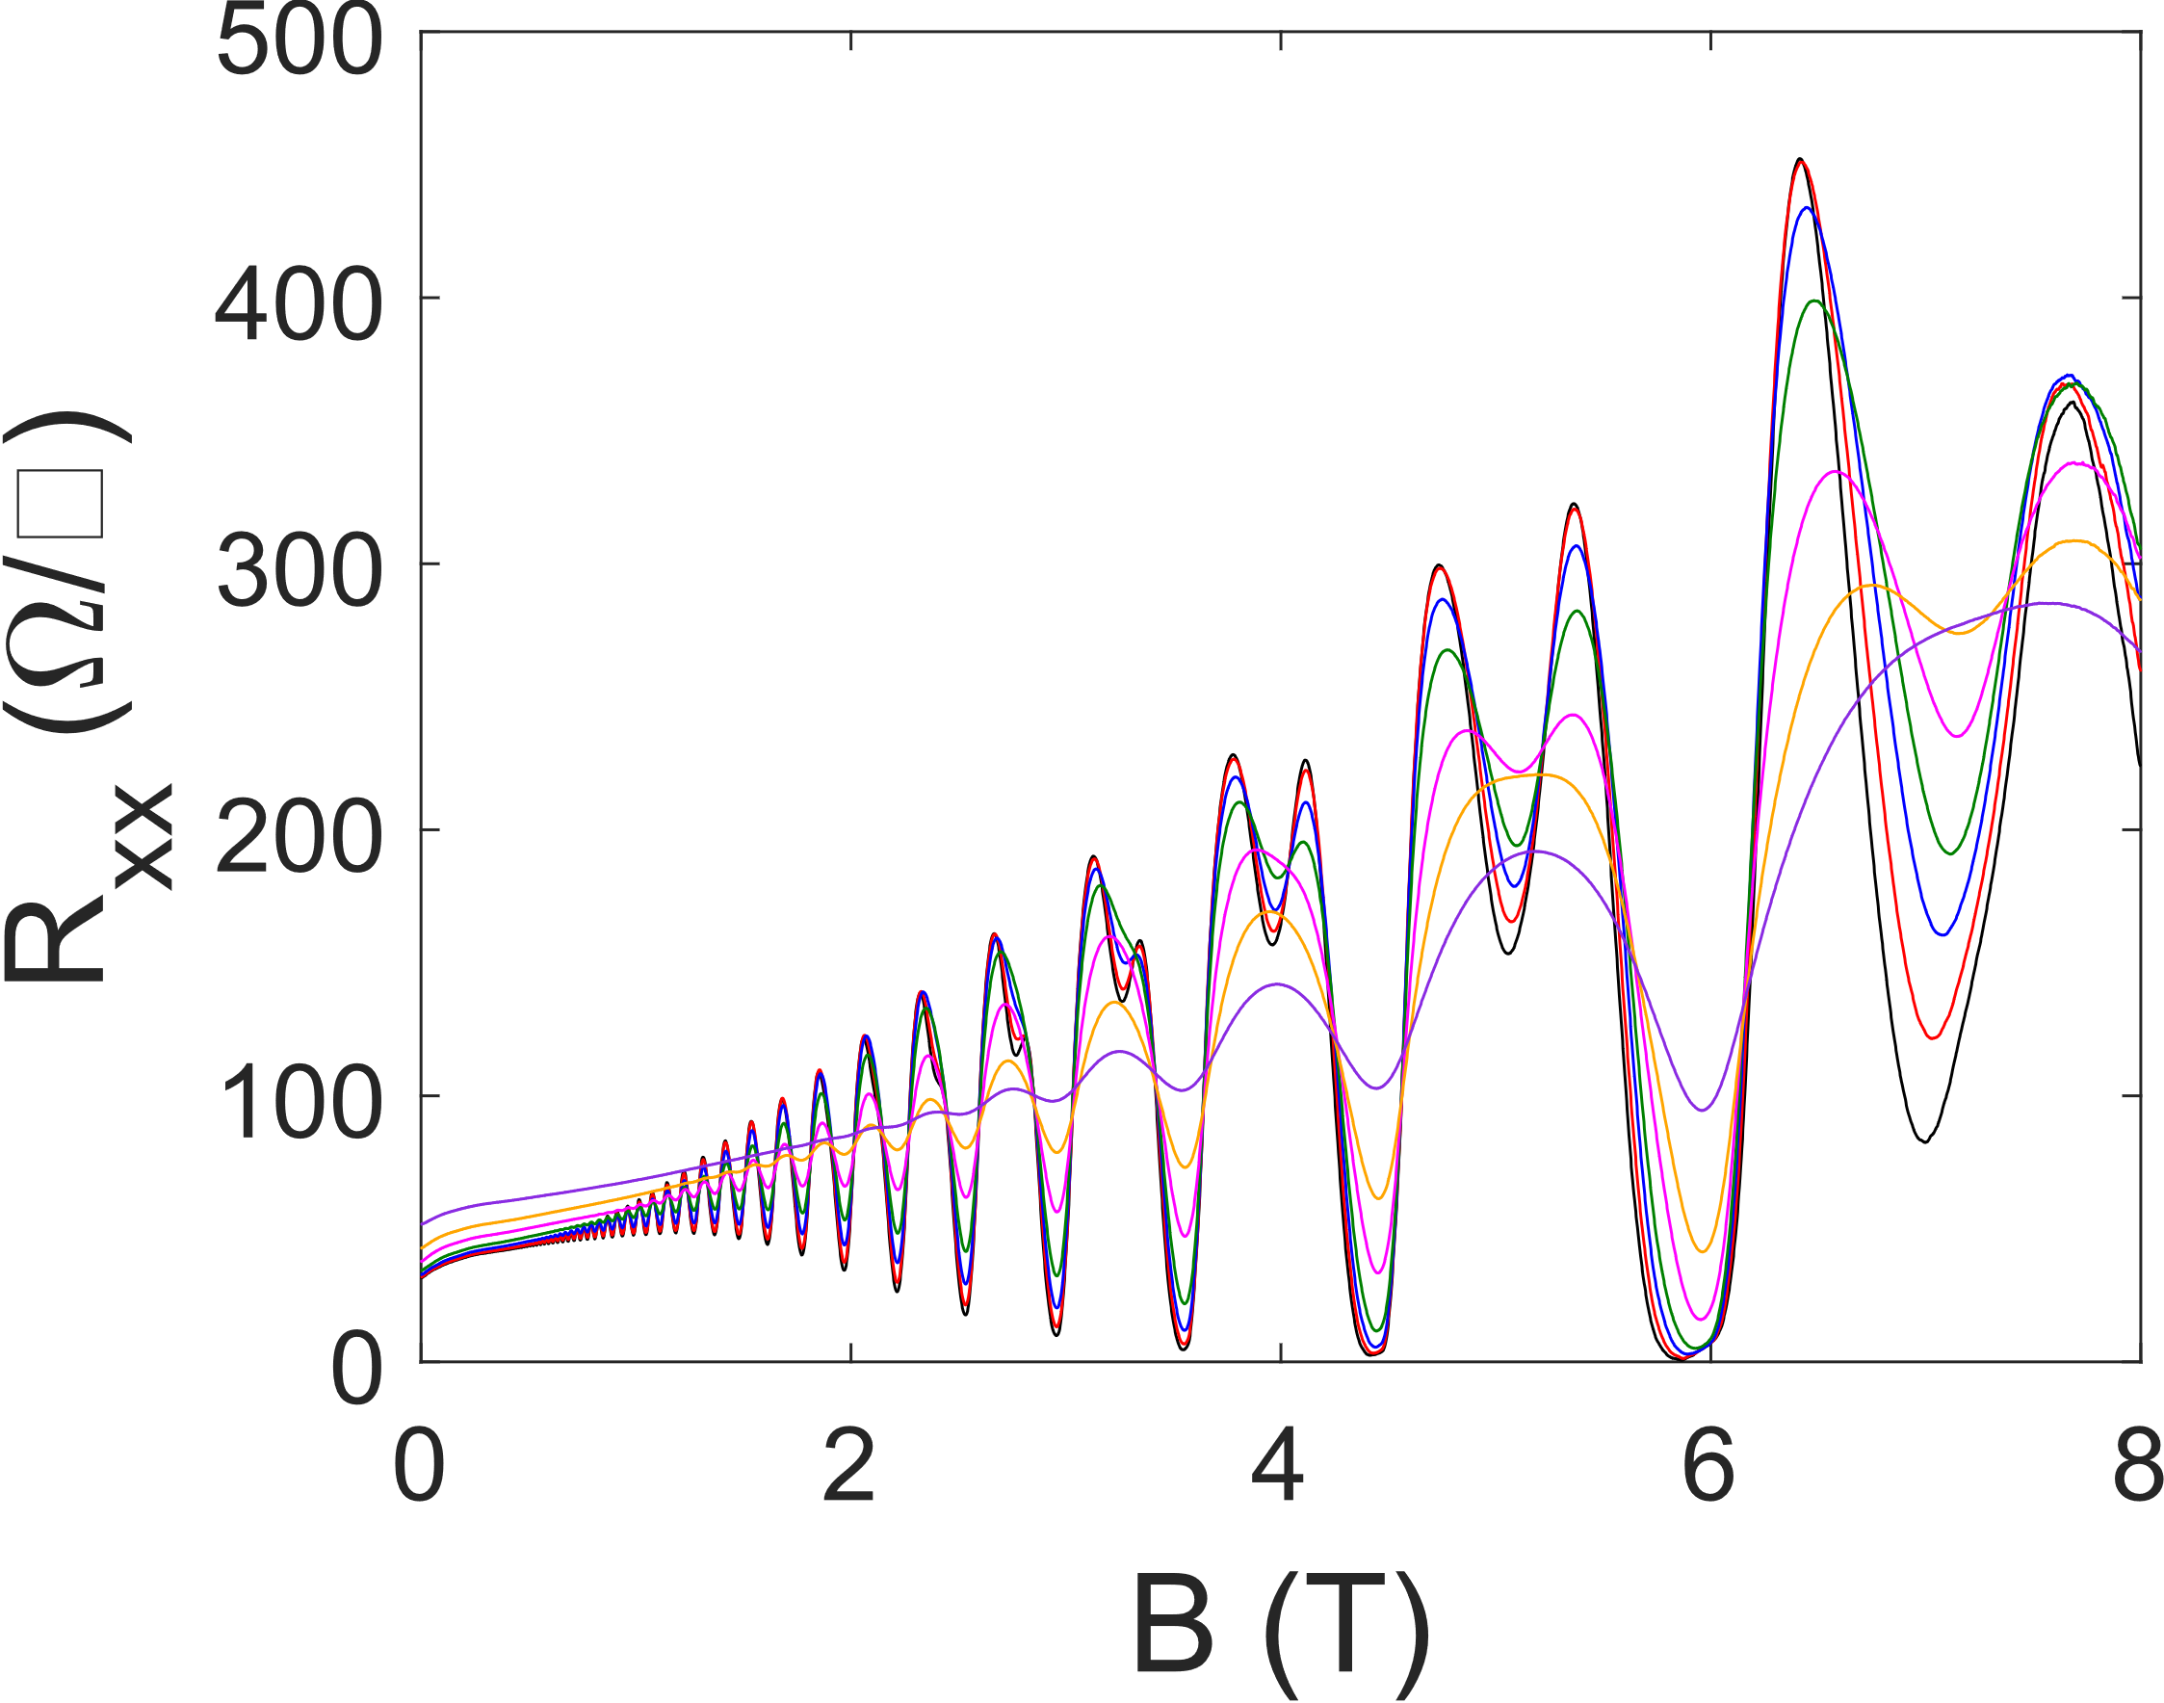
Quantum Hall Example
Hutchins-Delgado, Troy A., Andrew J. Miller, Robin Scott, Ping Lu, Dwight R. Luhman, and Tzu-Ming Lu. "Characterization of Shallow, Undoped Ge/SiGe Quantum Wells Commercially Grown on 8-in.(100) Si Wafers." ACS Applied Electronic Materials 4, no. 9 (2022): 4482-4489.
Notes:
By performing a Hall measurement at lower temperatures and higher magnetic fields, the measurement can probe the quantum regime. Quantum Hall measurements can provide even more information about the material such as effective mass, scattering order/mechanisms, g-factor, spin orbit coupling, and more. The characteristic features of a quantum Hall measurement are the Shubnikov de Haas oscillations in the longitudinal resistances and the plateaus in the transverse resistance that occur at the valleys of the oscillations. By looking at how these features change as a function of temperature and density you can extract the various physical parameters mentioned.

Slide 25
Capacitance-Voltage Example
Hutchins-Delgado, Troy A., Andrew J. Miller, Robin Scott, Ping Lu, Dwight R. Luhman, and Tzu-Ming Lu. "Characterization of Shallow, Undoped Ge/SiGe Quantum Wells Commercially Grown on 8-in.(100) Si Wafers." ACS Applied Electronic Materials 4, no. 9 (2022): 4482-4489.
Notes:
Here is an example of a capacitance-voltage measurement performed at room temperature using an impedance analyzer. Here you can see the measured capacitance as a function of voltage at several frequencies. Also, shown are various normalized conductance spectra. The measurement was used to estimated the interface trap density in our devices. The measurement was performed on a Hall bar devices that also had a backside substrate contact. As this was not a standard MOS capacitor device, it was important to take into account affects due to the structure and device geometry. This is why I emphasize using cross sections and drawing equivalent circuit diagrams. Even here, the equivalent circuit diagram is only valid within frequency range. At higher frequencies we observed more parasitic effects.

Slide 26
Nanofab Example:
Ge/SiGe Gate-Defined Quantum Dots

Slide 27
Gate-Defined Quantum Dot
Uses field-effect transistor physics on a nanoscale to induce quantum confinement
Acts as a single charge carrier transistor
Ohmic Contact
Bar
Bar
Ohmic Contact
Al₂O₃
Accumulation
Dot
Accumulation
Al₂O₃
Isolation
Hole Reservoir
SiGe
Hole Reservoir
Barrier
Barrier
s-Ge QW V(x)
Accumulation
Dot
Accumulation
E_{F}
SiGe Hole on QD
Isolation
Notes:
A lithographic or gate-defined quantum dot is a device that uses field-effect transistor (FET) physics on a nanoscale to induce 3D quantum confinement. The quantum dot then acts as a single charge carrier transistor. A schematic of such a device is visualized by the figure. The quantum well creates vertical confinement creating a quasi-2D system. Isolation gates shown in the top view schematic, create lateral confinement inducing a quasi-1D channel. The cross-section schematic is along the quasi-1D channel. Accumulation gates create reservoirs that are Ohmically contacted to serve as the source and drain of the device. A dot gate with barrier gates on either side serve as the electrostatic confinement of a quasi-0D system or quantum dot.

Slide 28
Cross Sections: Nanofabrication Overview
Initial
Microfab
Layer 1:
ALD AL₂O₃
Layer 1:
Isolation Gates
Layer 3:
ALD AL₂O₃
Layer 2:
Accumulation Gates
Layer 2:
ALD AL₂O₃
Layer 3:
Barrier Gates
Final
Microfab
Notes:
My work on gate-defined quantum dot devices started with refining a fabrication process developed at Sandia. We switched to a new atomic layer deposition (ALD) tool, dedicated for silicon- and germanium-based materials, for deposition of gate dielectrics. Another change we made was moving the electron beam lithography (EBL) from a Nabity system on a 30 kV scanning electron microscope (SEM) to a dedicated 100 kV JEOL EBL system. With this change, we were able to achieve smaller critical dimensions and improve yield. Finally, we worked on improving the oxide-semiconductor interface with the surface preparation procedure during the initial microfabrication, of which we are currently preparing a manuscript.

Slide 29
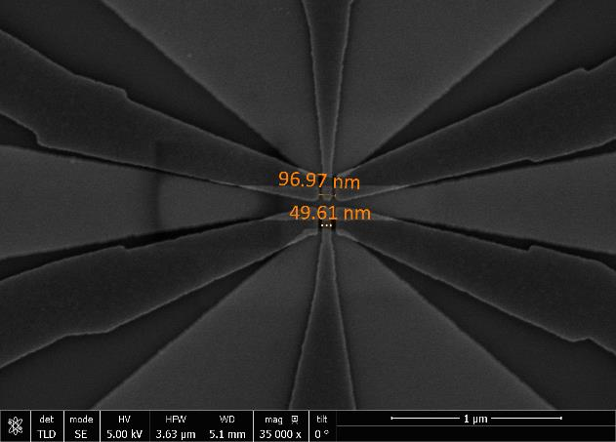
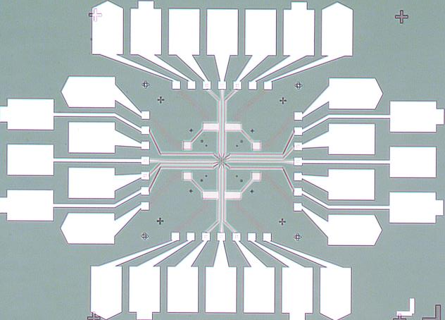
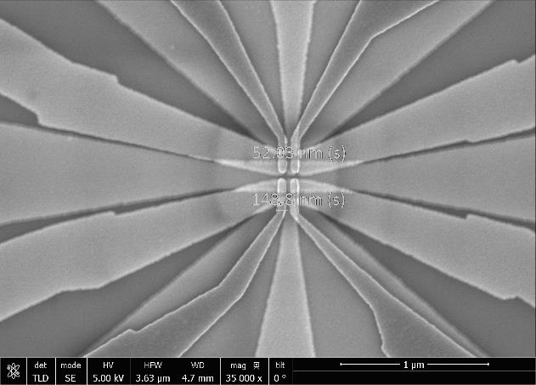
Nano Fabrication Example: 3xEBL Gate-Defined QDs

Slide 30
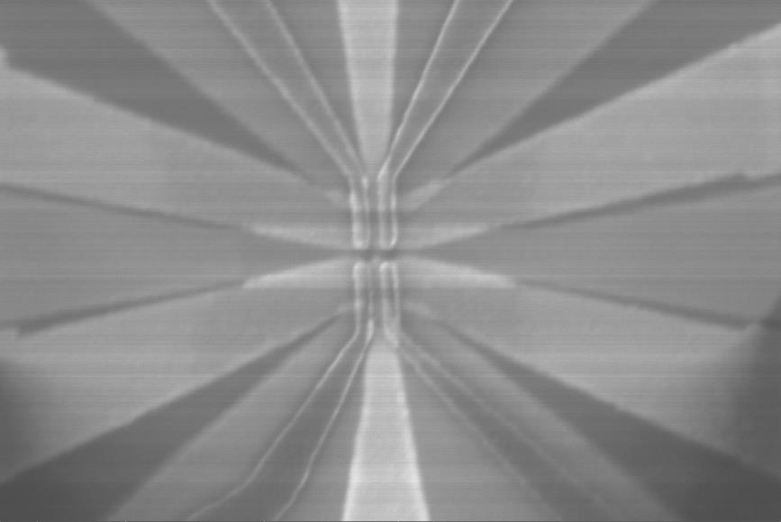
Gate-Defined Quantum Dot Transport Experiment
AWG
(BAR)
AWG
(ISO)
AWG
(ACU)
Lock-In #1
O1 A1
AWG
(DOT)
I/V
Amplifier
X
X
NOTE:
Setup is repeated for the bottom device

Slide 31
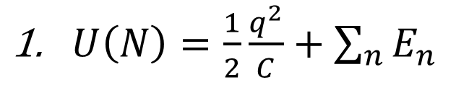
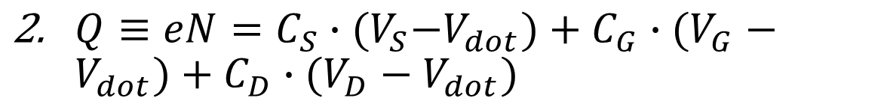
Quantum Dot Model & Coulomb Blockade
$U\left(N\right)=\frac{1}{2}\frac{q^{2}}{C}+\sum_{n}{E_{n}}$
${Q≡eN=C}_{S}∙{(V}_{S}−V_{dot})+C_{G}∙(V_{G}−V_{dot})+C_{D}∙(V_{D}−V_{dot})$
$μ\left(N\right)=\left(N−\frac{1}{2}\right)∙E_{c}−\frac{E_{c}}{e}∙\left(C_{S}∙V_{S}+C_{G}∙V_{G}+C_{D}∙V_{D}\right)+E_{n}$
V_{G}
C_{G}
S
D
QD
V_{S}
V_{D}
C_{S}
C_{D}
V_{dot}
Notes:
The main physical mechanism behind the single charge transport in a quantum dot is the Coulomb blockade. The Coulomb blockade is best described by the thermodynamics of a simple capacitance model which is highlighted in Figure 4 along with an example plot of quantum dot transport. The simple model shows three connections to the dot via a gate (G), source (S), and drain (D). Each connection has its respective voltage (VG, VS, VD) followed by its respective capacitor (CG, CS, CD). The source and drain also have a resistor in parallel with the capacitor to represent their respective tunneling currents. The three connections meet at the dot’s equipotential surface Vdot. The energy of the quantum dot is simply its charge-capacitance energy and sum of each charge’s single particle energies given by equation (1).
The total charge can be written in terms of the total charge on the capacitors represented by equation (2)
Therefore, the dot’s charge ,C*Vdot, can be expressed as the total charge subtracted from sum of the capacitors charge. Combining (1) and (2) using the definition of chemical potential, the amount of energy it takes to add the Nth charge to the dot, we arrive at (3) the equation for the chemical potential of the dot.
Here, EC ≡e2/C, is defined as the charging energy of the dot. For the Coulomb blockade to occur, the charging energy must be much greater than the thermal energy thus preventing thermionic emission. The most important result from equation (3) is that the chemical potential is linearly dependent on the bias voltage and gate voltages. The coefficient that relates the voltage to the chemical potential is known as the lever arm.
The transport plot in the bottom right figure highlights what one expects to see experimentally when operating in the Coulomb blockade regime. As the dot’s gate voltage is swept, it’s chemical potential is varied until it’s matched with the fermi level of the reservoirs. A resonance condition is then met allowing for tunneling to and from the dot creating a spike in current. The linewidth of current spike then corresponds to the tunneling rate.

Slide 32
Coulomb Diamonds & Lever Arm
eC_{G}/C_{S}
-eC_{G}/(C-C_{S})
N+1
μ_{S}
N
eV_{SD}
N-1
μ_{D}
Notes:
The more general characterization is a 2D scan, often referred as bias spectroscopy, where the conductance is measured as a function of both the source-drain bias and the gate voltage. A conceptualization schematic and plot are shown by the figures. The source-drain bias provides a difference in chemical potential across the dot while the gate voltage tunes the dot’s. The defining feature of the plot is the diamond shape where there is no conduction, referred to as Coulomb diamonds due to its relation to the Coulomb blockade. Excited orbital states can be revealed during such a scan and would be indicated by resonant conduction shown above and below the diamond nodes. Additionally, another important feature of the scan is extraction of the lever arm values. The coefficients of each voltage in equation (3), eCi/C, are defined as a lever arms of the gates. It creates a relation between voltage and energy for the dot. The positive and negative slopes of the Coulomb diamonds correspond to the ratio of the corresponding capacitances involved thereby providing a means to extract the lever arm values. The voltage from consecutive peaks in the Coulomb diamonds, when multiplied by the lever arm, gives addition energy of the dot. The addition energy of the dot is equal to the charging energy plus the single particle energy difference between occupations.

Slide 33
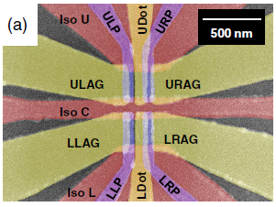
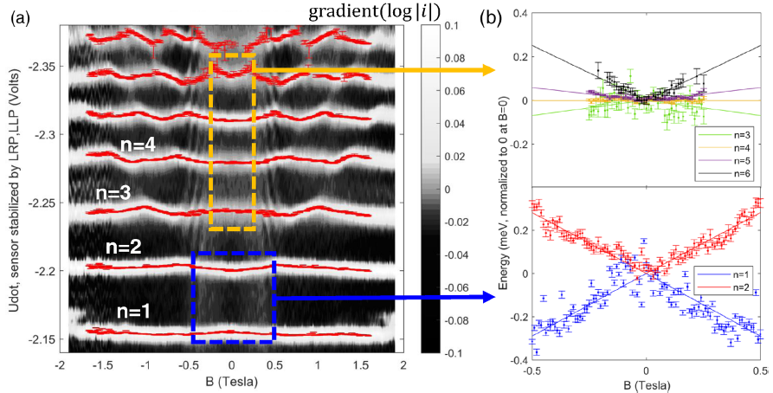
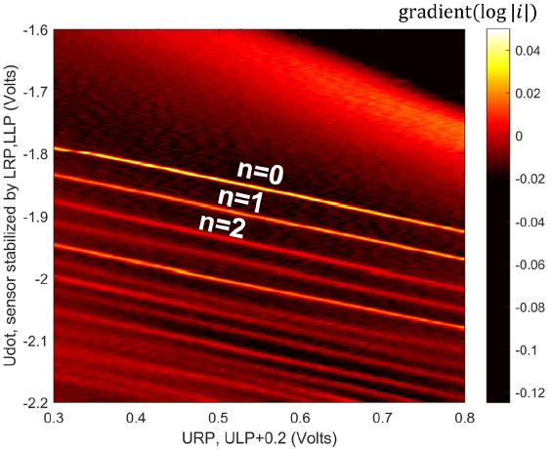
Quantum Dot Measurement Examples
Miller, Andrew J., Will J. Hardy, Dwight R. Luhman, Mitchell Brickson, Andrew Baczewski, Chia-You Liu, Jiun-Yun Li, Michael P. Lilly, and Tzu-Ming Lu. "Effective out-of-plane g factor in strained-Ge/SiGe quantum dots." Physical Review B 106, no. 12 (2022): L121402.

Slide 34
Questions?

