Slide 1
Lithography for micro and nanoscale patterning
Keshab Sapkota
(krsapko@sandia.gov)
Contributors:
Chloe Doiron, Tony James, Troy Hutchins-Delgado, Willie Luk
March 28, 3:30 - 4:30pm
1026/518 (CINT)
CINT Nanofabrication Workshop Series (CNWS)
SAND No. SAND2023-01295PE

Slide 2
CINT Nanofabrication Workshop Series (CNWS)
Goals: Help integration lab (IL) users community to
Smooth out learning curve for new users with no/little prior fabrication experience
Address fabrication bottlenecks for the users and minimize/avoid “rediscovering the wheel”
Discuss advanced fabrication topics with experts and learn from each other
Workshop Topics
Introductory Topics
Planning & design, fab process flow, sample handling, troubleshooting
Workshop Format
Presentation on the Topic
(40 minutes)
(30 min)
Intermediate Topics
Lithography, chemical processes, etching, depositions, metrology, holistic approach, troubleshooting
New IL Users
Discussion and fab questions
(20 minutes)
Advanced Topics
Materials specific, device architecture specific, complex process flow, integration
Existing IL Users

Slide 3
Design of Fabrication
Define problem, set goals
Device needs
Theory and simulation
Test a concept/theory, prototyping
Identify parameters
Fabrication shape, size, resolution
Materials stack, compatibility, integration needs
Measurement requirements
Identify Fab process
Identify sample size, design pattern
Step by step process flow based on parameters
Identify steps that need testing/optimization
Feedback
Execute Fab
Work in parts: test/optimize unknown steps- can be parallelized, may need multiple experiments
Put them together once individual steps are tested
Measurement & Analysis
Inspect/measure sample at each step when possible
Use reference sample with primary sample to enable additional measurements

Slide 4
Optimization
Controllable: Resist thickness, dose, plasma power
Partially controllable: Photoresist edge beads
Uncontrollable: Tools dependent variation
Uncontrolled: humidity and its impact on photoresist film
Design of Fabrication
Define problem, set goals
Controlled variables
Uncontrolled variables
Identify parameters
Error
Yield
Feedback
Identify Fab process
Optimize process
Execute Fab
Unknown variables
Iteration
Measurement & Analysis
Optimization of a process by iteration

Slide 5
Components of Nanofabrication
Process sample/substrate
Films processing
Oxides, nitrides, poly-Si, (ALD, CVD)
Additional treatments
RTA, annealing, passivation, protection
Sample preparation
Sample cleaning, mounting, transfer
Create patterns on polymer (photoresist)
Transfer pattern to sample/substrate
Lithography
e-beam, photo, imprint
Etch/Liftoff
Metal dep, dry etch, wet etch

Slide 6
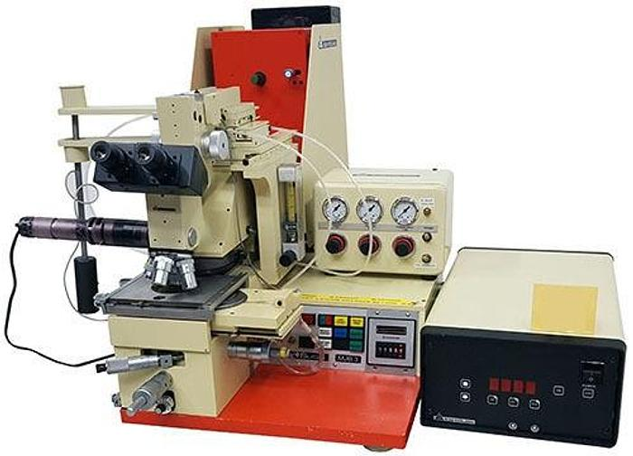
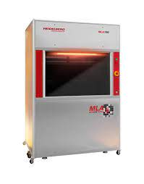
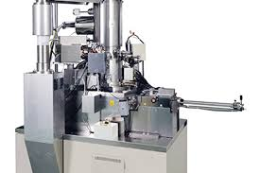
Patterning by Lithography
Lithography: process of creating patterns on a polymer/film
Photolithography
Electron-beam lithography
Mask aligner
Maskless aligner
100 kV EBL
Resolution depends on wavelength (nm)
Resolution depends electron energy (kV), beam current (pA)
Mask Aligner
Resolution available at CINT ~1um
Fast patterning
Maskless Aligner
Patterning from CAD design without mask
Patterning Slower than mask aligner
High resolution, down to 10nm
Slow patterning speed
Maskless patterning, create patterns directly from CAD design
Expose on Photoresist
Expose on E-beam resist

Slide 7
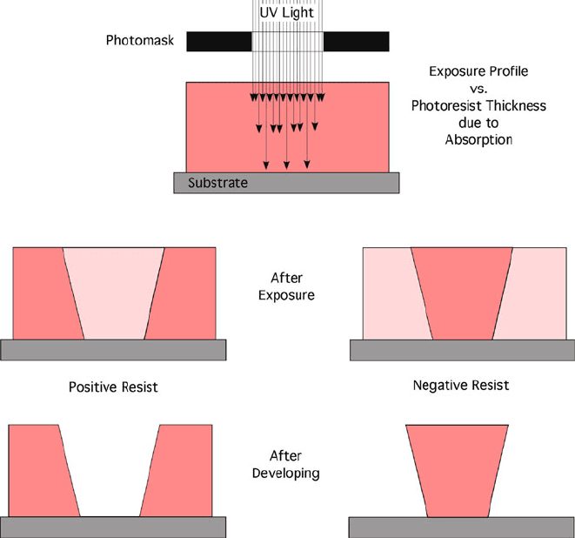
Photoresist: positive tone, negative tone, chemically amplified
Photoresist
Resin
e.g. Novolak
Photoactive compound e.g. DNQ➔ Carboxylic acid
Solvents or Thinner
e.g. PGMEA, Anisole
Chemical matrix, binder
photon/electron activates chemical reaction
Keeps photoresist in solution form
Positive & negative tone resists
Polymerization
Exposing photoresist with photons, electrons
Negative tone
Crosslinking
Decomposition
Positive tone
Positive tone
Negative tone
Image reversal resist
Can be used as positive or negative tone resist
As positive tone: single exposure; as negative tone: exposure ➔ bake ➔ flood exposure
Chemically amplified resist (CAR)
Light is absorbed by photoacid generators (PAGs) ➔ multiple photoacid molecules per photon
High quantum yield ➔ high sensitivity, low exposure dose

Slide 8
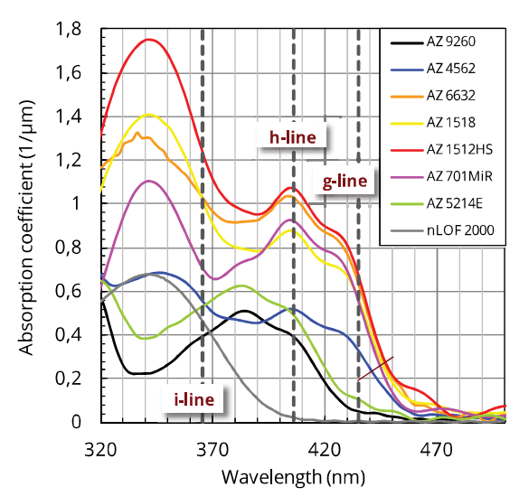
Photoresist process and choice
Spin coat
Prebake
Exposure
Post bake*
(photolithography)
*Post bake generally not necessary, can improve resolution by minimizing dose variation due to standing wave
Post bake temp = (20 ºC+ prebake) < 130 ºC
Things to consider
Softening & Rounding: Heating > 100 ºC softens resist resulting reflow and rounded corners. Positive tone resists are more susceptible than negative tone.
Embrittlement: Heating ≥130 ºC can form cracks on the photoresist.
Thermal cross-linking: Thermal cross-linking can be significant at ≥ 140 ºC making it difficult to remove the resist
Photoresist Choice
Wet etch: optimal adhesion is necessary to avoid creeping of etchant. AZ®1500 (thickness 0.5-3 μm), AZ ECI 3000 (thickness 1-4 μm), AZ 4500 (thickness ≥ 10 μm)
Dry etch: high softening temperature, steep sidewalls. AZ701 MiR (1-4um), thick resist AZ4500 (e.g.4562), NEB (EBL), HSQ (EBL), ZEP (EBL)
Liftoff: Undercut profile: AZ5214E, AZ nLOF 2000 (2-15 um), PMMA (EBL), multi stacks (e.g. PMMA/MMA)
www.microchemicals.com

Slide 9
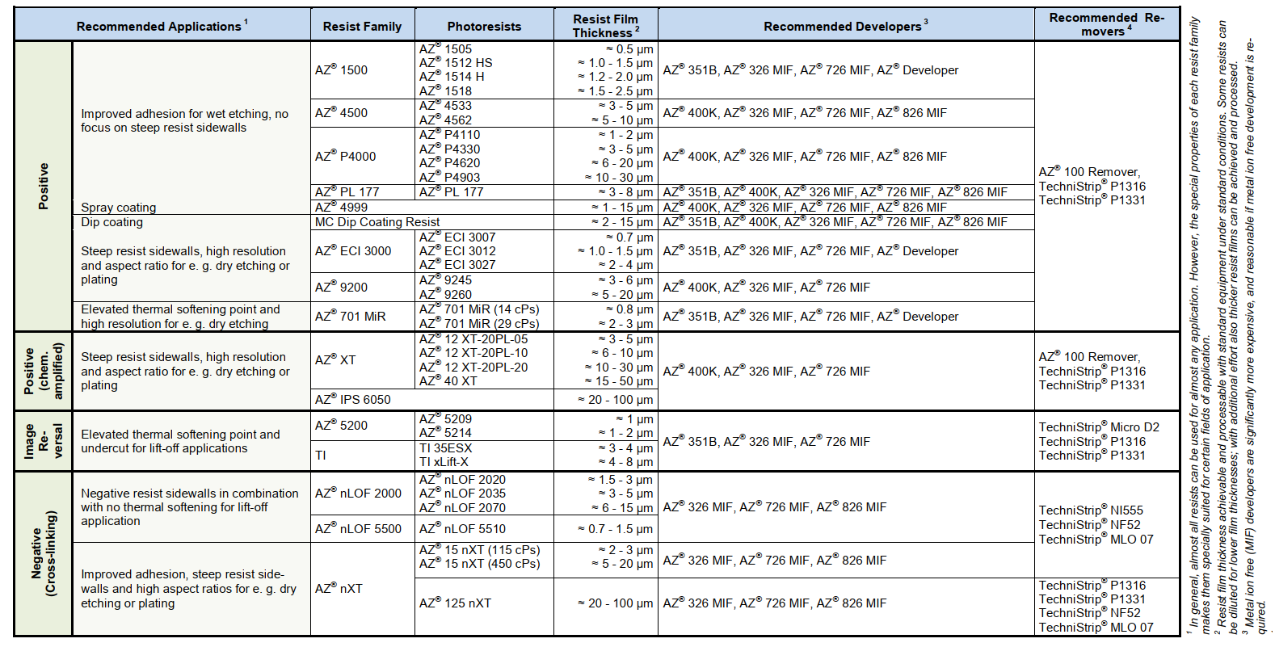
Photoresist: positive tone, negative tone, chemically amplified
Resists for photolithography
https://www.microchemicals.com/technical_information/image_reversal_resists.pdf

Slide 10
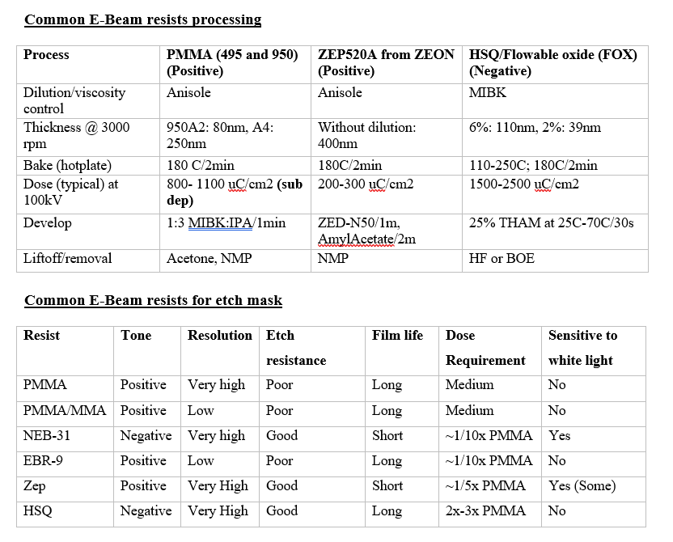
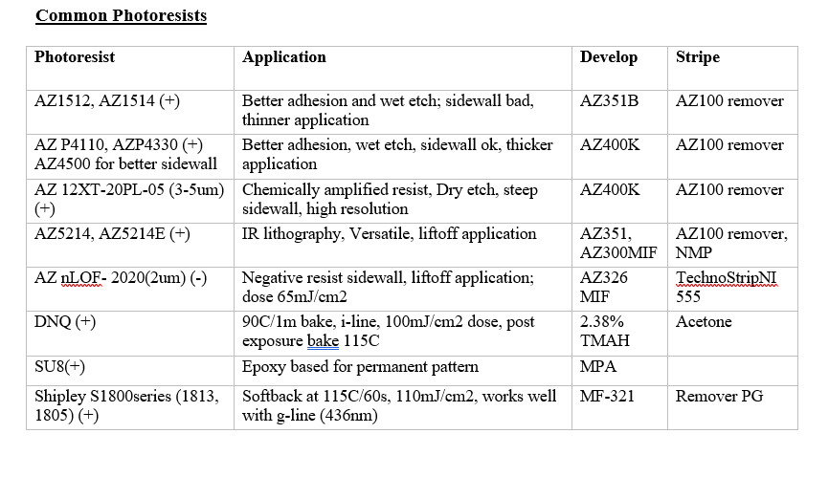
Common photoresist and e-beam resists

Slide 11
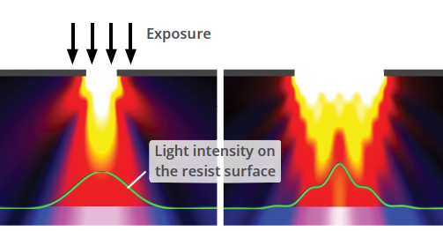
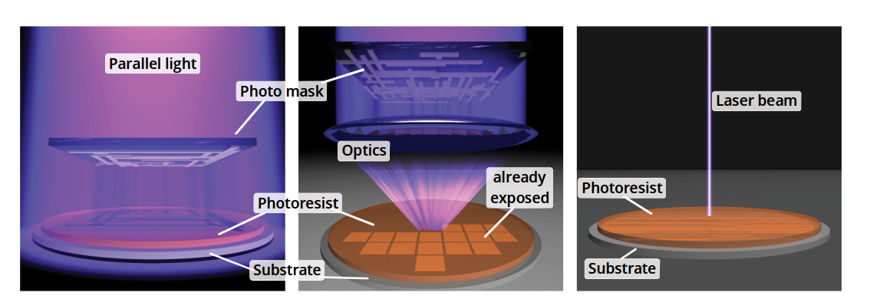
Revisiting Photolithography
Exposure
Exposure light source (CINT): Mercury lamp
Wavelengths: g-line: 436nm, h-line: 405nm, i-line: 365nm
Resolution is governed by Rayleigh criteria.
$$Resolution (R) α \frac{λ}{NA}, Depth of Focus \left(DOF\right) α \frac{λ}{NA^{2}}$$
Rayleigh criteria for resolution
Silicon VLSI technology
DOF restricts the photoresist thickness
Resolution and DOF are competing effects
Contact or proximity
Projection (stepper)
Laser writer (MLA)
Proximity & Contact patterning
Soft Contact: resolution 2um
Hard Contact: resolution 1um
Laser writer (MLA) with h-line
Resolution >0.6um
Available at CINT
www.microchemicals.com
Available at CINT

Slide 12
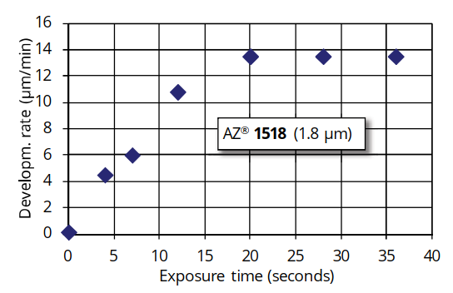
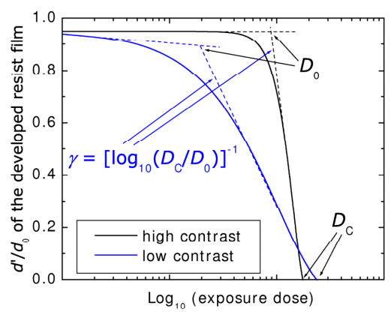
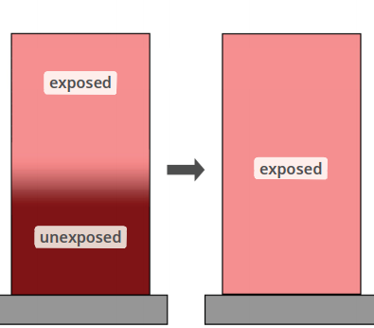
Revisiting Photolithography
Optimal Exposure Dose
For single photon process: dose = intensity x time
MLA: For high dose, use multi-pass write to avoid heating & bubble formation
Optimal exposure time (dose):
Positive tone: dose at which development rate starts to saturate
Negative tone: crosslinking saturation needs high dose, dose based on resolution and erosion rate of exposed region
Surface Reflectivity
Optimal dose depends on surface reflectivity. Glass: 10%, Si: 30%, Metal: ~90%
22 mW/cm²
Contrast curve
Ratio of remaining film thickness (d’) after development to original film thickness (d₀)
Thick film exposure and bleaching
Bleaching (being transparent to UV after exposure) helps to expose thick film
Gray tone lithography: dose based topographic variation.
Development and Removal
Metal ion free (MIF): e.g. MF319 ➔ attacks Al
Metal ion contained: e.g. AZ400K ➔ safer to Al
Removal: Acetone, Remover PG, NMP
Contrast curve example
Exposure of thick film
Useful resource: www.microchemicals.com/downloads/application_notes.html

Slide 13
Revisiting Photolithography
Exposure Errors and Corrections
Photoresist bubbles and particles
Impact on mask alignment, create defects on patterns
Edge Beads
Thick photoresist at the edge of sample (edge effect)
Results poor exposure due to contact gap (mask aligners) and thick photoresist (> DOF) at the edge
Edge beads removal: soak a Q-tip in acetone and gently remove the edge beads
Wedge Error and Compensation (WEC)
Wedge error occurs due to tilted sample originated from edge beads, backside photoresist coating, and improper sample placement
WEC is done for the proper planarization of substrate with mask
Focus
Focusing can be challenging on the transparent substrate, autofocus can fail (e.g. MLA). Use defects or features to focus
Edge beads
https://research.engineering.ucdavis.edu/cnm2/wp-content/uploads/sites/11/2014/07/Alignment_Document-final.pdf

Slide 14
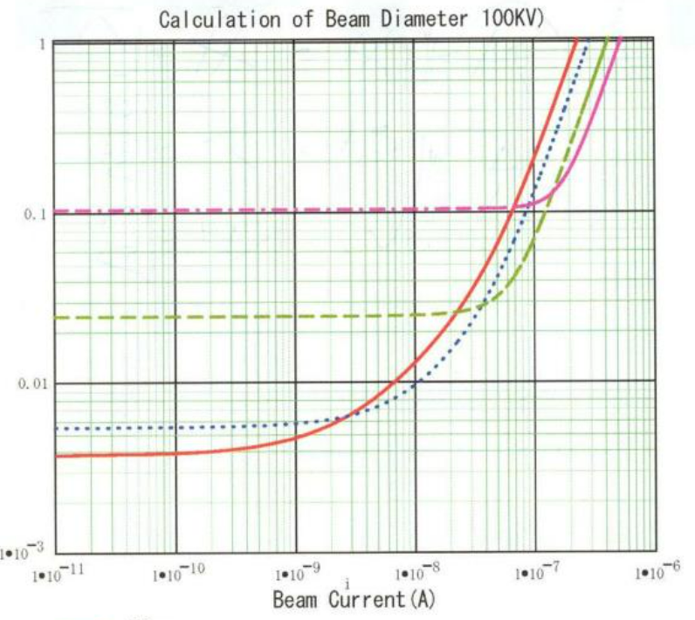
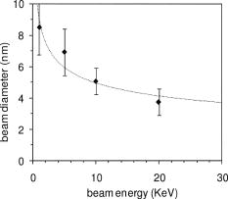
Electron Beam Lithography (EBL)
EBL writing is achieved by series of discrete point exposures
JEOL: exposure defined by beam spot size and shot pitch
Nabity (NPGS): exposure defined by center to center distance of shots and line spacing
$$Dose=I∗t/A$$
Spot size, electron energy, beam current, resolution
Spot size defines resolution limit
Smaller aperture: smaller current, smaller spot size
Low beam current: less beam spreading, smaller spot size, high resolution patterning, slow
Higher electron energy: smaller spot size, larger depth of focus, high contrast patterning
Spot size
Shot pitch
330 um aperture
200 um aperture
100 um aperture
60 um aperture
EBL exposure scheme
JEOL JBX Beam spot calculation (Georgia Tech)
Cord et al., JVSTB (1990)
Spot size vs Beam current & aperture size
Spot size vs electron energy

Slide 15
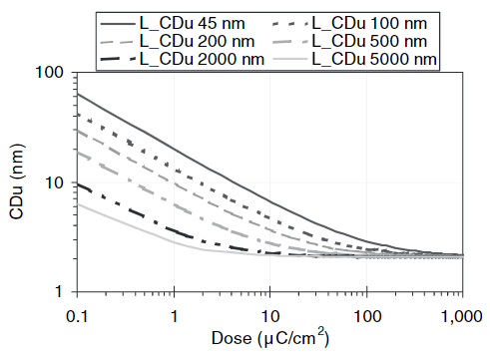
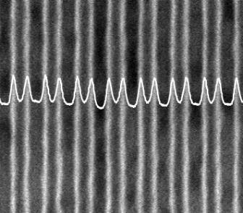
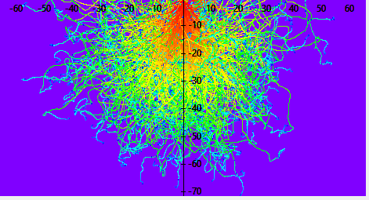
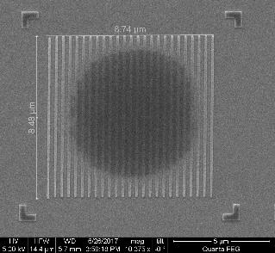
Electron Beam Lithography (EBL)
Shot noise
Shot noise is prominent when electrons needed to fulfill dose requirement falls to few thousands
Small feature size ➔ larger shot noise
High dose resists (e.g. HSQ) are better to minimize shot noise
Proximity Effect
Scattered and second
dary electrons contribute to unwanted dose in the neighboring features
Low dose resists (e.g. ZEP) are better to minimize proximity effect
Proximity effect leads to some degree of undercut for good liftoff application
CDu = Critical dimension uniformity
LCDu = Averaged CDu over length L
Scale in um
Kruit, SCANNING VOL. 28, 20–26 (2006)
Impact of shot noise
Tracer Simulated Electron Trajectories
Proximity effect observed
on HSQ
Dose dependent shot noise

Slide 16
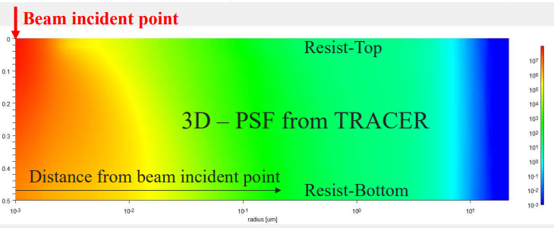
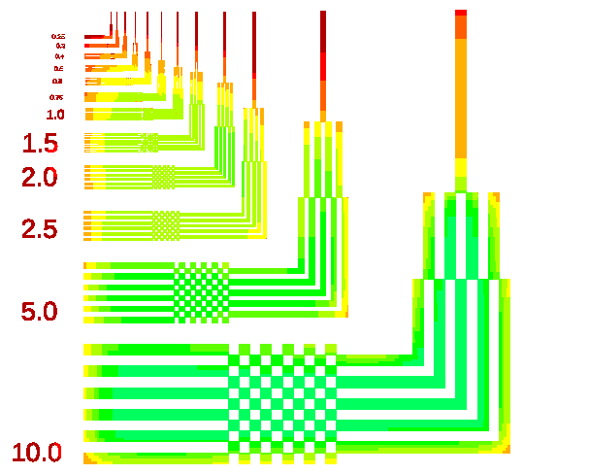
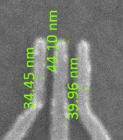
Electron Beam Lithography (EBL)
Point Spread Function (PSF)
Energy deposition as a function of distance from the beam incident point
Tracer ➔ Monte Carlo simulation of PSF
Scale in um
Tracer Simulated Electron Trajectories
Proximity Effect Correction (PEC)
PEC by design (Nabity)
PEC by choice of low dose resist (ZEP instead of PMMA for liftoff)
PEC by using point spread function (JEOL)
Fracturing ➔ symmetric are better
Assign dose based on fracturing
Thick
Thick
Thin
PEC by design (Nabity)
Dose:
PEC using PSF (Beamer)
Asymmetric
Symmetric

Slide 17
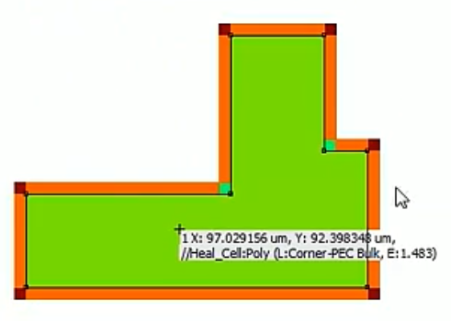
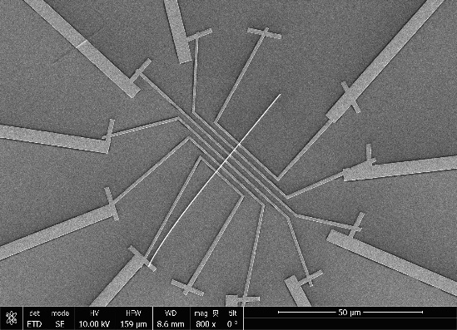
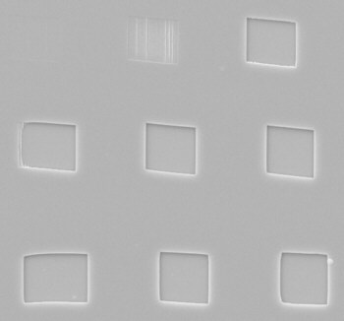
Electron Beam Lithography (EBL)
Writing speed vs resolution
Multi-beam write (Nabity and JEOL):
High resolution small features by low beam current
Larger features by high beam current
Bulk-Sleeve write (JEOL)
Use when high resolution large size features are needed
Core/Bulk part of the feature is written by high beam current. High precision sleeve is written around the bulk by low beam current
Different beams center offset compensation by alignment or design
Charging effect
Insulating substrate accumulate charge and deflects incoming beam
Use conducting discharge layer (e.g. thin gold or conducting polymer) on the top of e-beam resist to remove accumulated charge
Right EBL tool choice
Nabity (NPGS):
High resolution patterning limited to field of view (writing field),
No in-built stitching capability
Easier for contact patterning (e.g. nanowire contacts)
JEOL:
High resolution large array patterning
Stitching of patterns to multiple writing fields
Sleeve
Bulk
Beams center offset compensation: inner features written by low beam outer features written by high beam
Effect of charging on EBL write

Slide 18
Alignment and multilayer patterning
Global and chip markers
Global/wafer markers: markers to align the wafer
For high accuracy use chip level alignment markers. Chip markers << global markers
Use global markers as a 1st alignment step, then go to chip markers for high accuracy alignment
Chip makers
Wafer makers
Patterns
area
chip
chip
chip
Patterns
area
chip
chip
chip
Better
chip
chip
chip
Good design
Bad design
chip
chip
chip
Metal markers and etched markers (EBL)
Metal markers: markers thickness ~ 2600/(Z-14), Z is atomic number of metal. Au = 40nm, Cu = 170nm
Etched markers: Etch depth ≥ 1um for good contrast
Markers imaging consideration (EBL)
Backscattered electrons α Z ➔ good material contrast; secondary electrons ➔ good topography
Other considerations
Markers may be destroyed in subsequent processes
Uneven resist coating due to presence of markers on the wafer

Slide 19
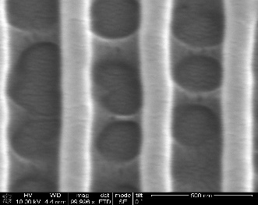
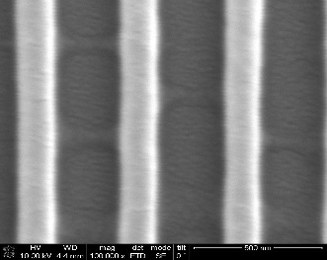
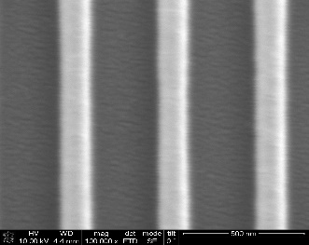
Optimization for high resolution patterning
Resist thickness and depth of focus (DOF)
Maintain resist thickness < DOF
Optical: DOF α λ/NA²
EBL: DOF α electron energy (kV)
Focus optimization
Optical: use defects or markers to focus on the transparent substrate, minimize sample tilt
EBL: Minimize astigmatism, Focus plan fit (Nabity), contamination dot focus (Nabity), S-focus correction (JEOL), height correction (JEOL)
Exposure corrections
Optical: Edge beads removal, wedge error compensation (WEC), wafer reflection and proximity
EBL: charge removal (discharge layer), proximity correction, shot noise minimization
Dose test, Dose test, Dose test
Optical and EBL: carry out series of dose test to identify optimal dose for the patterning
Dose test: Increased dose
Rounded corners: too much dose
Development control
Higher resolution with dilute developers; cold development ➔ higher resolution (requires higher dose)
Post process
Consider post processes (e.g. loftoff, etching) for final resolution of the feature

Slide 20
Example processes
Image reversal process (Photolithography)
Photoresist: AZ5214E
Spin coat AZ5214E at 4krpm on clean dry sample
Prebake at 110 ºC for 90s
Exposure: 40mJ/cm²
IR bake: 110 ºC for 2 minute
Flood exposure: 45 sec exposure on mask aligner
Develop in MF319 for 60-90s
HSQ process (EBL) on insulating substrate
Spin coat HSQ at desired speed on clean dry sample
Bake sample at 180 ºC for 2 minutes
Coat polymer discharge layer on the top of HSQ (alternately, 10nm Au layer)
Exposure for large sparse features: 1200uC/cm² at 30kV, dose test to optimize dose
Develop in 80ºC TMAH for 30sec
Rinse sample on water for about a minute

Slide 21
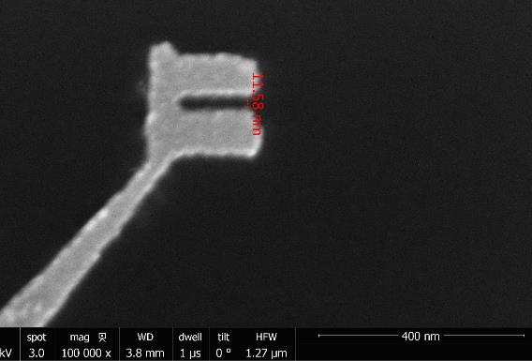
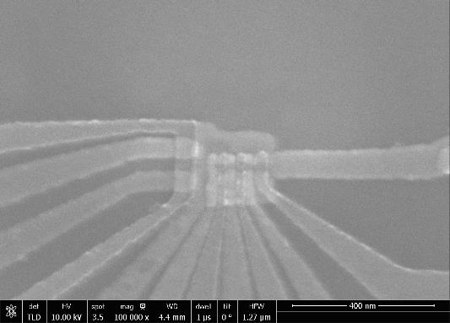
Example processes
Ultrahigh resolution (10nm) EBL patterning by cold development
PMMA 950A2 spun at 4krpm (~70-80nm)
Bake at 180C for 2 minutes
Expose in JEOL using 100 kV electrons, 1550uC/cm²
Prechill the developer (3:1 IPA:H2O) closer to -2C for at least 2 hours at chiller station
Fill the sonicator with an ice bath and
Place the developer cup in the ice bath and turn on the sonicator
Develop for 25-27s and remove sample from cup
Immediately dry with N2
Total development time 30-33s on average
Metal deposition, liftoff in Remover PG for 3 hrs, ultrasonication in acetone for ~30s
Process developed by Troy Hutchins-Delgado

Slide 22
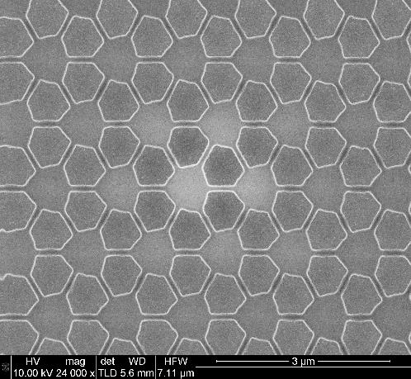
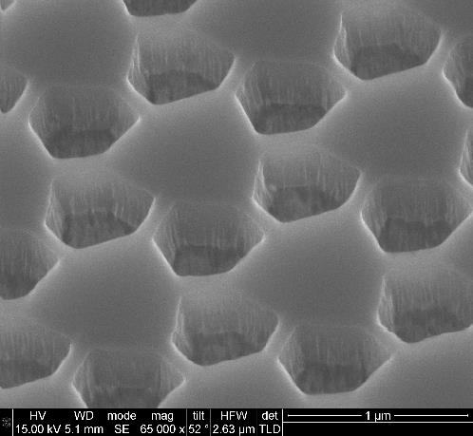
Example processes
Salt based development of high contrast HSQ patterns
Substrate: InGaAs with HMDS (Prime)
Dose: 3500-4500 µC/cm²
Developer: NaOH (1% wt.) and NaCl (6% wt.) at room temperature
Development time: 1 minute
Process developed by Choe Doiron

Slide 23
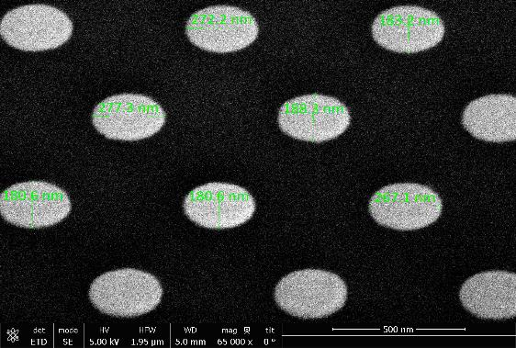
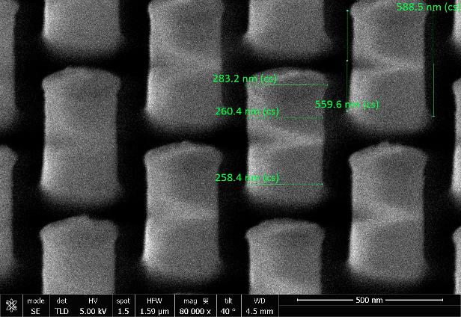
Example processes
Negative e-beam resist for etch mask
NEB31 resist to pattern ellipses on LPCVD Si on quartz
NEB 31 resist, 4000 rpm
Bake on hotplate at 110˚C for 2 minutes
Expose at a dose between 30-60uC/cm2 -can be much higher for thin isolated features
Post exposure bake on hotplate at 95˚C for 2 minutes
Develop in MIF 321 for 30 seconds
Rinse with DI water
Etch recipe: 6ºC, RF 1KW, Bias 13W, 26 SF6, 45 C4F8, 6mins
Jun 30, 2020 sample r3c2 120x290 dose120
2020-6-28 sample r1c1, 130x250_p500,
dose 136uC/cm2
Delta=-2nm
Process developed by Willie Luk

