Slide 1
CINT Proposal Submission Guide
Includes:
Proposal Submission Checklist
Proposal Template: Description of Proposed Research
Tips for Writing a Competitive User Proposal
Proposal Submission Step-by-Step Guide
Last updated 02/27/2014

Slide 2
CINT Proposal Submission Checklist
Proposal Information
Proposal Title
Is this a continuation Proposal?
If yes,
Continuation of what proposal #
Accomplishments of prior proposal
Productivity of prior proposal (please list and publications, patents, reports, conference talks, etc.)
Primary Funding Source
*Rapid Access justification. Please clearly state the time sensitive need of accessing the facility .
(*this applies to rapid access submissions only. Rapid Access submissions are not accepted during a regular call)
Is this research Proprietary? (i.e. you will not publish your project results and will be accessing the facilities for full cost recovery)
Subject (select from dropdown menu):
Have you been in contact with CINT staff regarding this proposal?
How did you hear about CINT?
Will your project require use of the Integration Lab (Clean Room)?
Will your project require use of the TEM?
If yes,
Indicate (1-3 sentences) what type of measurements the instrument will be used for (eg. TEM and/or STEM imaging, Diffraction, EDS, EELS, etc.)
Identify who the majority of TEM analysis/experiments will be performed by (select from dropdown menu)
In terms of 4 hour TEM sessions, how many sessions per month do you request for this work?
Project Personnel (non-CINT)
Project personnel information: name, institution, email
Provide a brief description of project activities to be performed by each individual
CINT Contacts
Select the lead and support CINT scientist(s), from a dropdown menu, who will play a role in your proposal. One Lead scientist must be selected per proposal.
Provide a brief description of project activities to be performed by each CINT Scientist
Abstract
Enter a brief abstract describing your proposed project. Figures allowed.
Environmental, Safety & Health
Does your proposal involve bringing hazardous/controlled materials into a CINT facility?
Attachments
Upload your two-page proposal (.pdf only). We recommend that you follow the template provided in this document.

Slide 3
CINT User Proposal template –
Description of Proposed Research
"CINT user proposals are evaluated by external reviewers based on six specific proposal elements. Proposals lacking any of that information will be at a competitive disadvantage for access to CINT. In order to ensure that your proposal contains all the expected information, we have provided a TEMPLATE (next 2 pages of this document). We encourage prospective users to download the template, enter the text/figures, then upload a pdf version of your completed 2-page proposal."
All CINT User proposals are expected to explicitly contain the following six element within the 2-page limit:
1. What is(are) the main scientific question(s) being addressed in this user project including the connection to nanoscience? (suggested length – 200 words)
2. Briefly describe the state of research in this area and how your work is advancing the field. (suggested length – 150 word
3. What is(are) the expected impact(s) of this user project? (suggested length – 150 words)
4. What specific work will be performed at the user’s institution in preparation for, or in support of, the proposed CINT work? (sample preparation, complementary characterization, calculations)
5. What specific tasks will be performed by the user(s) in conjunction with CINT? For each task, include task duration, expected task outcome, requested instrument(s) and CINT staff engagement. (This should be the longest and most detailed section.)
6. Key References

Slide 4
TEMPLATE
CINT User Proposal - Description of Proposed Research
Answer each question below. Proposers may determine the length of each response but the total document length cannot exceed 2 pages, including all text and figures.
(1) What is(are) the main scientific question(s) being addressed in this user project including the connection to nanoscience??
[suggested length – 200 words]
(2) Briefly describe the state of research in this area and how your work is advancing the field. [suggested length – 150 words]
(3) What is (are) the expected impact(s) of this user project?
[suggested length – 150 words]
Page 1 of 2
(Two page maximum. Longer proposals will not be accepted.)

Slide 5
(4) What specific work will be performed at the user’s institution in preparation for, or in support of, the proposed CINT work? (sample preparation, complementary characterization, calculations…)
(5) What specific tasks will be performed by the user(s) in conjunction with CINT? For each task, include task duration, expected task outcome, requested instrument(s) and CINT staff engagement.
(This should be the longest and most detailed section.)
(6) Key References:
Page 2 of 2
(Two page maximum. Longer proposals will not be accepted.)

Slide 6
Tips for Writing a Competitive User Proposal
Contact the facility staff before writing. Staff are available to
ü Provide details about the equipment and capabilities, including availability or subscription
ü Help confirm the feasibility of your approach
ü Help estimate and justify the amount of facility time you are requesting
ü Help address why this specific facility is the best choice to meet your requirements
ü Discuss opportunities for collaboration that might strengthen your proposal
ü Provide constructive comments on your draft proposal
Include background information on why the proposed research is important
ü Include a precisely defined objective; do not combine loosely related research in a single proposal
ü Clearly articulate the science case: state the problem and its importance
ü Place your research plan in the context of what others have done and are
doing; include references to literature where appropriate
ü State why your proposal is timely and describe what is particularly innovative about your strategy to address the problem
Contact facility staff early— the number of requests and response time increases as the proposal deadline approaches.
Science at user facilities is diverse and reviewers cover broad areas. Don’t assume all reviewers will be experts in your specialty.
Address how the research will make a difference. Focus on how this particular effort will contribute to the field. Describe the proposed work including samples, methods, and procedures.
ü State clearly and exactly what you are going to synthesize, measure, or calculate
ü Provide sufficient detail to demonstrate that you have thought carefully about your plan
ü Describe the techniques to be used to generate and analyze the data
ü Demonstrate familiarity with prior work done in this area
— Refer to current literature, especially your own work
— Summarize the key points of cited references and explain how your proposed work fits in
ü Demonstrate your team’s productivity at the facility, if applicable, by describing how the results of previous research was used and published
— Describe related results (published and unpublished) from work done by your group
— Include key data in graphic format
ü Explain why you need this particular user facility and instruments or methods
ü Justify the amount of time requested
ü Identify potential showstoppers and how you plan to avoid them; if you don’t identify them, the reviewers will!
Ensure that your facility publication record is current.
Show you made good use of prior facility time.
Be clear and specific, not vague or general

Slide 7
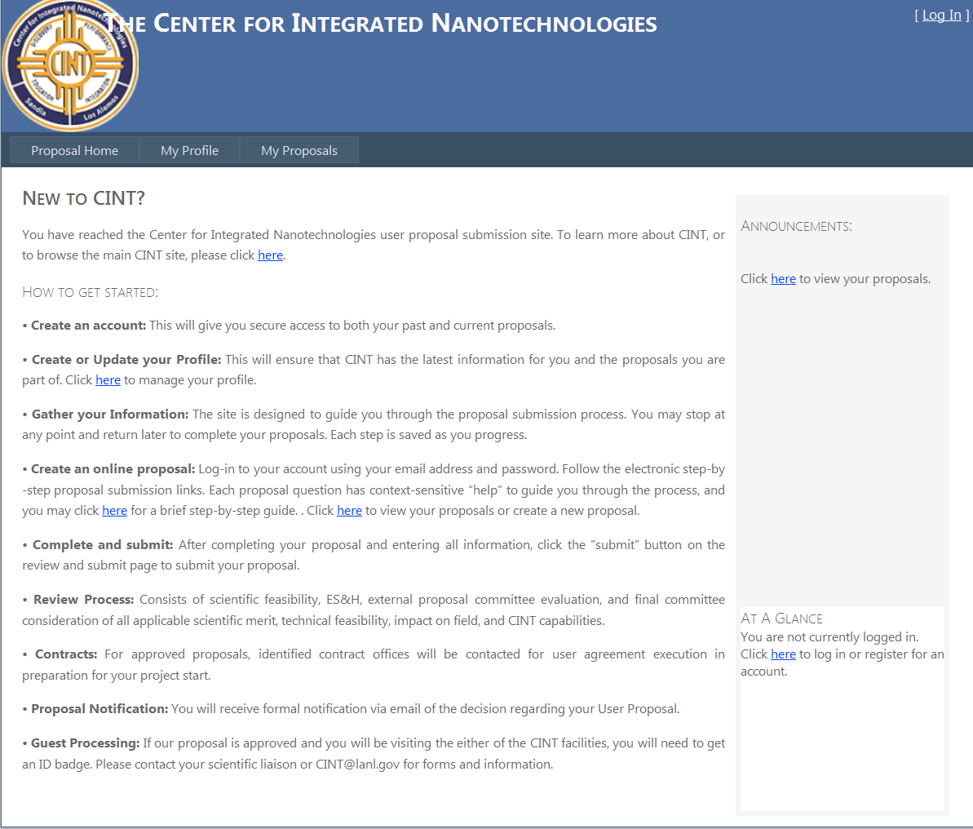
Proposal Submission Step-by-Step Guide
When you enter the proposal submission site (https://cint.sandia.gov/), this is the home page you will see. Please click “log in” in the upper right hand corner

Slide 8
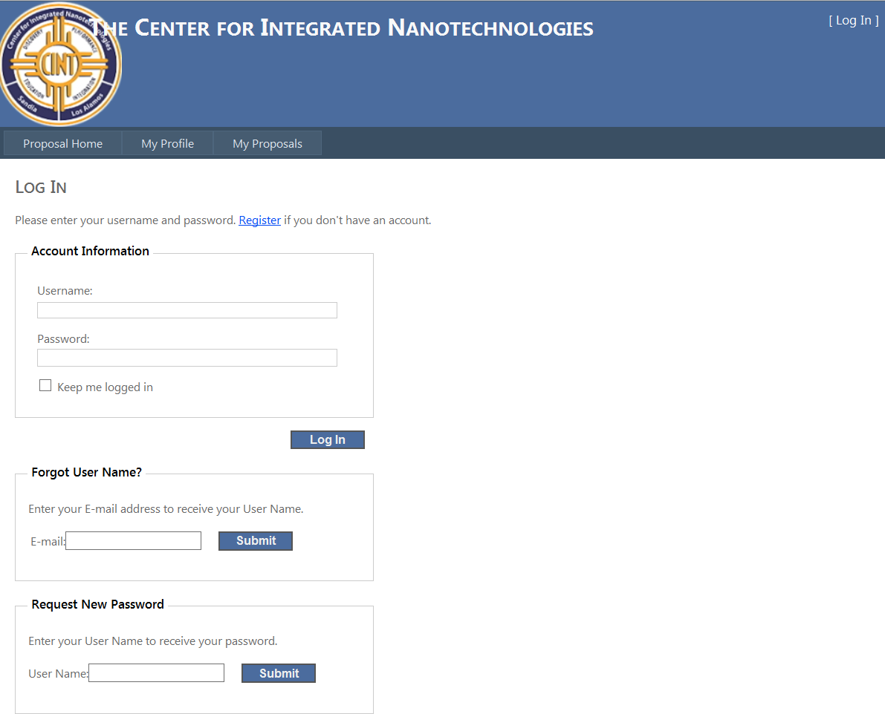
Once at the Log In page:
- If you are a current account holder, please log in with your username and password. If you have forgotten one of these please use the retrieval information at the bottom of the page to have your information emailed to you.
- If you have never logged in to this system before please select Register for an account

Slide 9
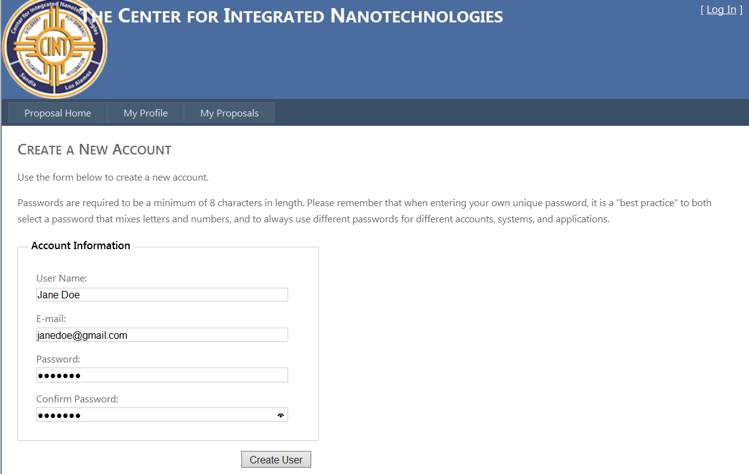
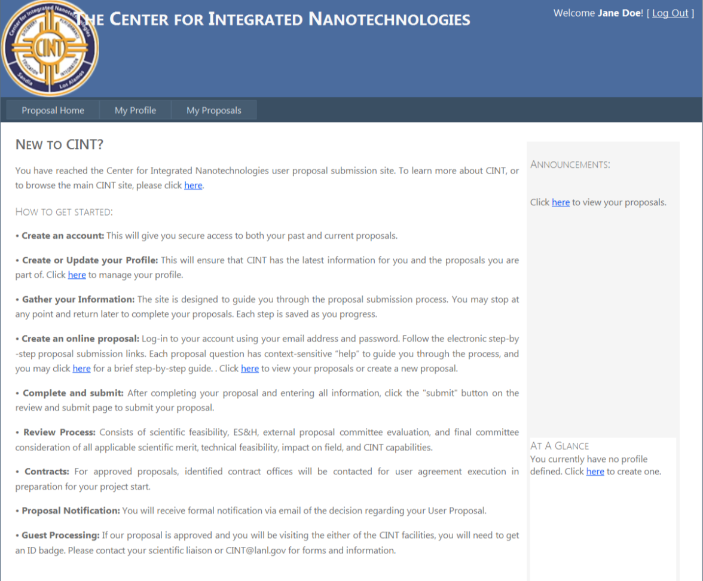
Fill in the appropriate account information and select the button “create user”
Once you have created your user account you will see your log in information in the top right screen confirming your log in. You are now ready to submit a proposal. To begin, click on My Profile
Your home page will now show any proposals you have in draft or that have been submitted for the current call

Slide 10
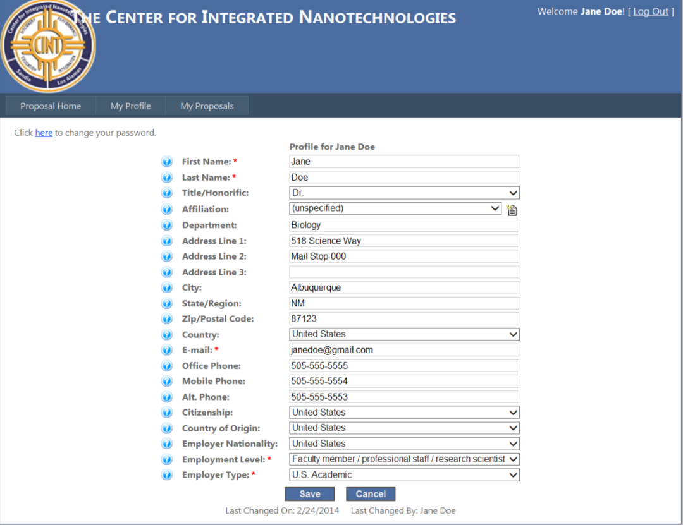
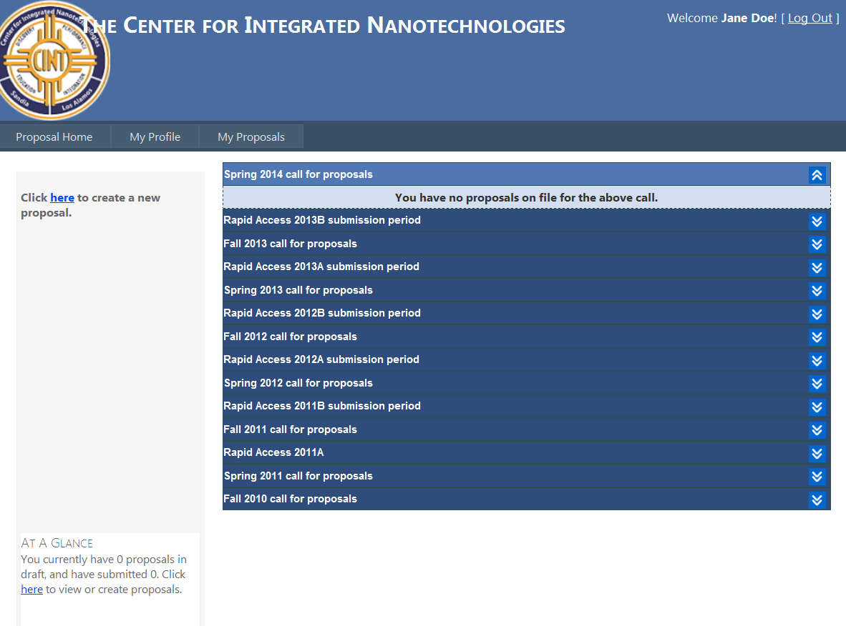
Enter the applicable information in to the fields. Fields with a red * are required.
Once complete select the save button.
If your current affiliation is not list in the dropdown menu, select “unspecified” and then click on the icon to add your affiliation to our list.
After you have selected the save button, you will see a note listing your modified date. Once you see this confirmation. Click on the My Proposals tab.
To submit a proposal, click on the link in the left hand menu bar.
Any proposals you have in the system will be listed on this page, under their respective calls.

Slide 11
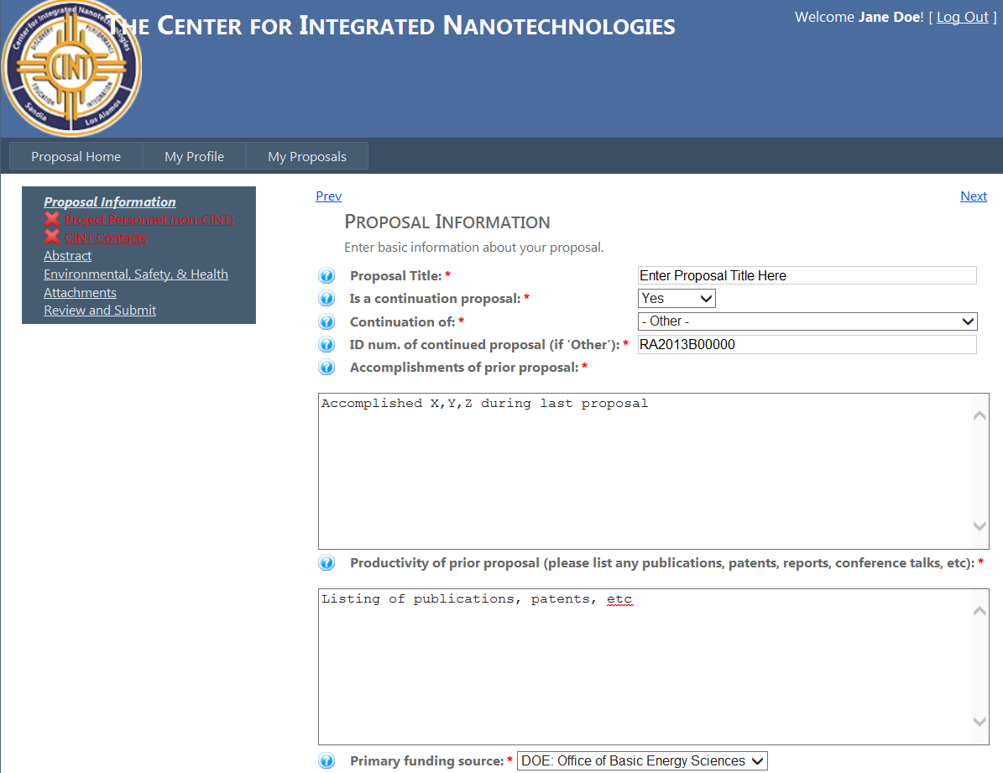
Proposal Information. Enter the information in to the data fields. Fields with a red * are required. Once complete click “next” in the upper right hand corner of the screen.

Slide 12
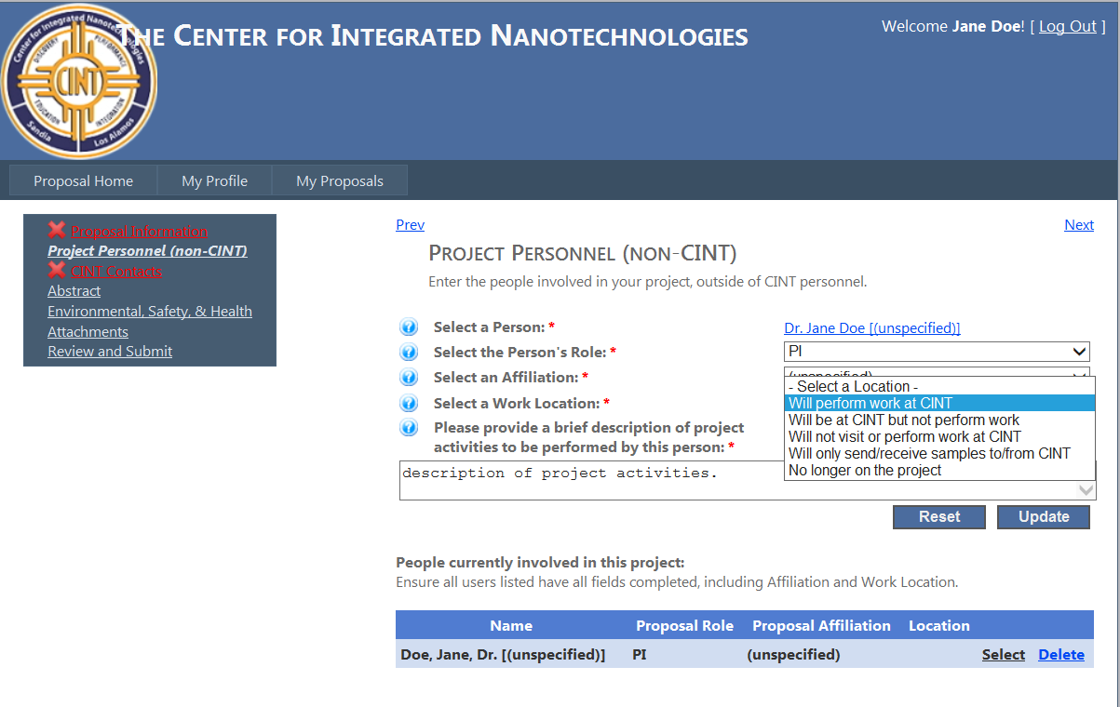
Project Personnel (non-CINT). Enter the information in to the data fields regarding the users that will be participating on this proposal.
You will note at the bottom that you are defaulted as the PI. Click on the “Select” hyperlink under location and fill in the applicable information for your intended time as a user of the facility.

Slide 13
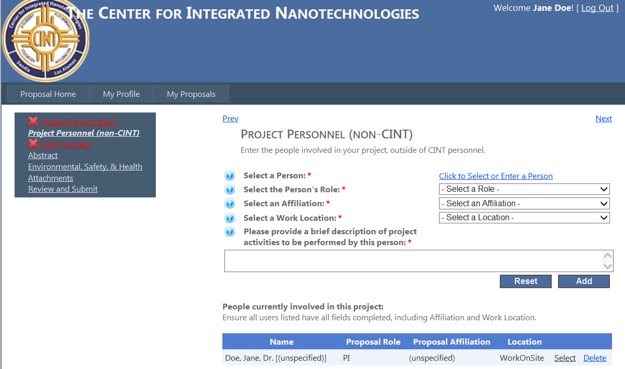
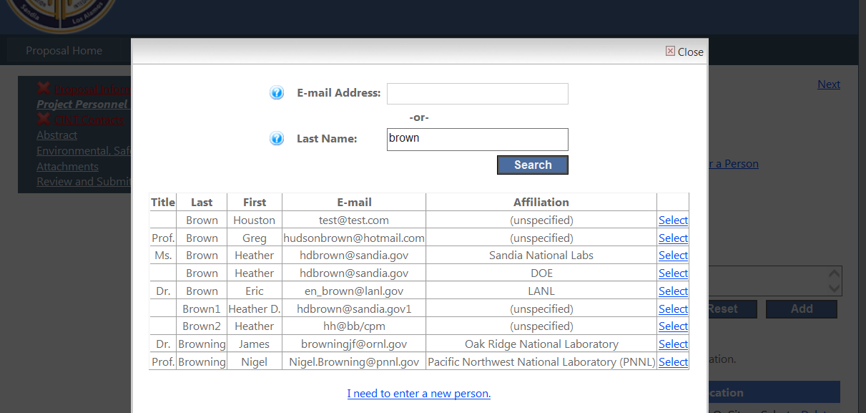
To add additional personnel, click on the blue hyperlink “click to Select or Enter a New person”.
A box will pop up asking you to first search for a person, this will help cut down on duplicate profiles. Begin by either typing in an email address or name of the project personnel. If the person you are entering appears, press the select button. If they do not appear, click on the link that reads “I need to enter a new person”

Slide 14
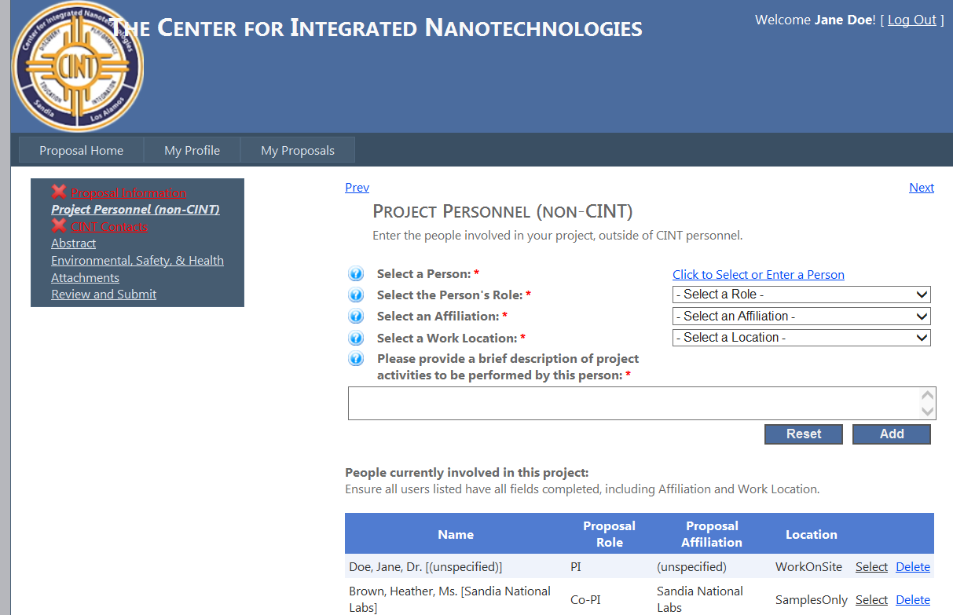
Once you have selected your project personnel, fill in the rest of the fields and select the “add” button. If you would like to clear the selection, select the “reset” button
As you add your project personnel, you will see them added to your project personnel list at the bottom of the page. Once your selections are complete, click on the “next” link on the upper right corner of your screen.

Slide 15
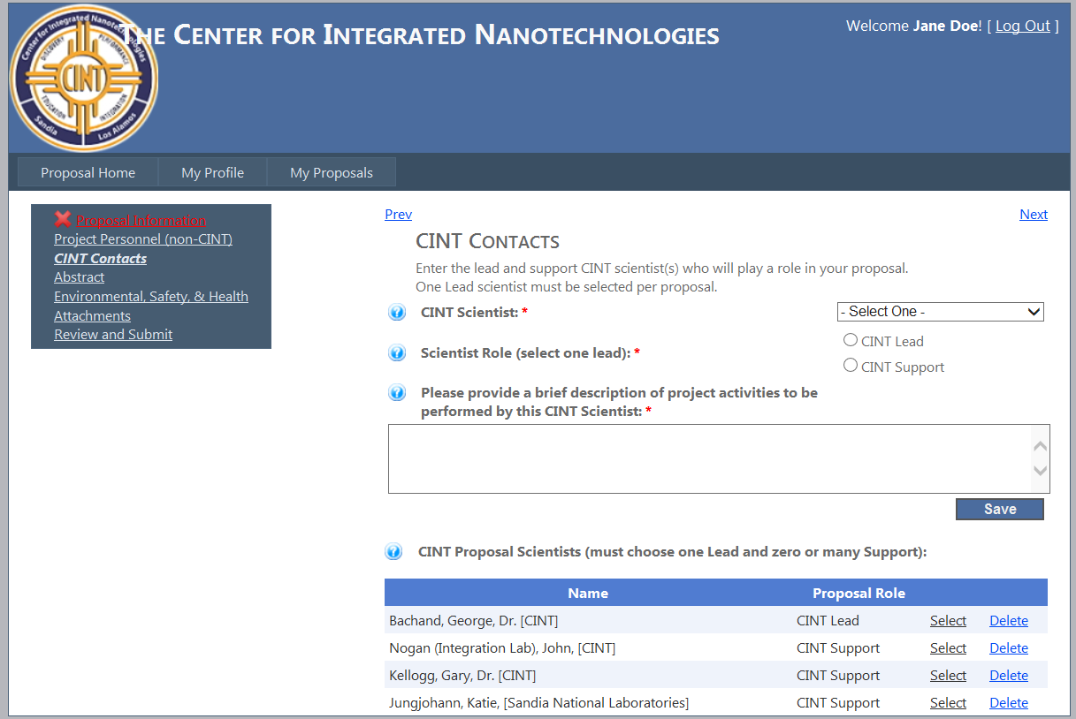
CINT Contacts.
Please select CINT scientists from the dropdown menu provided who you would like Please note that you can select only one LEAD scientist, and multiple Support scientists. One Lead scientist must be selected per proposal.
*If your proposal will be accessing the Integration Lab (CleanRoom), please select John Nogan, the Integration Lab manager, as either the Lead or support scientist
*If your proposal will be accessing the TEM, please select Katie Jungjohann as either the Lead or support scientist
As you add your CINT scientists, you will see them added to your proposal scientists list at the bottom of the page. Once your selections are complete, click on the “next” link on the upper right corner of your screen.

Slide 16
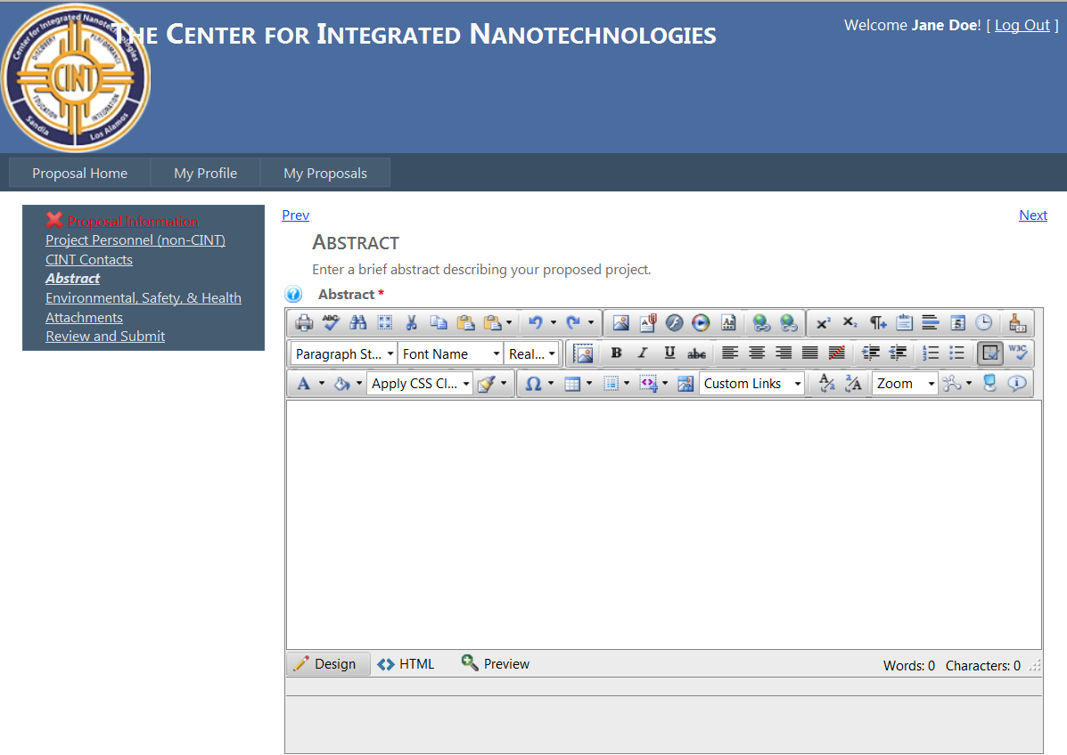
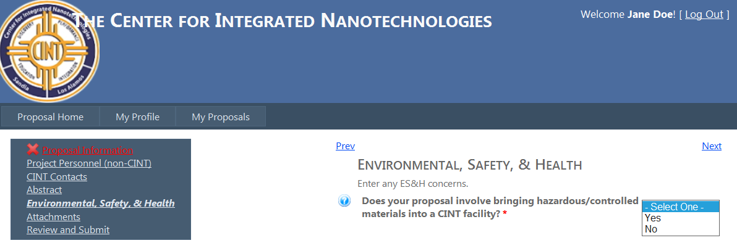
Abstract: Enter a brief abstract describing your proposed project. Figures are allowed. Once you’ve entered your abstract, click on the “next” link on the upper right corner of your screen.
Environmental, Safety & Health: Answer the required question regarding any ES&H concerns/issues. Once your selection is complete, click on the “next” link on the upper right corner of your screen.

Slide 17
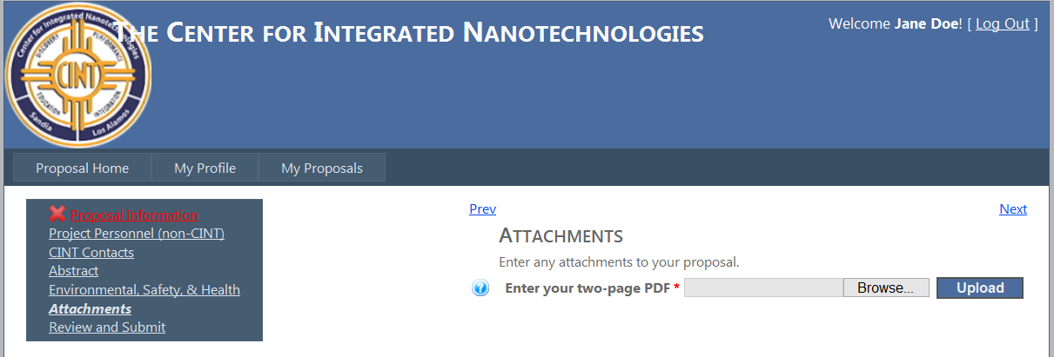
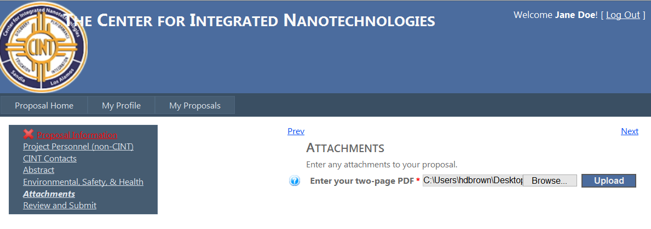
Attachments: To upload your 2 page pdf proposal, click on the browse button.
Once you have selected your CINT proposal, select the upload button
Once your upload is complete you will see a notice stating that your file was uploaded successfully. To replace the current uploaded proposal select the “change” button. Once complete click “next” in the upper right hand corner of the screen.

Slide 18
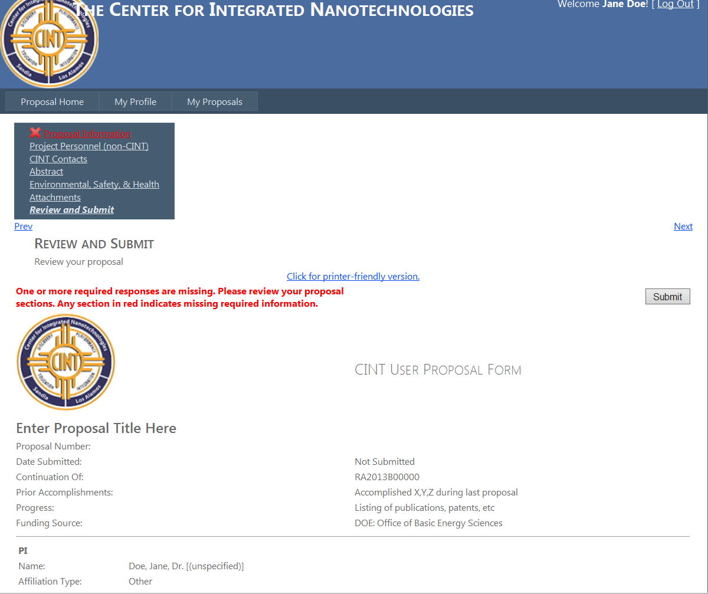
Review and Submit: Once you have reviewed your proposal, you may print a copy of the proposal by selecting the link “Click for printer-friendly version” and you may submit your proposal by selecting the “submit” button at the upper right corner or bottom right hand corner of your screen.
If you have not completed all the required fields within a section, you will be given an error message. You will need to go to the section(s) with a red X and complete the required fields prior to submitting your proposal

Slide 19
Once your proposal has been submitted you will see a confirmation message. You should also receive an email confirmation. If you do not receive an email confirmation, please first check your profile to make sure you entered the correct email address.

Slide 20
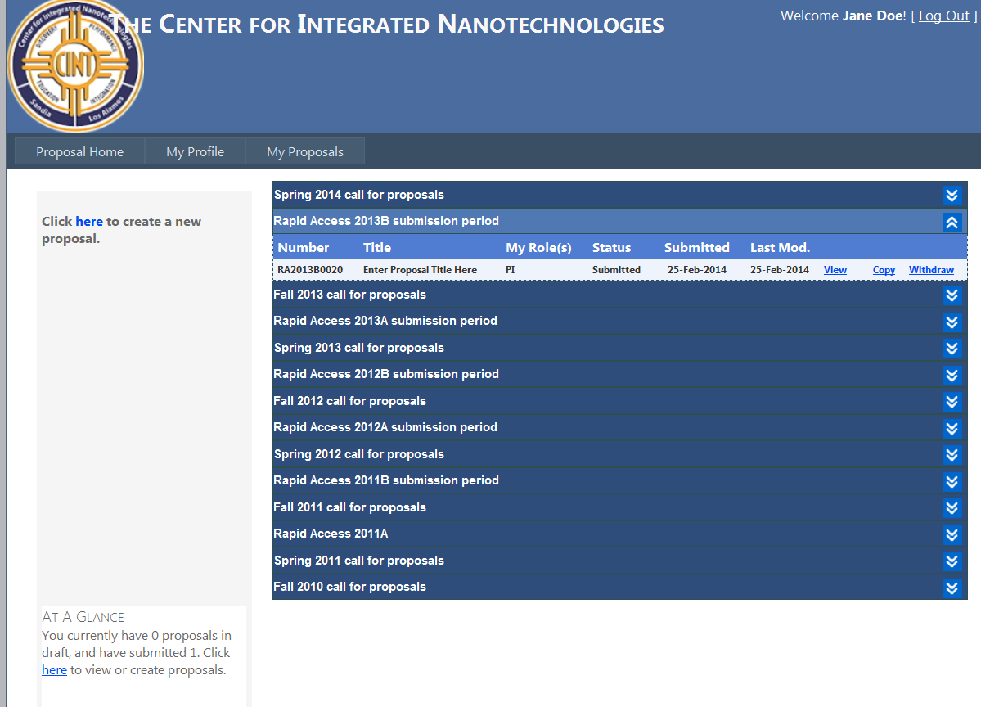
When proposal has been submitted you can click on the “My Proposals” tab where you will see your proposal listed under the current call with a status shows as “submitted” as well as proposal number. Once a proposal has been submitted you will not be able to delete or edit a proposal. Your options are to “View”, “Copy” or “Withdraw” your proposal. If you need to make changes to the proposal please withdraw the current proposal, copy it and resubmit once the changes are complete. When you have finished your can Log Out of the system using the button on the top right hand corner of your screen.
Your proposal will be assigned a unique proposal number
Your “at a glance” has now been updated to show that you have submitted 1 proposal
For any questions, please contact Heather Brown @ hdbrown@sandia.gov

