Slide 1
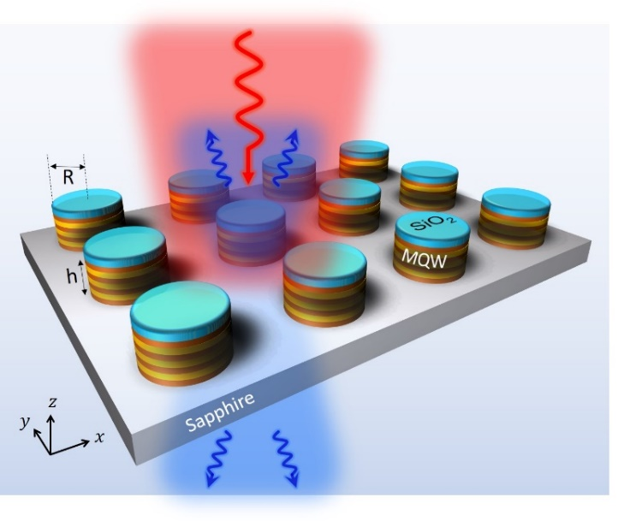
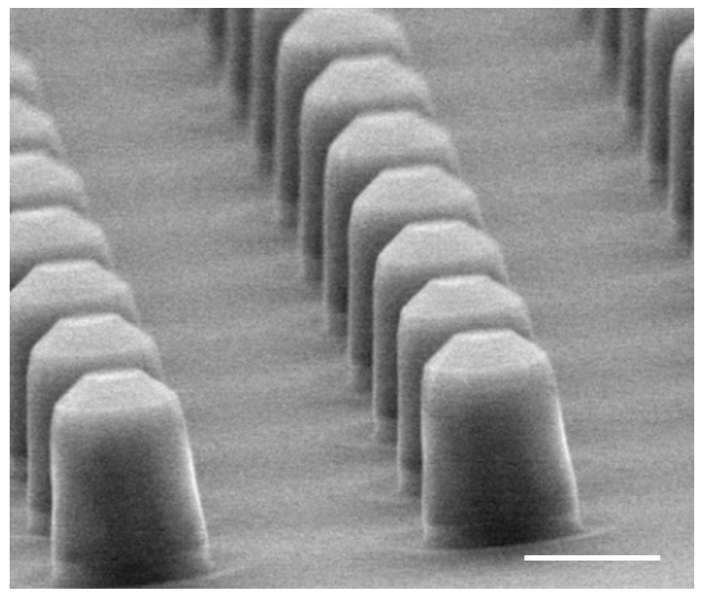
An All-Dielectric Polaritonic Metasurface with a Giant Nonlinear Response
Scientific Achievement — Demonstrated nonlinear, all-dielectric polaritonic metasurfaces that utilize coupling between photonic modes in nanoresonators and quantum-engineered intersubband (ISB) transitions in multi-quantum wells, and generate second-harmonic (SHG) light. Efficiencies are higher than record values reported to date but with three orders of magnitude lower pump power.
R= 1.4 µm
λ ~ 8 µm
The nonlinear all-dielectric polaritonic metasurface. Meta-atoms are designed to support a photonic mode (with strong E_{z} field components) spectrally overlapping with the intersubband (ISB) transition; the insets correspond to band structure of ISB (top) & SEM (bottom).
Significance and Impact
Polaritonic semiconductor metasurfaces provide a unique platform for nonlinear optics as they allow for independent control of the material nonlinearities at the nanoscale and the photonic modes. These unique properties allow for polaritonic-topology optimization and can open a new direction for designing high efficiency classical and quantum light sources, optical limiters, and novel thermal emitters.
Research Details
Arrays of InGaAs/InAlAs meta-atoms were designed and fabricated with spectral overlapping of photonic modes with strong Ez field components, and quantum engineered ISB transitions in coupled-quantum wells. SHG was generated in the mid infrared.
h= 1.5 µm
Experimentally measured linear reflectance spectrum (left) and reflected second-harmonic signal from the metasurface at 7.6 µm (right).
This work was performed in part at The Center for Integrated Nanotechnologies.
Sarma, R.; Xu, J.; de Ceglia, D.; Carletti, L.; Campione, S.; Klem, J.; Sinclair, M. B.; Belkin, M. A.; Brener, I. An All-Dielectric Polaritonic Metasurface with a Giant Nonlinear Optical Response. Nano Letters 2022, 22 (3), 896–903.
Notes:
1-2 paragraph description of highlight
Enhancing the efficiency of second-harmonic generation using all-dielectric metasurfaces to date has mostly focused on electromagnetic engineering of optical modes in the meta-atom. Further advances in nonlinear conversion efficiencies can be gained by engineering the material nonlinearities at the nanoscale, however this cannot be achieved using conventional materials. Semiconductor heterostructures that support resonant nonlinearities using quantum engineered intersubband transitions can provide this new degree of freedom. By simultaneously optimizing the heterostructures and meta-atoms, we experimentally realized an all-dielectric polaritonic metasurface with a maximum second-harmonic generation power conversion factor of 0.5 mW/W² and power conversion efficiencies of 0.015% at nominal pump intensities of 11 kW/cm². These conversion efficiencies are higher than the record values reported to date in all-dielectric nonlinear metasurfaces but with 3 orders of magnitude lower pump power. Our results therefore open a new direction for designing efficient nonlinear all-dielectric metasurfaces for new classical and quantum light sources.
These metasurfaces offer a unique and flexible platform for nonlinear wave mixing as the material nonlinearities at the nanoscale ( determined by the ISBs) and mode profiles ( determined by the photonic modes) can be engineered independently. In our on-going BES-MSE work, we are collaborating with a theorist Prof. Alejandro Rodriguez from Princeton University to exploit this feature and are designing metasurfaces which are light-matter coupled ( polaritonic) and topologically optimized for field enhancements, field overlaps, and emission directions. These polaritonic-topology optimized metasurfaces will be the first of its kind.
Funding details for all sources: This work was supported by the U.S. Department of Energy, Office of Basic Energy Sciences, Division of Materials Sciences and Engineering and performed in part at the Center for Integrated Nanotechnologies, an Office of Science User Facility operated for the U.S. Department of Energy (DOE) Office of Science. Sandia National Laboratories is a multimission laboratory managed and operated by National Technology and Engineering Solutions of Sandia, LLC, a wholly owned subsidiary of Honeywell International, Inc., for the U.S. Department of Energy’s National Nuclear Security Administration under contract DE-NA0003525. The University of Texas and the Technical University of Munich members of the team acknowledges financial support from the DARPA NASCENT program. The University of Padova team members were partly supported by MIUR (Italian Minister for Education) under the initiative “Departments of Excellence” (Law 232/2016). This paper describes objective technical results and analysis. Any subjective views or opinions that might be expressed in the paper do not necessarily represent the views of the U.S. Department of Energy or the United States Government.
Publication/ press releases/ related links:
Sarma, R.; Xu, J.; de Ceglia, D.; Carletti, L.; Campione, S.; Klem, J.; Sinclair, M. B.; Belkin, M. A.; Brener, I. An All-Dielectric Polaritonic Metasurface with a Giant Nonlinear Optical Response. Nano Letters 2022, 22 (3), 896–903. DOI:10.1021/acs.nanolett.1c03325.

