Slide 1
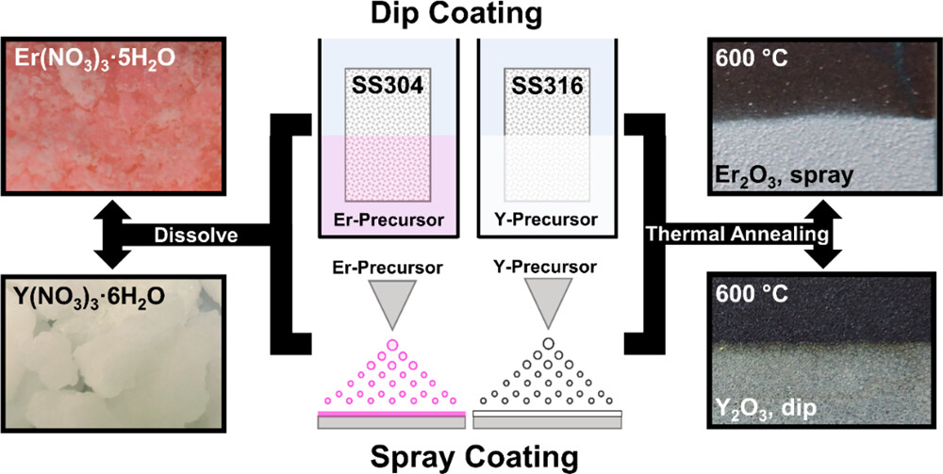
Chemical Solution Deposition of Rare-Earth Oxide Coatings for Molten Metal Casting
Scientific Achievement: Exploration of chemical solution deposition (CSD) to allow 2D/3D objects to be coated efficiently by either dip or spray coating. Using the CSD method, thin layers of protective oxides can be administered onto nearly any high temperature substrate.
Significance and Impact: CSD of rare-earth oxides is important in nuclear foundries where casting of molten actinides leads to rapid destruction of molds and crucibles, significantly increasing the costs for replacements and removal of hazardous waste. By coating metal molds with rare-earth oxides, a protective layer is formed allowing the molds to become “reusable.”
Research Details:
Research team successfully deposited rare-earth oxides, such as erbia (Er₂O₃) and yttria (Y₂O₃), onto low-cost steel substrates by dipping and spraying of precursor mixtures.
Resultant coatings are on the order of a few microns in thickness, with favorable properties of adhesion and uniformity.
The process transfers over to spray coating, assuming substrate temp high enough to allow the aerosolized mixture to decompose upon impact with the hot metal surface.
Caption: Chemical solution deposition (CSD) for erbia and yttria is done by dissolving metal nitrate crystals into water, which can then be coated onto metal substrates by either spraying or dipping. Subsequent annealing of the nitrate coating causes decomposition and leaves behind a stable oxide.
This work was performed in part at The Center for Integrated Nanotechnologies.
Rodriguez, D. J.; Edgar, A. S.; Williams, D. J.; Chov, A. M.; Vodnik, D. R.; Ross, D. J.; Siller, V. P.; Usov, I. O. Chemical Solution Deposition of Protective Er₂O₃ and Y₂O₃ Coatings onto Stainless Steel for Molten Metal Casting using Metal-Nitrate Precursors. ACS Applied Materials and Interfaces, 2023.
Notes:
HL Type (place “X” where appropriate): User___, Staff__, User & Staff_X_
1-2 paragraph description of highlight
Casting of molten metals, including f-table elements, is important for nuclear metallurgical foundries, and it is common for thermally robust materials (e.g., carbides, oxides, refractory metals) to be used as molds and crucibles. To prevent their corrosion from molten metals, alloying has been used before as a method of protection, (1) but even alloys are still susceptible to corrosion after repeated exposure. As a result, molds greatly suffer from short lifespans, drastically increasing the costs for replacements and the removal of generated waste. Indeed, ceramics are anticorrosive in the temperature (T) range of interest, but they are limited, given their fragility and difficulty of machining. Thus, one solution to mitigate corrosion is to create a “reusable” mold (increasing their lifespans and reducing costs) by depositing a protective coating onto the melt-containing surface.
Collaborating Institutions
LANL
Funding Overview Section (place “X” for all relevant sources)
BES Funding: MSED___, CSGB___, EFRC___, SUFD_X__
SC Funding: ASCR___, BES___, BER___, FES___, HEP___, NP___, WDTS___, SBIR___, etc.
Other Funding: DOD___, DOE__X_, NIH___, NSF___, etc.
Funding details for all sources: (example)
Los Alamos National Laboratory – LDRD program
Publication/ press releases/ related links:
https://pubs.acs.org/doi/10.1021/acsami.3c05186

