Slide 1
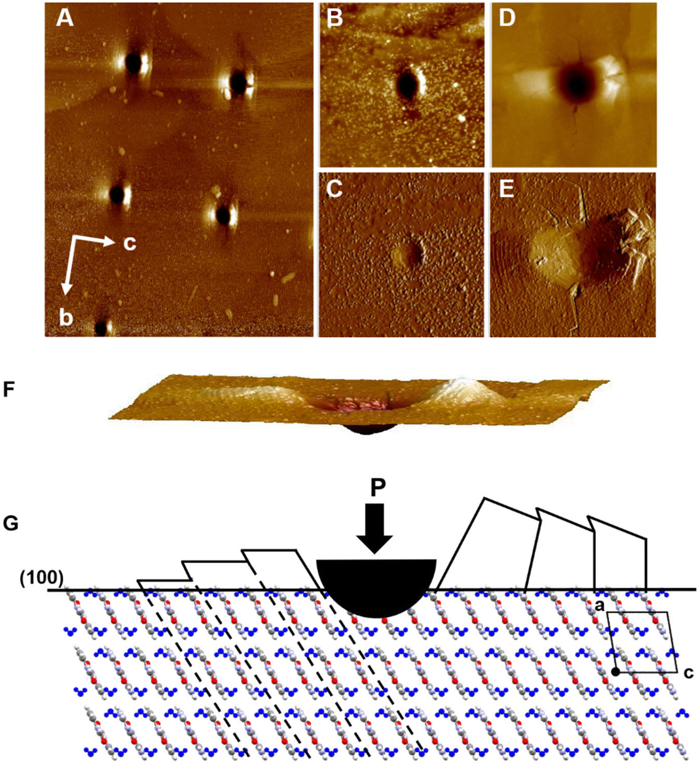
Mechanical properties and dehydration mechanisms in molecular materials
Scientific Achievement
Mechanical strength and deformation mechanisms linked in molecular crystals.
Significance and Impact
Molecular materials are key components of biological, pharmaceutical, food, dye, and many other materials. Processing of these materials, creation of biomimetic materials, and biological processes themselves rely on understanding mechanics and hydration/dehydration.
Research Details
Follows research on uric acid (e.g. kidney stones) quantifying the effect of defects on mechanical properties.
Demonstrated through nanoindentation and atomic force microscopy (AFM) that anisotropic mechanical deformation and dehydration mechanisms are linked in cytosine monohydrate (CM, a DNA component).
(A) AFM image of the CM surface after indents with increasing forces from 1000–8000 μN. (B and C) Close up of a 1000 μN indent (9.4 μm)2. (D and E) Close up of an 8000 μN (15 μm)2 and (10 μm)2. (F) Side-on view of the 8000 μN indent viewed edge-on. (G) Schematic of the indent and anisotropic pileup along the + and −c-axes.
This work was performed in part at The Center for Integrated Nanotechnologies.
Fleming, M. E.; Hooks, D. E.; McBride, M.; Li, N.; Swift, J. A. Cytosine monohydrate under mechanical stress. CrystEngComm 2023 (25). 3044.
Notes:
HL Type (place “X” where appropriate): User___, Staff__, User & Staff__X_
1-2 paragraph description of highlight
A large percentage of molecular compounds, with applications ranging from explosives to pharmaceuticals, can crystallize as hydrates. The relative stability of hydrated and anhydrous crystal forms depends on their structures and the environment (e.g. temperature, pressure, relative humidity). During manufacturing a wide range of environmental conditions may be encountered, and in some systems these environmental changes may induce phase transformations. For hydrates in particular, high temperatures may result in water loss and the transition to a less hydrated or anhydrous form as well as particle fracture. Similarly, elevated pressures used in compaction steps in the preparation of pharmaceutical tablets or plastic bonded explosives can also lead to particle breakage or phase transformations. How and where a crystal will fracture are not always obvious, but are important aspects to consider since new surfaces are created.
Nanoindentation performed with a conospherical tip on the (100) face of cytosine monohydrate (CM) revealed a highly anisotropic response over a range of loads. Post-indent atomic force microscopy images identified an asymmetric deformation response owing to the pro-chiral structure of the surface. Activation of low rugosity slip planes induces movement of π-stacks rather than their displacement along the 1-dimensional hydrogen bonded ribbon direction. Anisotropy arises because slip can only propagate to one side of the indent, as the tip itself imparts a barrier to slip on the preferred plane thereby forcing the activation of secondary slip systems and pileup. The anisotropic deformation is of interest in relation to previous work which proposed a ribbon–rotation model to account for the topotactic conversion between CM and the product of its dehydration. The asymmetry in the nanomechanical properties exhibited by CM provides further support for the rotational model put forth and also serves to underscore the inherent relationship between a hydrate's mechanical properties and its solid state dehydration mechanism.
Collaborating Institutions
Georgetown University
LANL
Funding Overview Section (place “X” for all relevant sources)
BES Funding: MSED___, CSGB___, EFRC___, SUFD___
SC Funding: ASCR___, BES__X_, BER___, FES___, HEP___, NP___, WDTS___, SBIR___, etc.
Other Funding: DOD___, DOE___, NIH___, NSF_X__, etc.
Funding details for all sources: (example)
Publication/ press releases/ related links:
https://pubs.rsc.org/en/content/articlehtml/2023/ce/d3ce00293d

