Slide 1
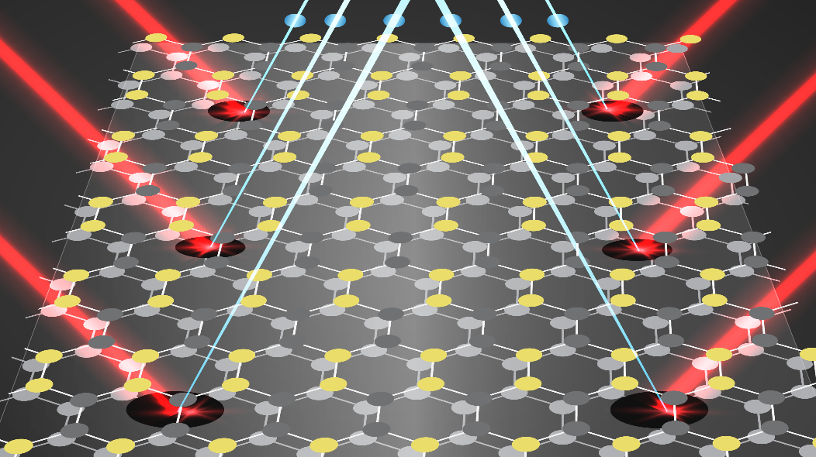
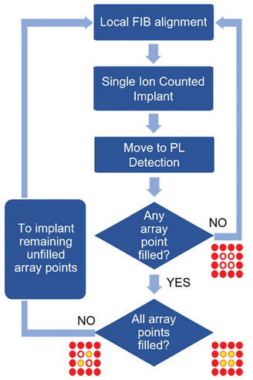
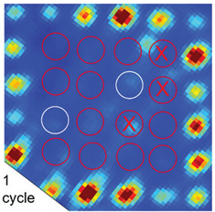
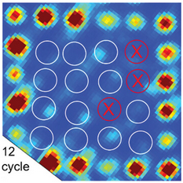
Towards 100% Scalable Quantum Defects: High-Yield Deterministic Focused Ion Beam Implantation of Quantum Defects Enabled by In Situ Photoluminescence Feedback
An iterative process of nanometer resolution focused low ion number implantation (blue) results in the creation of arrays of single silicon vacancy center in silicon carbide by utilizing in-situ photoluminescence (red) feedback at the end of every round of implantation.
Scientific Achievement
An industry-adaptive scalable technique is demonstrated to deterministically create quantum defects in commercial grade silicon carbide by performing repeated low ion number implantation and in-situ photoluminescence evaluation after each round of implantation.
Significance and Impact
Our technological approach of utilizing an FIB Poisson process of filling an array using in-situ verification potentially solves the most critical bottleneck for solid-state quantum emitters, i.e., the creation process with simultaneous high-yield and positional accuracy, to achieve proof-of-concept quantum photonic devices.
Process flow for creating single defects using FIB by getting feedback from our integrated in-situ PL system. Photoluminescence image taken after 1 round of implantation shows only 2/13 targeted spots are filled (shown as white circles). At the end of 12 rounds, all 13 spots are filled with quantum defects.
Research Details
We found that a typical 1 round of ion implantation results in uncontrolled creation of defect numbers in each location of an array (i.e., could be anything between 0 to N) since the underlying physical mechanism is inherently random (Poisson process).
We use a very low ion number counted implantation of <3> ions/spot to target 13 locations to be filled with single defects. We iteratively go back and forth between implantation and photoluminescence spectroscopy to fill any remaining unfilled spots all under one machine at room temperature.
This work was performed in part at The Center for Integrated Nanotechnologies.
Chandrasekaran, V.; Titze, M.; Flores, A. R.; Campbell, D.; Henshaw, J.; Jones, A. C.; Bielejec, E. S.; Htoon, H. "High-Yield Deterministic Focused Ion Beam Implantation of Quantum Defects Enabled by In Situ Photoluminescence Feedback." Advanced Science 2023, 2300190. DOI:10.1002/advs.202300190
Image credit: Brittney Flores, SNL
Notes:
HL Type (place “X” where appropriate): User___, Staff___, User & Staff__X_
1-2 paragraph description of highlight
Defects in solid state materials are actively pursued for various quantum information technologies. However, high yield deterministic implantation remains a major challenge. Here we use nanometer resolution focused ion beam and in-situ PL inspection iteratively to demonstrate near unity yield implantation of silicon vacancy array in silicon carbide.
Collaborating Institutions
MPA-CINT, LANL & SNL;
Funding Overview Section (place “X” for all relevant sources)
BES Funding: MSED___, CSGB___, EFRC___, SUFD__
SC Funding: ASCR___, BES__X_, BER___, FES___, HEP___, NP___, WDTS___, SBIR___, etc.
Other Funding: DOD___, DOE__X_, NIH___, NSF___, etc.
Funding details for all sources: (example)
This work was performed at the Center for Integrated Nanotechnologies, an Office of Science User Facility jointly operated for the U.S. Department of Energy (DOE) Office of Science by Sandia National Laboratories (Contract DE-NA-0003525) and Los Alamos National Laboratory (Contract 89233218CNA000001). The in situ PL assisted FIB capability was developed under the support of DOE BES Quantum Information Science project “Deterministic Placement and Integration of Quantum Defect,” DOE BES LANLE3QR.
Publication/ press releases/ related links:
Vigneshwaran C., Titze M., et al. "High-Yield Deterministic Focused Ion Beam Implantation of Quantum Defects Enabled by In Situ Photoluminescence Feedback." Advanced Science 2023, 2300190 DOI : 10.1002/advs.202300190

