Slide 1
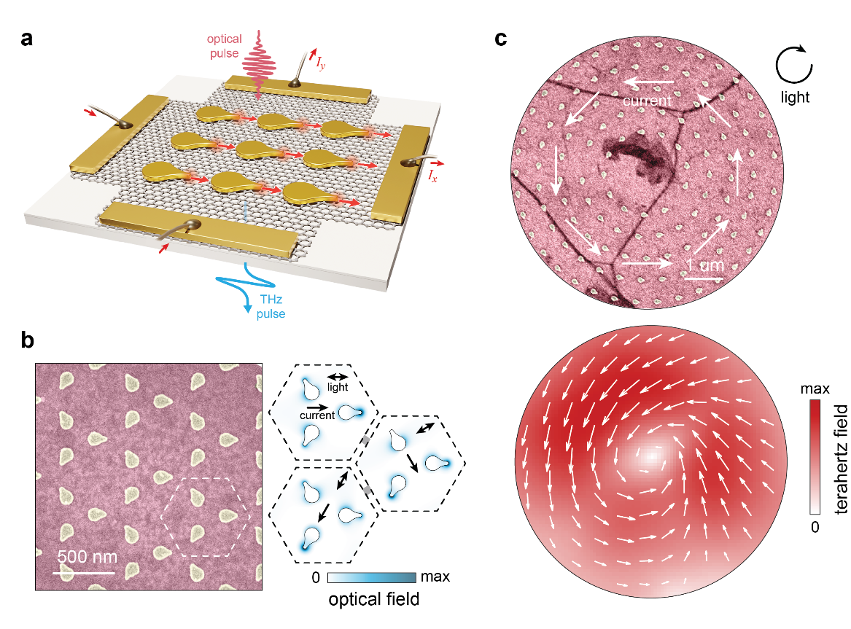
Vectorial Metasurfaces for Ultrafast Light-Based Current Control at the Nanoscale
Scientific Achievement
By combining simple asymmetric structures and simple light fields, a rich landscape of tunable “vectorial” current patterns has been demonstrated for the first time at nanoscopic spatial scales.
Significance and Impact
This unlocks an entirely new level of control over charge flows that cannot be realized by any other means, with broad applications in information processing, microelectronics, terahertz science, materials diagnostics and many other realms.
Research Details
Asymmetric gold nanostructures (serving as antennas or “lightning rods” for light) drive directional currents in underlying graphene
First demonstration of arbitrary and actively tunable current patterning (driven by ultrafast light) down to the nanoscale
Versatile new source of radiation in the terahertz frequency range, including direct generation of elusive terahertz vector beams
Local and spatially-varying vectorial currents. a. Illustration of vectorial optoelectronic metasurface concept. b. Kagome metasurface with current driven in any direction (omni-directional control) at the nanoscale unit cell level via incident laser polarization. c. Azimuthal metasurface for azimuthal current and generation of terahertz vector beam.
Pettine, J.; Padmanabhan, P.; Shi, T.; Gingras, L.; McClintock, L.; Chang, C.-C.; Kwock, K. W.; Yuan, L.; Huang, Y.; Nogan, J.; Baldwin, J. K.; Adel, P.; Holzwarth, R.; Azad, A. K.; Ronning, F.; Taylor, A. J.; Prasankumar, R. P.; Lin, S.-Z.; Chen, H.-T. Light-Driven Nanoscale Vectorial Currents. Nature 2024.
This work was performed at The Center for Integrated Nanotechnologies.
Notes:
1-2 paragraph description of highlight –
Despite their fundamental relevance to nearly all areas of modern sciences and technologies, charge currents remain remarkably challenging to control at the smallest (measured in nanometers) and fastest (measured in femtoseconds) frontiers. A computer’s central processing unit serves as a good example, now boasting billions of nanoscale transistors that perform complex operations in a flash. But these processors rely on vast logical cascades arising from only a thousand or so input pins and the currents are restricted to moving back and forth along pre-patterned conductive pathways at speeds that remain relatively slow by modern standards (around a hundred-thousand femtoseconds per operation). By contrast, emerging methods using ultrafast light fields to drive currents in any direction on femtosecond time scales could usher in entirely new capabilities for information processing and other applications, if only such light-based control could be squeezed down into smaller spatial scales. This is where nanoscale structuring comes in.
Metal nanostructures can act as lightning rod antennas, concentrating light pulses down into nanoscale regions much smaller than the light’s wavelength (which is usually disallowed by diffraction effects). This provided the first ingredient for nanoscale current control, but the question remained, how can directional currents be driven by light fields that oscillate and point in both directions? At the most basic level, a net current can only be generated if the system has some form of directionality. We thus simply broke inversion symmetry with lightning rod nanoantennas pointing in a specific direction and concentrating the optical field on only one side of the structure. When fabricated on top of graphene, we found that large arrays (metasurfaces) of these structures emit strong pulses of terahertz radiation when excited with near-infrared laser pulses. This rectification of high-frequency near-infrared fields to nearly 1,000-fold lower frequency terahertz fields indicated the generation of net directional current, serving as a source of terahertz radiation and also read out directly through electrical contacts. The immediate implication was that each symmetry-broken nanoscale structure generated a directional current when exposed to laser light. Further tests confirmed this and revealed the ability to arrange structures for control over local symmetries and vectorial current responses, including patterning spatially-varying currents and THz vector beams.
Acknowledgements –
Partial support for this work was provided by the Los Alamos National Laboratory Laboratory Directed Research and Development (LDRD) program. K.W.C.K. acknowledges support from the Department of Energy (DOE) National Nuclear Security Administration (NNSA) Laboratory Residency Graduate Fellowship program no. DE-NA0003960. F.R. was supported by the U.S. DOE Basic Energy Sciences, Division of Materials Science and Engineering project ‘Quantum fluctuations in narrow-band systems’. Work was primarily performed at the Center for Integrated Nanotechnologies, an Office of Science User Facility operated for the U.S. DOE Office of Science. Los Alamos National Laboratory, an affirmative action equal opportunity employer, is managed by Triad National Security, LLC for the U.S. DOE NNSA, under contract no. 89233218CNA000001.
Publication/ press releases/ related links: A LANL media release has been prepared but to be posted.

