Slide 1
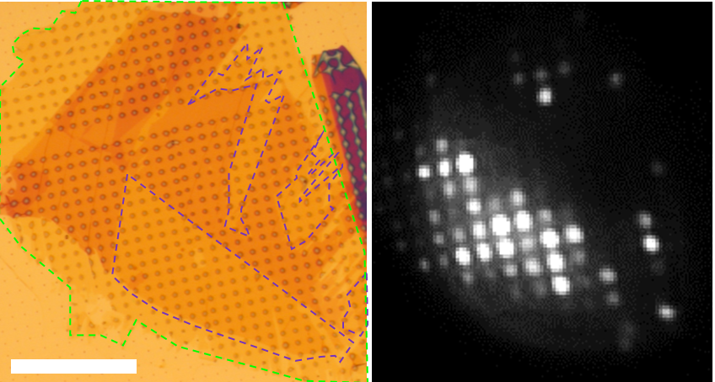
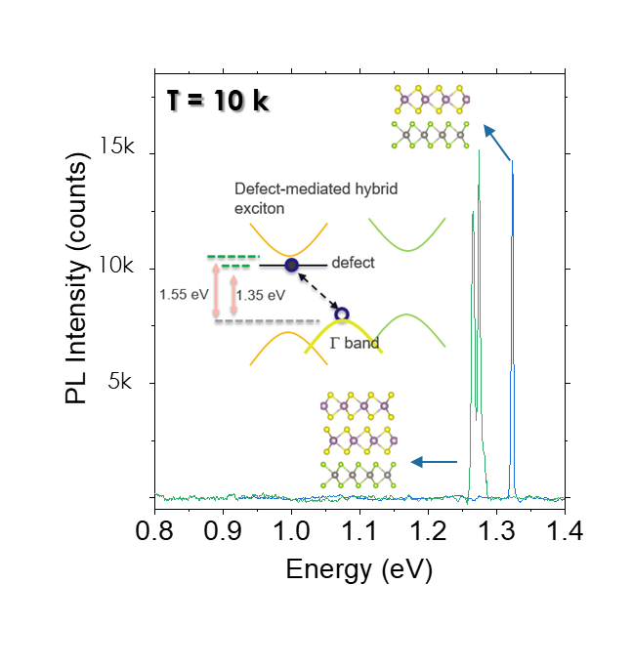
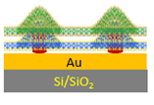
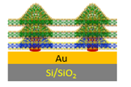
Manipulation of Interlayer Excitons for Near-Infrared Quantum Light Generation
Scientific Achievement
Strain, defects, and layering created defect-bound interlayer excitons (IXs) capable of bright, robust, and tunable quantum light emission in the technologically important near-infrared spectral range.
K/-K
Significance and Impact
Creating site-controlled QEs from defect-bound IXs signifies a paradigm shift in 2D quantum photonics research — from engineering intralayer exciton in monolayer structures toward IXs in 2D heterostructures.
Hanbury Brown-Twiss experiment achieves quantum light emission with very high single photon purity (0.95).
K/-K
D
Γ
Quantum light emitting excitonic state is formed between an electron trapped in defect state of MoS₂ layer and a hole in hybridized Γ band.
Optica (left) and photoluminescence (right) images of WSe₂/MoS₂ heterostructures on nanopillar array.
Research Details
MoS₂/WSe₂ hetero-bilayer and bilayer-MoS₂/monolayer-WSe₂ hetero-trilayers placed on top of an array of nanometer-sized pillars.
Strain and defects induced by nanopillars led to formation of localized excitons state between an electron trapped in the S vacancy state of MoS₂ and a hole in the hybridized Γ point of the balance band.
Photoluminescence excitation experiments and DFT calculations were performed to confirm the formation of defect- Γ IX.
Emission wavelength can be tuned with the use of heterotrilayer.
g⁽²⁾(0) = 0.01, 6 K
PL spectra of MoS₂/WSe₂ heterobilayer (Blue) and MoS₂/WSe₂ heterotrilayer on nanopillars (Green).
HBT experiment yielded g⁽²⁾ trace evidencing single photon emission.
Zhao, H.; Zhu, L.; Li, X.; Chandrasekaran, V.; Baldwin, J.; Pettes, M.; Piryatinski, A.; Yang, L.; Htoon, H. "Manipulating Interlayer Excitons for Near-Infrared Quantum Light Generation." Nano Letters 2023
This work was performed in part at The Center for Integrated Nanotechnologies.
Notes:
HL Type (place “X” where appropriate): User___, Staff__, User & Staff_X__
1-2 paragraph description of highlight
Interlayer excitons (IXs) formed at the interface of van der Waals (vdW) materials possess various novel properties. In a parallel development, strain engineering has emerged as an effective means for creating 2D quantum emitters (QEs). Exploring the intersection of these two exciting areas, we use MoS₂/WSe₂ heterostructure as a model system and demonstrate how strain, defects, and layering can be utilized to create defect-bound IXs capable of bright, robust, and tunable quantum light emission in the technologically important near-infrared spectral range. Our approach unlocks the freedom of combining arbitrary 2D semiconductors for building IXs with desired emission energy and extending this strategy for engineering interfacial Γ point transitions in other 2D heterostructures,³⁴ for instance, in MoS₂/WS₂. Given that monolayer TMDCs emit in the visible spectral range can be combined to generate IXs that emit in the NIR,³⁵ our findings pave the way for extending the operational wavelength of 2D quantum light sources into the technologically important yet rarely reached NIR regime. Our strategy of creating site-controlled QEs from the defect-bound IXs signifies a paradigm shift in 2D quantum photonics research, moving from engineering intralayer exciton in monolayer structures towards IXs in 2D heterostructures.
Collaborating Institutions
MPA-CINT, LANL; Washington University St. Louis
Funding Overview Section (place “X” for all relevant sources)
BES Funding: MSED___, CSGB___, EFRC___, SUFD___
SC Funding: ASCR___, BES__X_, BER___, FES___, HEP___, NP___, WDTS___, SBIR___, etc.
Other Funding: DOD___, DOE__X_, NIH___, NSF__X_, etc.
Funding details for all sources: (example)
This work was performed at the Center for Integrated Nanotechnologies, an Office of Science User Facility operated for the U.S. Department of Energy (DOE), Office of Science, by Los Alamos National Laboratory (LANL). H.Z., X.L., and H.H. acknowledge the primary support by Quantum Science Center, a National Quantum Information Science Research Center supported by Office of Science, U.S. DOE. V.C. is supported by DOE BES Program BES LANL22. A.P. acknowledges support from the Laboratory Directed Research and Development (LDRD) program 20200104DR. M.T.P. is supported by LDRD 20210782ER and LDRD 20210640ECR. H.Z. also acknowledges a LANL Director’s Postdoctoral Fellow Award. L.Z. is supported by the National Science Foundation (NSF) Grant No. DMR-2124934, and L.Y. is supported by the Air Force Office of Scientific Research (AFOSR) Grant No. FA9550-20-1-0255. The first-principles simulation uses Anvil at Purdue University through allocation DMR100005 from the Advanced Cyberinfrastructure Coordination Ecosystem: Services & Support (ACCESS) program, which is supported by NSF grants #2138259, #2138286, #2138307, #2137603, and #2138296.
Publication/ press releases/ related links:
https://pubs.acs.org/doi/10.1021/acs.nanolett.3c03296?ref=PDF

