Slide 1
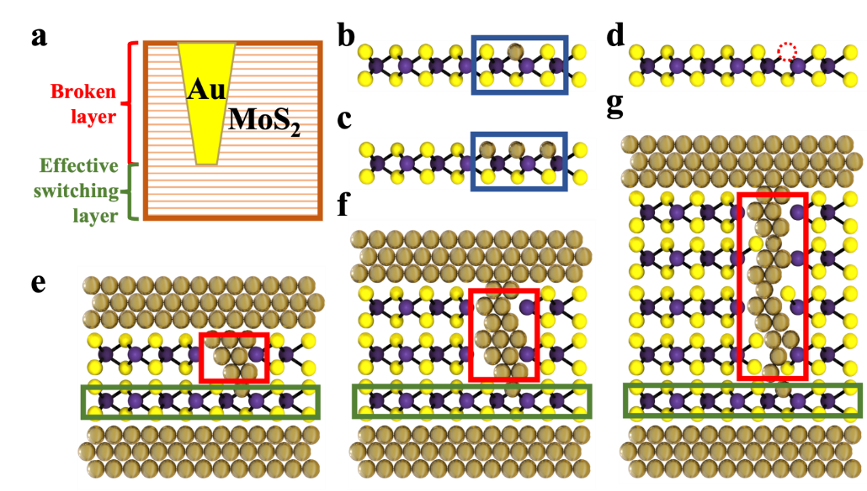
Reliable Switching in MoS₂ Memristors
Scientific Achievement
New 2D-memristor research demonstrates a statistical yield reliability of 92% and 16 times improvement in DC cycling endurance over prior reports by carefully controlling the top electrode deposition rate and active material thickness.
Significance and Impact
2D memristors demonstrate attractive resistive switching characteristics but also suffer from a severe reliability issue, which limits their use in practical application.
Statistical electrical measurements demonstrate a new strategy for optimizing 2D-material based memristors and shed light on the switching mechanism for few-layer MoS₂ memristors.
Research Details
The team studied the impact of metallization conditions and the thickness of MoS₂ films on the reliability and other device metrics of MoS₂ memristors.
Statistical analysis of all measured switching cycles revealed the convergence of switching metrics allowing for optimization of the set and reset voltages and high resistance state/low resistance state ratio with different fabrication process parameters.
Development of a general purpose “effective switching layer” model to interpret the reliability enhancement and switching metrics independence on layer thickness during fabrication process optimization.
Illustration of the “effective switching layer” model for MoS₂-based memristors. The thickness of the broken layer is related to overall MoS₂ thickness and the top electrode deposition rate, while the effective switching layer is maintained as a monolayer-like layer.
Huang, Y.; Gu, Y.; Mohan, S.; Dolocan, A.; Ignacio, N. D.; Kutagulla, S.; Matthews, K.; Londoño‐Calderon, A.; Chang, Y.; Chen, Y.; Warner, J. H.; Pettes, M. T.; Lee, J. C.; Akinwande, D. Reliability improvement and effective switching model of thin-film MoS₂ memristors. Advanced Functional Materials Early View, 2214250 (2023).
This work was performed in part at The Center for Integrated Nanotechnologies.
Notes:
HL Type (place “X” where appropriate): User___, Staff__, User & Staff_X_
1-2 paragraph description of highlight
2D memristors have demonstrated attractive resistive switching characteristics recently but also suffer from reliability issues, which limit practical applications. Previous efforts on 2D memristors have primarily focused on exploring new material systems, while damage from the metallization step remains a practical concern for the reliability of 2D memristors. Here, the impact of metallization conditions and the thickness of MoS₂ films on the reliability and other device metrics of MoS₂-based memristors is carefully studied. The statistical electrical measurements show that the reliability can be improved to 92% for yield and improved by ≈16× for average DC cycling endurance in the devices by reducing the top electrode (TE) deposition rate and increasing the thickness of MoS₂ films. Intriguing convergence of switching voltages and resistance ratio is revealed by the statistical analysis of experimental switching cycles. An “effective switching layer” model compatible with both monolayer and few-layer MoS₂, is proposed to understand the reliability improvement related to the optimization of fabrication configuration and the convergence of switching metrics. The Monte Carlo simulations help illustrate the underlying physics of endurance failure associated with cluster formation and provide additional insight into endurance improvement with device fabrication optimization.
Collaborating Institutions
The University of Texas Northern Arizona University Intel
Funding Overview Section (place “X” for all relevant sources)
BES Funding: MSED___, CSGB___, EFRC___, SUFD_X(CINT user program)_
SC Funding: ASCR___, BES_X(CINT user program)_, BER___, FES___, HEP___, NP___, WDTS___, SBIR___, etc.
Other Funding: DOD___, DOE___, NIH___, NSF_X_, etc.
Funding details for all sources: (example)
This work was supported in part by the National Science Foundation (NSF) grant #1809017, and an NSF MRSEC under Cooperative Agreement No. DMR-1720595. The authors acknowledge use of Texas Nanofabrication Facilities supported by the NSF NNCI award #1542159. D.A. acknowledges the Temple Foundation Professorship. This work was performed in part at the Center for Integrated Nanotechnologies, an Office of Science User Facility operated for the U.S. Department of Energy (DOE) Office of Science. Los Alamos National Laboratory, an affirmative action-equal opportunity employer, is managed by Triad National Security, LLC for the U.S. Department of Energy's NNSA, under contract 89233218CNA000001. The authors would like to appreciate Jo Wozniak of Texas Advanced Computing Centre (TACC) for 3D renderings. The authors would also like to thank Raluca Gearba and Karalee Jarvis of Texas Materials Institute (TMI) for assistance on FIB and TEM.
Publication/ press releases/ related links:
Huang, Y.; Gu, Y.; Mohan, S.; Dolocan, A.; Ignacio, N. D.; Kutagulla, S.; Matthews, K.; Londoño‐Calderon, A.; Chang, Y.; Chen, Y.; Warner, J. H.; Pettes, M. T.; Lee, J. C.; Akinwande, D. Reliability improvement and effective switching model of thin-film MoS₂ memristors. Advanced Functional Materials Early View, 2214250 (2023). https://doi.org/10.1002/adfm.202214250

