Slide 1
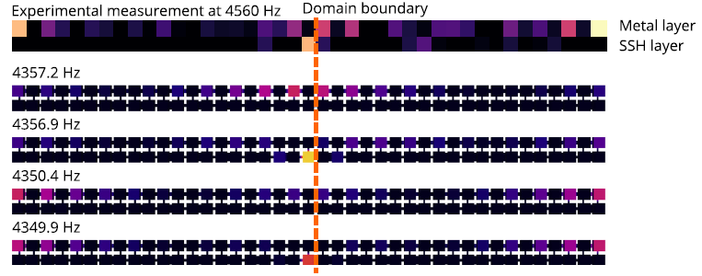
Revealing topology in metals using experimental protocols inspired by K-theory
Scientific Achievement
Direct observation of topological phenomena in gapless “metallic” acoustic crystals and realization of a general experimental technique to demonstrate their topology.
Significance and Impact
Traditional theories of topology can not predict a measure of protection for any topological phenomena that might be present. By leveraging a new theoretical framework, we can predict topological protection and yield the first observation of a topological metal.
Research Details
Our acoustic metamaterial is fabricated from 3D-printed plastic with laser cut holes to control the coupling between adjacent resonators.
We use a real-space topological framework that can predict robustness even in the absence of band gaps.
This new theoretical framework, called the spectral localizer, makes use of recent mathematical discoveries in the study of C*-algebras.
(Top) Photographs of the fully assembled acoustic metallized SSH lattice as well as its constituent parts. (Bottom) Experimental measurement and numerical simulations of the topological boundary-localized modes in this acoustic metal.
This work was performed in part at The Center for Integrated Nanotechnologies.
Cheng, W.; Cerjan, A.; Chen, S.-Y.; Prodan, E.; Loring, T. A.; Prodan, C. Revealing Topology in Metals Using Experimental Protocols Inspired by K-Theory. Nature Communications 2023, 14 (1).
Notes:
HL Type (place “X” where appropriate): User___, Staff___, User & Staff_X_
1-2 paragraph description of highlight
Topological metals are conducting materials with gapless band structures and nontrivial edge-localized resonances. Their discovery has proven elusive because traditional topological classification methods require band gaps to define topological robustness. Inspired by recent theoretical developments that leverage techniques from the field of C∗-algebras to identify topological metals, here, we directly observe topological phenomena in gapless acoustic crystals and realize a general experimental technique to demonstrate their topology. Specifically, we not only observe robust boundary-localized states in a topological acoustic metal, but also re-interpret a composite operator—mathematically derived from the K-theory of the problem—as a new Hamiltonian whose physical implementation allows us to directly observe a topological spectral flow and measure the topological invariants. Our observations and experimental protocols may offer insights for discovering topological behavior across a wide array of artificial and natural materials that lack bulk band gaps.
To the best of our knowledge, our study represents the first implementation of a robust topological metal with an observed bulk-boundary correspondence in any experimental platform. Despite significant efforts from the community aimed at the discovery of topological metals, work on this previously hypothetical class of materials has been stymied for a fundamental reason -- previous band theory-based approaches to topology are unable to classify a system if it does not exhibit a bulk band gap. Instead, our adoption of a new theoretical framework to both guide our experiments and inspire a new observational methodology is what has enabled us to circumvent this fundamental challenge. Given the generality of our methods, we are confident that these findings open opportunities for the discovery of gapless topological phenomena across a wide range of natural and artificial materials.
Collaborating Institutions
New Jersey Institute of Technology, Sandia National Laboratories, University of New Mexico, Yeshiva University
Funding Overview Section (place “X” for all relevant sources)
BES Funding: MSED___, CSGB___, EFRC___, SUFD_X_
SC Funding: ASCR___, BES_X_, BER___, FES___, HEP___, NP___, WDTS___, SBIR___, etc.
Other Funding: DOD___, DOE___, NIH___, NSF_X_, etc.
Funding details for all sources:
T.L. acknowledges support from the National Science Foundation, grant DMS-2110398. This work was performed, in part, at the Center for Integrated Nanotechnologies, an Office of Science User Facility operated for the U.S. Department of Energy (DOE) Office of Science. A.C. and T.L. acknowledge support from the Laboratory Directed Research and Development program at Sandia National Laboratories. Sandia National Laboratories is a multimission laboratory managed and operated by National Technology & Engineering Solutions of Sandia, LLC, a wholly owned subsidiary of Honeywell International, Inc., for the U.S. DOE’s National Nuclear Security Administration under contract DE-NA-0003525. The views expressed in the article do not necessarily represent the views of the U.S. DOE or the United States Government. C. P. acknowledges support from the National Science Foundation, grant CMMI-2131759. E.P. was supported by the U.S. National Science Foundation through the grants DMR-1823800 and CMMI-2131760.
Publication/ press releases/ related links:
Cheng, W.; Cerjan, A.; Chen, S.-Y.; Prodan, E.; Loring, T. A.; Prodan, C. Revealing Topology in Metals Using Experimental Protocols Inspired by K-Theory. Nature Communications 2023, 14 (1). https://doi.org/10.1038/s41467-023-38862-2

