Slide 1
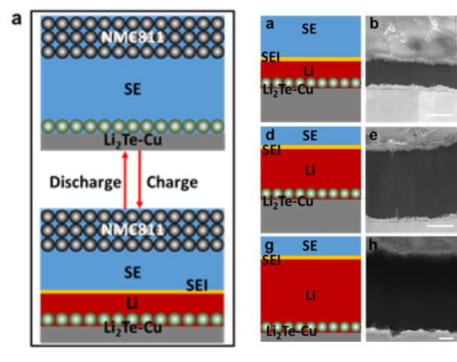
Stable Anode-Free All-Solid-State Lithium Battery through Tuned Metal Wetting
Scientific Achievement
Development of the first sulfide-based anode free all solid-state battery (AF-ASSB).
Significance and Impact
Solid-state electrolytes (SSEs) provide greater battery safety since most inorganic SSEs are nonflammable. An anode free configuration reduces overall cell weight and reduces ignition risk.
Research Details
High activity is achieved by tuning the wetting of Li on an “empty” copper current-collector by the initial synthesis of a 1 µm layer of Li₂Te.
Cryo-FIB sectioning demonstrates uniform electrodeposited Li metal, with no signs of voids or dendrites at the collector-SE interface.
Schematic diagram of the working principle in an anode-free solid-state battery, and representative atomic structures of one Li atom or a monolayer of Li on top of fcc Cu or fcc Li2Te.
Wang, Y.; Liu, Y.; Nguyen, M.; Cho, J.; Katyal, N.; Vishnugopi, B. S.; Hao, H.; Fang, R.; Wu, N.; Liu, P.; Mukherjee, P. P.; Nanda, J.; Henkelman, G.; Watt, J.; Mitlin, D. Stable Anode-Free All-Solid-State Lithium Battery through Tuned Metal Wetting on the Copper Current Collector. Advanced Materials. 2022
This work was performed in part at The Center for Integrated Nanotechnologies.
Notes:
HL Type (place “X” where appropriate): User___, Staff___, User & Staff__X_
1-2 paragraph description of highlight
A stable anode-free all-solid-state battery (AF-ASSB) with sulfide-based solid-electrolyte (SE) (argyrodite Li6PS5Cl, LPSCl) is achieved by tuning wetting of lithium metal on “empty” copper current-collector. A layer of lithiophilic 1 μm Li2Te is first synthesized by exposing the collector to tellurium vapor, followed by in-situ Li activation during the first charge. The Li2Te significantly reduces the electrodeposition/electrodissolution overpotentials and improves Coulombic efficiency (CE). During continuous plating experiments using half-cells (1 mA cm-2), the accumulated thickness of electrodeposited Li on Li2Te-Cu is more than 70 μm, which is the thickness of Li foil counter-electrode. Full AF-ASSB with NMC811 cathode delivers an initial CE of 83% at 0.2C, with a cycling CE above 99%. Cryo-FIB sectioning demonstrates uniform electrodeposited metal microstructure, with no signs of voids or dendrites at the collector-SE interface. Electrodissolution is uniform and complete, with Li2Te remaining structurally stable and adherent. By contrast, unmodified Cu current collector promotes inhomogeneous Li electrodeposition/electrodissolution, electrochemically inactive “dead metal”, dendrites that extend into SE, and thick non-uniform solid electrolyte interphase (SEI) interspersed with pores. Density functional theory and mesoscale calculations provide insight regarding nucleation-growth behavior. This work paves the way for viable AF-ASSBs that deliver significantly higher specific energies and cost less than ASSBs which require metal or ion storing anodes.
Collaborating Institutions
University of Texas at Austin
Purdue University
Oak Ridge National Laboratory
Los Alamos National Laboratory
Funding Overview Section (place “X” for all relevant sources)
BES Funding: MSED__X_, CSGB___, EFRC___, SUFD___
SC Funding: ASCR___, BES_X__, BER___, FES___, HEP___, NP___, WDTS___, SBIR___, etc.
Other Funding: DOD___, DOE___, NIH___, NSF___, etc.
Funding details for all sources: (example)
This work was performed, in part, at the Center for Integrated Nanotechnologies, an Office of Science User Facility operated for the U.S. Department of Energy (DOE) Office of Science. Los Alamos National Laboratory, an affirmative action equal opportunity employer, is managed by Triad National Security, LLC for the U.S. Department of Energy’s NNSA, under contract 89233218CNA000001. The calculations were supported by the Welch Foundation (F-1841), and computing resources at the Extreme Science and Engineering Discovery Environment (XSEDE) and Texas Advanced Computing Center (TACC).
Publication/ press releases/ related links: (example)
Wang, Y.; Liu, Y.; Nguyen, M.; Cho, J.; Katyal, N.; Vishnugopi, B. S.; Hao, H.; Fang, R.; Wu, N.; Liu, P.; Mukherjee, P. P.; Nanda, J.; Henkelman, G.; Watt, J.; Mitlin, D. “Stable Anode-Free All-Solid-State Lithium Battery through Tuned Metal Wetting on the Copper Current Collector.” Advanced Materials. 2022, n/a, e2206762. doi.org/10.1002/adma.202370058

