Slide 1
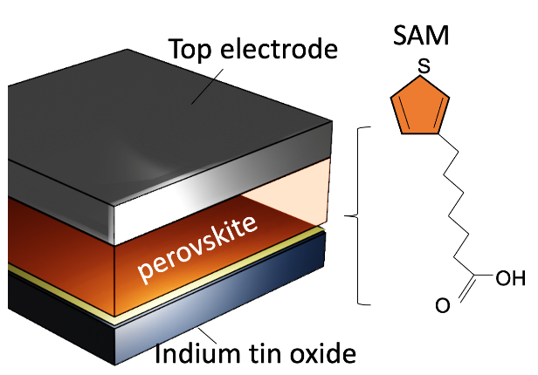
Self-assembled monolayer boost solar cell efficiency
Scientific Achievement
Development of a self-assembled polythiophene monolayer for 2D perovskite solar cells that boosts the power conversion efficiency.
Significance and Impact
2D perovskites make stable solar cell, but high efficiency cells remain to be lab-scale size. CINT users developed a SAM polythiophene layer that facilitates large area 2D perovskite layer growth for upscaling 2D perovskite solar modules.
Research Details
Self assembly polythiophene guided growth of oriented 2D perovskites.
Large area, uniform film can be obtained.
Demonstrated high solar cell efficiency >17%.
High photovoltage (1.24V) obtained, approaching the thermodynamic limit.
(Left) A polythiophene self-assembled on indium tin oxide can facilitate the scalable growth of 2D perovskite.
(right) X-ray scattering pattern of the resulting 2D perovskite grown on SAM layer that exhibit near single crystal structure and preferential crystal orientations.
Huang, H.-H.; Yang, T.-A.; Su, L.-Y.; Chen, C.-H.; Chen, Y.-T.; Ghosh, D.; Lin, K.-F.; Tretiak, S.; Chueh, C.-C.; Nie, W.; Tsai, H.; Wang, L. Thiophene-Based Polyelectrolyte Boosts High-Performance Quasi-2d Perovskite Solar Cells with Ultralow Energy Loss. ACS Materials Letters 2023, 5 (5), 1384–1394. DOI:10.1021/acsmaterialslett.2c01104.
This work was performed in part at The Center for Integrated Nanotechnologies.
Notes:
HL Type (place “X” where appropriate): User___, Staff__, User & Staff__X_
1-2 paragraph description of highlight
2D perovskites are environmentally stable alternative to 3D perovskites for high efficiency solar cell with long operational stabilities. However, a precise control of the crystalline orientation is required to make a high performance 2D perovskite solar cell. As a result, the reported 2D perovskite solar cells are limited to the laboratory scale size < 1cm².
CINT users found a polythiophene monolayer self-assembled (SAM) over the indium tin oxide electrode can facilitate the 2D perovskite crystalline layer growth. The SAM layer functions as the p-type charge collection electrode, and facilitate the large scale growth of 2D perovskite layer. On the SAM layer, we obtain highly crystalline 2D perovskite layer with preferential crystal orientations. Such a high quality perovskite layer warrants a high energy conversion from light to electricity, yielding a high photovoltage over 1.24V approaching the thermodynamic limit. As a result, we demonstrate a uniform growth of 2D perovskite layer covering 10cm by 10cm substrate. Solar cells built with our 2D perovskite layer show exceptional uniformity in their power conversion efficiency. Our method paves the path of building 2D perovskite solar module with minimal energy losses.
Collaborating Institutions
National Taiwan University
Southern Taiwan University Science and Technology
Los Alamos National Laboratory
Funding Overview Section (place “X” for all relevant sources)
BES Funding: MSED___, CSGB___, EFRC___, SUFD___
SC Funding: ASCR___, BES_X__, BER___, FES___, HEP___, NP___, WDTS___, SBIR___, etc.
Other Funding: DOD___, DOE___, NIH___, NSF___, etc.
Funding details for all sources: (example)
This work was financially supported by the Ministry of Science and Technology, Taiwan (MOST 111-2113-M-002-011; 108- 2113-M-002-015-MY3), Academia Sinica (AS-iMATE-111- 31), and the Center of Atomic Initiative for New Materials, National Taiwan University (grant nos. 110 L9008 and 111 L9008) from the Featured Areas Research Center Program within the framework of the Higher Education Sprout Project by the Ministry of Education, Taiwan. L.-Y. Su thanks the financial support from NSTC (112-2222-E-218-002). Work performed by H. Tsai and W. Nie. are supported by Mission Foundation Research Project and Exploratory Research Project at Los Alamos National Laboratory (LANL) LDRD program. This work was performed, in part, at the Center for Integrated Nanotechnologies, an Office of Science User Facility operated for the U.S. Department of Energy (DOE) Office of Science (Contract 89233218CNA000001) and the Center for Non- linear Studies (CNLS) by LANL.
Publication/ press releases/ related links:
https://pubs.acs.org/doi/10.1021/acsmaterialslett.2c01104

