Slide 1
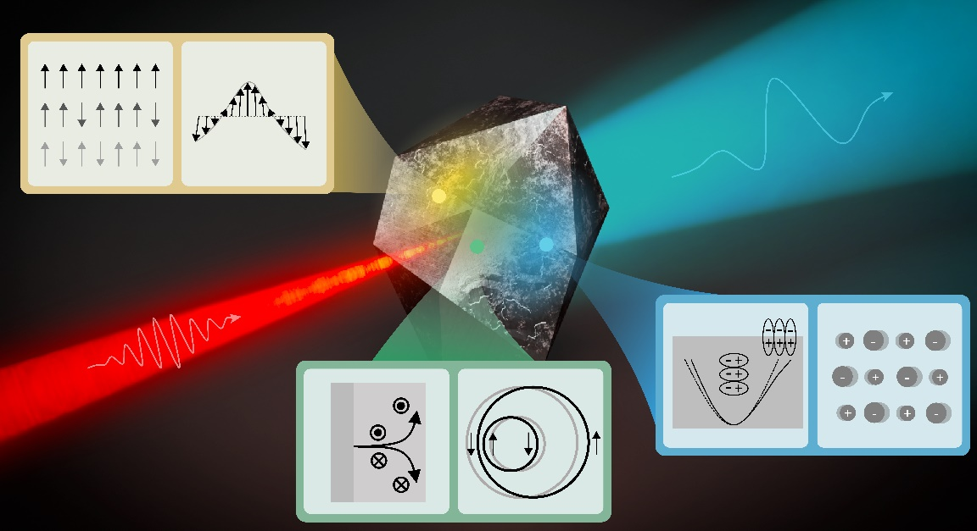
Ultrafast terahertz emission from emerging symmetry-broken materials
Scientific Achievement
A broad review of pulsed terahertz emission spectroscopy, with an emphasis on emerging quantum and low-dimensional materials.
Significance and Impact
Review of recent work using a novel nonlinear spectroscopy for a variety of material investigations.
Research Details
Terahertz (THz) emission spectroscopy has emerged as a valuable technique for investigating static physical properties as well as ultrafast dynamics that may remain hidden to other probes. In this review article, a broad selection of recent THz emission studies involving quantum and low-dimensional materials is surveyed, emphasizing unifying symmetry considerations as well as opportunities to exploit the interplay between intrinsic and extrinsic (artificial nano–microscale) structure for designer properties.
Ultrafast optical field incident on material with broken spatial symmetry (blue), time-reversal symmetry (yellow), or both (green) to generate THz radiation. Insets illustrate various mechanisms that lead to rectified THz currents high-frequency optical fields. (Image courtesy of Los Alamos National Laboratory)
Pettine, J.; Padmanabhan, P.; Sirica, N.; Prasankumar, R. P.; Taylor, A. J.; Chen, H.-T. Ultrafast Terahertz Emission from Emerging Symmetry-Broken Materials. Light: Science &amp; Applications 2023, 12 (1).
Work was performed, in part, at the Center for Integrated Nanotechnologies.
Notes:
Highlight Type (place “X” where appropriate): User____, Staff_X_, User & Staff ___
1-2 paragraph description of highlight
Terahertz (THz) emission spectroscopy has emerged as a valuable technique for investigating static physical properties as well as ultrafast dynamics occurring in novel material systems that may remain hidden to other probes. In this review article, the authors survey a broad selection of recent THz emission studies involving quantum and low-dimensional materials, emphasizing unifying symmetry considerations as well as opportunities to exploit the interplay between intrinsic and extrinsic (artificial nano–microscale) structure for designer properties.
Funding Overview Section (place “X” for all relevant sources)
BES Funding: MSED___, CSGB___, EFRC___, SUFD___
SC Funding: ASCR___, BES_X_, BER___, FES___, HEP___, NP___, WDTS___, SBIR___, etc.
Other Funding: DOD___, DOE___, NIH___, NSF__, etc. DOE LDRD __X__
Acknowledgements
The authors would like to thank Shi-Zeng Lin and Stuart Trugman for helpful conversations. JP and HTC acknowledge partial support of the Los Alamos National Laboratory Laboratory-Directed Research and Development (LDRD) program via projects 20230124ER and 20210845PRD1. NS gratefully acknowledges the support of the US Department of Energy, Office of Science, Office of Basic Energy Sciences, Division of Materials Sciences and Engineering via FWP No. LANLE1NT. This work was performed, in part, at the Center for Integrated Nanotechnologies, an Office of Science User Facility operated for the U.S. Department of Energy (DOE) Office of Science. Los Alamos National Laboratory, an affirmative action equal opportunity employer, is managed by Triad National Security, LLC for the U.S. Department of Energy’s NNSA, under Contract No. 89233218CNA000001.
Publication/ press releases/ related links:
Pettine, J.; Padmanabhan, P.; Sirica, N.; Prasankumar, R. P.; Taylor, A. J.; Chen, H.-T. Ultrafast Terahertz Emission from Emerging Symmetry-Broken Materials. Light: Science &amp; Applications 2023, 12 (1). DOI:10.1038/s41377-023-01163-w.
* Equal contributors
Press release: https://phys.org/news/2023-06-ultrafast-terahertz-emission-emerging-symmetry-broken.html

