Slide 1
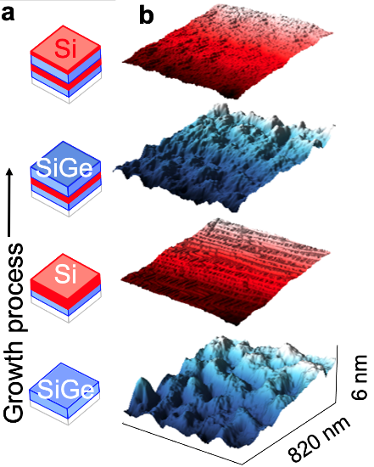
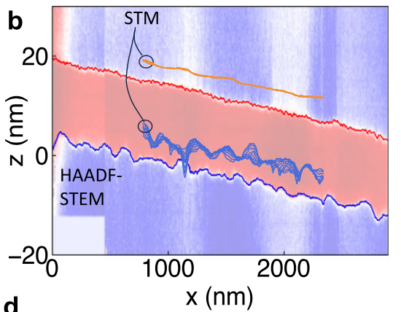
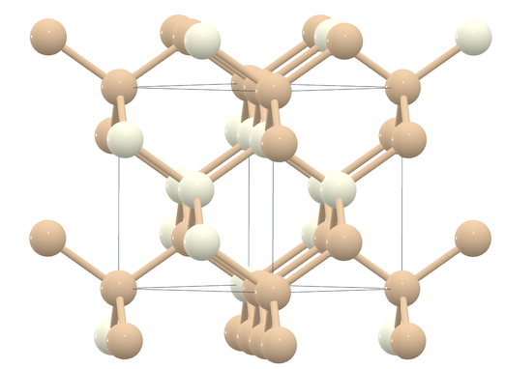
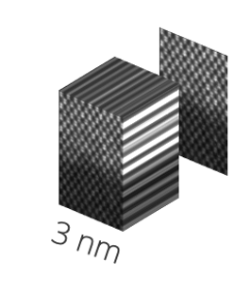
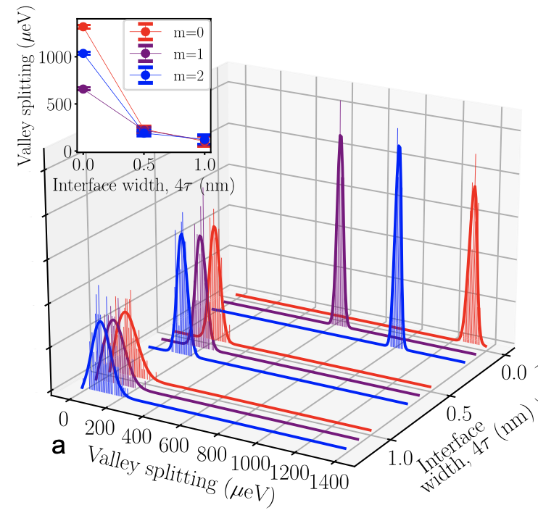
Multi-perspective Microscopy Reconstruction of Interface Atomic Disorder to Infer Silicon Quantum Dot Variability
Scientific Achievement
Demonstrated large-scale reconstruction of atom-scale structure hidden at semiconductor interfaces.
Through modeling, we infer resulting variability in quantum dot properties relevant for silicon qubits.
Post-synthesis cross-sectional imaging STEM
Significance and Impact
Si/SiGe is a promising material for making Si qubits, but disorder affects qubit performance and yield.
This approach enables measurement of atomic disorder and modeling of qubit variability to address this problem.
Imaging disorder during synthesis operando STM
Atomic structure & model predicted qubit property distributions
SiGe
Si
qubit electron density
Research Details
Atom-scale imaging with scanning tunneling microscopy during growth and post-growth scanning transmission electron microscopy.
Quantum dot properties modeled with Schrödinger solves that incorporate measured atomic positions.
Figure: Inferring Si/SiGe interface disorder from multi-perspective atomic resolution images to calculate disorder-induced qubit variability.
Peña, L. F.; Koepke, J. C.; Dycus, J. H.; Mounce, A.; Baczewski, A. D.; Jacobson, N. T.; Bussmann, E. Modeling Si/Sige Quantum Dot Variability Induced by Interface Disorder Reconstructed from Multiperspective Microscopy. npj Quantum Information 2024, 10.
Notes:
1-2 paragraph description of highlight –
Promising future quantum computing technologies are being integrated into Si foundry manufacturing using layered thin-film materials, e.g., Si/SiGe, common in microelectronics.
In this approach, qubit devices are nested at heterogeneous interfaces between thin-film layers, where residual atomic-scale disorder can affect qubit variability.
As one means to predict qubit variability, then find viable control strategies to mitigate it, Sandia National Laboratories has built quantum electronic structure models (multivalley effective mass theory) that incorporate an atomistic description of the material. High-fidelity qubit modeling requires spatially-resolved 3D atomic structure data over micrometer-sized/multiqubit interface areas. Holistic microscale yet atomic-fidelity interface structure measurements are challenging for even the most powerful tools ( e.g., DOE’s X-ray nanoprobes, atom-probe tomography, or electron microscopy). One strategy is to reconstruct interface structure by combining multiple data types capturing different perspectives and scales.
We report a technique to reconstruct 3D atomic-scale interface disorder by correlating and reconciling multi-perspective image data obtained during and after thin-film synthesis. Specifically, we combine scanning tunneling microscopy (STM) during thin film growth with post-growth cross-sectional images to reconstruct atomic interface structure. Then, we utilize our structure data to infer how measured disorder impacts qubit variability by using quantum mechanics calculations, e.g., effective mass theory. Our approach yields atomic structure spanning orders of magnitude larger areas than each post-growth microscopy or tomography alone, enabling more holistic predictions of disorder-induced qubit variability. Our models predict appreciable qubit spectral variability owing to both short-range alloy disorder and longer-range roughness. The results indicate qubit variability that might be improperly attributed to other factors, e.g., trapped charges. Next, we plan to use our structure data to investigate variability in qubit processes, such as qubit shuttling along micron-scale distances, that are likely to be integral in realizing larger quantum computers.
Acknowledgements
Experiment performed at Center for Integrated Nanotechnologies, a DOE Office of Science User Facility
Analysis and manuscript preparation supported as part of μ-ATOMS, DOE Energy Frontier Research Center, award DE-SC0023412
Publication/ press releases/ related links:
Peña, L. F.; Koepke, J. C.; Dycus, J. H.; Mounce, A.; Baczewski, A. D.; Jacobson, N. T.; Bussmann, E. Modeling Si/Sige Quantum Dot Variability Induced by Interface Disorder Reconstructed from Multiperspective Microscopy. npj Quantum Information 2024, 10 (1). DOI:10.1038/s41534-024-00827-8.
https://www.nature.com/articles/s41534-024-00827-8

Slide 2
How to Build a DOE Office of Science Highlight Slide
Purpose
Convey current scientific and technical research results in a way that is intriguing, succinct, relevant, and easily understood by both technical and non-technical communities.
Use
Information can be employed and adapted for multiple uses, including meetings with other federal agencies, review committees, scientific panels, and budget meetings.
Highlight text can also be a critical component of annual budget request documents that are reviewed by DOE senior leadership and Congress.
Needs
It is exceptionally important to convey the importance or significance the research has on the particular research field.
A standard format for scientific highlights helps the Office of Science to efficiently and effectively communicate research results to the public.

Slide 3
How to Build a DOE Office of Science Highlight Slide
Submission
Highlights should be submitted regularly to your Point of Contact (POC). In general, highlights should focus on a published, or soon to be published, paper. Information on publication timing, should be shared (in writing). Highlights involving sensitive information that would compromise patents, for example, should be shared in emails, not as a highlight slide.
Send your POC a copy the published paper (if available) or preprint if not yet published with the highlight.
If your institution has a press release (or planned press release), please forward to your POC.
All graphics should be clear and large enough to be easily viewed. Keep resolution of the embedded graphic in mind.
Well crafted highlight slides may be presented by many different people with many different science backgrounds!

Slide 4
How to Build a DOE Office of Science Highlight Slide
Title
Attention grabbing and accessible but not exaggerated
Text
All text should be short and to the point – minimize words and stress significance to society. Please do not adjust font sizes.
Scientific Achievement – 22 pt text
Significance and Impact – 22 pt text
Importance, relevance, or intriguing component of the finding to the field
Research Details – Address the research approach in 2-4 bullet points – 20 pt text
Citation - Full citation with DOI is preferable
PowerPoint Notes
Give a 1-2 paragraph detailed explanation with acknowledgements and optional related links
Sponsor delineation of work should be made clear here, and reflect acknowledgements/credit lines

Slide 5
How to Build a DOE Office of Science Highlight Slide
Figures
Visually compelling figure(s) to explain the research
Include legends and descriptive caption
DOE has the right to use published journal images per contractual funding agreements
Institutional logo(s)
Include affiliations or institutional logos
Indicate institution where research was performed (if possible)

Slide 6
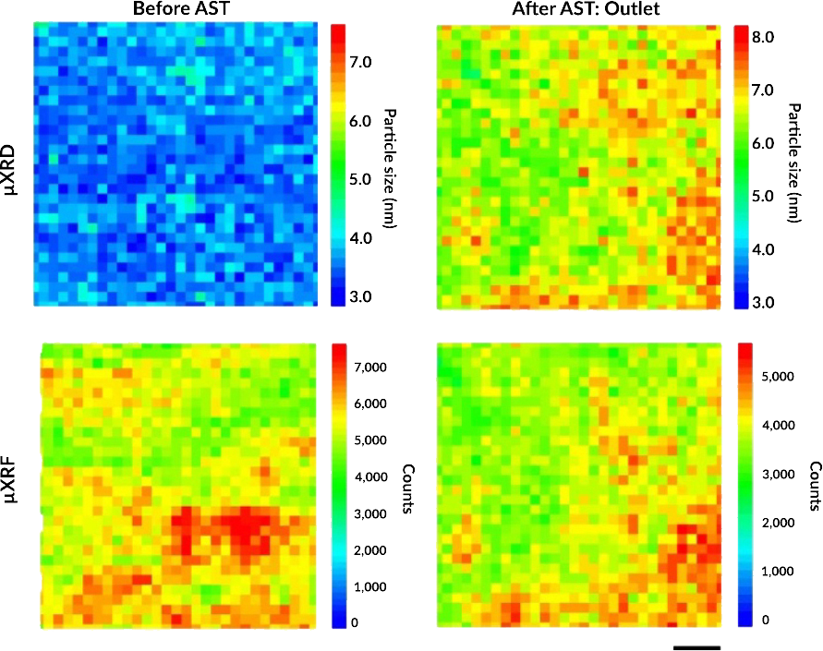
Tracking Platinum Movement on Fuel-Cell Electrodes
Scientific Achievement
The movement of platinum (Pt) nanoparticles that catalyze reactions in polymer electrolyte fuel cells (PEFCs) were tracked and correlated with nanoparticle degradation.
Significance and Impact
Yielded solutions that could mitigate loss of catalytic activity and reduce Pt waste in emission-free heavy-duty fuel-cell vehicles.
Research Details
Catalyst-coated membranes (CCMs) designed for potential use in heavy-duty vehicles were subjected to accelerated stress tests (ASTs).
X-ray microdiffraction (µXRD) and microfluorescence (µXRF) at the Advanced Light Source revealed a linear correlation between Pt nanoparticle growth (i.e., degradation) and local Pt mass loading (i.e., distribution).
CCMs were scanned before (left) and after (right) ASTs. µXRD (top) yielded Pt particle size, and µXRF (bottom) revealed Pt particle loading. Statistical analysis showed a linear correlation between particle size and loading only after the ASTs. Scale bar = 50 µm.
K. Khedekar, A. Zaffora, M. Santamaria, M. Coats, S. Pylypenko, J. Braaten, P. Atanassov, N. Tamura, L. Cheng, C. Johnston, and I.V. Zenyuk, Nat. Catal. 6, 676 (2023), doi:10.1038/s41929-023-00993-6.
Work was performed at ALS/LBNL.
Notes:
Polymer electrolyte fuel cells (PEFCs) that run on green hydrogen are a promising option for powering heavy-duty vehicles that produce zero greenhouse-gas emissions. This type of fuel cell has the potential to extend driving range without incurring additional weight penalties. However, PEFCs use platinum as a catalyst to drive a key chemical reaction. The fast degradation of this precious metal in a PEFC and the resulting high cost currently prevent the widespread commercialization of this otherwise excellent technology. In this study, researchers wanted to better understand the nanoscale mechanisms by which platinum degrades during PEFC operation. They put the relevant components through accelerated stress tests that simulated the conditions of use in heavy-duty vehicles. They then probed the changes in platinum nanoparticle size and location using x-ray microdiffraction and microfluorescence at the ALS. The results point the way to improvements in PEFC fabrication that can significantly extend the lifetime and efficiency of PEFCs in heavy-duty vehicles, reduce their cost, improve air quality, and fight climate change.
Researchers: K. Khedekar, P. Atanassov, and I.V. Zenyuk (University of California, Irvine); A. Zaffora (UC Irvine and University of Palermo, Italy); M. Santamaria (University of Palermo, Italy); M. Coats and S. Pylypenko (Colorado School of Mines); J. Braaten, L. Cheng, and C. Johnston (Bosch Research and Technology Center North America); and N. Tamura (ALS).
Acknowledgement from paper: Bosch Research and Technology Center North America. Operation of the ALS is supported by the US Department of Energy, Office of Science, Basic Energy Sciences program.
Full highlight: https://als.lbl.gov/tracking-platinum-movement-on-fuel-cell-electrodes/

