Slide 1
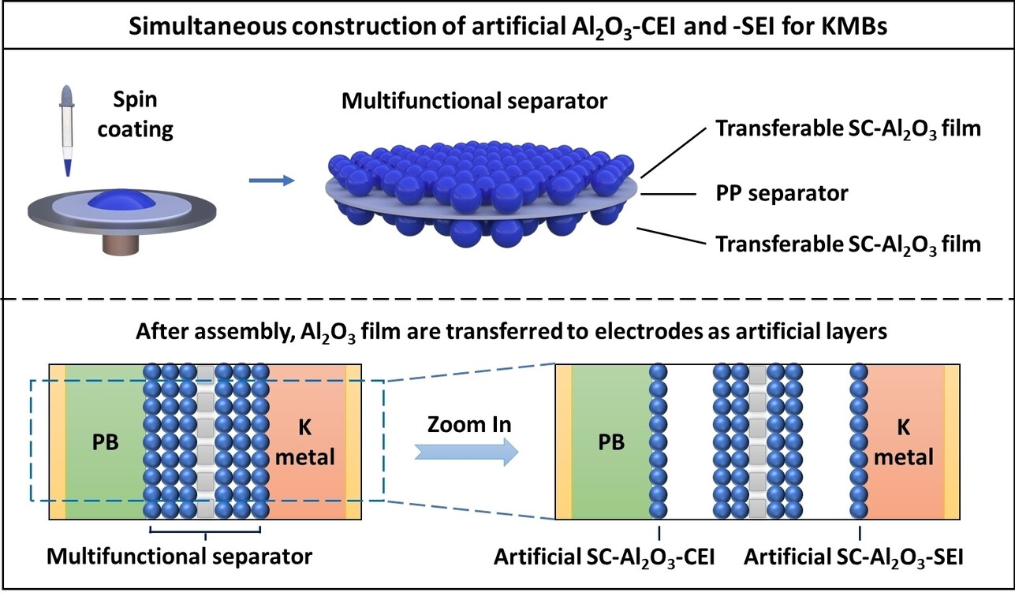
Artificial and Stabilized Interfaces in Potassium Metal Batteries
Scientific Achievement
The creation of an artificial SEI/CEI using a spin coating of alumina (Al₂O₃) nanopowder, substantially enhancing the electrochemical kinetics of potassium metal batteries (KMBs).
Significance and Impact
Demonstrated state-of-the-art electrochemical properties and general approach for stabilizing electrochemical interphases in K metal batteries.
Research Details
Al₂O₃ is stabilizes sodium metal batteries but is difficult to coat onto low melting-point K anodes.
We address this challenge by room-temperature spin coating 10 μm films of Al₂O₃ nanopowder onto both sides of a commercial polypropylene separator.
Spin-coated Al₂O₃ prevents dendrite filament growth (half-cells) and cycling-induced cracking (full-cells).
A thin film (10 μm) of alumina (Al₂O₃) nanopowder is spin-coated on both sides of commercial polypropene separators, then transferred onto both anode and cathode surfaces during cell assembly.This creates both artificial solid-electrolyte interphase (SEI) and cathode electrolyte interface (CEI) that enhance electrochemical kinetics of potassium metal batteries (KMBs).
Liu, P.; Hao, H.; Singla, A.; Vishnugopi, B. S.; Watt, J.; Mukherjee, P. P.; Mitlin, D., Alumina - Stabilized SEI and CEI in Potassium Metal Batteries. Angewandte Chemie, International Edition. 2024, e202402214.
This work was performed, in part, at the Center for Integrated Nanotechnologies.
Notes:
Potassium metal batteries (KMBs, PMBs) and potassium ion batteries (KIBs, PIBs) are attracting the increasing scientific attention. The targeted application for potassium-based electrochemical energy storage are various stationary electrical energy storage systems (ESSs), where there may be cost and supply advantage over lithium-ion batteries (LIBs). The mineral precursors employed for KMBs and KIBs are more abundant than those employed for LIBs, while not directly competing with automotive applications. However, due to potassium metal‘s high reactivity with organic electrolytes, the anodes display an unstable solid electrolyte interphase (SEI) and the associated growth of dendrites. Furthermore, in the full-cell KMBs, the transition-metal elements in cathodes are known destabilize the SEI. Therefore, the stability of the cathode-electrolyte interface (CEI) is also a key consideration for electrochemical stability of KMBs.
Aluminum oxide (Al₂O₃) is known to stabilize the SEI of lithium and sodium metal batteries. However, it is not feasible to employ standard physical vapor deposition (PVD) and chemical vapor deposition routes (CVD) routes to coat it onto low melting-point K anodes. This study addresses this challenge by room-temperature spin coating 10 μm films of Al₂O₃ nanopowder onto both sides of a commercial polypropylene separator. The alumina then becomes incorporated into the electrode surfaces during cell assembly, creating an artificial SEI/CEI that substantially enhances the stability of K metal half-cells and that of potassium metal batteries (KMBs) using Prussian Blue (PB) cathodes. State-of-the-art electrochemical properties are demonstrated.
Researchers: Pengcheng Liu, Honchang Hao, David Mitlin (University of Texas at Austin) Aditya Singla, Bairav S. Vishnugopi, Partha P. Mukherjee (Purdue University) John Watt (LANL)
Acknowledgement from paper: This research was supported by U.S. Department of Energy, Office of Science, Basic Energy Sciences under Award# DE-SC0023260. This work was performed, in part, at the Center for Integrated Nanotechnologies, an Office of Science User Facility operated for the U.S. Department of Energy (DOE) Office of Science. Los Alamos National Laboratory, an affirmative action equal opportunity employer, is managed by Triad National Security, LLC for the U.S. Department of Energy's NNSA, under contract 89233218CNA000001.
Full highlight: https://onlinelibrary.wiley.com/doi/full/10.1002/anie.202402214

