Slide 1
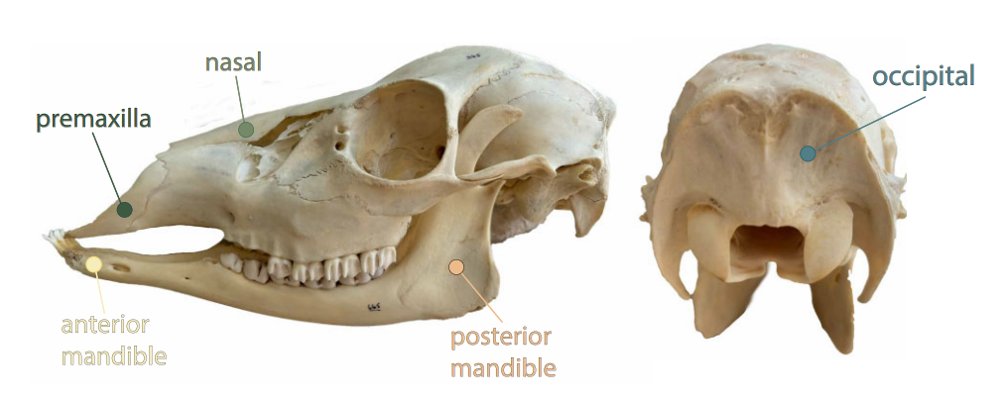
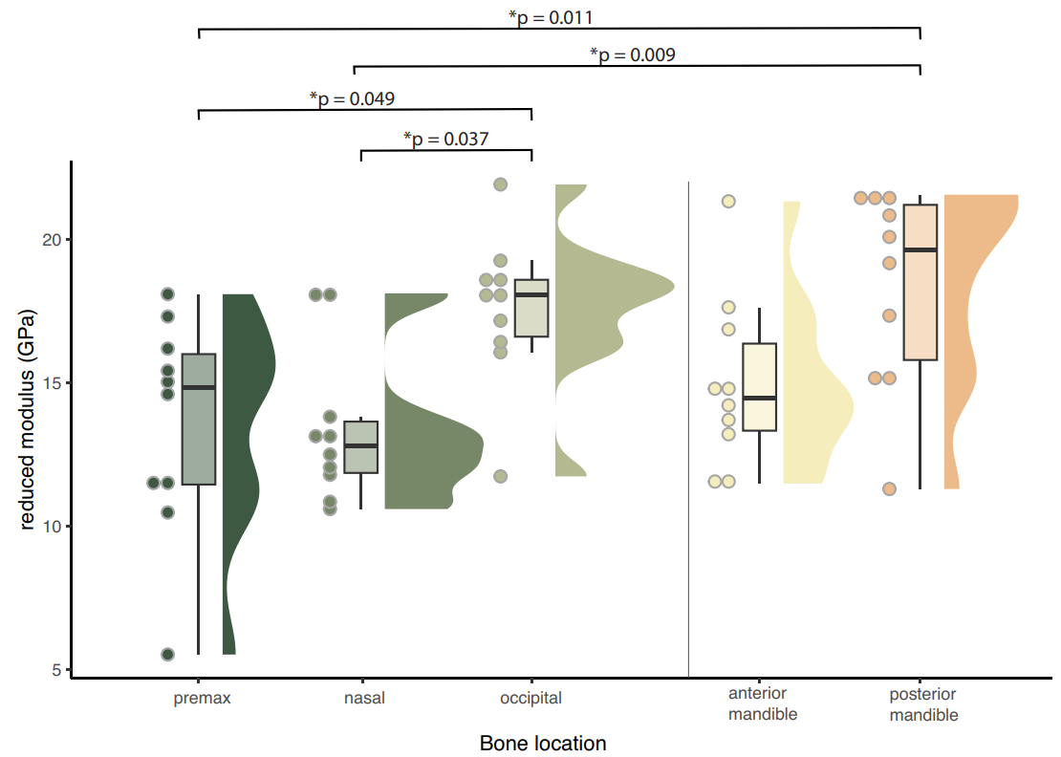
Nanostiffness Heterogeneities in Artiodactyl Skulls
Scientific Achievement
Posterior regions of Artiodactyl mammals’ skulls are stiffer than anterior regions. Artiodactyl mammals that participate in head-to-head combat (bighorn sheep, goats, etc.) have a stiffer posterior mandible than those that don’t.
Significance and Impact
Differentiation in skull properties over time suggests that combat-oriented Artiodactyl mammals adapted their effective bone properties to improve impact performance. The paper elucidates many of the challenges of valid nanoindentation methodology, a topic familiar in the nanomechanics community but less familiar in the comparative and evolutionary biology community.
Figure caption
Research Details
Use of nanoindentation minimizes disruption of museum specimens.
Phenogram analysis of museum artiodactyl skulls spanned the past 60 million years.
Spatial variation in the reduced modulus distribution in five locations across a range of artiodactyl skulls
Adams, D. S.; Boyce, B. L.; Hooks, D. E.; Garber, K. W.; Klitsner, B.; Price, S. A.; Blob, R. “A Brief Introductory Guide to Nanoindentation for Comparative and Evolutionary Biologists, with a Case Study of Bone Material Property Diversity across Artiodactyl Skulls.” Integrative Organismal Biology, Volume 7, Issue 1, 2025
Work was performed, in part, at the Center for Integrated Nanotechnologies.
Notes:
HL Type (place “X” where appropriate): User___, Staff__, User & Staff_X__
1-2 paragraph description of highlight
Quantifying the material properties of hard biological materials can improve understanding of the relationships between form, function, and performance. This study illustrates the use of nanoindentation as a tool for evaluating material properties in a comparative biology framework. The CINT users provide a step-by-step guide for comparative and evolutionary biologists illustrating the collection and analysis of nanoindentation data from samples of artiodactyl skull bones. They assess the impact of methodological decisions on the output of nanoindentation tests. They also investigate whether evolutionary variations in skull bone properties are present between artiodactyl species that engage in intraspecific head-to-head combat and those that do not. Elastic modulus exhibited little variation among numbers of indents performed per test and per bone sample. The average elastic modulus was significantly lower when bones were hydrated with deionized water. The skulls of artiodactyls exhibited a gradient of elastic modulus values in which the anterior of the skull is less stiff than more posterior locations. Species involved in head-to-head combat showed little difference in elastic modulus values compared to non-combat species. This suggests that ecological factors influence the evolutionary diversity of bone material properties, rather than strictly phylogenetic constraints. In a phylogenetic context, nanoindentation reveals tetrapod bone heterogeneity and provides insights into the evolution of these traits.
Collaborating Institutions
Sandia, Los Alamos, Clemson University
Funding Overview Section (place “X” for all relevant sources)
BES Funding: MSED___, CSGB___, EFRC___, SUFD___
SC Funding: ASCR___, BES__X_, BER___, FES___, HEP___, NP___, WDTS___, SBIR___, etc.
Other Funding: DOD___, DOE___, NIH___, NSF___, American Society of Mammologists
Funding details for all sources:
The Clemson authors acknowledge support from the Bob and Betsey Campbell Natural History Museum for obtaining the specimens and funding support from American Society of Mammologists Grant-in-Aid, the Grant ID is G20230315-5454
Publication/ press releases/ related links:
https://academic.oup.com/iob/article/7/1/obaf010/8090181

