Slide 1
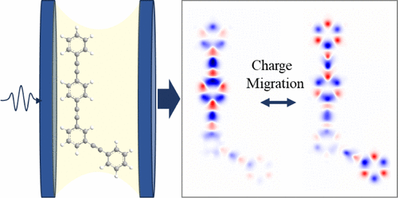



Cavity Manipulation of Attosecond Charge Migration
Scientific Achievement
Our theoretical modeling demonstrates that attosecond charge migration in molecular systems can be attained with strong-light matter interactions in apolatitonic cavity. Coherent X-ray sources can sensitively monitor the emerging dynamics.
Significance and Impact
Controlling photophysical and photochemical processes in molecules can be achieved in polaritonic cavity. This process can be probed at the national X-ray facilities.
Research Details
  Developed computational framework for simulating attosecond charge migration in molecules
  Validated by applying to two molecular systems and linked to potential experiments
The picture illustrates attosecond charge migration in molecules that can be controlled by strong light-matter interactions in the cavity and monitored with X-ray light sources
Zhang, B.; Gu, Y.; Freixas, V. M.; Sun, S.; Tretiak, S.; Jiang, J.; Mukamel, S. Cavity Manipulation of Attosecond Charge Migration in Conjugated Dendrimers. Journal of the American Chemical Society 2024, 146 (39), 26743–26750. DOI:10.1021/jacs.4c06727.
Work was performed, in part, at the Center for Integrated Nanotechnologies.
Notes:
1-2 paragraph description of highlight –
The primary step of numerous photophysical and photochemical processes in many molecules involves ultrafast coherent electronic dynamics and charge oscillations triggered by photoexcitation. This electronic wavepacket motion at short times where the nuclei are frozen is known as attosecond charge migration. We show how charge migration in a dendrimer can be manipulated by placing it in an optical cavity and monitored by time-resolved X-ray diffraction. Our simulations demonstrate that the dendrimer charge migration modes and the character of photoexcited wave function can be significantly influenced by the strong light-matter interaction in the cavity. Representative applications to two dendrimer molecules with two and three branch geometries emphasize generality of the phenomenon. Simulating time-resolved X-ray diffraction signals to monitor the modulated ultrafast charge dynamics in momentum space provide direct link to potential attosecond experiments. This presents a new avenue for modulating initial ultrafast charge dynamics and subsequently controlling coherent energy transfer in dendritic nanostructures.
Acknowledgements –
This work was primarily supported by the U.S. Department of Energy, Office of Science, Office of Basic Energy Sciences, grant. FG02-04ER15571. Y.G., V.M.F. and S.S. gratefully acknowledge the support of NSF grant CHE-2246379. The work at Los Alamos National Laboratory was performed in part at the Center for Integrated Nanotechnologies (CINT), a U.S. Department of Energy, Office of Science User Facility. J.J. and B.Z. gratefully acknowledge the support of the National Natural Science Foundation of China (22025304, 22033007).
Publication/ press releases/ related links:
https://pubs.acs.org/doi/10.1021/jacs.4c06727?ref=pdf

