Slide 1
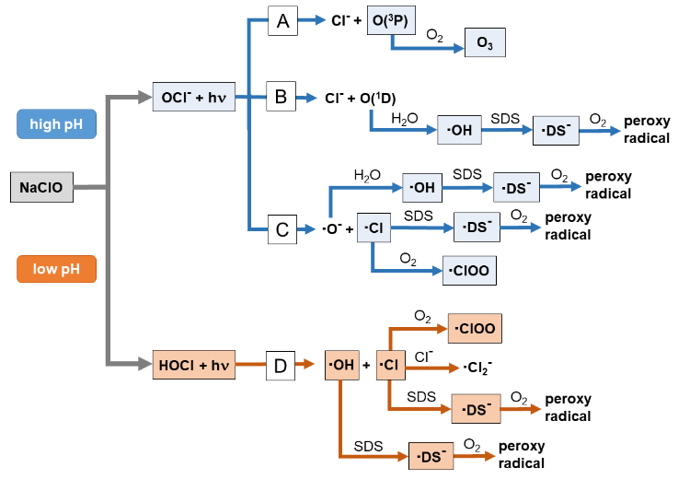
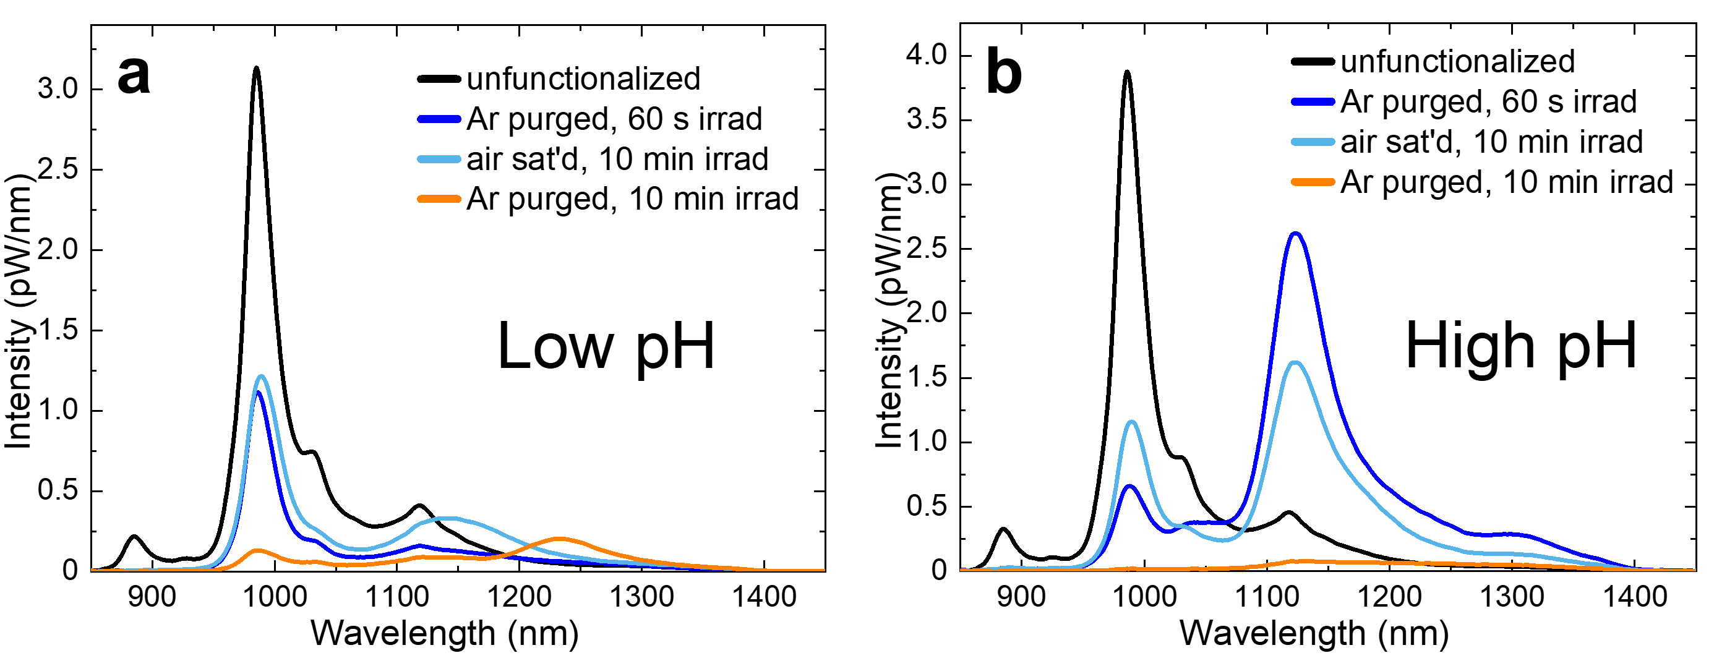
Complexity in the Photofunctionalization of Single-Wall Carbon Nanotubes with Hypochlorite
Scientific Achievement
Exploration of the photofunctionalization of SWCNTs by NaClO at varying pH and dissolved oxygen levels reveals that the process is much more complex than previously realized.
Significance and Impact
Prior reports claimed that nanotube photofunctionalization with NaClO gave oxygen doping through an addition reaction with O(¹D).
This work reveals a different and more complex reaction process that depends strongly on sample conditions.
This system can lead not only to O-doped SWCNTs, but also to adducts from addition of •OH and • Cl radicals.
Fluorescence spectra of products following HOCl photofunctionalization treatment show that dissolved O₂ strongly hinders the functionalization reaction.
Proposed relevant reaction pathways for photodissociation of NaOCl under low and high pH conditions
Research Details
Sodium hypochlorite was photolyzed by UV light in the presence of coated SWCNTs under both low and high pH conditions (giving initially HOCl and OCl⁻) air-saturated and argon-saturated conditions.
Resulting covalently functionalized SWCNTs were characterized with NIR fluorescence, UV-Vis absorption, and X-ray photoelectron Spectroscopies
Figure caption
These spectra compare spectra of products formed under low and high pH reaction conditions. While similarities suggest similar exciton trap depths, study results show that different pH levels lead to different chemical adducts.
This work was performed in part at The Center for Integrated Nanotechnologies.
Espinoza, V. B.; Bachilo, S. M.; Zheng, Y.; Htoon, H.; Weisman, R. B. Complexity in the Photofunctionalization of Single-Wall Carbon Nanotubes with Hypochlorite. ACS Nano 2025, 19 (2), 2497–2506.
Notes:
1-2 paragraph description of highlight
The reaction of aqueous suspensions of single-wall carbon nanotubes (SWCNTs) with UV-excited sodium hypochlorite has previously been reported to be an efficient route for doping nanotubes with oxygen atoms. We have investigated how this reaction system is affected by pH level, dissolved O₂ content, and radical scavengers and traps. Products were characterized with near-IR fluorescence, Raman, and XPS spectroscopy. The reaction is greatly accelerated by removal of dissolved O₂ and strongly suppressed by TEMPO, a radical trap. Alcohols added as radical scavengers alter the reaction efficiency and the product peak emission wavelengths. Photofunctionalization with 300 nm irradiation is substantially less efficient at pH levels low enough to protonate the OCl⁻ ion to HOCl. We deduce that in mildly treated high pH samples, the main product is sp² hybridized O-doped adducts formed by reaction of SWCNTs with atomic oxygen in its ³P (ground) level. By contrast, treatment under low pH conditions leads to sp³ hybridized SWCNT adducts formed by the addition of secondary radicals from reactions of •OH and •Cl. There is also evidence for additional photoreactions of product species under stronger irradiation. Researchers using photoexcited hypochlorite for SWCNT functionalization should be alert to the range of products and the sensitivity to reaction conditions in this system.
Acknowledgements
This research was supported by grant CHE-2203309 from the National Science Foundation. We thank Bo Chen of the Rice Shared Equipment Authority for expert guidance in XPS interpretation. This work was conducted in part at the Center for Integrated Nanotechnologies, an Office of Science User Facility operated for the U.S. Department of Energy (DOE) Office of Science. Los Alamos National Laboratory (LANL), an affirmative action equal opportunity employer, is managed by Triad National Security, LLC for the U.S. Department of Energy’s NNSA, under contract 89233218CNA000001. Y.Z. was supported by Los Alamos National Laboratory Directed Research and Development fund 20200104DR. H.H. acknowledges support by Quantum Science Center, a National Quantum Information Science Research Center.
Publication/ press releases/ related links:
Espinoza, V. B.; Bachilo, S. M.; Zheng, Y.; Htoon, H.; Weisman, R. B. Complexity in the Photofunctionalization of Single-Wall Carbon Nanotubes with Hypochlorite. ACS Nano 2025, 19 (2), 2497–2506. DOI:10.1021/acsnano.4c13605.

Slide 2
How to Build a DOE Office of Science Highlight Slide
Purpose
Convey current scientific and technical research results in a way that is intriguing, succinct, relevant, and easily understood by both technical and non-technical communities.
Use
Information can be employed and adapted for multiple uses, including meetings with other federal agencies, review committees, scientific panels, and budget meetings.
Highlight text can also be a critical component of annual budget request documents that are reviewed by DOE senior leadership and Congress.
Needs
It is exceptionally important to convey the importance or significance the research has on the particular research field.
A standard format for scientific highlights helps the Office of Science to efficiently and effectively communicate research results to the public.

Slide 3
How to Build a DOE Office of Science Highlight Slide
Submission
Highlights should be submitted regularly to your Point of Contact (POC). In general, highlights should focus on a published, or soon to be published, paper. Information on publication timing, should be shared (in writing). Highlights involving sensitive information that would compromise patents, for example, should be shared in emails, not as a highlight slide.
Send your POC a copy the published paper (if available) or preprint if not yet published with the highlight.
If your institution has a press release (or planned press release), please forward to your POC.
All graphics should be clear and large enough to be easily viewed. Keep resolution of the embedded graphic in mind.
Well crafted highlight slides may be presented by many different people with many different science backgrounds!

Slide 4
How to Build a DOE Office of Science Highlight Slide
Title
Attention grabbing and accessible but not exaggerated
Text
All text should be short and to the point – minimize words and stress significance to society. Please do not adjust font sizes.
Scientific Achievement – 22 pt text
Significance and Impact – 22 pt text
Importance, relevance, or intriguing component of the finding to the field
Research Details – Address the research approach in 2-4 bullet points – 20 pt text
Citation - Full citation with DOI is preferable
PowerPoint Notes
Give a 1-2 paragraph detailed explanation with acknowledgements and optional related links
Sponsor delineation of work should be made clear here, and reflect acknowledgements/credit lines

Slide 5
How to Build a DOE Office of Science Highlight Slide
Figures
Visually compelling figure(s) to explain the research
Include legends and descriptive caption
DOE has the right to use published journal images per contractual funding agreements
Institutional logo(s)
Include affiliations or institutional logos
Indicate institution where research was performed (if possible)

Slide 6
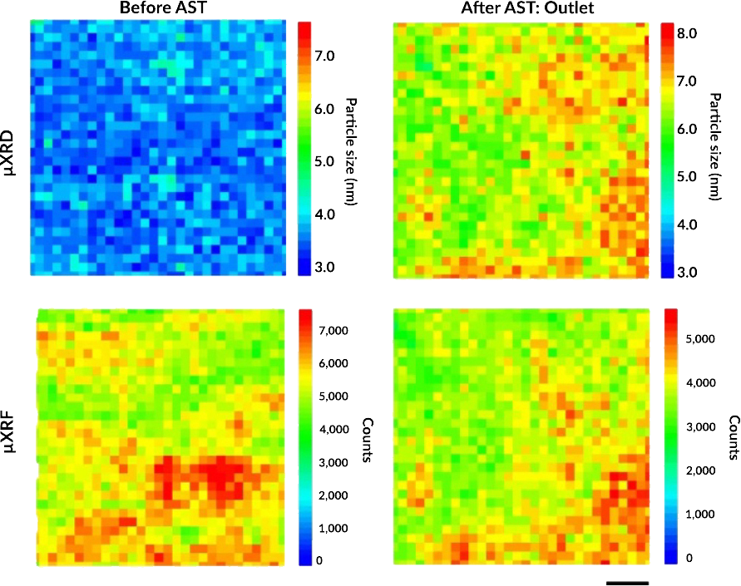
Tracking Platinum Movement on Fuel-Cell Electrodes
Scientific Achievement
The movement of platinum (Pt) nanoparticles that catalyze reactions in polymer electrolyte fuel cells (PEFCs) were tracked and correlated with nanoparticle degradation.
Significance and Impact
Yielded solutions that could mitigate loss of catalytic activity and reduce Pt waste in emission-free heavy-duty fuel-cell vehicles.
Research Details
Catalyst-coated membranes (CCMs) designed for potential use in heavy-duty vehicles were subjected to accelerated stress tests (ASTs).
X-ray microdiffraction (µXRD) and microfluorescence (µXRF) at the Advanced Light Source revealed a linear correlation between Pt nanoparticle growth (i.e., degradation) and local Pt mass loading (i.e., distribution).
CCMs were scanned before (left) and after (right) ASTs. µXRD (top) yielded Pt particle size, and µXRF (bottom) revealed Pt particle loading. Statistical analysis showed a linear correlation between particle size and loading only after the ASTs. Scale bar = 50 µm.
K. Khedekar, A. Zaffora, M. Santamaria, M. Coats, S. Pylypenko, J. Braaten, P. Atanassov, N. Tamura, L. Cheng, C. Johnston, and I.V. Zenyuk, Nat. Catal. 6, 676 (2023), doi:10.1038/s41929-023-00993-6.
Work was performed at ALS/LBNL.
Notes:
Polymer electrolyte fuel cells (PEFCs) that run on green hydrogen are a promising option for powering heavy-duty vehicles that produce zero greenhouse-gas emissions. This type of fuel cell has the potential to extend driving range without incurring additional weight penalties. However, PEFCs use platinum as a catalyst to drive a key chemical reaction. The fast degradation of this precious metal in a PEFC and the resulting high cost currently prevent the widespread commercialization of this otherwise excellent technology. In this study, researchers wanted to better understand the nanoscale mechanisms by which platinum degrades during PEFC operation. They put the relevant components through accelerated stress tests that simulated the conditions of use in heavy-duty vehicles. They then probed the changes in platinum nanoparticle size and location using x-ray microdiffraction and microfluorescence at the ALS. The results point the way to improvements in PEFC fabrication that can significantly extend the lifetime and efficiency of PEFCs in heavy-duty vehicles, reduce their cost, improve air quality, and fight climate change.
Researchers: K. Khedekar, P. Atanassov, and I.V. Zenyuk (University of California, Irvine); A. Zaffora (UC Irvine and University of Palermo, Italy); M. Santamaria (University of Palermo, Italy); M. Coats and S. Pylypenko (Colorado School of Mines); J. Braaten, L. Cheng, and C. Johnston (Bosch Research and Technology Center North America); and N. Tamura (ALS).
Acknowledgement from paper: Bosch Research and Technology Center North America. Operation of the ALS is supported by the US Department of Energy, Office of Science, Basic Energy Sciences program.
Full highlight: https://als.lbl.gov/tracking-platinum-movement-on-fuel-cell-electrodes/

