Slide 1
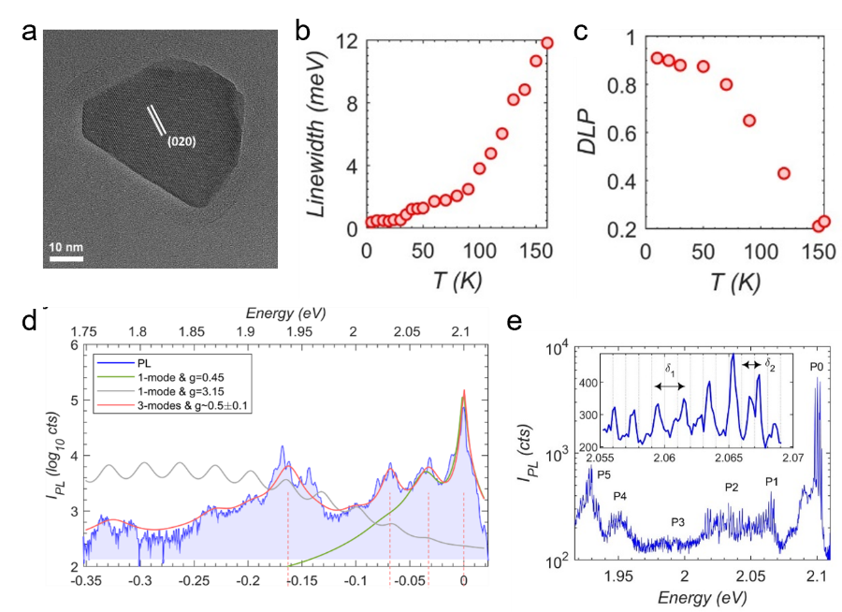
Correlated Excitons in a Nanoscale 2D-Antiferromagnet
Scientific Achievement
Individual nano-flakes of NiPS3 2D-antiferromagnet displays signatures of correlated excitons arising from entangled charge, spin, orbital, and lattice degrees of freedom.
Significance and Impact
Lateral size can be utilized to control the emission characteristics towards integrated magneto-optic devices.
Research Details
Crystalline nano-flakes of NiPS3 are chemically synthesized using metathesis reaction and the photoluminescence showed spin-correlated excitons reflecting Néel transition.
Cryogenic study revealed ultra-sharp spectral peaks indicative of highly coherent emission, multiple phonon replicas from strong exciton phonon coupling, and a comb-like spectra from discretized charge fluctuations in 2D-antiferromagnet layers.
(a) TEM image of NiPS3 nano-flake. (b-c) Trend of linewidth and degree of linear polarization with temperature reflects the Néel transition behavior. (d) Multiple phonon replica. (e) Comb-like spectra.
Chandrasekaran, V.; DeLaney, C. R.; Trinh, C. T.; Parobek, D.; Lane, C. A.; Zhu, J.-X.; Li, X.; Zhao, H.; Campbell, M. A.; Martin, L.; Wyckoff, E. F.; Jones, A. C.; Schneider, M. M.; Watt, J.; Pettes, M. T.; Ivanov, S. A.; Piryatinski, A.; Dunlap, D. H.; Htoon, H. Correlated Excitonic Signatures of Individual van Der Waals Nips3 Antiferromagnet Nanoflakes. Nanoscale Horizons 2024.
This work was performed in part at The Center for Integrated Nanotechnologies.
Notes:
1-2 paragraph description of highlight – By the display of correlated photo-physical properties, excitons in 2D-antiferromagnetic bulk-NiPS₃ help comprehend the complex phenomena in many-body physics. Similar to nanoscale-semiconductor excitons exhibiting distinct optical properties compared to bulk-semiconductor excitons that enabled the advancement of modern photonic technologies, we aimed to discover if the nanoscale correlated 2D-antiferromagnet NiPS3 has any unique properties compared to the bulk counterpart. Therefore, we chemically synthesized NiPS3 2D-antiferromagnet nano-flakes using metathesis reaction, for the first time over two decades. We had reproduced the crystallinity of bulk-NiPS3 confirming that our bottom-up approach can synthesize composite materials with magnetic properties in the solution phase. Our magnetization experiment revealed a larger Néel temperature (170-190K) than the bulk (150K) where the magnetic susceptibility comprises antiferromagnetic contribution from the interior of the nano-flakes and the paramagnetic contribution from the uncompensated spins arising across their edges. This showed the ability of nano-flakes to have different magnetic transition temperature when compared to the bulk, while still having the same crystalline structure.
Next, we have conducted photoluminescence spectroscopy on individual nano-flakes and identified excitons with very narrow (<120 µeV) spectral peaks in the visible region (1.8-2.2 eV) contrasting to the near-infrared region in the bulk (1.45 eV). We showed that the photoluminescence of excitons is correlated with spins of NiPS3 since the trend of anisotropic polarization was matching the Néel transition behavior. The excitons had up to 10 phonon replica peaks, and our Holstein model identified a polaronic character for the exciton by coupling with at least three phonon modes. This showed that the rich manifold of phonon modes in the correlated material resulted in the observed multiple phonon replicas. Finally, the excitons displayed a ‘comb-like’ unique spectral jumps with regular steps in energies instead of a random spectral diffusion behavior that are usually associated with excitons in nanoscale semiconductors. We developed a parallel-capacitor charging model that explained the interlayer charge tunnelling dynamics in van der Waals stacked layers creating a discrete homogeneous electric field around the excitons. Here, the combination of nanoscale lateral dimension, correlated antiferromagnetic structure, and van der Waals interlayer stacking configuration contribute to these distinct excitonic signatures entangled with charge, spin, orbital, and lattice degrees of freedom. Our findings on the correlated excitons in nanoscale 2D-antiferromagnets show that these are a promising platform for integrated magneto-optic devices.
Acknowledgements – This work was performed at the Center for Integrated Nanotechnologies, an Office of Science User Facility operated for the U.S. Department of Energy (DOE) Office of Science (OS). Los Alamos National Laboratory (LANL), an affirmative action equal opportunity employer, is managed by Triad National Security, LLC for the U.S. Department of Energy’s NNSA, under contract 89233218CNA000001. C.R.D., D.P., C.A.L., J.-X.Z., M.A.C., and A.P. acknowledge support for the works from Laboratory Directed Research and Development (LDRD) program 20200104DR. S.A.I., and C.T.T. are supported by LDRD 20220757ER. H.H., V.C., X.L., and H.Z. acknowledge partial support by Quantum Science Center, a National QIS Research Center supported by DOE, OS. M.T.P. acknowledges support from LDRD awards 20210782ER and 20210640ECR. A.C.J. is supported by DOE BES QIS program LANLE3QR.
Publication/ press releases/ related links: V. Chandrasekaran, C. R. DeLaney, C. T. Trinh, D. Parobek, C. A. Lane, J. X. Zhu, X. Li, H. Zhao, M. A. Campbell, L. Martin, E. F. Wyckoff, A. C. Jones, M. M. Schneider, J. Watt, M. T. Pettes, S. A. Ivanov, A. Piryatinski, D. H. Dunlap, H. Htoon. Correlated Excitonic Signatures of Individual van der Waals NiPS3 Antiferromagnet Nanoflakes. Nanoscale Horizons. (2024). https://doi.org/10.1039/d4nh00390j

