Slide 1
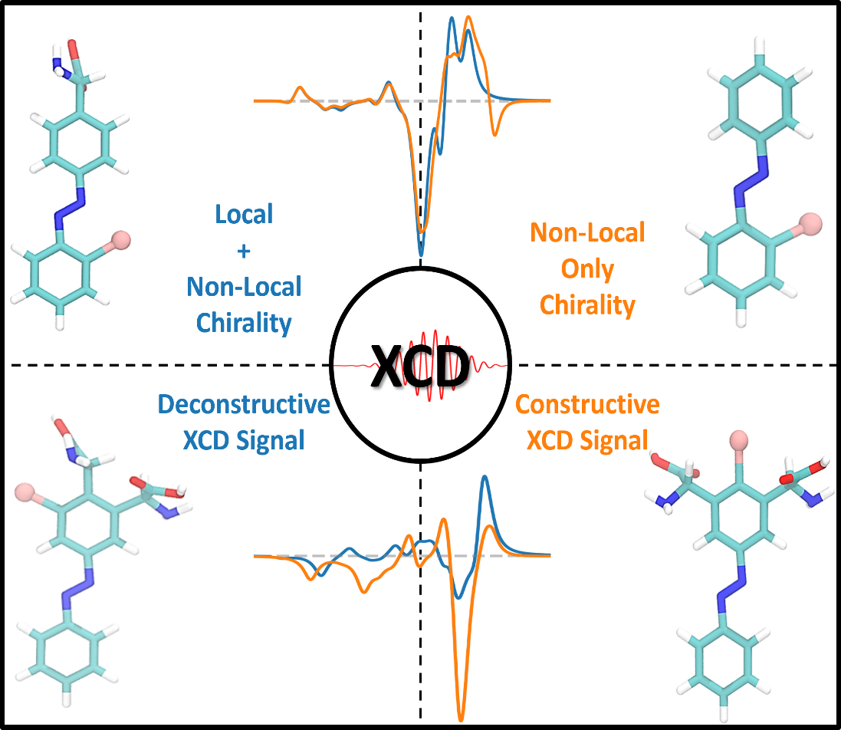






Deconstructing Chirality with Site-Specific X-Ray Probes
Scientific Achievement
Differentiation of local from non-local chirality revealed that non-local effects can dominate and interfere destructively with local signals. This insight establishes that chiroptical signals can be rationally enhanced through the constructive interference of multiple chiral centers.
Significance and Impact
This work enables the design of novel materials with tailored light-interaction properties and offers a sophisticated framework for interpreting complex CD spectra to precisely identify sources of chirality.
Research Details
Using Azobenzene, systematically compared Optical CD and X-ray CD responses using quantum chemistry simulations.
Deconstructed chiroptical signals by varying the positions of the chiral center (glycine) and the X-ray probe (bromine).
Investigated cooperative steric hindrance between substituents as a method for inducing chiroptical response
Figure: X-ray Circular Dichroism (XCD) resolves molecular chirality in azobenzene derivatives.
Khanna, A.; Freixas, V. M.; Xu, L.; Rouxel, J. R.; Govind, N.; Garavelli, M.; Mukamel, S.; Tretiak, S. Deconstructing Chirality: Probing Local and Nonlocal Effects in Azobenzene Derivatives with X-Ray Circular Dichroism. The Journal of Physical Chemistry Letters. 2025.
Work was performed, in part, at the Center for Integrated Nanotechnologies.
Notes:
1-2 paragraph description of highlight – Traditional optical methods often struggle to differentiate between the inherent twist of a specific atom (local chirality) and the overall twisting shape of the entire molecule (non-local chirality). By using a core site-specific X-rays, we successfully separated these signals for the first time. We discovered a crucial and non-intuitive insight: the global structural distortion of a molecule can be powerful enough to dominate the overall signal, sometimes even canceling out the effects of the local chiral centers.
The real impact of this work lies in moving from simply measuring chirality to actively controlling it. The study establishes clear design principles for engineering molecules where these local and global effects work together constructively to boost performance. This provides a roadmap for the rational design of functional nanotechnology, such as light-driven unidirectional molecular motors and advanced smart materials, where precise control over atomic-level structure is essential for function.
Acknowledgements
This study was supported by the U.S. Department of Energy, Office of Science, Office of Basic Energy Sciences, Division of Chemical Sciences, Geosciences, and Biosciences under FWP LANLE3T1 (A.K and S.T. at Los Alamos National Laboratory (LANL), FWP 72684 (L.X. and N.G. at the Pacific Northwest National Laboratory (PNNL), DE-SC0022225 (V.M.F., S.M. at the University of California, Irvine, and M.G. at the University of Bologna, Italy), and DE-FOA-0003176 (J.R.R at Argonne National laboratory). This work was performed in part at the Center for Integrated Nanotechnologies (CINT), a U.S. Department of Energy, Office of Science user facility at LANL. This research used resources provided by the LANL Institutional Computing Program. LANL is operated by Triad National Security, LLC, for the National Nuclear Security Administration of the U.S. Department of Energy.
Publication/ press releases/ related links: https://pubs.acs.org/doi/10.1021/acs.jpclett.5c02638
Khanna, A., Freixas, V. M., Xu, L., Rouxel, J.R., Govind, N., Garavelli, M., Mukamel, S. Tretiak Deconstructing Chirality: Probing Local and Non-local Effects in Azobenzene Derivatives with X-ray Circular Dichroism J. Phys. Chem. Lett., 16, 11542 (2025).

