Slide 1
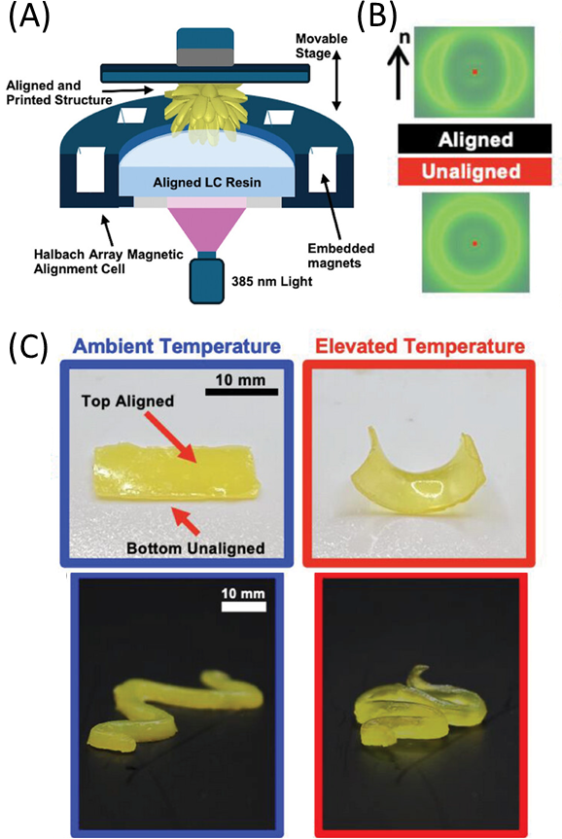
Magnetic Alignment of Vat Polymerized Liquid Crystal Elastomers
Scientific Achievement
A novel process to 3D print aligned liquid crystal elastomers (LCEs) by integrating defined magnetic fields (Halbach arrays) into a digital light processing (DLP) vat polymerization setup.
Significance and Impact
Molecular alignment in macroscale fabrication is a considerable challenge. 3D printing of aligned LCEs provides a straightforward path to fabricate stimuli-responsive materials in form factors optimized for energy absorption and soft robotics.
Research Details
Static magnetic fields integrated into a commercial 3D printer could be switched layer-to-layer to define complex alignments of LCE molecules.
Mechanical characterization, wide-angle X-ray scattering, and thermal response were used to evaluate printed actuators and soft robots.
(A) A Halbach array integrated with a bottom-up DLP printer is used to define molecular alignment (B) within 3D actuators and soft robots (C).
Work was performed, in part, at the Center for Integrated Nanotechnologies.
Herman, J. A.; Telles, R.; Caitlyn C. Cook, C. C.; Leguizamon, S. C.; Lewis,J. A.; Kaehr, B.; White, T. J.; Roach, D. J. "Digital Light Process 3D Printing of Magnetically Aligned Liquid Crystalline Elastomer Free–forms." Advanced Materials (2024)
Notes:
Liquid crystalline elastomers (LCEs) are anisotropic soft materials capable of large dimensional changes when subjected to a stimulus. The magnitude and directionality of the stimuli-induced thermomechanical response is associated with the alignment of the LCE. Recent reports detail the preparation of LCEs by additive manufacturing (AM) techniques, predominately using direct ink write printing. Another AM technique, digital light process (DLP) 3D printing, has generated significant interest as it affords LCE free-forms with high fidelity and resolution. However, one challenge of printing LCEs using vat polymerization methods such as DLP is enforcing alignment. Here, we document the preparation of aligned, main-chain LCEs via DLP 3D printing using a 100 mT magnetic field. Systematic examination isolates the contribution of magnetic field strength, alignment time, and build layer thickness on the degree of orientation in 3D printed LCEs. Informed by this fundamental understanding, DLP is used to print complex LCE free-forms with through-thickness variation in both spatial orientations. The hierarchical variation in spatial orientation within LCE free-forms is used to produce objects that exhibit mechanical instabilities upon heating. DLP printing of aligned LCEs opens new opportunities to fabricate stimuli-responsive materials in form factors optimized for functional use in soft robotics and energy absorption.
Acknowledgement from paper: J.A.H. acknowledges support from the National Science Foundation via a Graduate Research Fellowship. T.J.W. acknowledges support from the National Science Foundation and Air Force Office of Scientific Research. The authors appreciate experimental assistance and consultation with Jonathan Hoang and Joselle McCracken. The authors also acknowledge John Cochrane and Esteban Baca for their help in designing and FDM printing the Halbach array and custom printing stage. Finally, the authors acknowledge Alex Commisso for their helpful tips in DLP printing. This work was performed, in part, at the Center for Integrated Nanotechnologies, an Office of Science User Facility operated for the U.S. Department of Energy (DOE) Office of Science and by the Laboratory Directed Research and Development program at Sandia National Laboratories. Sandia National Laboratories is a multimission laboratory managed and operated by National Technology & Engineering Solutions of Sandia, LLC, a wholly-owned subsidiary of Honeywell International, Inc., for the U.S. DOE's National Nuclear Security Administration under contract DE-NA-0003525. The views expressed in the article do not necessarily represent the views of the U.S. DOE or the United States Government. The authors gratefully acknowledge support from the National Science Foundation through the Harvard MRSEC (DMR-2011754) and the ARO MURI program (W911NF-17-1-03; W911NF-22-1-0219).

