Slide 1
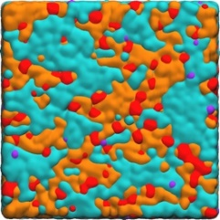
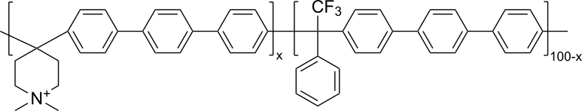
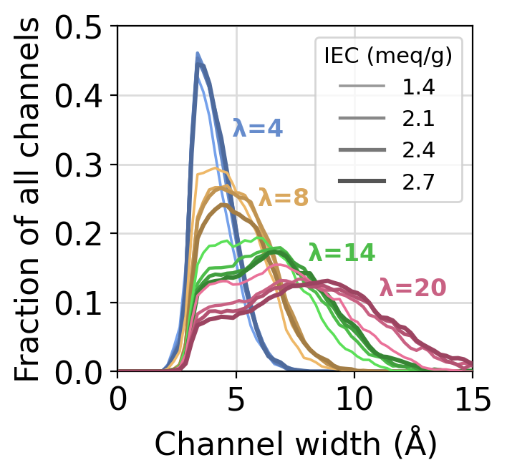
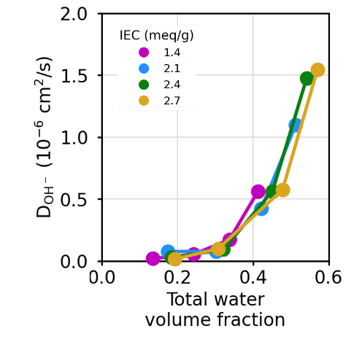



Simulations Reveal Nanoscale Morphology in Cationic Polymer
Scientific Achievement
The morphology of nanoscale water channels and the transport of ions in the polymer are found to be determined mostly by water content and are only weakly dependent on polymer ionic content.
Significance and Impact
This work demonstrates that high hydroxide ion transport can be independent of cationic content, enabling more flexibility in the design of polymers for applications such as electrolyzers.
Research Details
  Atomistic molecular dynamics simulations were performed as a function of ion content (IEC) and water content (λ)
  Simulations were in good agreement with experiment
Simulations of a piperidinium-functionalized polymer (upper left) nanophase-separate into water (blue) and polymeric channels (orange) (upper right). The size of the water channels depends on water content λ but less on the IEC (lower left). The hydroxide ion diffusion constant depends on water volume fraction (lower right).
Clary, J. M.; Wang, L.; Yan, Y.; Frischknecht, A. L.; Vigil-Fowler, D. Effect of Stoichiometry and Hydration Level on Water Domain Size and Transport in Poly(aryl piperidinium) Alkaline Anion-exchange Membranes. Journal of Membrane Science 2025
Work was performed, in part, at the Center for Integrated Nanotechnologies.
Notes:
1-2 paragraph description of highlight – Cationic polymer membranes are needed in a variety of applications, including in alkaline water electrolyzers and alkaline fuel cells. These membranes need to be mechanically robust and
have high hydroxide ion conductivities. Recent work has shown that poly(arylene piperidinium) polymers have good overall performance and are more stable in alkaline solution than previously used polymers with quaternary ammonium
cations. However, the nanoscale properties of these polymers were not well known.
To better understand the effects of the nanoscale morphology on the properties, we conducted atomistic molecular dynamics (MD) simulations of poly(arylene piperidinium) polymers over a range of water contents and ion contents.
Water content is characterized by λ, the number of water molecules per ionic group, while IEC is the weight of ionic group relative to the weight of the polymer. We found that both the morphology and the hydroxide ion transport are
much more affected by water content than by ionic content. This finding will be useful in future design of new polymers.
Acknowledgements – We acknowledge financial support from the US DOE Office of Energy Efficiency and Renewable Energy, Hydrogen and Fuel Cell Technologies Office, under the ElectroCat Consortium,
DOE technology managers McKenzie Hubert and William Gibbons, and DOE program managers David Peterson and Dimitrios Papageorgopolous. This work was authored by the National Renewable Energy Laboratory,
operated by the Alliance for Sustainable Energy, LLC, for the U.S. Department of Energy (DOE) under Contract No. DE-AC36-08GO28308. We acknowledge financial support from the US Department of Defense (W911NF-23-2-
0028). The research was performed using computational resources sponsored by the Department of Energy’s Office of Energy Efficiency and Renewable Energy and located at the National Renewable Energy Laboratory.
This work was performed, in part, at the Center for Integrated Nanotechnologies, an Office of Science User Facility operated for the U. S. Department of Energy (DOE) Office of Science. Sandia National Laboratories is a
multimission laboratory managed and operated by National Technology & Engineering Solutions of Sandia, LLC, a wholly owned subsidiary of Honeywell International, Inc., for the U.S. DOE’s National Nuclear Security Administration
under contract DE-NA0003525. The views expressed in the article do not necessarily represent the views of the U.S. DOE or the United States Government.
Publication/ press releases/ related links:
Clary, J. M.; Wang, L.; Yan, Y.; Frischknecht, A. L.; Vigil-Fowler, D. Journal of Membrane Science 2025, 717, 123517.
https://doi.org/10.1016/j.memsci.2024.123517

