Slide 1
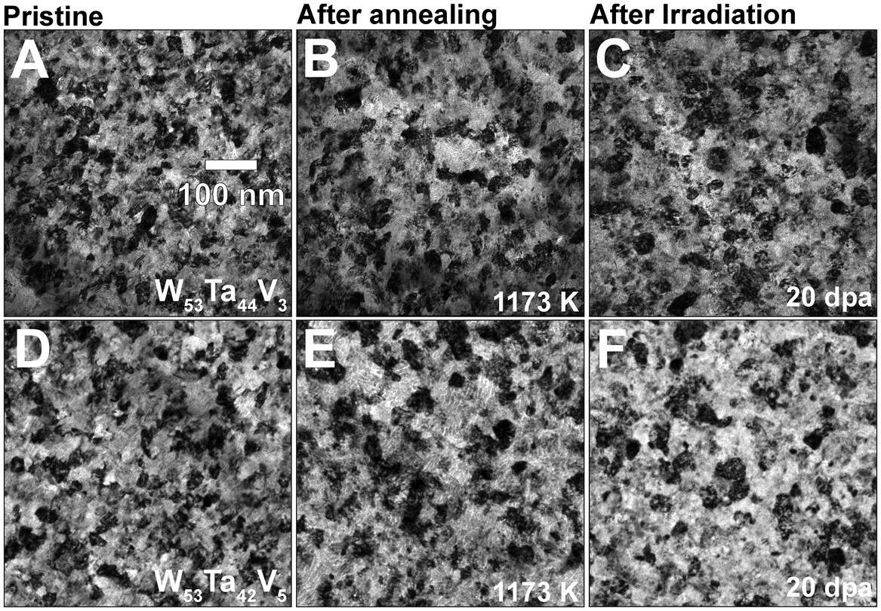
Engineering Radiation Resistant Nanomaterials in Nuclear Fusion Technologies
Scientific Achievement
Demonstration via irradiation-testing and characterization experiments that new HCRAs can be developed, and their radiation response can be tailored as a function of minor modifications in the alloys' chemistry.
Significance and Impact
The experiments conducted in this study provide preliminary evidence that the HCRA alloys investigated could be viable candidates for further evaluation in materials test reactors (MTRs).
Research Details
Two new nanocrystalline HCRAs were synthesized and investigated in this work: W53Ta42V5 and W53Ta44V3.
Atomistic simulations of short-range order in these bcc HCRAs unraveled the significant role of V alloying effects on radiation-induced micro-structural stability and defect formation properties in W–Ta–V via a systematic investigation of dependence in CSRO for the Ta-V in 1NN and those for the W-V in 2NN as a function of V concentration and temperature.
Response to annealing and irradiation | BFTEM micrographs taken at pristine condition, after annealing (at 1173 K) and after irradiation (at 1073 K) are shown in (A–C)and (D–F), respectively for the W53Ta44V3 and the W53Ta42V5 HCRAs.
Tunes, M. A.; Parkison, D.; Sun, B.; Willenshofer, P.; Samberger, S.; Frühwirth, C.; Tripathi, S.; Derby, B. K.; Baldwin, J. K.; Fensin, S. J.; Sobieraj, D.; Wróbel, J. S.; Byggmästar, J.; Pogatscher, S.; Martinez, E.; Nguyen‐Manh, D.; El‐Atwani, O. High Radiation Resistance in the Binary w‐TA System through Small V Additions: A New Paradigm for Nuclear Fusion Materials. Advanced Science 2025. DOI:10.1002/advs.202417659.
Work was performed, in part, at the Center for Integrated Nanotechnologies.
Notes:
1-2 paragraph description of highlight –
Since the 1970s, materials selection for application in future thermonuclear fusion reactors has posed a significant challenge for materials science and metallurgy.^{[1-6]} The deuterium-tritium fusion reaction exposes fusion reactors and their structural materials to exceptionally harsh environmental conditions. To date, considering the design and selection of materials for experimental fusion reactors, the following key factors must be addressed, not exhaustively:^{[1-6]}
Impact of highly-energetic fusion neutrons (≈14.1 MeV) resulting in radiation damage;
Implantation of helium (He) and hydrogen (H) ions at moderate-to-low energies, resulting in synergistic radiation damage, inert gas bubbles nucleation, and growth and materials embrittlement; and
The presence of a plasma with high-power density, resulting in high-temperature exposure and thermal gradients.
Acknowledgements –
Funding from the U.S. Department of Energy, Advanced Research Projects Agency-Energy under contract DE-AR0001541 is gratefully acknowledged. Research presented in this article was supported by the Laboratory Directed Research and Development (LDRD) program of Los Alamos National Laboratory primarily under project number 20200689PRD2 (M.A.T.). This work was performed, in part, at the Center for Integrated Nanotechnologies, an Office of Science User Facility operated for the U.S. Department of Energy (DOE) Office of Science. Los Alamos National Laboratory, an affirmative action equal opportunity employer, is managed by Triad National Security, LLC for the U.S. Department of Energy NNSA, under contract 89233218CNA000001. O.E.A. and E.M. acknowledge support from the Department of Energy - Fusion Energy Science pilot program under contract number AT2030110. D.N.M., J.S.W., and D.S. work had been carried out within the framework of the EUROfusion Consortium, funded by the European Union via the Euratom Research and Training Programme (Grant Agreement No. 101052200 EUROfusion). The work at UKAEA was partially supported by the Broader Approach Phase II agreement under the PA of IFERC2-T2PA02. Views and opinions expressed were however those of the author(s) only and do not necessarily reflect those of the European Union or the European Commission. Neither the European Union nor the European Commission can be held responsible for them. D.N.M. also acknowledged funding by the EPSRC Energy Programme [grant number EP/W006839/1]. The work at WUT was supported by the National Science Centre, Poland, under research project no UMO-2019/35/D/ST5/03526‥ D.N.M. and J.S.W. would like to thank the support from high-performing computing facility MARCONI (Bologna, Italy) provided by EUROfusion. J.B. acknowledged funding from the Research council of Finland, grant number 354234, and access to the LUMI supercomputer, owned by the EuroHPC Joint Undertaking, hosted by CSC (Finland) and the LUMI consortium. All the authors are grateful for funding provided by the Austrian Research Promotion Agency (FFG) in the project 3DnanoAnalytics (FFG-No 858040).
Publication/ press releases/ related links:

