Slide 1
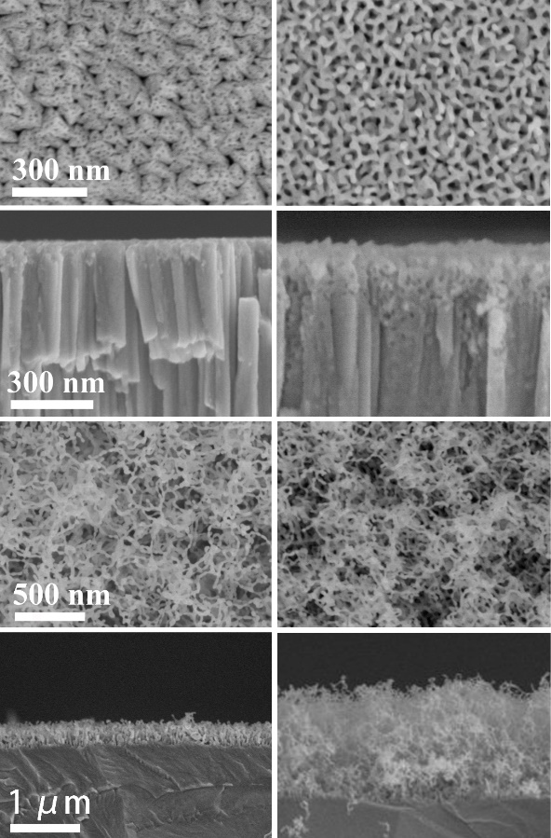
Enhanced resistance to helium irradiations through unusual interaction between nanochannel high-entropy-alloy and He
(a1)
a
(a2)
(c)
Scientific Achievement
Discovery of new plasma facing materials — high entropy alloy (HEA) which has enhanced radiation resistance with a new mechanism of unusual interaction between HEA and He. In contrast to traditional metal, the bubble growth in HEA leads to non-directional emission of interstitial atoms and greatly suppresses the growth of He bubbles.
N-HEA
(a1)
(a2)
Significance and Impact
Finding high performance plasma-facing materials is one of the most challenging obstacles confronting commercial application of fusion reactors. The nanochannel HEA (N-HEA) film presents the best reported performance under the low-energy high-flux He plasma exposure, which not only has one order higher initial fluence for the formation of fuzz than that of W, but also a remarkable 8.9 times longer serving lifetime.
(b1)
a
(b2)
(d)
c
W
(b1)
(b2)
Research Details
CrMoTaWV nanochannel HEA film was deposited on polished W substrates at 873 K by ultrahigh vacuum DC magnetron sputtering.
Samples were exposed to the high-flux He plasma (50 eV) at ion flux of 1 × 10²² ions/m²s and temperature of ~1300 K.
(a) Surface and cross-sectional SEM of the nanochannel HEA (a) and W (b) irradiated by He plasma to fluences of 1 × 10²⁴ (a1,b1) and 1 × 10²⁶ (a2, b2) ions/m². (c) Fuzz thickness of the nanochannel HEA , W and the results in references. (d) He bubble growth process in the HEA and W close to the surfaces.
Cheng, T.; Wei, G.; Jiang, S.; Zhang, J.; Wang, Y.; Liu, P.; Hong, M.; Guo, E.; Zhong, F.; Cai, G.; Jiang, C.; Ren, F. “Enhanced resistance to helium irradiations through unusual interaction between high-entropy-alloy and helium.” Acta Materialia, 248, 118765 (2023).
This work was performed in part at The Center for Integrated Nanotechnologies.
Notes:
HL Type (place “X” where appropriate): User___, Staff_X_, User & Staff___
1-2 paragraph description of highlight
Nuclear energy, as clean, reliable, sustainable and affordable energy, is considered to be one of the most effective ways to solve the energy crisis and is crucial to worldwide economic prosperity and stability. Developing advanced nuclear material is the most important key point for the next generation of nuclear systems. Because helium (He) hardly dissolves in solids, He bubbles formed by the aggregation of transmuted or incident He atoms is one of the most serious and typical issues for nuclear materials, which greatly affects their microstructure and mechanical properties (e.g. swelling, hardening and embrittlement behaviors). Controlling the behavior of He atoms and their aggregates in materials is a key task for developing advanced nuclear materials. For example, developing high-performance plasma-facing materials (PFMs) is the most urgent challengeable task in the field of material for the realization of commercial fusion reactors because PFM suffers from harsh environments, including irradiation by high fluxes of hydrogen isotopes (D and T) and He plasma (∼1022 m−2s−1).
In this work, combining the advantages of both the nanochannel structure and high entropy alloys, a new nanochannel CrMoTaWV HEA is designed, prepared and tested under the irradiation of high-flux He plasma at high temperature. The results show that the nanochannel HEA film has 20 times higher initial fluence for the formation of fuzz and a remarkable 8.9 times slower fuzz growth rate than those of W during He plasma irradiation. A new mechanism for the greatly enhanced resistance of HEA compared to traditional metal to He irradiations through the unusual interaction between the HEA and He is proposed by the in-situ TEM observation and molecular dynamics simulations of the growth of He bubble, where the bubble growth leads to non-directional emission of interstitial atoms while HEA greatly suppress the growth of He bubbles. The presented results show that the refractory metal HEA is a kind of promising PFM and nuclear structural materials with high performance and enhanced serving lifetime.
Funding Overview Section (place “X” for all relevant sources)
BES Funding: MSED___, CSGB___, EFRC___, SUFD__X_
SC Funding: ASCR___, BES__X_, BER___, FES___, HEP___, NP___, WDTS___, SBIR___, etc.
Other Funding: DOD___, DOE___, NIH___, NSF___, etc.
Funding details for all sources:
This work was supported by the National Natural Science Foundation of China (grants 12275197, 12105206, and 11935011), the Natural Science Foundation of Hubei Province, China (grants 2020CFA041), the SPC-Lab Research Fund (WDZC202001) and the Fundamental Research Funds for the Central Universities (2042022kf1184) for financial support. This work was performed, in part, at the Center for Integrated Nanotechnologies, an Office of Science User Facility operated for the U. S. Department of Energy (DOE) Office of Science. Los Alamos National Laboratory, an affirmative action equal opportunity employer, is managed by Triad National Security, LLC for the U.S. Department of Energy’s NNSA, under contract 89233218CNA000001. The numerical calculations in this paper have been done on the supercomputing system in the Supercomputing Center of Wuhan University.
Collaborating Institutions:
Wuhan University, Xiamen University, and Shandong University, China; LANL. The lead institution is Wuhan University
Publication/ press releases/ related links:
Cheng, T.; Wei, G.; Jiang, S.; Zhang, J.; Wang, Y.; Liu, P.; Hong, M.; Guo, E.; Zhong, F.; Cai, G.; Jiang, C.; Ren, F. Acta Materialia 2023, 248, 118765.

