Slide 1
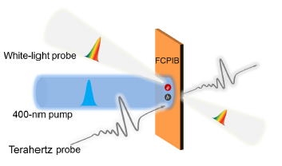
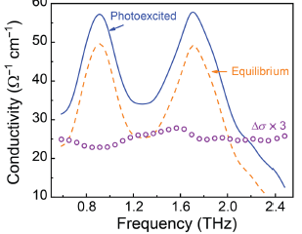
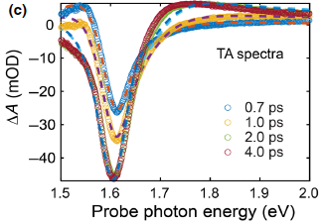
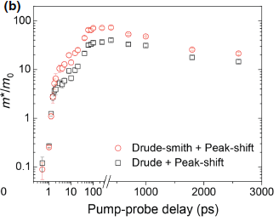
Evidence of Polaron Formation in Halide Perovskites via Carrier Effective Mass Measurements
a
b
Scientific Achievement
The first-of-its-kind demonstration combining time-resolved terahertz spectroscopy and transient absorption spectroscopy to extract the ultrafast change in the carrier effective mass after photoexcitation in halide perovskites. We observed a large and long-lived photoinduced enhancement of the carrier effective mass.
c
Significance and Impact
Our work demonstrated a new approach to track the strength and ultrafast lifetimes of photoinduced carrier-phonon interactions down to picosecond timescales, that enables us to design and fabricate perovskite-based photovoltaic devices to extract the carriers at the optimal time after photoexcitation, thus harnessing the energy of the hot carriers more efficiently.
c
d
Research Details
We performed time-resolved terahertz spectroscopy to measure the complex optical conductivity and investigate the photoinduced carriers in the mixed-halide perovskite FA_{0.85}Cs_{0.15}Pb(I_{0.97}Br_{0.03})₃ (FCPIB).
We measured the steady-state and transient absorption spectra to extract Fermi energy and band gap of FCPIB.
Effective carrier mass was then analyzed within the Drude based models.
(a) Schematic of the transient absorption and frequency-resolved
time-resolved terahertz spectroscopy measurements. (b) Real part of photoconductivity. (c) Transient absorption spectra. (d) Calculated effective carrier mass using the Drue based models.
This work was performed in part at The Center for Integrated Nanotechnologies.
Bao, D.; Chang, Q.; Chen, B.; Chen, X.; Sun, H.; Lam, Y. M.; Zhao, D.; Zhu, J.-X.; Chia, E. E. M. PRX Energy 2, 013001 (2023)
Notes:
1-2 paragraph description of highlight –
When a carrier (either an electron or hole) is placed inside a solid, due to its interaction with its surroundings, its “effective” mass $m^{∗}$ is different from its mass in vacuum. The value of $m^{∗}$ is a measure of the strength of the interaction between the carrier and excitations arising from its surrounding medium, and features prominently in transport and optical properties. Experimental techniques employed to determine this important quantity are steady-state ones, and so are unable to detect any change in $m^{∗}$ after a strong dynamical perturbation to the system, e.g. strong optical excitation.
By combining time-resolved terahertz spectroscopy and transient absorption spectroscopy, on a mixed-cation mixed-halide perovskite thin film, we observed a large and long-lived photoinduced enhancement of $m^{∗}$, and obtained a two-fold increase of the carrier-phonon coupling constant. This is evidence of the formation of polarons, which is a “quasiparticle” consisting of a carrier and the distortion it produces in the nearby lattice.
Our work demonstrated a new approach to track the strength and ultrafast lifetimes of photoinduced carrier-phonon interactions down to picosecond timescales, that enables us to design and fabricate perovskite-based photovoltaic devices to extract the carriers at the optimal time after photoexcitation, thus harnessing the energy of the hot carriers more efficiently. This method can be applied to a wide range of solid-state systems.
Acknowledgments –
E.E.M.C acknowledges support from a Singapore
Ministry of Education (MOE) AcRF Tier 2 grant (Grant
No. MOE2019-T2-1-097). H.S. acknowledges financial
support from Project AME-IRG-A20E5c0083. Y.M.L.
acknowledges financial support from the Ministry of Education
(MOE-T2-1-085). Work at Los Alamos was carried
out under the auspices of the U.S. Department of Energy
(DOE) National Nuclear Security Administration under
Contract No. 89233218CNA000001, and was supported
by the LANL LDRD Program. This work is supported in
part by the Center for Integrated Nanotechnologies, a U.S.
DOE BES user facility.
Publication/ press releases/ related links:
https://journals.aps.org/prxenergy/pdf/10.1103/PRXEnergy.2.013001

