Slide 1
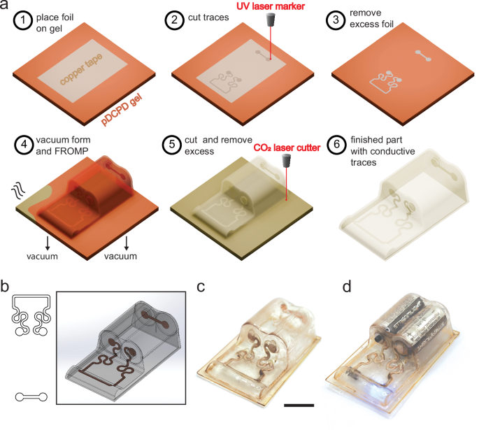
Structural Electronics using Autocatalytic Thermosets
Scientific Achievement
This work enables 3D device fabrication using an In-Mold Electronics (IME) approach and integration into a wider range of durable products, extreme environments, and complex architectures.
Significance and Impact
Vacuum forming is a ubiquitous manufacturing process requiring meltable thermoplastics, which are not compatible with extreme environments. An energy-efficient vacuum-forming approach for thermoset materials was enabled by moldable gels that lock into shape through autocatalytic curing.
Research Details
Dicyclopentadiene (DCPD) is prepared into a gel that is vacuum formed into 3D structures and subsequently cured by localized heating propagated throughout the part via frontal ring-opening metathesis polymerization (FROMP).
Electronic traces patterned onto gel surfaces conform into 3D shapes to generate rugged, thermoset-based structural electronics.
Process for creating structural electronics from thermosets.
Trace, mold, and placement design for a power module.
Photo of the module with copper traces. Scale bar is 20 mm.
Functional LED circuit operated by a switch.
Work was performed, in part, at the Center for Integrated Nanotechnologies.
Fowler, H. E.; Taylor, M. S.; Nguyen, C. P.; Boese, D. A.; Baca, E.; Greenlee, A. J.; Kaufman, G. E.; Gallegos, M. A.; Huntley, E. F.; Appelhans, L. N.; Kaehr, B.; Leguizamon, S. C. Frontal Polymerization of Thermosets to Enable Vacuum-Formed Structural Electronics. Nature Communications 2025, 16 (1).
Notes:
Polymer electrolyte fuel cells (PEFCs) that run on green hydrogen are a promising option for powering heavy-duty vehicles that produce zero greenhouse-gas emissions. This type of fuel cell has the potential to extend driving range without incurring additional weight penalties. However, PEFCs use platinum as a catalyst to drive a key chemical reaction. The fast degradation of this precious metal in a PEFC and the resulting high cost currently prevent the widespread commercialization of this otherwise excellent technology. In this study, researchers wanted to better understand the nanoscale mechanisms by which platinum degrades during PEFC operation. They put the relevant components through accelerated stress tests that simulated the conditions of use in heavy-duty vehicles. They then probed the changes in platinum nanoparticle size and location using x-ray microdiffraction and microfluorescence at the ALS. The results point the way to improvements in PEFC fabrication that can significantly extend the lifetime and efficiency of PEFCs in heavy-duty vehicles, reduce their cost, improve air quality, and fight climate change.
Researchers: K. Khedekar, P. Atanassov, and I.V. Zenyuk (University of California, Irvine); A. Zaffora (UC Irvine and University of Palermo, Italy); M. Santamaria (University of Palermo, Italy); M. Coats and S. Pylypenko (Colorado School of Mines); J. Braaten, L. Cheng, and C. Johnston (Bosch Research and Technology Center North America); and N. Tamura (ALS).
Acknowledgement from paper: Bosch Research and Technology Center North America. Operation of the ALS is supported by the US Department of Energy, Office of Science, Basic Energy Sciences program.
Full highlight: https://als.lbl.gov/tracking-platinum-movement-on-fuel-cell-electrodes/
Fowler, H. E.; Taylor, M. S.; Nguyen, C. P.; Boese, D. A.; Baca, E.; Greenlee, A. J.; Kaufman, G. E.; Gallegos, M. A.; Huntley, E. F.; Appelhans, L. N.; Kaehr, B.; Leguizamon, S. C. Frontal Polymerization of Thermosets to Enable Vacuum-Formed Structural Electronics. Nature Communications 2025, 16 (1). DOI:10.1038/s41467-025-59455-1.

