Slide 1
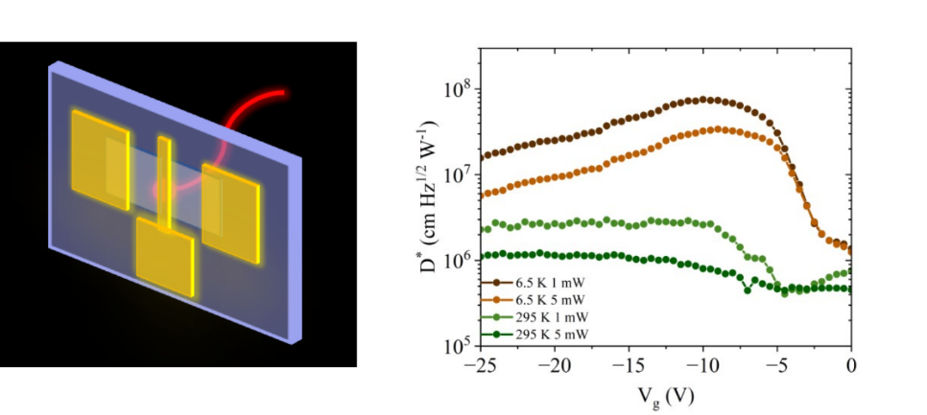



Polycrystalline GeSn Phototransistors for the Short-Wave Infrared
Scientific Achievement
Polycrystalline GeSn thin films on an amorphous silica substrate were characterized and phototransistors made from the GeSn thin films were demonstrated. The phototransistors showed a gate-tunable infrared photoresponse with responsivities up to 1.7 mA/W with only a 30 nm-thick GeSn layer.
Significance and Impact
GeSn is a group-IV semiconductor that can be made direct bandgap.
It is compatible with the existing Si CMOS technology.
The demonstrated photoresponse from a very thin GeSn film grown on an amorphous substrate paves the way for back-end-of-the-line integrated photodetectors, with night-vision and telecommunications applications.
Research Details
  Polycrystalline GeSn (~10% Sn) was characterized with Raman and photoluminescence spectroscopy, X-ray diffraction, electron backscatter diffraction, and energy-dispersive X-ray spectroscopy
  Phototransistors were fabricated and characterized as a function of wavelength, gate voltage, and temperature.
Schematic of phototransistor; specific detectivity at 1600 nm as a function of gate bias.
Petluru, P.; Liu, S.; McClintock, L.; Norden, T.; Wang, Y.; Muhowski, A. J.; Deitz, J.; Ruggles, T.; Lu, P.; Padmanabhan, P.; Liu, J.; Lu, T.-M. Gate-Tunable Short-Wave Infrared Polycrystalline GESN Phototransistors on Noncrystalline Substrates. ACS Applied Materials &amp; Interfaces 2025, 17 (10), 15593–15602.
Work was performed, in part, at the Center for Integrated Nanotechnologies.
Notes:
HL Type (place “X” where appropriate): User___, Staff__, User & Staff_X__
1-2 paragraph description of highlight
GeSn is a group-IV alloy with immense potential to advance microelectronics technology due to its intrinsic compatibility with existing Si CMOS processes. With a sufficiently high Sn composition, GeSn is classified as a direct bandgap semiconductor. Polycrystalline GeSn holds several additional advantages, including its significantly lower synthesis cost compared to its epitaxial counterpart, as well as the versatility to grow these films on a variety of substrates. Here, we present a polycrystalline thin-film GeSn phototransistor on a fused silica substrate with a Sn composition of ∼10%, showing a photoresponse in the short-wave infrared wavelength range, critical for emerging sensing applications. This device shows a gate-tunable response, with responsivities approaching up to 1.7 mA/W with only a 30 nm-thick GeSn layer. Furthermore, phototransistors offer additional adaptability through gating, which allows for the reduction of dark current. This not only enhances the signal-to-noise ratio but also offers more flexible integration with various image sensor readout implementations using different substrates. The specific detectivity of this phototransistor is within an order of magnitude of those of previously reported GeSn photodetectors grown by molecular beam epitaxy and chemical vapor deposition, even though the absorber is 3 to 20× thinner while the electrode spacing for photocarrier transport is approximately 15× longer than the carrier diffusion length in this work, showing great potential benefits of extending similar device structures to epitaxial GeSn layers. As these GeSn phototransistors utilize a noncrystalline substrate, our work establishes a fundamentally more versatile path toward monolithically integrated GeSn-based photodetectors for next-generation multimodal sensors.
Collaborating Institutions
Sandia, Los Alamos, Clemson University
Funding Overview Section (place “X” for all relevant sources)
BES Funding: MSED___, CSGB___, EFRC___, SUFD_X__
SC Funding: ASCR___, BES__X_, BER___, FES___, HEP___, NP___, WDTS___, SBIR___, etc.
Other Funding: DOD___, DOE___, NIH___, NSF___, American Society of Mammologists
Funding details for all sources:
This work was supported as part of μ-ATOMS, an Energy Frontier Research Center funded by the U.S. Department of Energy, Office of Science, Basic Energy Sciences under award DE-SC0023412. Device fabrication, electrical, and optoelectronic measurements were performed at the Center for Integrated Nanotechnologies, an Office of Science User Facility operated for the U.S. Department of Energy (DOE) Office of Science. Sandia National Laboratories is a multimission laboratory managed and operated by National Technology & Engineering Solutions of Sandia, LLC, a wholly owned subsidiary of Honeywell International, Inc., for the U.S. DOE’s National Nuclear Security Administration under contract DE-NA-0003525. This article has been authored by an employee of National Technology & Engineering Solutions of Sandia, LLC with the U.S. DOE. The employee owns all right, title, and interest in and to the article and is solely responsible for its contents. The United States Government retains, and the publisher, by accepting the article for publication, acknowledges that the United States Government retains a nonexclusive, paid-up, irrevocable, worldwide license to publish or reproduce the published form of this article or allow others to do so, for United States Government purposes. The DOE will provide public access to these results of federally sponsored research in accordance with the DOE Public Access Plan https://www.energy.gov/downloads/doe-public-access-plan. This paper describes objective technical results and analysis. Any subjective views or opinions that might be expressed in the paper do not necessarily represent the views of the U.S. Department of Energy or the United States Government.
Publication/ press releases/ related links:
DOI:10.1021/acsami.4c20693.

