Slide 1
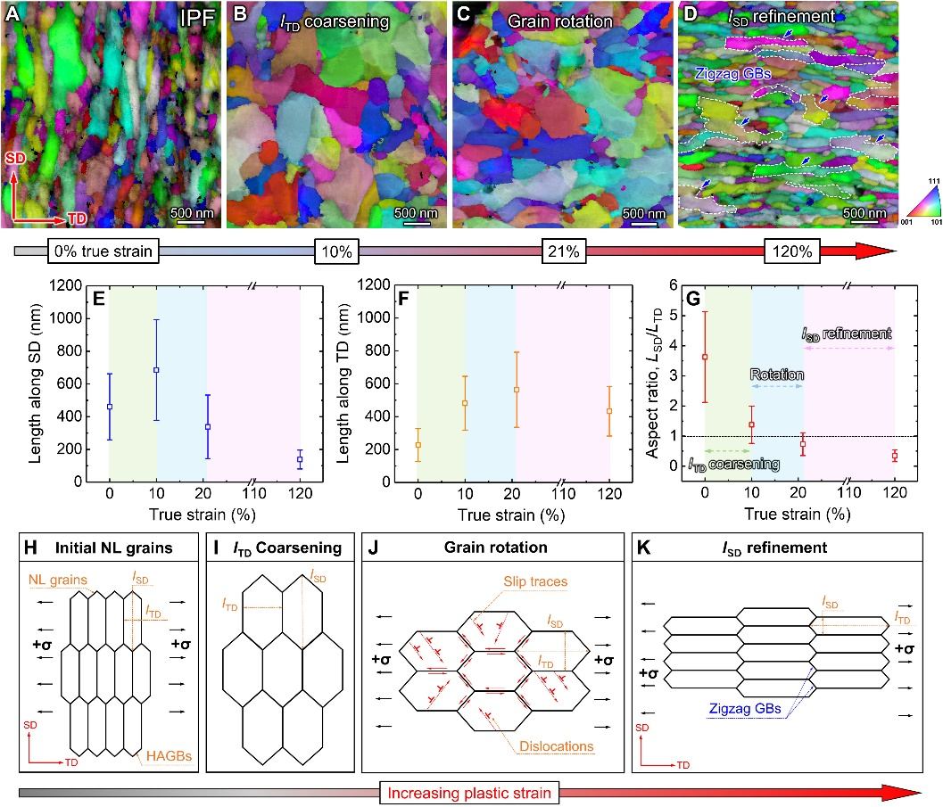
Gradient Nanostructured Steels with Simultaneous Improvements in Strength and Ductility
Scientific Achievement
An existing, commercial steel alloy is tailored via gradient nanostructuring to achieve substantially enhanced properties.
Significance and Impact
Generally, alloy design involves a tradeoff between strength and ductility — increase in one involves decrease in the other. By invoking tailored nanostructures that support sequential deformation mechanisms, we show how this can be overcome.
Research Details
Surface mechanical grinding treatment (SMGT) was employed to produce the gradient nanostructured condition. This process is commercially scalable
In-situ SEM deformation of miniature tensile specimens coupled with high-speed electron backscatter diffraction allow the evolution of the deformation mechanisms to be tracked.
Complementary TEM characterization of samples at various interrupted stages elucidate further mechanistic details.
During deformation, the surface of this gradient nanostructured steel undergoes three distinct phases of deformation: strain-driven grain coarsening, grain rotation, and grain elongation/refinement.
This work was performed in part at The Center for Integrated Nanotechnologies.
Shang, Z.; Sun, T.; Ding, J.; Richter, N. A.; Heckman, N. M.; White, B. C.; Boyce, B. L.; Hattar, K.; Wang, H.; Zhang, X. Gradient Nanostructured Steel with Superior Tensile Plasticity. Science Advances 2023, 9 (22).
Notes:
HL Type (place “X” where appropriate): User___, Staff_X_, User & Staff___
1-2 paragraph description of highlight
CINT users from Purdue University led by Prof. Xinghang Zhang (former LANL employee) championed this research on gradient nanostructuring of steel alloys. Departing from most prior studies on the effects of gradient nanostructured alloys in pure metals or model systems, this study examines a commercially-relevant T91 steel alloy that is currently used in nuclear and petrochemical applications. The commercial alloy was processed via an emerging technique known as Surface Mechanical Grinding Treatment (SMGT), a recent variant within the class of general severe plastic deformation (SPD) techniques. SMGT induces a steep gradient in the microstructure occurring over a substantial distance (200 micrometers) from the surface. When compared to the conventional homogeneous T91 steel, this gradient-nanostructured variant of T91 exhibited 36% higher yield strength and 50% higher tensile elongation (ductility). TEM along with CINT’s in-situ SEM capability helped reveal that the deformation process is not monotonic, but evolves through several different deformation modes as the modified alloy is strained. This collaboration also aligns well with Boyce BES Core Program on “Nanomechanics and Nanometallurgy of Boundaries”.
Based on this result, the Purdue group is planning related follow-up CINT experiments on different alloy systems to examine the generalizability of these findings, and their extensibility to materials that are dominated by other deformation mechanisms.
Collaborating Institutions
Purdue University
Funding Overview Section (place “X” for all relevant sources)
BES Funding: MSED___, CSGB___, EFRC___, SUFD___
SC Funding: ASCR___, BES_X__, BER___, FES___, HEP___, NP___, WDTS___, SBIR___, etc.
Other Funding: DOD___, DOE__X_, NIH___, NSF_X__, etc.
Funding details for all sources: (example)
This research is funded primarily by NSF-MOM 2217727 with S. Qidwai as the program manager. We acknowledge primary financial support by NSF-MOM 2217727 with S. Qidwai as the program manager. N.M.H., B.L.B., and K.H. were supported by the DOE Office of Basic Energy Science, Materials Science and Engineering Division. T.S. is supported by the DOE Office of Nuclear Energy and Nuclear Energy University Program through the NEUP Project 18-15703 under the grant no.: DE-NE0008787.
Publication/ press releases/ related links:
https://www.purdue.edu/newsroom/releases/2023/Q2/treatment-creates-steel-alloys-with-superior-strength-and-plasticity.html
Shang, Z.; Sun, T.; Ding, J.; Richter, N. A.; Heckman, N. M.; White, B. C.; Boyce, B. L.; Hattar, K.; Wang, H.; Zhang, X. Gradient Nanostructured Steel with Superior Tensile Plasticity. Science Advances 2023, 9 (22).
DOI:10.1126/sciadv.add9780.

