Slide 1
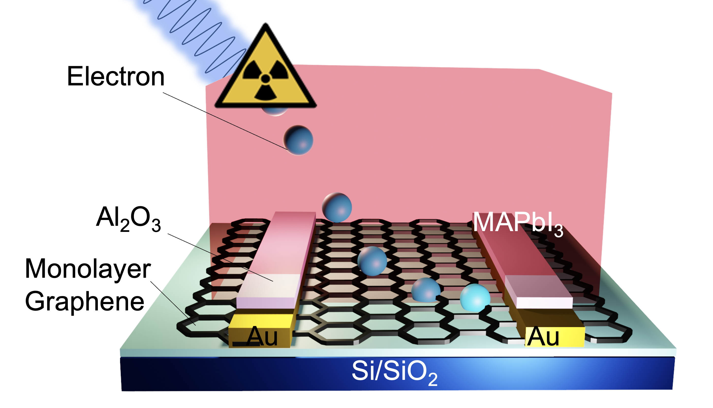

Recyclable Perovskite/Graphene hybrid detector
Scientific Achievement
A perovskite/graphene hetero-structure transistor for high efficiency X-ray sensing that can be completely recycled through a low energy consuming, room temperature, solution-based method.
(A)
(B)
Significance and Impact
Semiconductor X-ray imagers are typically made with high-cost materials. This study investigates a new chip made with a solution-cast perovskite layer built over a monolayer graphene channel. The device can be fully recyclable, lowering the environmental burden for end-of-life electronics disposal.
With a phantom
(C)
Research Details
Discovery of a solution method that deposits perovskite onto a monolayer graphene chip for high performance X-ray sensing
High mobility of the graphene chip promotes high X-ray detection gain.
Team demonstrates that washing with an organic solvent at room temperature creates a fully restored graphene device ready to fabricate a new perovskite/graphene chip.
Schematic illustration of the hybrid detector.
Detector’s response taken under X-ray pulse
generated by a standard 2D mammogram
system at a hospital.
Graphene transistor’s transfer curve before
and after recycling.
This work was performed in part at The Center for Integrated Nanotechnologies.
Shirley, K.; Tsai, H.; Cucciniello, N.; Bird, J.; Jia, Q.; Torres, E.; Butler, P.; Butler, A.; Crocco, J.; Taha, E.; Alhawsawi, A.; Germino, J.; Dor, M.; Dun, C.; Firat, O.; Parker, J.; Graham, M.; Novoselov, K. S.; Nie, W. High-Efficiency X-Ray Sensing with Recyclable Perovskite–Graphene Heterostructured Transistors. ACS Energy Letters 2023, 8 (7), 3161–3170. DOI:10.1021/acsenergylett.3c00787.
Notes:
HL Type (place “X” where appropriate): User___, Staff_X_, User & Staff___
1-2 paragraph description of highlight
Semiconductor radiation sensor that directly convers radiation photon to electrical charge offers the best detection quantum efficiency. However, sensors made from classical semiconductor are too expensive to scale up for large scale imaging applications. Here we presents a novel hybrid sensor by stacking perovskite semiconductors over graphene channel, which delivers an ultra-high detection sensitivity of 10⁸ uC/Gy_{air}*cm². This is benefitted from the signal amplification effect in the high mobility graphene channel. We tested our detector under a 2D mammogram system at a hospital which delivered intense signals that can differentiate the X-ray pulse. More interestingly, perovskite layer can be fully removed by room temperature organic solvent bath without damaging the graphene channel, allowing for recycling the device at a low cost.
Our demonstration suggests a low cost path to build large scale X-ray imager with printable methods. The recyclability will further reduce the manufacturing cost, and lower the environmental burden when disposing the end-of-life electronics.
Collaborating Institutions
1. Kairos Sensors, LLC, Corvallis, Oregon, 97330, U.S.A.
2. University of California, Berkeley, Berkeley, California, 94720, U.S.A
3. University at Buffalo, Buffalo, New York, 14260, U.S.A
4. Graphenea, Inc, San Sebastian, 83-20009, Spain
5. University of Otago, Christchurch 8011, New Zealand
6. dpiX Inc., Colorado Springs, Colorado, 80916, U.S.A
7. King Abdulaziz University, Jeddah, 21589, Saudi Arabia
8. Corvallis Radiology, Corvallis, Oregon, 97330, U.S.A
9. Michigan State University, Ann Arbor, Michigan, 48103, U.S.A
10. Lawrence Berkeley National Laboratory, Berkeley, California, 97420 USA
11. Oregon State University, Corvallis, Oregon, 97331, U.S.A
12. National University of Singapore, 119077 Singapore
13. Los Alamos National Laboratory, Los Alamos, New Mexico, 87545, U.S.A
Funding Overview Section (place “X” for all relevant sources)
BES Funding: MSED___, CSGB___, EFRC___, SUFD___
SC Funding: ASCR___, BES_X__, BER___, FES___, HEP___, NP___, WDTS___, SBIR___, etc.
Other Funding: DOD___, DOE_X__, NIH__X_, NSF___, etc.
Funding details for all sources: (example)
Research reported in this publication was supported by the National Institute Of Biomedical Imaging And Bioengineering of the National Institutes of Health under Award Number R43EB032694. This work was performed, in part, at the Center for Integrated Nanotechnologies, an Office of Science User Facility operated for the U.S. Department of Energy (DOE) Office of Science. Los Alamos National Laboratory, an affirmative action-equal opportunity employer, is managed by Triad National Security, LLC for the U.S. Department of Energy’s NNSA, under contract 89233218CNA000001. Part of this research was conducted at the Advanced Technology and Manufacturing Institute (ATAMI) facility of the Northwest Nanotechnology Infrastructure, a National Nanotechnology Coordinated Infrastructure site at Oregon State University which is supported in part by the National Science Foundation (grant NNCI-2025489) and Oregon State University. This Project was funded in part by the Oregon State Lottery and administered by the Oregon Business Development Department. KSN is grateful to the Ministry of Education, Singapore (Research Centre of Excellence award to the Institute for Functional Intelligent Materials, I-FIM, project No. EDUNC-33-18-279-V12) and to the Royal Society (UK, grant number RSRP\R\190000) for support
Publication/ press releases/ related links:
https://doi.org/10.1021/acsenergylett.3c00787

