Slide 1
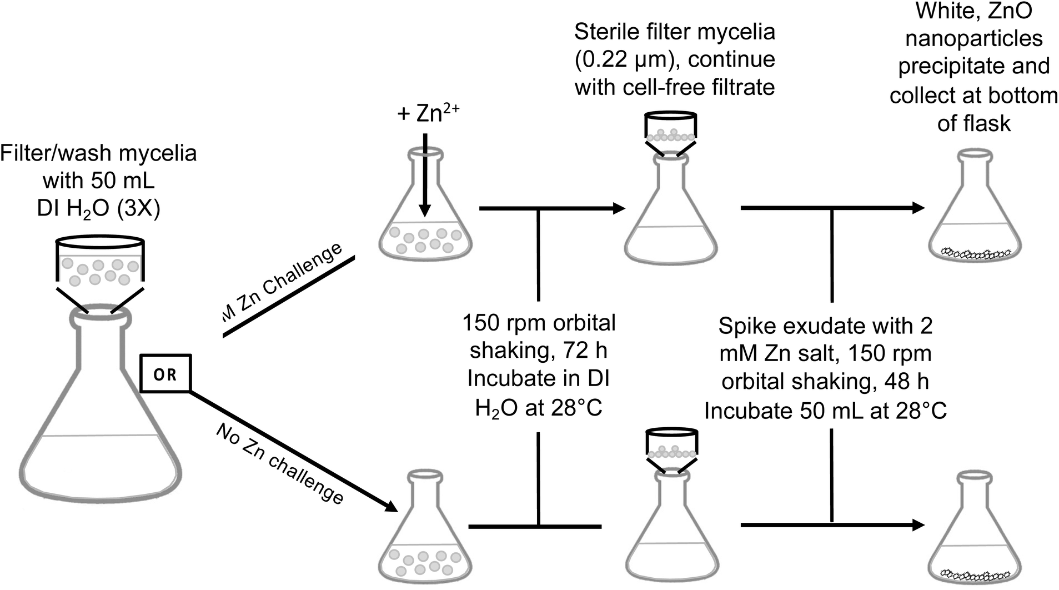



Metabolites Excreted by Fungi Enable Nanoparticle Synthesis
Scientific Achievement
Demonstrated that small molecule metabolites excreted by filamentous fungi, (hexamethylenetetramine , e.g.) regulate the synthesis of zinc oxide nanoparticles
Significance and Impact
This work identifies key biochemical details that may be used to controllably regulate nanoparticle synthesis.
Research Details
  Metabolomic analyses of fundal exudates identified small molecule biochemicals involved in nucleation & growth of nanoparticles.
  Protein expression and proteomic analysis suggest that protein form a corona that reduce coagulation.
Process flow (top) and resulting zinc oxide nanoparticles (bottom) formed by biosynthesis using fungal extracts.
Brady, N. G.; O’Leary, S. L.; Kuo, W.; Blackwell, B. R.; Mach, P. M.; Watt, J.; Bachand, G. D. Identifying Biochemical Constituents Involved in the Mycosynthesis of Zinc Oxide Nanoparticles. Nanoscale 2024, 16 (18), 9036–9046.
Notes:
1-2 paragraph description of highlight – The applications of nanoparticles are rapidly expanding. Their synthesis, however, tends to be energy intensive, uses toxic chemical agents, and/or uses non-aqueous organic solutions. Thus, scalable, more environmentally friendly (green) approaches to nanoparticle synthesis are actively being sought. One of those approaches involves the use of biochemicals excreted by filamentous fungi to synthesis nanoparticle such as zinc oxide nanoparticles (ZnO NPs). To date, the mechanisms and biochemicals critical to nanoparticle synthesis remain largely unknown. We had previously demonstrated that the morphology of ZnO NPs was depending on the fungal species. In these current paper, we used mass spectrometry-based metabolomics and proteomics to characterize the profiles of small molecules and proteins, respectively, present in the exudates from different filamentous fungi. We hypothesized that these analyses would reveal small molecule metabolites and proteins the regulate the synthesis of the different NP morphologies. Our data suggested metal chelators such as HMTA in fungal exudates are likely critical to the production of dense, well-defined ZnO NPs potentially by facilitating nucleation of the metal centers into the ZnO lattice. Moreover, differences in the metabolomes and enhanced production and secretion of small molecules is likely due to the Zn stress imparted on the fungi. In contrast, the secreted proteins likely play a role in forming a corona around the well-defined ZnO NPs, preventing coagulation into larger micro-sized structures. Collectively, these results provide a deeper, more comprehensive understanding of the biochemical factors
that are critical to mycosynthesis, which in turn may be leveraged to regulate the size and shape of NPs in future studies.
Acknowledgements
We would like to thank Charlie Easterling for critically reviewing this manuscript. This work was performed, in part, at the Center for Integrated Nanotechnologies, an Office of Science User Facility operated for the U.S. Department of Energy (DOE) Office of Science. Sandia National Laboratories is a multimission laboratory managed and operated by National Technology & Engineering Solutions of Sandia, LLC, a wholly owned subsidiary
of Honeywell International, Inc., for the U.S. DOE’s National Nuclear Security Administration under contract DE-NA-0003525. The views expressed in the article do not necessarily represent the views of the U.S. DOE or the United States Government. Los Alamos National Laboratory, an affirmative action equal opportunity employer, is managed by Triad National Security, LLC for the U.S. Department of Energy’s NNSA, under contract 89233218CNA000001.
Publication/ press releases/ related links:
Brady NG, O'Leary SL, Kuo W, Blackwell, BR, Mach, PM, Watt, J, and Bachand, GD. Identifying biochemical constituents involved in the mycosynthesis of zinc oxide nanoparticles. Nanoscale 16(18), 9036-9046
https://pubs.rsc.org/en/content/articlelanding/2024/nr/d4nr00624k

