Slide 1
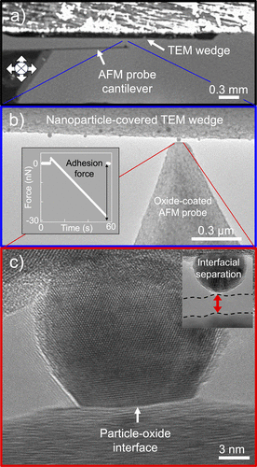
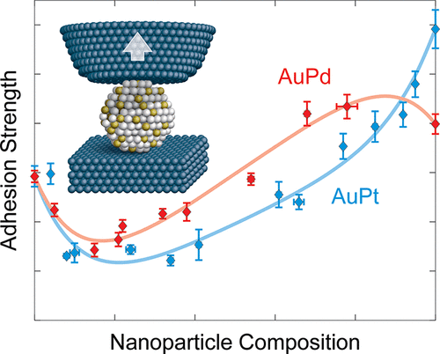
In-Situ Measurement of Adhesion for Multimetallic Nanoparticles
Scientific Achievement
Discovery of a new method to measure nanoparticle adhesion to multimetallic particles, a critical parameter for nanoparticle applications.
Significance and Impact
This work demonstrates that multimetallic nanoparticles have non-trivial relationships between adhesion and composition and provides an extensible experimental approach for further investigations.
Research Details
In-Situ Transmission Electron Microscopy (TEM) adhesion experiments were performed on several different metal nanoparticle-oxide interfaces.
A simple model was suggested for non-monotonic adhesion trends for multimetallic particles.
Baker, A.; Vishnubhotla, S. B.; Karpe, S.; Yang, Y.; Veser, G.; Jacobs, T. D. In Situ Measurement of Adhesion for Multimetallic Nanoparticles. Nano Letters 2025, 25 (17), 6903–6909.
This work was performed, in part, at The Center for Integrated Nanotechnologies.
Notes:
1-2 paragraph description of highlight
The adhesion of nanoparticles to their supports is key to their performance and stability. However, scientific advances in this area have been hampered by the difficulty of experimentally probing adhesion. To date, only a single technique has been developed that can directly measure nanoparticle adhesion, and this technique is inherently limited to monometallic systems. We present a versatile technique for the direct measurement of adhesion for bimetallic nanoparticle systems. This technique combines the spatial resolution of transmission electron microscopy with the force resolution of an atomic force microscope to probe individual, well-characterized nanoparticles. A first study of supported bimetallic nanoparticles provides new insights into the complex impact of alloying on nanoparticle adhesion, explained by charge transfer between constituent metals. The new experimental technique is readily extensible to study other multimetallic nanoparticle systems, including the effects of particle size, shape, and orientation, thus enabling advances in our understanding of nanoparticle physics.
Acknowledgements
The authors gratefully acknowledge discussion with L. Pastewka, G. Mpourmpakis, S. House, F. Cassin, and D. Alsem about experimental challenges and data analysis. The authors acknowledge the use of the Nanoscale Fabrication and Characterization Facility (NFCF) in the Gertrude E. & John M. Petersen Institute of NanoScience and Engineering (PINSE). The authors acknowledge funding from the National Science Foundation (NSF) under CMMI-1844739. This work was performed, in part, at the Center for Integrated Nanotechnologies, an Office of Science User Facility operated for the U.S. Department of Energy (DOE) Office of Science. Sandia National Laboratories is a multimission laboratory managed and operated by National Technology & Engineering Solutions of Sandia, LLC, a wholly owned subsidiary of Honeywell International, Inc., for the U.S. DOE’s National Nuclear Security Administration under contract DE-NA-0003525. The views expressed in the article do not necessarily represent the views of the U.S. DOE or the United States Government.
Publication/ press releases/ related links:
https://pubs.acs.org/doi/full/10.1021/acs.nanolett.5c00076

