Slide 1
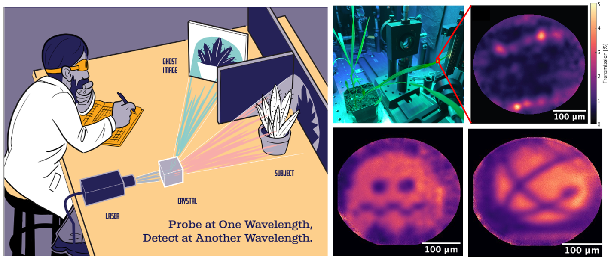
Infrared Quantum Ghost Imaging of Living and Undisturbed Plants
Scientific Achievement
Clear images of living plants with illumination light far dimmer than starlight, enabling imaging of delicate, light-sensitive samples, such as biofuel crops, without perturbation or damage. Demonstrated live plant imaging of several representative plant samples, including the biofuel crop sorghum.
Significance and Impact
This ultra-sensitive Quantum Ghost Imaging technique allows for detailed monitoring of plant health and growth without exposing crops to harmful light levels and causing stress or damage. Using label-free infrared imaging, researchers can gather critical information about important plant processes,
including water content and photosynthetic activity, even in low-light conditions. This capability is particularly beneficial for studying biofuel crops, where optimizing growth and health is essential for maximizing yield and sustainability.
Research Details
Using NCam, a novel single-photon detector, demonstrated non-degenerate QGI with unprecedented sensitivity and contrast, obtaining images of living plants with less than 1% light transmission.
Plants imaged with photon flux orders of magnitude below starlight.
Realization of QGI expands the method to extremely low light bioimaging and imaging of light-sensitive samples, where minimizing illumination intensity is crucial to prevent phototoxicity or sample degradation.
Left: Cartoon illustrating principles of quantum ghost imaging. Top Middle: Picture of sorghum plant in quantum ghost microscope. Top Right: Quantum ghost microscope transmission image of live sorghum leaf. Bright spots are rows of stomata.
Bottom: Quantum ghost images of binary test targets, including a ghost from Pac-Man (Bottom middle) and the Los Alamos National Laboratory logo (Bottom right).
Ryan, D.; Meier, K.; Seitz, K.; Hanson, K.; Morales, D.; Palmer, D.; Hanson, B.; Goodwin, P.; Newell, R.; Holmes, R.; Thompson, D,; Werner, J. “Infrared Quantum Ghost Imaging of Living and Undisturbed Plants.” Optica, 2024.
Work was performed, in part, at the Center for Integrated Nanotechnologies.
Notes:
1-2 paragraph description of highlight
Quantum ghost imaging (QGI) allows for capturing images at extremely low light levels. Moreover, it enables using one color to examine a sample and another color to form the image. This approach improves imaging in spectral regions where traditional cameras struggle. By employing a novel detector, we obtained clear images of living plants with an illumination light far dimmer than starlight. This advancement enables imaging of delicate, light-sensitive samples, such as biofuel crops, without perturbation or damage.
Quantum ghost imaging offers key advantages for plant research. This ultra-sensitive technique allows for detailed monitoring of plant health and growth without exposing the crops to harmful light levels, which could cause stress or damage. By using label-free infrared imaging, researchers can gather critical information about important plant processes, such as water content and photosynthetic activity, even in low-light conditions. This capability is particularly beneficial for studying biofuel crops, where optimizing growth and health is essential for maximizing yield and sustainability.
Quantum ghost imaging (QGI) is a method that measures absorption at extremely low light intensities. Non-degenerate QGI probes a sample at one wavelength while forming an image with correlated photons at a different wavelength. This spectral separation alleviates the need for imaging detectors with high sensitivity in the near-infrared (NIR) region, thereby reducing the required illumination intensity. Using NCam, a novel single-photon detector, we demonstrated non-degenerate QGI with unprecedented sensitivity and contrast, obtaining images of living plants with less than 1% light transmission. The plants were imaged with a photon flux orders of magnitude below starlight. This realization of QGI expands the method to extremely low light bioimaging and imaging of light-sensitive samples, where minimizing illumination intensity is crucial to prevent phototoxicity or sample degradation. We demonstrate live plant imaging of several representative plant samples, including the biofuel crop sorghum.
Acknowledgements
Research presented in this article was supported by the US Department of Energy (DOE) Biological and Environmental Research (BER) Biological Characterization and Imaging Science Program (BCIS). This work was performed, in part, at the Center for Integrated Nanotechnologies, an Office of Science User Facility operated for the U.S. DOE Office of Science by Los Alamos National Laboratory (Contract 89233218CNA000001).
Publication/ press releases/ related links
Ryan, D.; Meier, K.; Seitz, K.; Hanson, K.; Morales, D.; Palmer, D.; Hanson, B.; Goodwin, P.; Newell, R.; Holmes, R.; Thompson, D,; Werner, J. “Infrared Quantum Ghost Imaging of Living and Undisturbed Plants.” Optica, 2024. 10.1364/OPTICA.527982

