Slide 1
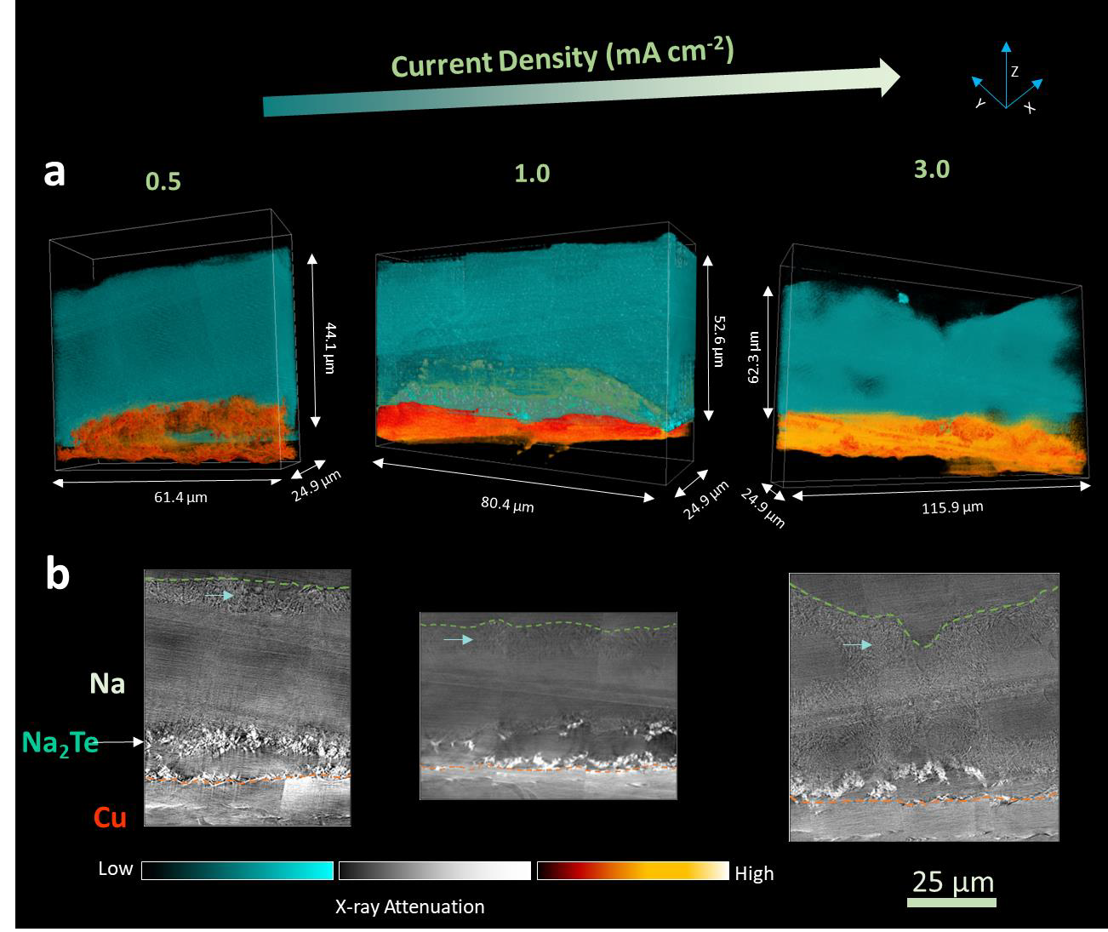
Interdependence of Wettability and Electrodeposition Rate in Na Batteries
Scientific Achievement
First of its kind multimodal investigation of the interdependence of the current collector support sodiophilicity, electrodeposition current density, and sodium metal and associated SEI structure.
Significance and Impact
This study examines how current collector support chemistry (sodiophilic intermetallic Na₂Te vs. sodiophobic baseline Cu) and electrodeposition rate affect microstructure of sodium metal and its solid electrolyte interphase (SEI).
Research Details
Investigated the role of current collector wettability on cycle-one microstructure of electrodeposited sodium metal and its solid electrolyte interphase (SEI).
Experiments demonstrate complex support and rate dependent interrelations to predict the effect on localized current density, and onset of electrochemical instability.
Figure. 3D synchrotron X-ray nano-tomography by transmission X-ray microscopy for visualizing the internal structure of the deposited Na on Te-Cu as a function of current density. (a) 3D tomographic volume rendering and (b) Corresponding pseudo cross-sectional 2D images along the XZ plane. Cyan arrows indicate surface Na structures.
Lo, C.-A.; Wang, Y.; Kankanallu, V. R.; Singla, A.; Yen, D.; Zheng, X.; Naik, K. G.; Vishnugopi, B. S.; Campbell, C.; Raj, V.; Zhao, C.; Ma, L.; Bai, J.; Yang, F.; Li, R.; Ge, M.; Watt, J.; Mukherjee, P. P.; Mitlin, D.; Chen-Wiegart, Y. K. Interdependence of Support Wettability ‐electrodeposition Rate ‐ Sodium Metal Anode and Sei Microstructure. Angewandte Chemie International Edition 2024.
This work was performed in part at The Center for Integrated Nanotechnologies.
Notes:
This study examines how current collector support chemistry in sodium metal batteries and electrodeposition rate affect the microstructure of plated sodium metal and its solid electrolyte interphase (SEI). The study looked at sodiophilic intermetallic Na2Te as a novel current collector vs. sodiophobic baseline Cu). The capacity and currents studied were representative of commercially relevant mass loading in anode-free sodium metal battery (AFSMBs). This study was multimodal, incorporating synchrotron X-ray nanotomography and grazing-incidence wide-angle Xray scattering (GIWAXS) with with cryogenic focused ion beam (cryo-FIB) microscopy. Highlighted are major differences in film morphology, internal porosity, and crystallographic preferred orientation e.g. (110) vs. (100) and (211) with support and deposition rate. Within the SEI, sodium fluoride (NaF) is more prevalent with Te-Cu versus sodium hydride (NaH) and sodium hydroxide (NaOH) with baseline Cu. Due to competitive grain growth the preferred orientation of sodium crystallites depends on film thickness. Mesoscale modelling delineates the role of SEI (ionic conductivity, morphology) on electrodeposit growth and onset of electrochemical instability. This study presents present a first of its kind multimodal investigation of the interdependence of the current
collector support sodiophilicity/phobicity, electrodeposition current density, and sodium metal and associated SEI structure (morphology, porosity, preferred orientation).
Researchers: Chang-An Lo, Varun R. Kankanallu, Dean Yen, Xiaoyin Zheng, Chonghang Zhao, Yu-chen Karen Chen-Wiegart. (Stony Brook University) Yixian Wang, Callum Campbell, Vikalp Raj, David Mitlin (UT Austin), Aditya Singla, Kaustubh G. Naik, Bairav S. Vishnugopi, Partha P. Mukherjee (Purdue University), Lu Ma, Jianming Bai, Feipeng Yang, Ruipeng Li, Mingyuan Ge (Brookhaven National Laboratory) John Watt (Los Alamos National Laboratory).
Acknowledgement from paper: This work was supported by the U.S. Department of Energy, Office of Basic Energy Sciences,
Division of Materials Sciences and Engineering under Award #DE-SC0023260. This research used
resources, Full Field X-ray Imaging (FXI) beamline (18-ID), Complex Materials Scattering (CMS)
beamline (11-BM), and Quick x-ray Absorption and Scattering (QAS) beamline (7-BM) of the
National Synchrotron Light Source II, a U.S. Department of Energy (DOE) Office of Science by
Brookhaven National Laboratory under Contract No. DE-SC0012704. This research used
resources of the Center for Functional Nanomaterials (CFN), which is a U.S. DOE Office of
Science Facility, at Brookhaven National Laboratory under Contract No. DE-SC0012704. Cryo-
EM was performed at the Center for Integrated Nanotechnologies, an Office of Science User
Facility operated for the U.S. Department of Energy (DOE) Office of Science. The Los Alamos
National Laboratory, an affirmative action equal opportunity employer, is managed by Triad
National Security, LLC for the U.S. Department of Energy’s NNSA, under contract
89233218CNA000001.
Full highlight:
Lo, C.-A.; Wang, Y.; Kankanallu, V. R.; Singla, A.; Yen, D.; Zheng, X.; Naik, K. G.; Vishnugopi, B. S.; Campbell, C.; Raj, V.; Zhao, C.; Ma, L.; Bai, J.; Yang, F.; Li, R.; Ge, M.; Watt, J.; Mukherjee, P. P.; Mitlin, D.; Chen-Wiegart, Y. K. Interdependence of Support Wettability ‐electrodeposition Rate ‐ Sodium Metal Anode and Sei Microstructure. Angewandte Chemie International Edition 2024. DOI:10.1002/anie.202412550.

