Slide 1
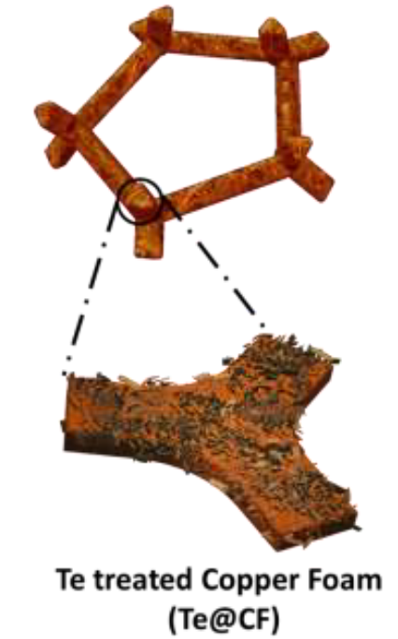



Sodiophilic Current Collectors Promote Stable Electrodeposition–Electrodissolution
Scientific Achievement
Development of novel sodiophilic micro-composite films of sodium chalcogenide intermetallics (Na₂Te, Na₂S) which were fabricated onto commercial foam current collectors to enhance metal wetting properties,leading to state-of-the-art electrochemical performance in sodium metal batteries.
a
Significance and Impact
Novel thermal treatment using sodium chalcogenide intermetallics turned the sodiophobic current collector sodiophilic, enabling planar-and-dendrite-free sodium metal wetting. Improved electrochemical performance is achieved in half-cell, symmetric cell, and full battery cell architectures. Cryo-FIB revealed early-stage deposition influenced late-stage cycling.
b
Research Details
  Sodium chalcogenides-coated 3D copper foam (CF) current collectors were fabricated using a one-step heat-treatment method.
  Sodium metal batteries with the modified current collectors as anodes are stable for 10,000 cycles at 10 ºC.
  Cryo-FIB analysis shows the difference in plating behavior between coated and uncoated copper foam occurred at a very early stage.
(a) Cryo-FIB shows that when a copper foam current collector is coated with sodium telluride, Na₂Te nanoplates (or sodium sulfide, Na₂S) sodium metal electrodeposition is dense, smooth, and free of dendrites. (b) On unmodified copper foam, sodium grows in a filament, dendrite-like manner.
This work was performed in part at The Center for Integrated Nanotechnologies.
Wang, Y.; Dong, H.; Katyal, N.; Vishnugopi, B. S.; Singh, M. K.; Hao, H.; Liu, Y.; Liu, P.; Mukherjee, P. P.; Henkelman, G.; Watt, J.; Mitlin, D. Intermetallics Based on Sodium Chalcogenides Promote Stable Electrodeposition-Electrodissolution of Sodium Metal Anodes. Advanced Energy Materials 2023, 2204402.
Notes:
1-2 paragraph description of highlight –
The past 3 decades have witnessed the dominance of lithium-ion batteries (LIBs), with extensive applications ranging from portable electronics to electric vehicles. However, as demand for LIBs continues to grow, concerns are raised regarding the economic and supply-chain sustainability of key elements making up the cathode, including Li precursors, Co and Ni. Sodium-based secondary batteries are emerging as potential alternatives to LIBs due to their analogous working mechanism but the greater availability of sodium precursors and the other elements making up the cathode.
Sodium metal batteries (SMBs) hold considerable promise due to the high theoretical capacity of the metal anode and the associated low electrodeposition/electrodissolution potential (0.33 V vs Li/Li+). Unfortunately, the metal dendrite growth and the associated unstable solid electrolyte interphase (SEI) prevail with SMBs in a wide range of electrolytes. In this study it is demonstrated a thin surface layer of electrochemically stable intermetallics (two systems examined, Na2Te and Na2S) thermally deposited onto a commercial 3D copper foam (CF) current collector enables state-of-the-art SMB electrochemical performance. The key difference observed versus the uncoated baseline copper foam is the wetting behavior of the sodium, which appears to have a major influence on almost all aspects of the electrodeposition/electrodissolution process.
Acknowledgments –
This work was supported by the U.S. Department of Energy, Office of Basic Energy Sciences, Division of Materials Sciences and Engineering under Award # DE-SC0023260. Cryo-EM was performed at the Center for Integrated Nanotechnologies, an Office of Science User Facility operated for the U.S. Department of Energy (DOE) Office of Science. The Los Alamos National Laboratory, an affirmative action equal opportunity employer, is managed by Triad National Security, LLC for the U.S. Department of Energy’s NNSA, under contract 89233218CNA000001. DFT calculations by N.K. and G.H. were supported by the Welch Foundation (F- 1841), and computing resources at the Extreme Science and Engineering Discovery Environment (XSEDE)/Advanced Cyberinfrastructure Coordination Ecosystem: Services and Support (ACCESS) and the Texas Advanced Computing Center (TACC) with the allocation CHE190010—Modeling Materials for Energy Conversion and Storage over Experimental Timescales.
Publication/ press releases/ related links:
Wang, Y.; Dong, H.; Katyal, N.; Vishnugopi, B. S.; Singh, M. K.; Hao, H.; Liu, Y.; Liu, P.; Mukherjee, P. P.; Henkelman, G.; Watt, J.; Mitlin, D. Intermetallics Based on Sodium Chalcogenides Promote Stable Electrodeposition–Electrodissolution of Sodium Metal Anodes. Advanced Energy Materials 2023. DOI:10.1002/aenm.202204402.

