Slide 1
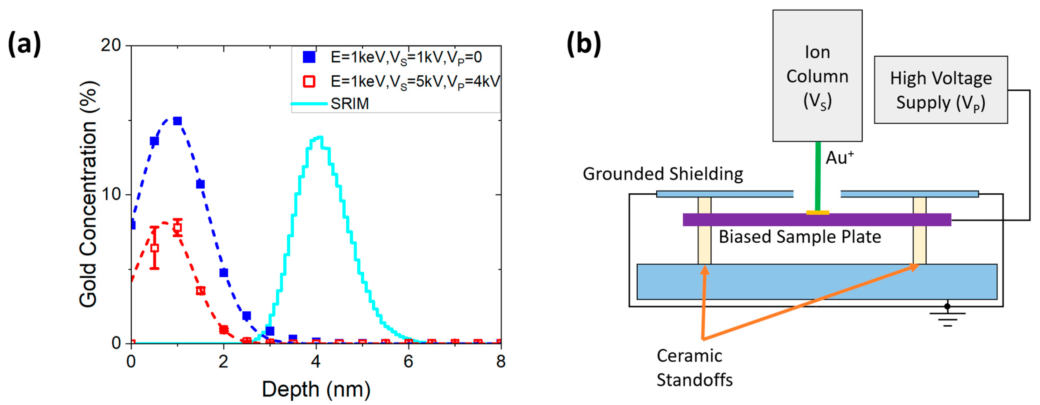
Measurement and Simulation of Ultra-Low-Energy Ion–Solid Interaction Dynamics
Scientific Achievement: Demonstrated 1 keV focused ion beam Au implantation into Si and validated results via atom probe tomography.
Significance and Impact
Ion implantation is a key capability for the semiconductor industry. As devices shrink, novel materials enter the manufacturing line and quantum technologies become mainstream. Traditional implantation methods fall short in terms of energy, ion species, and positional precision. Here, we demonstrate how model details are particularly important to the simulation of these low-energy heavy-ion implantations.
Research Details
Ions are produced at low energy or decelerated to low energy.
Measurement of ion depth achieved via atom probe tomography.
Simulations show ion beam focus can be maintained sub-micron.
Disagreement between SRIM simulations and measured values is due to surface sputtering and redeposition.
Au implant depth at 1 keV is 0.8 nm and identical results for low-energy ion implants can be achieved by lowering the column voltage or decelerating ions using bias while maintaining a sub-micron beam focus.
(a) Measured and simulated ion range for 1 keV Au ions. Ions generated at 1 keV (blue) or decelerated to 1 keV (red) have the same range. SRIM simulations fail to correctly capture the ion range since SRIM simulations assume a static substrate. (b) Schematic of the setup used for deceleration consisting of a commercially available focused ion beam system where the sample holder is replaced by a biased plate.
This work was performed in part at The Center for Integrated Nanotechnologies.
Titze, M.; Poplawsky, J. D.; Kretschmer, S.; Krasheninnikov, A. V.; Doyle, B. L.; Bielejec, E. S.; Hobler, G.; Belianinov, A. “Measurement and Simulation of Ultra-Low-Energy Ion–Solid Interaction Dynamics.”Micromachines, 14, 10, 1884 (2023)
Notes:
HL Type (place “X” where appropriate): User___, Staff__, User & Staff_X_
1-2 paragraph description of highlight
Ion implantation is a key capability for the semiconductor industry. As devices shrink, novel materials enter the manufacturing line, and quantum technologies transition to being more mainstream. Traditional implantation methods fall short in terms of energy, ion species, and positional precision. Here, we demonstrate 1 keV focused ion beam Au implantation into Si and validate the results via atom probe tomography. We show the Au implant depth at 1 keV is 0.8 nm and that identical results for low-energy ion implants can be achieved by either lowering the column voltage or decelerating ions using bias while maintaining a sub-micron beam focus. We compare our experimental results to static calculations using SRIM and dynamic calculations using binary collision approximation codes TRIDYN and IMSIL. A large discrepancy between the static and dynamic simulation is found, which is due to lattice enrichment with high-stopping-power Au and surface sputtering. Additionally, we demonstrate how model details are particularly important to the simulation of these low-energy heavy-ion implantations. Finally, we discuss how our results pave a way towards much lower implantation energies while maintaining high spatial resolution.
Keywords:
focused ion beam; ion implantation; ultra-low energy
Collaborating Institutions
CNMS – ORNL, Helmholtz Zentrum Dresden Rossendorf, TU Wien
Funding Overview Section (place “X” for all relevant sources)
BES Funding: MSED___, CSGB___, EFRC___, SUFD_X__
SC Funding: ASCR___, BES_X_, BER___, FES___, HEP___, NP___, WDTS___, SBIR___, etc.
Other Funding: DOD___, DOE___, NIH___, NSF__X_, etc.
Funding details for all sources: (example)
We thank Shei Sia Su for assisting with ion implantation, George Burns for assisting in the design of the high-voltage sample holder, and Gyorgy Vizkelethy for internal review of the manuscript. We thank James Burns for assistance in running the APT experiments. This work was performed, in part, at the Center for Integrated Nanotechnologies, an Office of Science User Facility operated for the U.S. Department of Energy (DOE) Office of Science. Sandia National Laboratories is a multimission laboratory managed and operated by National Technology and Engineering Solutions of Sandia, LLC, a wholly owned subsidiary of Honeywell International, Inc., for the U.S. DOE’s National Nuclear Security Administration under contract DE-NA-0003525. APT research was supported by the Center for Nanophase Materials Sciences (CNMS), which is a US Department of Energy, Office of Science User Facility at Oak Ridge National Laboratory. The views expressed in the article do not necessarily represent the views of the U.S. DOE or the United States Government. GH and AVK thank the European Cooperation in Science and Technology (COST) action CA19140 “FIT4NANO” (https://www.fit4nano.eu (accessed on 29 September 2023)) for their support. This work was funded by Laboratory Directed Research & Development at Sandia National Laboratories.
Publication/ press releases/ related links:
Michael Titze, Jonathan D Poplawsky, Silvan Kretschmer, Arkady V Krasheninnikov, Barney L Doyle, Edward S Bielejec, Gerhard Hobler, Alex Belianinov, “Measurement and Simulation of Ultra-Low-Energy Ion–Solid Interaction Dynamics”, Micromachines, 14, 10, 1884 (2023)

