Slide 1
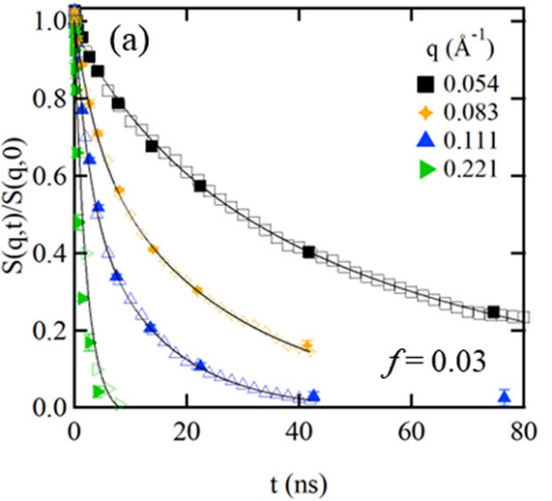
From Molecular Constraints to Macroscopic Dynamics in Associative Networks Formed by Ionizable Polymers
Scientific Achievement
Neutron spin echo (NSE) and atomistic molecular dynamics (MD) simulations revealed multi-scale dynamics of networks formed by sulfonated polystyrene solutions that strongly depends on the size and distribution of the ionic clusters.
Significance and Impact
Resolving the multiscale dynamics of these networks directly impacts the processing of ionizable polymers. A feedback loop between NSE and MD simulations results provides a new effective approach to study soft materials.
Visualization of sulfonated polystyrene ionomer in toluene. Sulfur (yellow), Oxygen (red), Na⁺ (black), polystyrene backbone (blue) (left). Dynamic structure factor S(q,t) from NSE (filled) and atomistic MD simulations (open) showing the excellent agree between the two (right).
Research Details
NSE results for polystyrene sulfonate in toluene were analyzed by the sum of two exponentials, providing two distinctive dynamics time scales.
Multimillion atomistic MD simulations generated computed networks for the same system. Dynamic structure factor is the same for the 2 methods with no adjustable parameters.
Kosgallana C.; Wijesinghe S.; Senanayake M.; Mohottalalage S. S.; Ohl, M.; Zolnierczuk, P., M.; Grest G. S.; Perahia D. “From Molecular Constraints to Macroscopic Dynamics in Associating Networks Formed by Ionizable Polymers: A Neutron Spin Echo and Molecular Dynamics Simulation Study,” ACS Polymers Au 4, 149-156 (2024).
Work was performed, in part, at the Center for Integrated Nanotechnologies
Notes:
1-2 paragraph description of highlight –
The dynamics of ionizable polymers grant their unique physics that ultimately enables their current and potential uses for light weigh energy applications. These polymers form physical networks with ionic assemblies, often termed clusters, as cross-linking centers, that determine the stability of the materials, and at the same time, enable the function of these polymers in device application. However, these assemblies morph as their environment changes, particularly in the presence of solvents that are integral to their function, introducing instabilities that ultimately result in device failure. Understanding the dynamics of these networks across time and length scales is fundamental to controlling these networks.
Capturing coupled dynamics exhibit a unique challenge, addressed in this work by combining results from neutron spin echo (NSE) experiments and molecular dynamics (MD) simulations carried out to times of the actual chain relaxation times. These groundbreaking long atomistic-level simulations were made possible by exascale computing, probing time scales that were not accessible before. With this two-prong approach, we were able to identify the dynamics within ionic clusters of a model ionic polymer solutions and provide a first direct correlation between ionic assembly and network dynamics. Beyond the impact of the results on ionic polymers’ enabling technologies, this approach would impact a broad range of soft matter systems that are governed by highly distinctive interactions.
Acknowledgements –
D.P. gratefully acknowledges DOE grant DE-SC0019284 for support. NSE measurements were carried at ORNL’s spallation neutron source. This research used resources at the Spallation Neutron Source, a DOE Office of Science User Facility operated by the Oak Ridge National Laboratory. The authors kindly acknowledge the use of computational resources provided by NSF MRI-1725573. This work was made possible in part by advanced computational resources deployed and maintained by Clemson Computing and Information Technology. This research used resources at the National Energy Research Scientific Computing Center (NERSC), a U.S. Department of Energy Office of Science User Facility operated under contract no. DE-AC02-05CH11231. This work was performed, in part, at the Center for Integrated Nanotechnologies, an Office of Science User Facility operated for the U.S. Department of Energy (DOE) Office of Science. Sandia National Laboratories is a multimission laboratory managed and operated by National Technology & Engineering Solutions of Sandia, LLC, a wholly owned subsidiary of Honeywell International, Inc., for the U.S. DOEs National Nuclear Security Administration under contract no. DE-NA-0003525. The views expressed in this article do not necessarily represent the views of the U.S. DOE or the United States Government. We thank Shalika Meedin for helpful discussions.
Corresponding Authors
Gary S. Grest - Sandia National Laboratories, Albuquerque, New Mexico 87175, United States; https://orcid.org/0000-0002-5260-9788; Email: gsgrest@sandia.gov
Dvora Perahia - Department of Chemistry, Clemson University, Clemson, South Carolina 29634, United States; Department of Physics, Clemson University, Clemson, South Carolina 29631, United States; https://orcid.org/0000-0002-8486-8645; Email: dperahi@g.clemson.edu
Authors
Chathurika Kosgallana - Department of Chemistry, Clemson University, Clemson, South Carolina 29634, United States
Sidath Wijesinghe - Department of Chemistry, Clemson University, Clemson, South Carolina 29634, United States; Department of ChemistryAppalachian State University, Boone, North Carolina 26808, United States; https://orcid.org/0000-0002-4812-1034
Manjula Senanayake - Department of Chemistry, Clemson University, Clemson, South Carolina 29634, United States; Present Address: Neutron Scattering Division, Oak Ridge National Laboratory, Oak Ridge, Tennessee 37831, USA; https://orcid.org/0000-0002-3139-0625
Supun S. Mohottalalage - Department of Chemistry, Clemson University, Clemson, South Carolina 29634, United States; Present Address: Materials Science Division, Lawrence Livermore National Laboratory, Livermore, California 94550, USA
Michael Ohl - Neutron Scattering Division, Oak Ridge National Laboratory, Oak Ridge, Tennessee 37831, United States; Present Address: Research Center Jülich, 52428 Jülich, Germany; https://orcid.org/0000-0002-8656-8005
Piotr Zolnierczuk - Neutron Scattering Division, Oak Ridge National Laboratory, Oak Ridge, Tennessee 37831, United States
Notes
Publication/ press releases/ related links:
doi.org/10.1021/acspolymersau.3c00049

