Slide 1
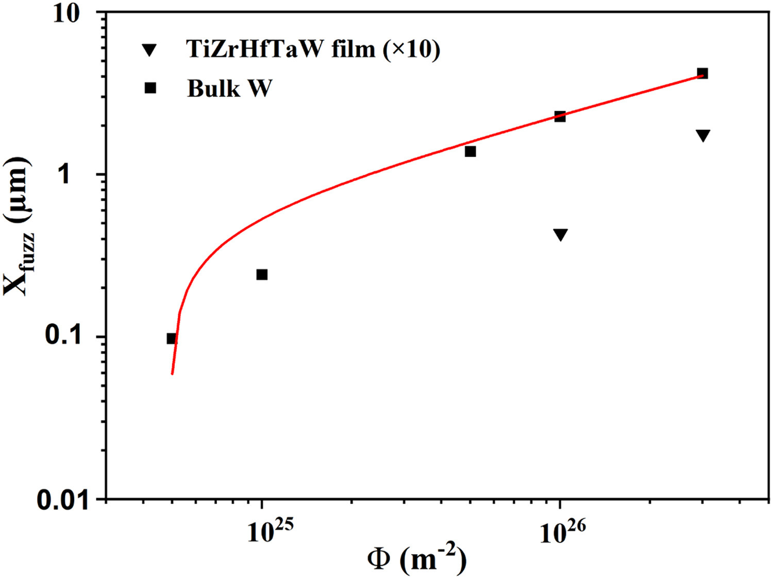
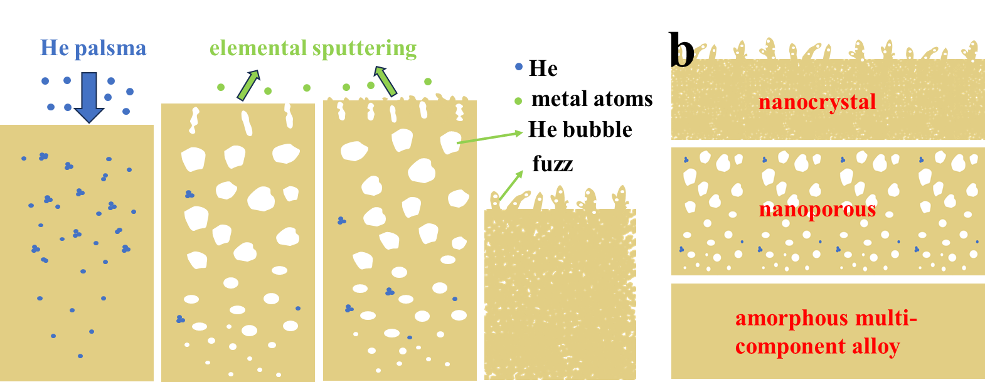
A New Type of Plasma Irradiation-Resistant Amorphous TiZrHfTaW Refractory Multi-component Alloy
(a1)
(a2)
(c)
Scientific Achievement
Discovery of new plasma facing materials, amorphous TiZrHfTaW film, with enhanced radiation resistance with a new mechanism.
W
Significance and Impact
Finding high performance plasma-facing materials for realization of commercial application of fusion reactors is a challenging task. With this new material, He migrates and merges to form large number of relatively small helium bubbles, leading to the formation of nanoporous structures, which blocks the diffusion of He.
(b1)
(b2)
(d)
TiZrHfTaW
Research Details
The amorphous TiZrHfTaW films were deposited on W discs by ultrahigh vacuum DC magnetron sputtering at room temperature .
The samples were exposed to the high-flux He plasma (50 eV) at ion flux of 1 × 1022 ions/m2s and temperature of around 1275 K.
The threshold fluence for forming fuzz structure in TiZrHfTaW film is increased greatly to 20 times higher and the length of fuzz irradiated to the fluence of 3 × 1026 ions/m2 is 28 times shorter than those of bulk W.
(a) Surface and cross-sectional SEM of the W (a) and amorphous TiZrHfTaW film (b) irradiated by He plasma to fluences of 5 × 10²⁴ (a1,b1) and 3 × 10²⁶ (a2, b2) ions/m². (c) Fuzz thickness of the amorphous TiZrHfTaW film and W. (d) Mechanism diagram of TiZrHfTaW film morphology changes with increasing irradiation fluence.
Ge, W.; Cai, G.; Qu, C.; Wei, G.; Ni, W.; Zhong, F.; Guo, E.; Fu, B.; Hong, M.; Wang, Y.; Ren, F. A New Type of Plasma Irradiation-Resistant Amorphous TiZrHfTaW Refractory Multi-Component Alloy. Acta Materialia 2025, 288, 120822.
Work was performed, in part, at the Center for Integrated Nanotechnologies.
Notes:
1-2 paragraph description of highlight –
Developing high performance plasma facing materials (PFMs) is one of the greatest challenges for fusion reactors because PFMs face unprecedented harsh environments. In this work, the radiation resistance of tungsten-containing amorphous refractory multi-component alloy film was studied by He plasma irradiation. The amorphous TiZrHfTaW film was evaluated by 50 eV helium plasma irradiation at 1275 K. The invaded helium atoms quickly diffuse inside the film delaying the formation of large He bubbles near surface and its break to form fuzz. Instead, He migrates and merges to form large number of relatively small helium bubbles, leading to the formation of nanoporous structures, which blocks the diffusion of He. This new "migration-blocking" strategy in the amorphous TiZrHfTaW film greatly slowing down the growth of fuzz. The threshold fluence for forming fuzz structure in TiZrHfTaW film is increased greatly to 20 times higher and the length of fuzz irradiated to the fluence of 3 × 10²⁶ ions/m² is 28 times shorter than those of bulk W. The presented results provide an idea for development of amorphous refractory multi-component alloys as a new kind of radiation resistant PFMs and trigger further study on it.
Acknowledgements –
The authors thank professor Minyou Ye and Dr. Zhe Lu from University of Science and Technology of China for supporting parial plasma irradiation experiments. This work was supported by the National Natural Science Foundation of China (grants 12105206, 11935011, and 12275197), and the Natural Science Foundation of Hubei Province, China (2020CFA041, 2023BAA009) for financial support. We thank the Core Facility of Wuhan University for assisting with the FIB and TEM measurements. This work was performed, in part, at the Center for Integrated Nanotechnologies, an Office of Science User Facility operated for the U.S. Department of Energy (DOE) Office of Science. Los Alamos National Laboratory, an affirmative action equal opportunity employer, is managed by Triad National Security, LLC for the U.S. Department of Energy's NNSA, under contract 89233218CNA000001.
Publication/ press releases/ related links:
Ge, W.; Cai, G.; Qu, C.; Wei, G.; Ni, W.; Zhong, F.; Guo, E.; Fu, B.; Hong, M.; Wang, Y.; Ren, F. A New Type of Plasma Irradiation-Resistant Amorphous TiZrHfTaW Refractory Multi-Component Alloy. Acta Materialia 2025, 288, 120822. DOI:10.1016/j.actamat.2025.120822.

