Slide 1
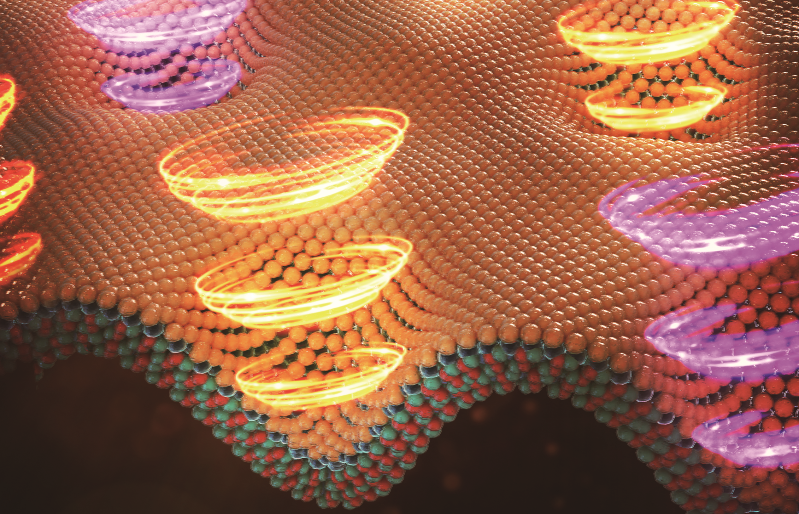
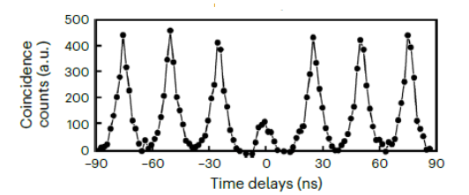






Turning Single Photons Chiral by Making a Source and a Magnet Together
Scientific Achievement
Strain engineering of WSe₂/NiPS₃ heterostructure to exploit proximity interaction for the generation of circularly polarized single photons (i.e., chiral quantum light).
Significance and Impact
Chiral quantum light emitters as the key component for non-reciprocal single-photon devices and deterministic spin–photon interfaces for quantum networks.
Exploit of proximity interactions as the effective route toward realization of quantum functionalities.
Research Details
Atomic force microscope (AFM) used to create nanoscale indentations on WSe2/NiPS3 heterostructure.
Strain of nano-indentations form quantum light-emitting state in WSe₂ co-located defect in antiferromagnetic order hosting a local magnetic moment.
Magnetic exchange interaction between localized exciton of WSe₂ and AFM defect leads to the emission of chiral quantum light.
Scanning diamond NV center microscopy and temperature-dependent magneto photoluminescence experiments prove proximity interaction is responsible for circularly polarized single photon emission.
PL intensity
1.6 Energy (eV) 1.7
Low-temperature (4K) PL spectra of an indentation show circularly polarized sharp photoluminescence emission from a localized exciton state.
Quantum states emitting circularly polarized single photons (yellow and purple spirals) are created by stacking a monolayer semiconductor (WSe₂ top layer) and an antiferromagnetic NiPS₃ crystal (bottom layer) and straining them with nanoscale indentations. Image credit: Xiangzhi Li
Hanbury Brown-Twiss experiment shows that a single circularly polarized photon is emitted per one excitation-emission cycle for 85% of the time.
Li, X.; Jones, A. C.; Choi, J.; Zhao, H.; Chandrasekaran, V.; Pettes, M. T.; Piryatinski, A.; Sinitsyn, N.; Crooker, S. A.; Han Htoon, H. Proximity-induced Chiral Quantum Light Generation in Strain-engineered WSe₂/NiPS₃ Heterostructures. Nature Materials 2023
Notes:
1-2 paragraph description of highlight
Quantum light emitters (QEs) capable of generating single photons of well-defined circular polarization could enable non-reciprocal single photon devices and deterministic spin-photon interfaces critical for realizing complex quantum networks. To date, emission of such chiral quantum light has been achieved via the application of intense external magnetic field electrical/optical injection of spin polarized carriers/excitons, or coupling with complex photonic/meta-structures. Here we report free-space generation of highly chiral single photons from QEs created in monolayer WSe2 - NiPS3 heterostructures at zero external magnetic field. These QEs emit in the 760-800 nm range with a degree of circular polarization and single photon purity as high as 0.71 and 80% respectively, independent of pump laser polarization. QEs are deterministically created by pressing a scanning probe microscope tip into a two-dimensional heterostructure comprising a WSe2 monolayer and a ~50 nm thick layer of the antiferromagnetic (AFM) insulator NiPS3. Temperature dependent magneto-photoluminescence studies indicate that the chiral quantum light emission arises from magnetic proximity interactions between localized excitons in the WSe2 monolayer and the out-of-plane magnetization of AFM defects in NiPS3, both of which are co-localized by the strain field arising from the nanoscale indentations.
The lead author, Wanyi Nie, of this work is recently featured as one of the women scientists in material research.
Acknowledgements –
This work was performed at the Center for Integrated Nanotechnologies, an Office of Science User Facility, operated for the US Department of Energy (DOE) Office of Science (OS). Los Alamos National Laboratory (LANL), an affirmative action equal opportunity employer, is managed by Triad National Security LLC for the US DOE’s NNSA, under contract 89233218CNA000001. Laboratory Directed Research and Development (LDRD) program 20200104DR provided primary support for the works of X.L., H.Z., A.P., N.S., S.A.C. and H.H. A.C.J. and V.C. acknowledge support from the DOE Basic Energy Sciences, QIS Infrastructure Development Program, Deterministic Placement and Integration of Quantum Defects. X.L., H.H. and S.A.C. also acknowledge partial support by the Quantum Science Center, a National QIS Research Center supported by the DOE, OS. J.C. and H.Z. also acknowledge partial support from LANL Director’s Postdoctoral Fellow Award. M.T.P. acknowledges support from LDRD awards 20210782ER and 20210640ECR. The National High Magnetic Field Laboratory is supported by the National Science Foundation (NSF) DMR-1644779, the State of Florida, and the US DOE. P.M., D.A.B., M.A.T. and P.R. acknowledge financial support from the National Centre of Competence in Research (NCCR) Quantum Science and Technology (QSIT), a competence centre funded by the Swiss National Science Foundation (SNF), by SNF project no. 188521, and by the ERC consolidator grant project QS2DM. We would like to acknowledge B. Zhou and X. Zhang for the magnetometry experiments using a near-surface ensemble of NV centres, and E. Peterson and C. A. Lane for insightful discussions on the magnetic-exchange proximity interaction.
Publication/ press releases/ related links:
Li, X.; Jones, A. C.; Choi, J.; Zhao, H.; Chandrasekaran, V.; Pettes, M. T.; Piryatinski, A.; Tschudin, M. A.; Reiser, P.; Broadway, D. A.; Maletinsky, P.; Sinitsyn, N.; Crooker, S. A.; Htoon, H. Proximity-Induced Chiral Quantum Light Generation in Strain-Engineered WSE2/NIPS3 Heterostructures. Nature Materials 2023. DOI:10.1038/s41563-023-01645-7.

