Slide 1
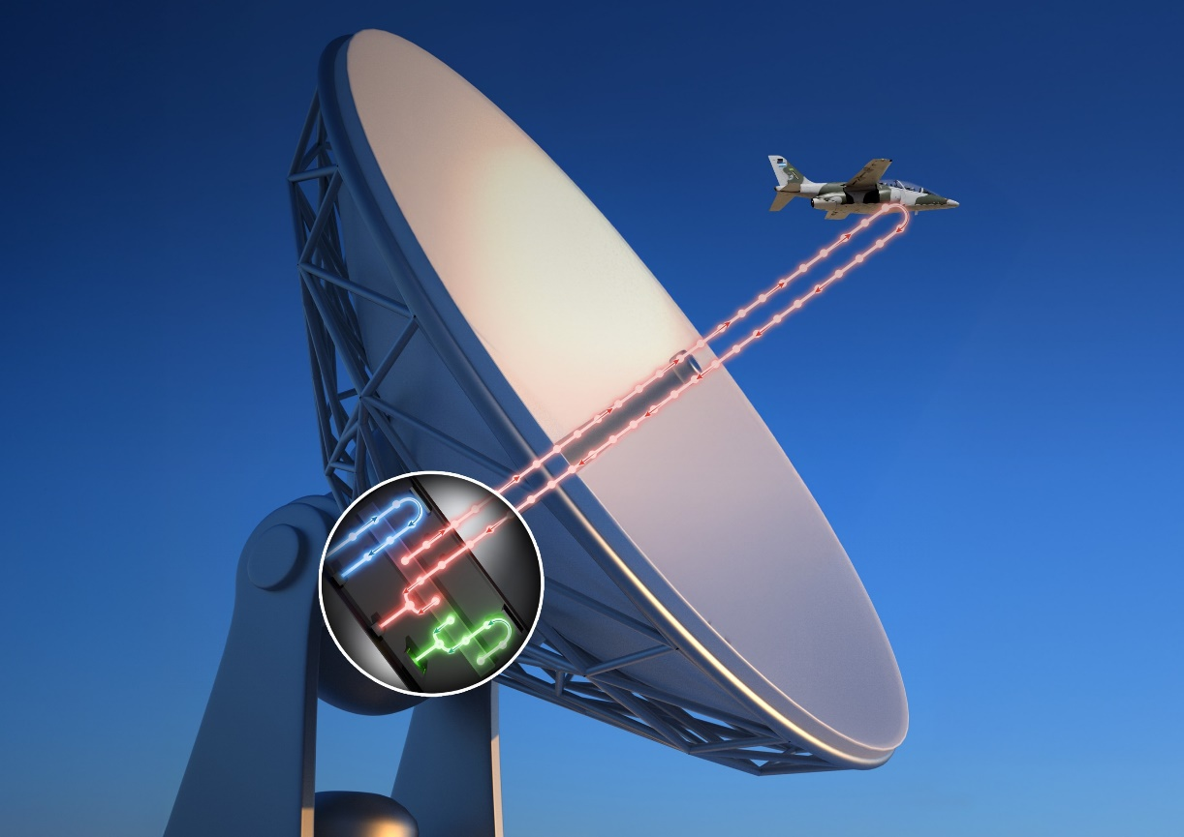
qCOMBPASS: Quantum Radar with Undetected Photons
Scientific Achievement
A novel quantum sensing framework using quantum frequency combs with path identity for remote sensing of signatures (“qCOMBPASS”).
Significance and Impact
Existing sensing schemes require a quantum memory to store a single photon of an initially entangled pair until its twin reflects off a target and returns.
qCOMBPASS uses quantum frequency combs — optical trains of identical laser pulses.
Research Details
Proposed scheme is akin to quantum radar based on entangled frequency comb pairs that uses path identity to detect/range/sense a remote target of interest by measuring pulses of one comb in the pair that never flew to target, but that contains target information “teleported” by quantum-induced coherence from the other comb in the pair that did fly to target but is not detected.
Challenges: long-time quantum storage and photon loss and noise.
qCOMBPASS in a surveillance operation. Quantum remote sensing allows to detect without being detected.
Dalvit, D.; Volkoff, T.; Choi, Y.-S.; Azad, A.; Chen, H.-T.; Milonni, P. Quantum Frequency Combs with Path Identity for Quantum Remote Sensing.
Work was performed, in part, at the Center for Integrated Nanotechnologies.
Notes:
1-2 paragraph description of highlight –
Quantum sensing promises to revolutionize sensing applications by employing quantum states of light or matter as sensing probes. Photons are the clear choice as quantum probes for remote sensing because they can travel to and interact with a distant target. Existing schemes are mainly based on the quantum illumination framework, which requires a quantum memory to store a single photon of an initially entangled pair until its twin reflects off a target and returns for final correlation measurements. Existing demonstrations are limited to tabletop experiments, and expanding the sensing range faces various roadblocks, including long-time quantum storage and photon loss and noise when transmitting quantum signals over long distances. We propose a novel quantum sensing framework that addresses these challenges using quantum frequency combs with path identity for remote sensing of signatures (“qCOMBPASS”). The combination of one key quantum phenomenon and two quantum resources, namely quantum induced coherence by path identity, quantum frequency combs, and two-mode squeezed light, allows for quantum remote sensing without requiring a quantum memory. The proposed scheme is akin to a quantum radar based on entangled frequency comb pairs that uses path identity to detect/range/sense a remote target of interest by measuring pulses of one comb in the pair that never flew to target, but that contains target information “teleported” by quantum-induced coherence from the other comb in the pair that did fly to target but is not detected. We develop the basic qCOMBPASS theory, analyze the properties of the qCOMBPASS transceiver, and introduce the qCOMBPASS equation – a quantum analog of the well-known LIDAR equation in classical remote sensing. We also describe an experimental scheme to demonstrate the concept using two-mode squeezed quantum combs. qCOMBPASS can strongly impact various applications in remote quantum sensing, imaging, metrology, and communications. These include detection and ranging of low-reflectivity objects, measurement of small displacements of a remote target with precision beyond the standard quantum limit (SQL), standoff hyperspectral quantum imaging, discreet surveillance from space with low detection probability (LPD, detect without being detected), very-long-baseline interferometry, quantum Doppler sensing, quantum clock synchronization, and networks of distributed quantum sensors.
Acknowledgements –
Contributions. DD conceived qCOMBPASS and developed the theory. TV contributed to the theoretical analysis of the path identity operation in the non-perturbative case. YC conducted the experimental demonstration of ZWM with a cw laser. AA made feasibility studies of experimental schemes. HTC performed experiment-theory analysis. PM did the full study of the qCOMBPASS equation and its distance scaling. AA, HTC, and DD designed the experimental implementation. All authors contributed to the writing of the manuscript.
Acknowledgments. We are grateful to J. Cox for insightful discussions on qCOMBPASS. We also acknowledge discussions with N. Dallmann, M. Everhart-Erickson, L.P. Garcia Pintos Barcia, W. Kort-Kamp, A. López Rubio, M. Lucero, R. Menzel, R. Newell, A. Touil, M. Wallace, and W. Zurek. Special thanks go to Profs. M. Cho and T.Y. Yoon at Korea University for crucial insights into frequency comb single-photon interferometry, and to Prof. M. Endo at University of Tokyo for discussions on photon squeezing. This work was supported by Los Alamos National Laboratory LDRD program. AA and HTC acknowledge partial support from the Center for Integrated Nanotechnologies.
Publication/ press releases/ related links:
https://arxiv.org/html/2410.07044v1

