Slide 1
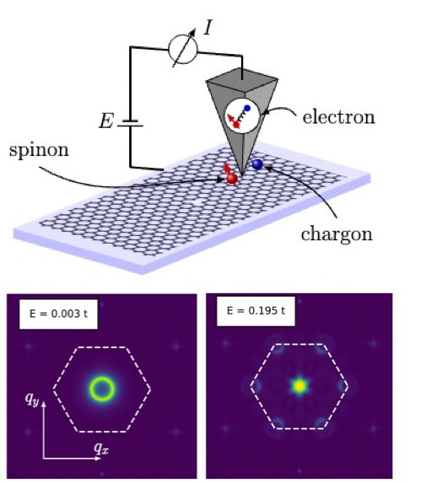
Quasiparticle Interference in Kitaev Quantum Spin Liquids
Scientific Achievement
Development of the first theoretical framework for understanding quasiparticle interference in Kitaev quantum spin liquids and revealing how electron tunneling signatures can directly probe fractionalized excitations like spinons and visons.
Significance and Impact
This work provides a novel method for identifying and characterizing Kitaev spin liquids through scanning tunneling microscopy. The approach opens a pathway to measure spinon dispersions and detect elusive vison excitations, advancing the search for topological quantum matter and potential platforms for quantum computing.
Research Details
Establishes a parton mean-field theory for electron tunneling into Kitaev spin liquids.
Demonstrates that electron tunneling spectra are governed by the convolution of spinon and chargon densities of states and that the energy derivative of tunneling conductance directly reflects spinon properties.
Identifies distinct quasiparticle interference patterns around impurities — signatures of visons and spinons.
Jahin, A.; Zhang, H.; Halász, G. B.; Lin, S.-Z. Quasiparticle Interference in Kitaev Quantum Spin Liquids. Physical Review Letters 2025, 134 (12). DOI:10.1103/physrevlett.134.126501.
This work was performed, in part, at The Center for Integrated Nanotechnologies.
Notes:
1-2 paragraph description of highlight –
A quantum spin liquid is an exotic state of matter with potential applications in quantum computing. Detecting this state experimentally remains a significant challenge. We propose using scanning tunneling microscopy (STM) to identify a quantum spin liquid by measuring the quasiparticle interference pattern near vacancies in the Kitaev quantum spin liquid. The interference pattern exhibits characteristic features uniquely associated with the quantum spin liquid state.
Acknowledgements –
We thank Yuhki Kohsaka, Yuji Matsuda, Cristian Batista, and Natalia Perkins for helpful discussions, and particularly Yuji Matsuda for sharing their unpublished manuscript. The work at LANL was carried out under the auspices of the U.S. DOE NNSA under Contract No. 89233218CNA000001 through the LDRD Program, was supported by the Center for Nonlinear Studies at LANL, and was performed, in part, at the Center for Integrated Nanotechnologies, an Office of Science User Facility operated for the U.S. DOE Office of Science, under user Proposals No. 2018BU0010 and No. 2018BU0083. G. B. H. was supported by the U.S. Department of Energy, Office of Science, National Quantum Information Science Research Centers, Quantum Science Center. This manuscript has been authored by UT-Battelle, LLC, under contract DE-AC05-00OR22725 with the US Department of Energy (DOE). The publisher acknowledges the US government license to provide public access under the DOE Public Access Plan
Publication/ press releases/ related links:
DOI: https://doi.org/10.1103/PhysRevLett.134.126501
ACS Nano 2025: https://doi.org/10.1021/acsnano.4c18261

