Slide 1
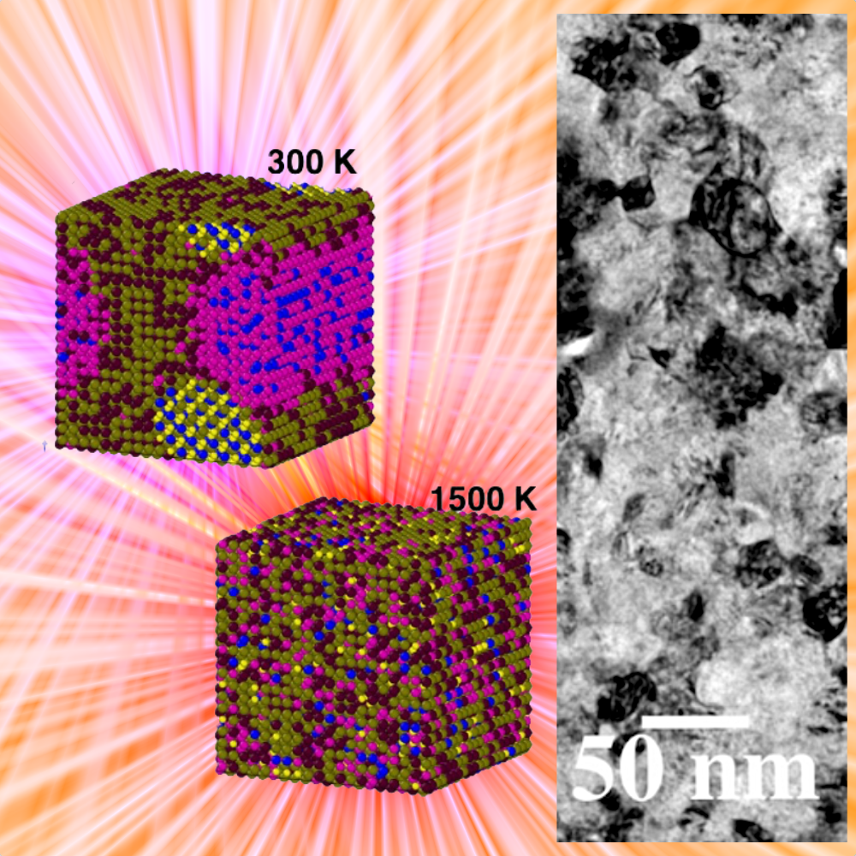
New refractory high-entropy alloys with enhanced radiation resistance to support nuclear fusion developments
Scientific Achievement
A new nanocrystalline refractory high-entropy alloy (RHEA) based on WTaCrVHf tested under simulated irradiation conditions mocking a nuclear fusion reactor. Results indicate a superior resistance to radiation damage compared to pure W and other materials.
Significance and Impact
RHEAs are promising candidate materials for future nuclear fusion reactors. Previous research has shown that a quaternary version of this system (i.e., WTaCrV RHEA) undergo precipitation at doses as low as 7 displacements-per-atom (no displacement damage in a form of loops or voids were observed).
Research Details
New RHEA was synthesized in the magnetron-sputtering laboratory at CINT.
Irradiation resistance was tested independently at the IVEM facility.
This new alloy has not exhibited any precipitation under irradiation.
WTaCrVHf RHEA present an order-to-disorder transition temperature that has been related to superior radiation tolerance in simulated nuclear fusion environments.
El Atwani, O.; Vo, H. T.; Tunes, M. A.; Lee, C.; Alvarado, A.; Krienke, N.; Poplawsky, J. D.; Kohnert, A. A.; Gigax, J.; Chen, W.-Y.; Li, M.; Wang, Y. Q.; Wróbel, J. S.; Nguyen-Manh, D.; Baldwin, J. K.; Tukac, O. U.; Aydogan, E.; Fensin, S.; Martinez, E. A Quinary WTACRVHF Nanocrystalline Refractory High-Entropy Alloy Withholding Extreme Irradiation Environments. Nature Communications 2023, 14 (1).
This work was performed in part at The Center for Integrated Nanotechnologies.
Notes:
HL Type (place “X” where appropriate): User___, Staff_X_, User & Staff__X_
1-2 paragraph description of highlight
In the quest of new materials that can withstand severe irradiation and mechanical extremes for advanced applications (e.g. fission & fusion reactors, space applications, etc.), design, prediction and control of advanced materials beyond current material designs become paramount. Here, through a combined experimental and simulation methodology, we design a nanocrystalline refractory high entropy alloy (RHEA) system. Compositions assessed under extreme environments and in situ electron-microscopy reveal both high thermal stability and radiation resistance. We observe grain refinement under heavy ion irradiation and resistance to dual-beam irradiation and helium implantation in the form of low defect generation and evolution, as well as no detectable grain growth. The experimental and modeling results—showing a good agreement—can be applied to design and rapidly assess other alloys subjected to extreme environmental conditions.
Collaborating Institutions
Los Alamos National Laboratory
Argonne National Laboratory
Oak Ridge National Laboratory (CNMS)
Funding Overview Section (place “X” for all relevant sources)
BES Funding: MSED___, CSGB___, EFRC___, SUFD___
SC Funding: ASCR___, BES___, BER___, FES___, HEP___, NP___, WDTS___, SBIR___, etc.
Other Funding: DOD___, DOE___, NIH___, NSF___, etc.
Funding details for all sources: (example)
This work was supported by the U.S. Department of Energy, Office of Nuclear Energy under DOE Idaho Operations Office Contract DE-AC07- 051D14517 as part of a Nuclear Science User Facilities experiment. Research in this work was performed, in part, at the Center for Integrated Nanotechnologies, and Office of Science User Facility operated for the U.S. Department of Energy (DOE) Office of Sciences by Los Alamos National Laboratory (Contract 89233218CNA000001) and Sandia National Laboratories (Contract DE-NA-0003525). O.E.A. acknowledges support from the Laboratory Directed Research and Development (LDRD) program of Los Alamos National Laboratory under the early career program project number 20210626ECR. O.E.A. and E.M. acknowledge support from the Department of Energy-Fusion Energy Science pilot program under AT2030110. M.A.T. also acknowledges support from LDRD under project number 20200689PDR2. D.N.M. and J.S.W. work has been carried out within the framework of the EUROfusion Consortium, funded by the European Union via the Euratom Research and Training Program (Grant Agreement No 101052200—EUROfusion). Views and opinions expressed are however those of the author(s) only and do not necessarily reflect those of the European Union or the European Commission. Neither the European Union nor the European Commission can be held responsible for them. D.N.M. also acknowledges funding from the RCUK Energy Program Grant No. EP/W006839/1. The work at WUT has been carried out as a part of an international project co-financed from the funds of the program of the Polish Minister of Science and Higher Education entitled “PMW” in 2019; Agreement No. 5018/H2020-Euratom/2019/2. D.N.M. and J.S.W. would like to thank the support from the high-performing computing facility MARCONI (Bologna, Italy) provided by EUROfusion. APT research was supported by the Center for Nanophase Materials Sciences (CNMS), which is a US Department of Energy, Office of Science User Facility at Oak Ridge National Laboratory. The authors would like to thank James Burns for their assistance in performing APT sample preparation and running the APT experiments. Authors acknowledge Koray Iroc for preliminary CALPHAD simulations.
Publication/ press releases/ related links:
El Atwani, O.; Vo, H. T.; Tunes, M. A.; Lee, C.; Alvarado, A.; Krienke, N.; Poplawsky, J. D.; Kohnert, A. A.; Gigax, J.; Chen, W.-Y.; Li, M.; Wang, Y. Q.; Wróbel, J. S.; Nguyen-Manh, D.; Baldwin, J. K.; Tukac, O. U.; Aydogan, E.; Fensin, S.; Martinez, E. A Quinary WTACRVHF Nanocrystalline Refractory High-Entropy Alloy Withholding Extreme Irradiation Environments. Nature Communications 2023, 14 (1). DOI:10.1038/s41467-023-38000-y.

