Slide 1
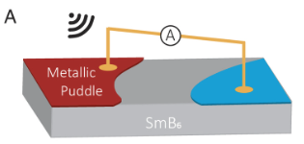
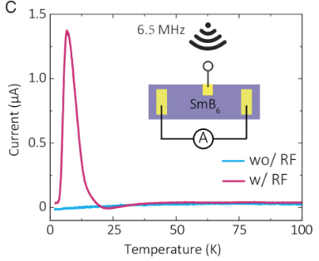
Realizing a Topological Diode Effect on the Surface of a Topological Kondo Insulator
Scientific Achievement
Rectification effects (conversion rf modulation into dc currents) are realized on the surface of SmB₆, a topological Kondo insulator.
Significance and Impact
Introducing the concept of topology to the field of microelectronics holds the potential for optoelectronic applications at low temperatures.
Research Details
The team synthesized high-quality SmB₆ crystals, a three-dimensional topological insulator driven by strong electronic correlations.
Electrical current was measurement as a function of temperature, rf frequency, doping level, and contact configuration.
Diode and rectification effects were observed and attributed to pn junctions created from spatial inhomogeneities that break mirror symmetry on the surface.
(A) Illustration of metallic surface puddles forming out of the insulating bulk states of SmB₆. (B) Rectification current measured by the two-contact method. A -20 dBm 6.5 MHz RF signal was applied to the sample through a third electrode.
Work was performed, in part, at the Center for Integrated Nanotechnologies.
Zhang, J.; Hua, Z.; Wang, C.; Smidman, M.; Graf, D.; Thomas, S.; Rosa, F. S. P.; Wirth, S.; Dai, X.; Peng, Yuan, H.; Wang, X.; Jiao, L. Proc. Natl. Acad. Sci. U.S.A. 122 (12) e2417709122 (2025),
Notes:
Polymer electrolyte fuel cells (PEFCs) that run on green hydrogen are a promising option for powering heavy-duty vehicles that produce zero greenhouse-gas emissions. This type of fuel cell has the potential to extend driving range without incurring additional weight penalties. However, PEFCs use platinum as a catalyst to drive a key chemical reaction. The fast degradation of this precious metal in a PEFC and the resulting high cost currently prevent the widespread commercialization of this otherwise excellent technology. In this study, researchers wanted to better understand the nanoscale mechanisms by which platinum degrades during PEFC operation. They put the relevant components through accelerated stress tests that simulated the conditions of use in heavy-duty vehicles. They then probed the changes in platinum nanoparticle size and location using x-ray microdiffraction and microfluorescence at the ALS. The results point the way to improvements in PEFC fabrication that can significantly extend the lifetime and efficiency of PEFCs in heavy-duty vehicles, reduce their cost, improve air quality, and fight climate change.
Researchers: K. Khedekar, P. Atanassov, and I.V. Zenyuk (University of California, Irvine); A. Zaffora (UC Irvine and University of Palermo, Italy); M. Santamaria (University of Palermo, Italy); M. Coats and S. Pylypenko (Colorado School of Mines); J. Braaten, L. Cheng, and C. Johnston (Bosch Research and Technology Center North America); and N. Tamura (ALS).
Acknowledgement from paper: Bosch Research and Technology Center North America. Operation of the ALS is supported by the US Department of Energy, Office of Science, Basic Energy Sciences program.
We thank Vidya Madhavan, Binghai Yan, Yuanfeng Xu, Yongqing Li, Joe Thompson, Cagliyan Kurdak, Wenxin Ding, Chunyu Guo, and Jinglei Zhang for fruitful discussions. We appreciate the technical support from Da Xu on the RF signal measurements and Chao Cao on numerical calculations. This study was funded in part by the National Key R&D Program of China (Grant Nos. 2022YFA1402200 and 2023YFA1406100), the National Natural Science Foundation of China (Grant Nos. 12374151, 12350710785 12222410 and 12034017), the Zhejiang Provincial Natural Science Foundation of China (Grant No. LR25A040003), and the Fundamental Research Funds for the Central Universities (Grants Nos. 226-2024-00039 and 226-2024-00068). Work at Florida State University is supported by the NSF via Grants DMR-1905843 and DMR-2325147. A portion of this work was performed at the National High Magnetic Field Laboratory, which is supported by the NSF Cooperative Agreement (Nos. DMR-2128556 and DMR-1644779) and the State of Florida. Work at Los Alamos National Laboratory was performed under the auspices of the U.S. Department of Energy, Office of Basic Energy Sciences, Division of Materials Science and Engineering. Scanning electron microscope and energy dispersive X-ray measurements were supported by the Center for Integrated Nanotechnologies, an Office of Science User Facility operated for the U.S. Department of Energy Office of Science.
Full highlight: https://als.lbl.gov/tracking-platinum-movement-on-fuel-cell-electrodes/
doi:10.1073/pnas.2417709122.

