Slide 1
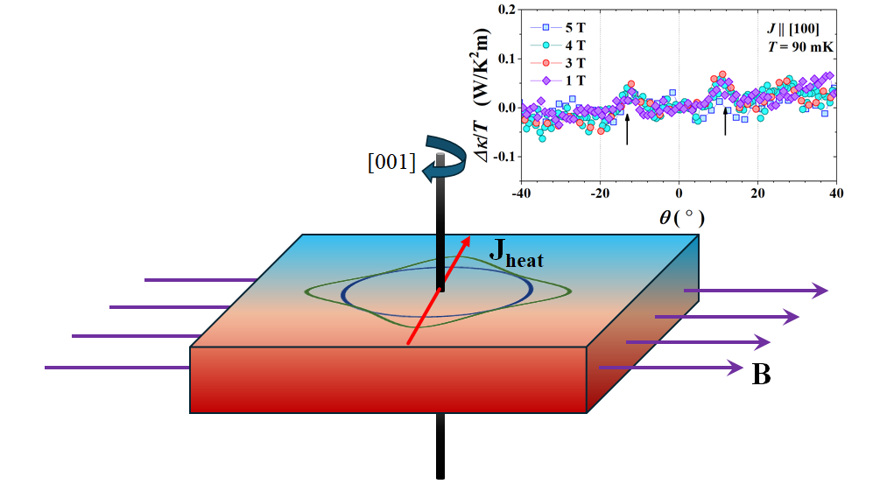
Revealing Normal Fermi Surface In Superconductors
Scientific Achievement
Identification of uncondensed Landau quasiparticles inside the superconducting phase through the quantum oscillation in thermal conductivity.
Significance and Impact
Novel identification of the normal Fermi surface within a superconductor.
Research Details
Distinct resonance in thermal conductivity when a magnetic field is applied at specific angles.
Observed resonances are attributed to the emergence of uncondensed Landau quasiparticles in the superconducting state.
Theory calculations reveal several sharp peaks in the density of states as the magnetic field's direction is varied, consistent with the experiment.
Quantum oscillation in superconducting state.
Lee, S.; Kim, D. Y.; Rosa, P. F. S.; Bauer, E. D.; Ronning, F.; Thompson, J. D.; Lin, S.-Z.; Movshovich, R. Normal Fermi Surface in the Nodal Superconductor. Physical Review Letters 2024, 132 (23). DOI:10.1103/physrevlett.132.236002.
Work was performed, in part, at the Center for Integrated Nanotechnologies.
Notes:
1-2 paragraph description of highlight
Thermal conductivity is a powerful transport probe of a superconducting state. The superconducting condensate does not carry heat current; only normal quasiparticles participate in electronic (charge) thermal transport. As a result, thermal conductivity is exquisitely sensitive to the structure of the superconducting energy gap. It can easily differentiate between a conventional superconductor with a fully gapped Fermi surface (FS) with exponential dependence of thermal conductivity on temperature, and an unconventional superconductor with nodes (zeros) in the superconducting gap, which leads to a power-law temperature dependence. In this manner, CeCoIn5 was quickly identified as an unconventional superconductor with lines of nodes (similar to high- 𝑇𝑐 cuprates) upon the discovery of superconductivity in this compound.
Acknowledgements
We are grateful to Ilya Vekhter and Anton Vorontsov for numerous stimulating discussions. Theoretical work (S. Z. L.) was supported by DOE via LDRD program at LANL and in part, by the Center for Integrated Nanotechnologies, an Office of Science User Facility operated for the U.S. DOE Office of Science, under user proposals No. 2018BU0010 and No. 2018BU0083. Experimental work was conducted under the auspices of the U.S. Department of Energy, Office of Science, Basic Energy Sciences, Materials Sciences and Engineering Division.
Publication/ press releases/ related links

