Slide 1
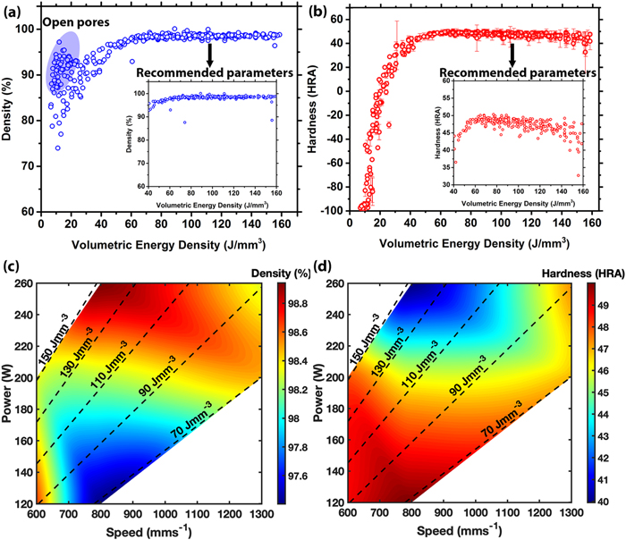
Tailoring Additive Manufacturing to Optimize Dynamic Properties in 316L Stainless Steel
Scientific Achievement
Development of a high-throughput approach to manufacture samples using additive manufacturing.
Significance and Impact
This work allows for the investigation of structure–property relationships between build parameters and resulting microstructures.
Research Details
316L stainless steel (SS) was manufactured via selected laser melting and its microstructure was altered through changing build parameters, e.g., laser power, speed, and hatch spacing systematically.
These samples were then subjected to spall recovery experiments to measure the spall strength and quantify the amount of damage as a function of build parameters.
(a) Density plot of each as-built sample as a function of VED.
(b) Hardness measurements for each as-built sample as a function of VED.
(c) and (d) Density and hardness maps for each sample.
Derby, B. K.; Agrawal, A.; Jones, D. R.; Pokharel, R.; Martinez, D. T.; Martinez, R.; Wanni, J.; Thoma, D.; Fensin, S. J. Tailoring Additive Manufacturing to Optimize Dynamic Properties in 316l Stainless Steel. Journal of Applied Physics 2025, 137 (10).
Work was performed, in part, at the Center for Integrated Nanotechnologies.
Notes:
1-2 paragraph description of highlight –
Material performance under dynamic loading is dependent on how energy gets dissipated internally, which is ultimately determined by a microstructure. The internal pathways that metals seek to dissipate energy include twinning,^{1–3} rapid dislocation generation and motion,⁴ void nucleation,⁵ or adiabatic shear banding.⁶ In face-centered cubic (FCC) metals, the mechanical strength is controlled via solute concentration, dislocation density, and grain boundaries.⁷ In fact, previous work has shown that changes in the microstructure that might have a relatively small effect on quasi-static properties, such as porosity, or crystallographic texture can have a huge effect on the dynamic strength and damage response of a material.^{8–12} Hence, the microstructure is a variable that can be modified to tailor a material’s response in a rapid manner.
Acknowledgements –
This work was supported by the U.S. Department of Energy through the Los Alamos National Laboratory. Los Alamos National Laboratory is operated by Triad National Security, LLC, for the National Nuclear Security Administration of the U.S. Department of Energy (Contract No. 89233218CNA000001). DLPA data were collected by Bjørn Clausen on SMARTS. UW-Madison would like to acknowledge partial support by the Department of Energy/National Nuclear Security Administration under Award No. DE-NA0003921. The electron microscopy was carried out using facilities and instrumentation that are partially supported by the National Science Foundation (NSF) through the Materials Research Science and Engineering Center (No. DMR-1720415).
Publication/ press releases/ related links:
DOI:10.1063/5.0245699.

