Slide 1
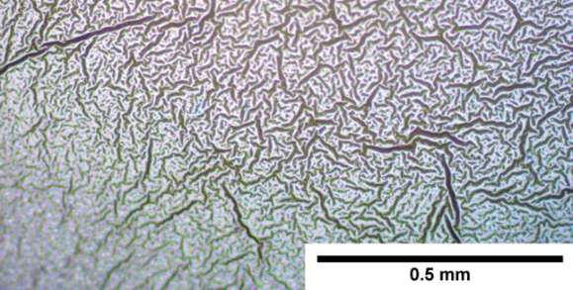
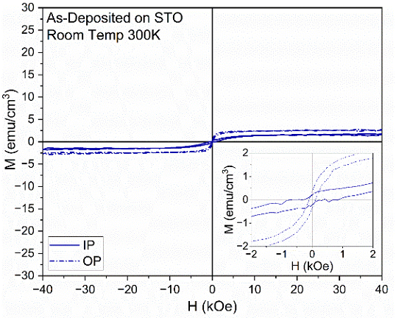
Transferring Millimeter-Scale Strained Multiferroic Epitaxial Thin Films
Scientific Achievement
We demonstrate a process using rigid substrate transfer to achieve the transfer of large, crack-free regions of Bi₃Fe₂Mn₂O_{x} (BFMO) supercell films, which exhibit both ferromagnetism and ferroelectricity. This rigid substrate process enables the transfer of areas 10x larger than those achieved by previous methods.
(a)
(b)
Significance and Impact
BFMO is a promising platform for memory devices, computing paradigms, acoustic sensors, and integrated photonics. The ability to transfer large areas of BFMO may lead to new surface acoustic wave devices, acoustically driven ferromagnetic resonance transducers, and four-state memory cells. This method is generalizable and can be used for transferring a variety of strained films.
(c)
(d)
Research Details
Highly-strained layered supercells are epitaxially grown using pulsed layer deposition.
The built-in strain is prevented from relaxing through epoxy bonding. Further strain control enables the clean removal of the epitaxial growth substrate.
(a) Optical image of traditional process for transferring Bi₃Fe₂Mn₂O_{x} (BFMO) supercell films resulting in cracking and wrinkling. (b) Films transferred using rigid substrate process resulting in a 10x improvement in crack-free areas. Magnetic hysteresis curves for (c) as-deposited and (d) rigid transferred films with the magnetic saturation increasing from 2.5 emu/cm³ to 26 emu/cm³.
Barnard, J. P.; Zhang, Y.; Quigley, L.; Shen, J.; Tsai, B. K.; Chhabra, M. R.; Noh, J.; Jung, H.; Mitrofanov, O.; Sarma, R.; Siddiqui, A.; Brener, I.; Doiron, C. F.; Wang, H. Transfer of Millimeter‐scale Strained Multiferroic Epitaxial Thin Films on Rigid Substrates via an Epoxy Method Producing Magnetic Property Enhancement. Advanced Electronic Materials 2024.
Work was performed, in part, at the Center for Integrated Nanotechnologies
Notes:
1-2 paragraph description of highlight –
Acknowledgements – The thin film growth effort was supported by the U.S. Office of Naval Research (N00014-20-1-2600). The film transfer effort was supported by the U.S. National Science Foundation (DMREF-2323753). Y.Z. and H.W. acknowledge the support from the U.S. National Science Foundation (DMR-2016453) for high resolution microscopy analysis. J.S. also acknowledges the support from the Purdue Bilsland Fellowship. I.B., J.N., H.J, O.M., and R.S. acknowledge the support from the U.S. Department of Energy, Office of Basic Energy Sciences, Division of Materials Sciences and Engineering (BES 20-017574). This work was performed, in part, at the Center for Integrated Nanotechnologies, an Office of Science User Facility operated for the U.S. Department of Energy (DOE) Office of Science. This article has been authored by an employee of the National Technology & Engineering Solutions of Sandia, LLC under Contract No. DE-NA0003525 with the U.S. Department of Energy (DOE). This work was performed under the Laboratory Directed Research and Development (LDRD) program at Sandia National Laboratories. Sandia National Laboratories is a multimission laboratory managed and operated by National Technology and Engineering Solutions of Sandia, LLC, a wholly owned subsidiary of Honeywell International Inc., for the U.S. Department of Energy's National Nuclear Security Administration under contract DE-NA0003525. This paper describes objective technical results and analysis. Any subjective views or opinions that might be expressed in the paper do not necessarily represent the views of the U.S. Department of Energy or the United States Government.
.
Publication/ press releases/ related links: https://advanced.onlinelibrary.wiley.com/doi/full/10.1002/aelm.202400492

