Slide 1
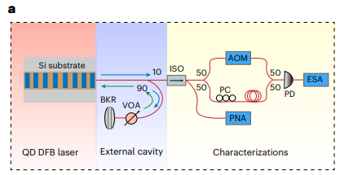
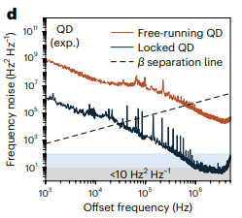
Turnkey Locking of Quantum-dot Lasers Directly Grown on Silicon
Scientific Achievement
Demonstrated turnkey approach to achieve high spectral stability in quantum-dot (QD) lasers directly grown on Silicon.
Significance and Impact
Direct growth on Silicon enables integration with Silicon photonics in complex photonics integrated circuits (PICs).
Cost-effective manufacturability from turnkey components.
16 Hz linewidth reduces noise in conventional and quantum coherent sensing and communication systems.
Quintessent is commercializing this technology in an onshore foundry.
Research Details
High-performance QD lasers provide scalable, low-cost, integration platforms to implement external-cavity locking.
1st-principle theory provides understanding of band structure, many-body and cavity quantum electrodynamics (cQED) physics.
a
b
(a) Experimental setup for QD external-cavity locking (ECL). (b) Frequency-noise spectra of the QD laser in free-running (burgundy) and turnkey (black) operation.
B. Dong, Y. Wating, W. W. Chow, C. Shang, A. Prokoshin, E. Alkhazraji, R. Koscica, H. Wang, J. E. Bowers, Nat. Photon. 18, (2024)
Notes:
1-2 paragraph description of highlight —
Quantum dot lasers are important for photonic systems because of their high reliability, high temperature operation, high tolerance to radiation, and low noise. We demonstrate record low noise and low linewidth of quantum dot lasers in external cavity configuration with turnkey locking of the laser to the cavity.
Acknowledgements —
This work is supported by the Defense Advanced Research Projects Agency (DARPA) MTO GRYPHON (HR0011-22-2-0009) and LUMOS (HR0011-20-2-0044) programs. We acknowledge King Abdullah University of Science and Technology (KAUST) under award nos. RFS-OFP2023-5558, ORA-2022-5314 and ORA-2022-5313, and SDAIA-KAUST Center of Excellence in Data Science and Artificial Intelligence (SDAIA-KAUST AI). W.W.C. acknowledges support from the Sandia National Laboratories, a multimission laboratory managed and operated by National Technology & Engineering Solutions of Sandia, LLC, a wholly owned subsidiary of Honeywell International Inc., for the US Department of Energy’s National Nuclear Security Administration under contract DE-NA0003525. This paper describes objective technical results and analysis. Any subjective views or opinions that might be expressed in the paper do not necessarily represent the views of the US Department of Energy or the United States Government. This work was performed, in part, at the Center for Integrated Nanotechnologies, an Office of Science User Facility operated for the U.S. Department of Energy (DOE) Office of Science.
Publication/ press releases/ related links —
Dong, B.; Wan, Y.; Chow, W. W.; Shang, C.; Prokoshin, A.; Alkhazraji, E.; Koscica, R.; Wang, H.; Bowers, J. E. Turnkey Locking of Quantum-Dot Lasers Directly Grown on Si. Nature Photonics 2024. DOI:10.1038/s41566-024-01413-2.

