Slide 1
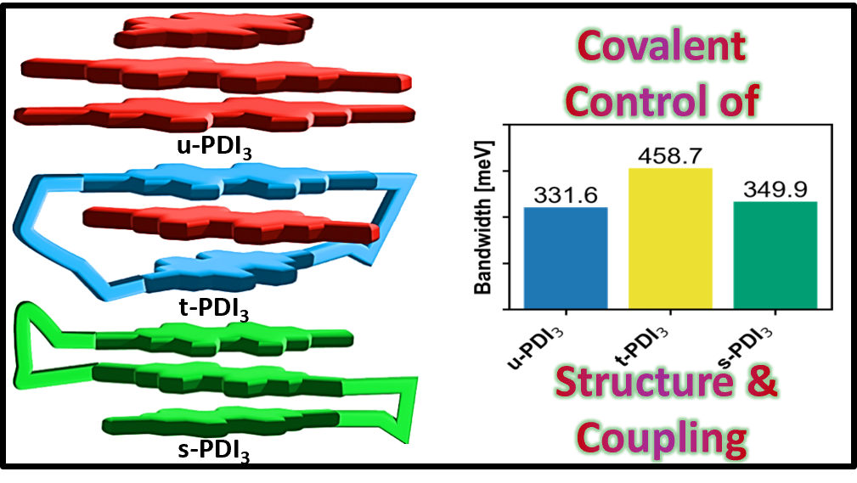




Covalent Control of Excitonic Interactions: The Twist!
Scientific Achievement
A CINT User Team demonstrated that molecular twist angles, not separation distance, control how efficiently energy moves between molecules. Chemical bonds that hold molecules in symmetric arrangements create uniform, efficient charge transfer. Without these bonds, molecules twist asymmetrically, creating diverse electronic behaviors useful for different applications.
Significance and Impact
Provides design guidelines for creating better solar cells, organic electronics, and light-harvesting materials. By controlling molecular geometry through chemical bonds, researchers can engineer materials with specific properties for energy conversion, flexible electronics, and advanced photonic devices.
Research Details
  Used ab-initio methods to predict electronic properties and energy transfer in three different PDI architectures
  Analyzed how molecular geometry, particularly twist angles and alignments, affects energy and charge movement
  Compared molecules without chemical bonds to those held together by different bonding strategies in water-like environments
Figure: Molecular twist patterns provides design rules for building better organic solar cells and electronic devices.
Khanna, A.; Olivier, J.-H.; Fernandez-Alberti, S.; Tretiak, S. Covalent Control of Excitonic Interactions in Perylenediimide Trimers: A Computational Study. Nano Letters. 2026.
Work was performed, in part, at the Center for Integrated Nanotechnologies.
Notes:
1-2 paragraph description of highlight
Organic molecules that absorb light can be connected together like building blocks to create materials for solar cells and electronics. How these molecules are attached, whether loosely stacked or chemically linked, dramatically changes how energy and electrical charges move through the material. We used computer simulations to compare three different ways of connecting these molecular building blocks to understand what makes energy transfer efficient or inefficient.
We discovered that the way molecules twist relative to each other matters much more than how far apart they are. When molecules are held in symmetrical arrangements through chemical bonds, they work together uniformly and efficiently move charges. When molecules are not held in place, they twist into asymmetric arrangements that create diverse electronic behavior. This gives us clear design rules for building better solar energy materials and organic electronics by controlling molecular geometry.
Acknowledgements
This study was supported by the U.S. Department of Energy, Office of Science, Office of Basic Energy Sciences, Division of Chemical Sciences, Geosciences, and Biosciences, under the LANLE3T1 workpackage (to A.K and S.T.) at LANL. This work was performed, in part, at the Center for Integrated Nanotechnologies at LANL. LANL is operated by Triad National Security, LLC, for the National Nuclear Security Administration of the U.S. Department of Energy. S.F.-A. acknowledges support of CONICET. J.-H.O acknowledges support from an NSF CAREER award (CHE-2401869).
Publication/ press releases/ related links: https://pubs.acs.org/doi/full/10.1021/acs.nanolett.5c05802

