Slide 1
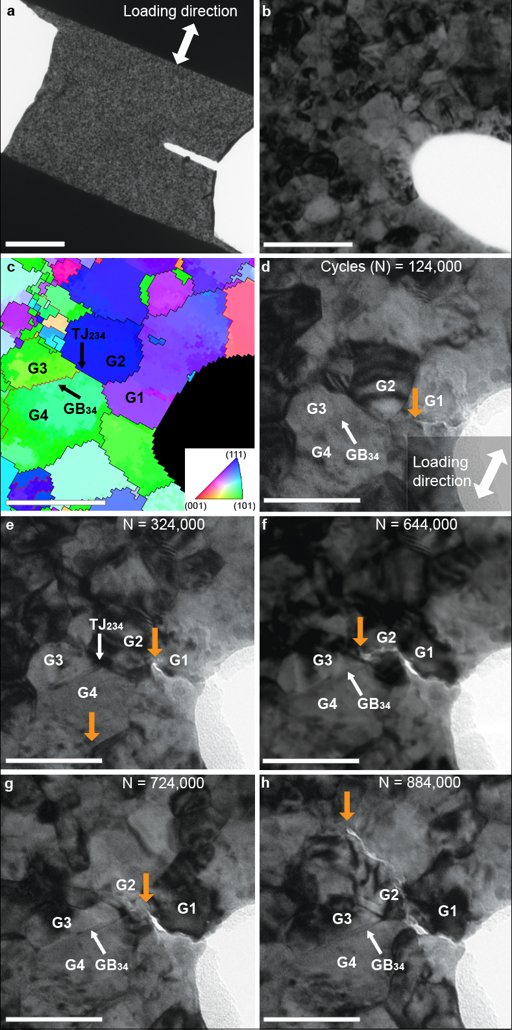
Autonomous healing of fatigue cracks in metals
Scientific Achievement
Discovery that fatigue-cracks in metals heal themselves at the nanoscale via a process that involves crack-flank contact and cold welding.
Significance and Impact
These results could motivate new strategies to tailor metals for fatigue-crack resistance and reframe the mechanistic interpretation of several prior observations, e.g., effects of vacuum & mean stress on fatigue thresholds.
Initial images (a-b), grain orientation map (c), and still images taken at intermediate steps during fatigue loading (d-h). The crack tip (orange arrow) propagates as a function of number of fatigue cycles (N) in the vicinity of Grains G1-G4. Crack healing occured between 644K and 724K cycles, and subsequent regrowth in a new direction. Two additional confirmatory fatigue-crack healing experiments were performed in Pt and Cu. Scale bars: (a) 1000 nm, (b) 100 nm, and (c-h) 50 nm.
Research Details
Sandia’s rare capability to perform high-cycle fatigue tests in the TEM was necessary to observe the healing phenomena.
Grain boundary migration was shown to facilitate crack flank contact needed to induce cold welding.
Modeling shows that only some local microstructural configurations are suitable to induce crack flank contact and cold welding.
While the present observations were made in pure Pt and Cu, atomistic models of the process suggest that it could happen in many other metals.
This work was performed in part at The Center for Integrated Nanotechnologies.
Barr, C. M.; Duong, T.; Bufford, D. C.; Milne, Z.; Molkeri, A.; Heckman, N. M.; Adams, D. P.; Srivastava, A.; Hattar, K.; Demkowicz, M. J.; Boyce, B. L. Autonomous Healing of Fatigue Cracks via Cold Welding. Nature 2023, 620 (7974), 552–556. DOI:10.1038/s41586-023-06223-0.
Notes:
1-2 paragraph description of highlight
The BES program investigates the behavior of grain boundaries and their role in controlling the mechanical behavior of nanocrystalline metals and alloys. In the present study, we employed a rare Sandia/CINT capability to perform high-cycle fatigue tests on nanocrystalline, pure metal films in the microscope. During cyclic loading, we observed several expected behaviors including stable crack propagation, crack deflection influenced by local microstructure, and crack arrest at particular microstructural features. However, the astonishing observation, repeated twice in Pt, and once in Cu, was that the cracks would also sometimes ‘heal’ themselves locally, and subsequently propagate along an alternative crack path. As we show through modeling, this unexpected behavior occurs when crack flanks undergo cold welding as they are pressed into contact, either due to grain boundary migration, or also potentially due to the local compressive stresses of a microstructural region. This autonomous process that happens naturally in pure metals (and likely in other materials) is distinct from other reports of crack healing, where contrived, latent microstructural features (e.g., a low-melting point phase) are activated via external stimuli to weld shut previously formed cracks.
The observation was not rare or seemingly anomalous: happening three separate times in a total of <10 successful experiments. An open question is the extent to which the vacuum environment or the lack-of-constraint in the electron-transparent thin film plays a crucial role. With regard to the effect of vacuum, we note that even in air, fatigue crack flanks in contact with one another can disrupt the oxide films and expose fresh metal. With regard to the thin film effect, we note that crack flank contact, driven by either boundary migration or local compressive stresses, is expected to occur even in bulk films. We also examine the question of which metals, and which microstructural configurations, give rise to this effect. While there are notable differences, the analysis suggests that this effect occurs (to greater or lesser extent) in many metals, and in many (local) microstructural configurations. Finally, we discuss how this healing process, may help explain a wide range of long-standing observations, ranging from the existence of fatigue-thresholds to the role maximum stress (load ratio) on fatigue resistance. This new knowledge of the possibility of crack healing in pure metals may lead to new ideas for how to tailor microstructures for enhanced crack flank contact and improved fatigue resistance.
Collaborating Institutions
Sandia, Texas A&M
HL Type (place “X” where appropriate): User___, Staff__, User & Staff_X__
Funding Overview Section (place “X” for all relevant sources)
BES Funding: MSED_X__, CSGB___, EFRC___, SUFD___
SC Funding: ASCR___, BES__X_, BER___, FES___, HEP___, NP___, WDTS___, SBIR___, etc.
Other Funding: DOD___, DOE___, NIH___, NSF___, etc.
Funding details for all sources:
C.M.B., D.C.B., N.H., D.P.A., K.H., and B.L.B. were supported by the DOE Office of Basic Energy Science, Materials Science and Engineering Division. The contributions of T.D. and M.J.D. were supported by the Department of Energy, National Nuclear Security Administration under award no. DE-NA0003857. A.M. and A.S. acknowledge support from the National Science Foundation, Division of Civil, Mechanical, and Manufacturing Innovation under award no. 1663130. This work was performed, in part, at the Center for Integrated Nanotechnologies, an Office of Science User Facility operated for the U.S. Department of Energy (DOE) Office of Science. Sandia National Laboratories is a multimission laboratory managed and operated by National Technology & Engineering Solutions of Sandia, LLC, a wholly owned subsidiary of Honeywell International, Inc., for the U.S. DOE’s National Nuclear Security Administration under contract DE-NA-0003525. The views expressed in the article do not necessarily represent the views of the U.S. DOE or the United States Government.
Publication/ press releases/ related links:
Barr, C. M.; Duong, T.; Bufford, D. C.; Milne, Z.; Molkeri, A.; Heckman, N. M.; Adams, D. P.; Srivastava, A.; Hattar, K.; Demkowicz, M. J.; Boyce, B. L. Autonomous Healing of Fatigue Cracks via Cold Welding. Nature 2023, 620 (7974), 552–556. DOI:10.1038/s41586-023-06223-0.

